Slide 1




Бөлшектерге амалдар қолдану

Slide 2


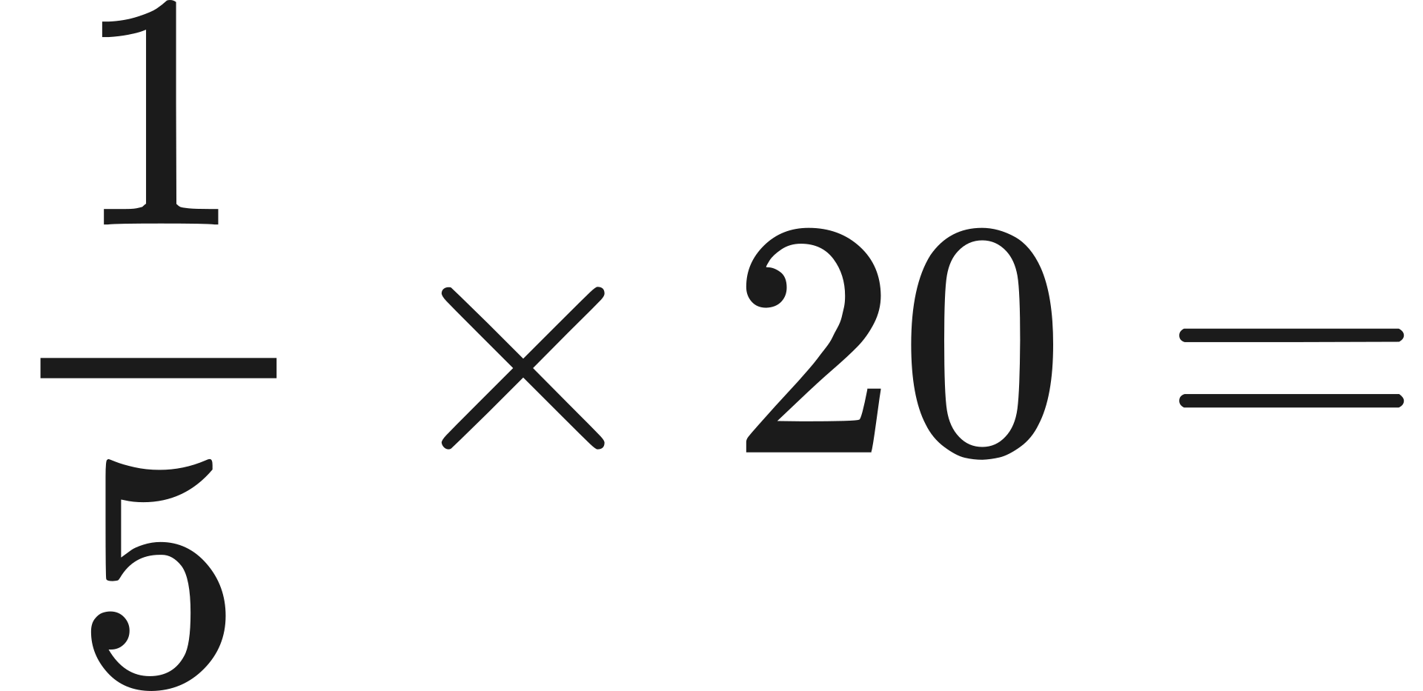
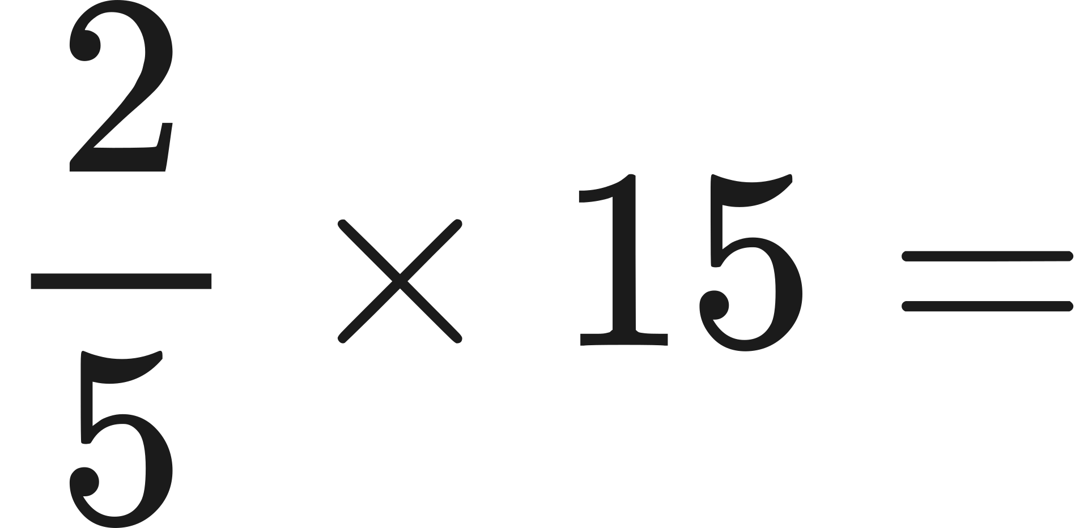
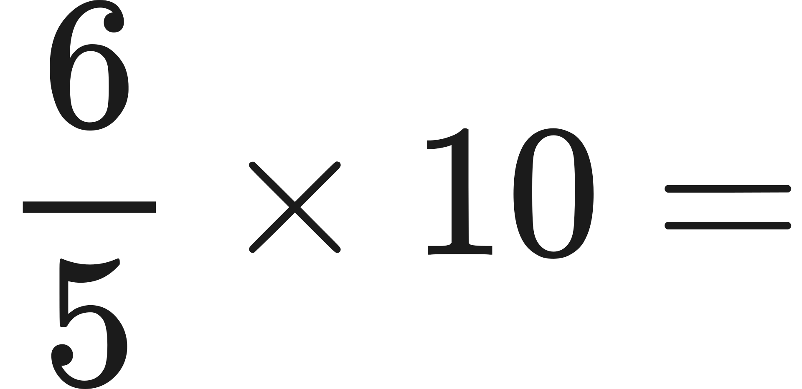
Let’s Recap!

Slide 3
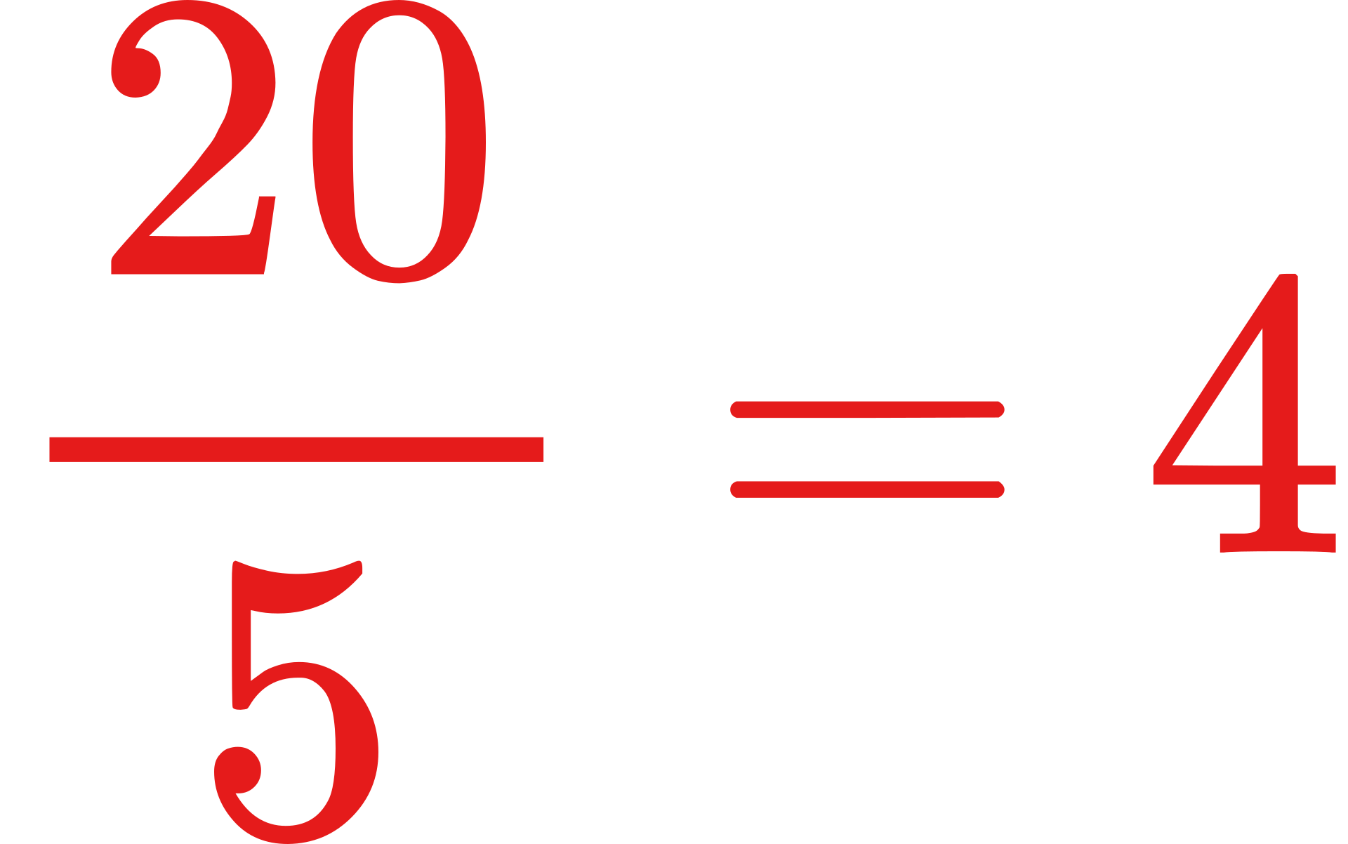
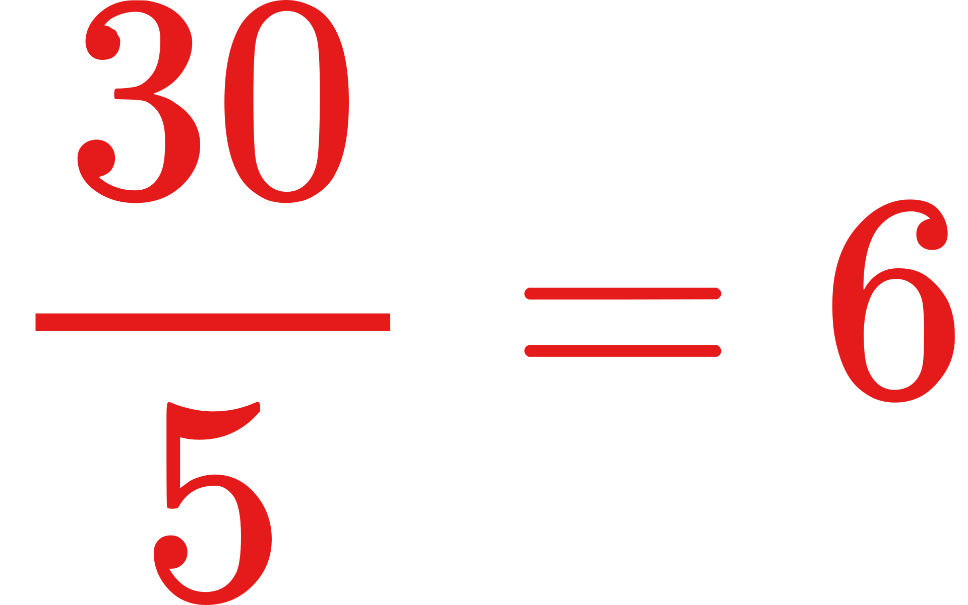
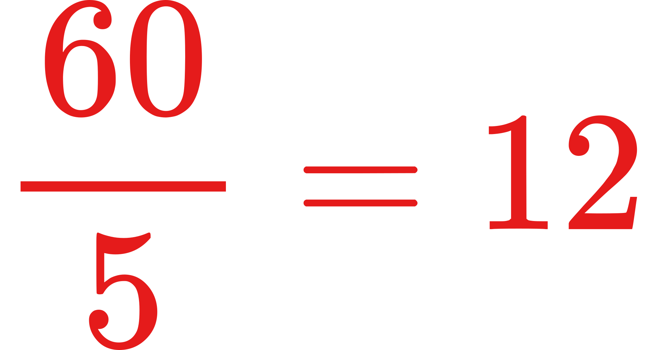
Answers...

Slide 4



Learning Objective
Use fractions as operators to perform multiplication and division calculations.

Slide 5
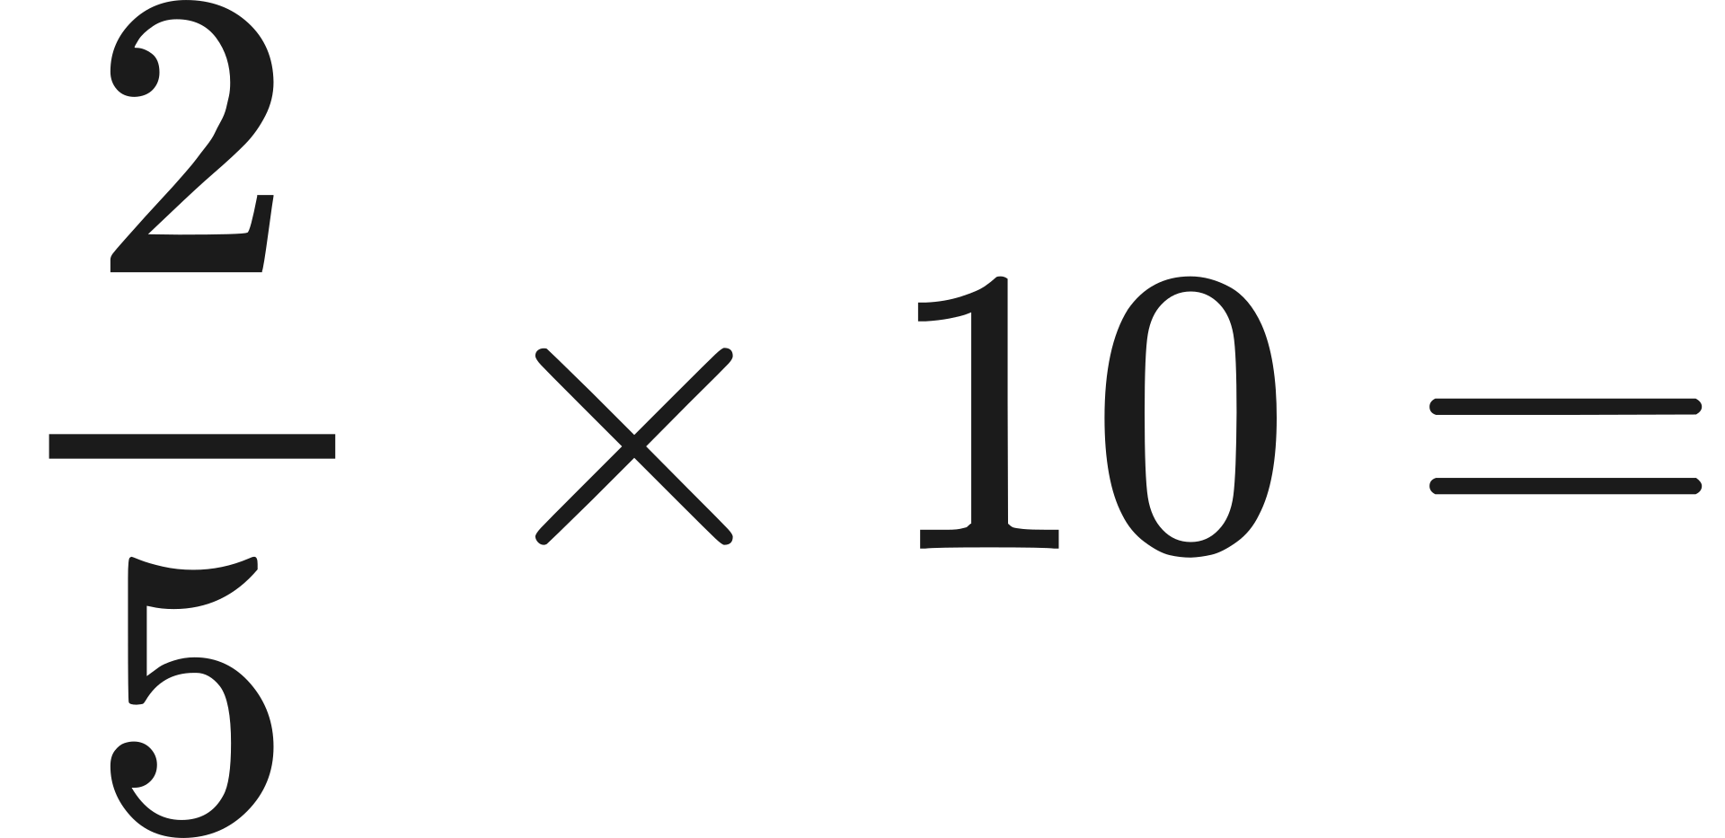
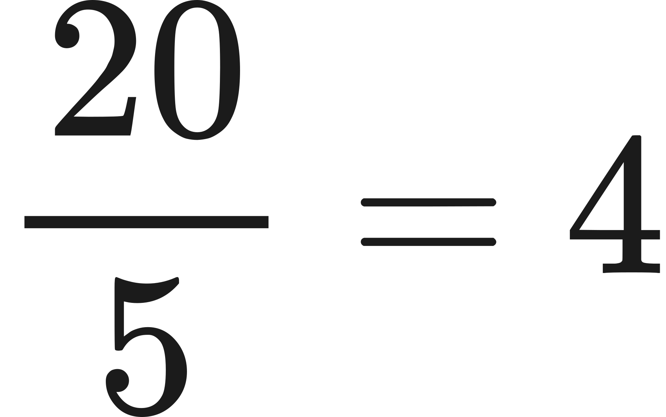



Slide 6

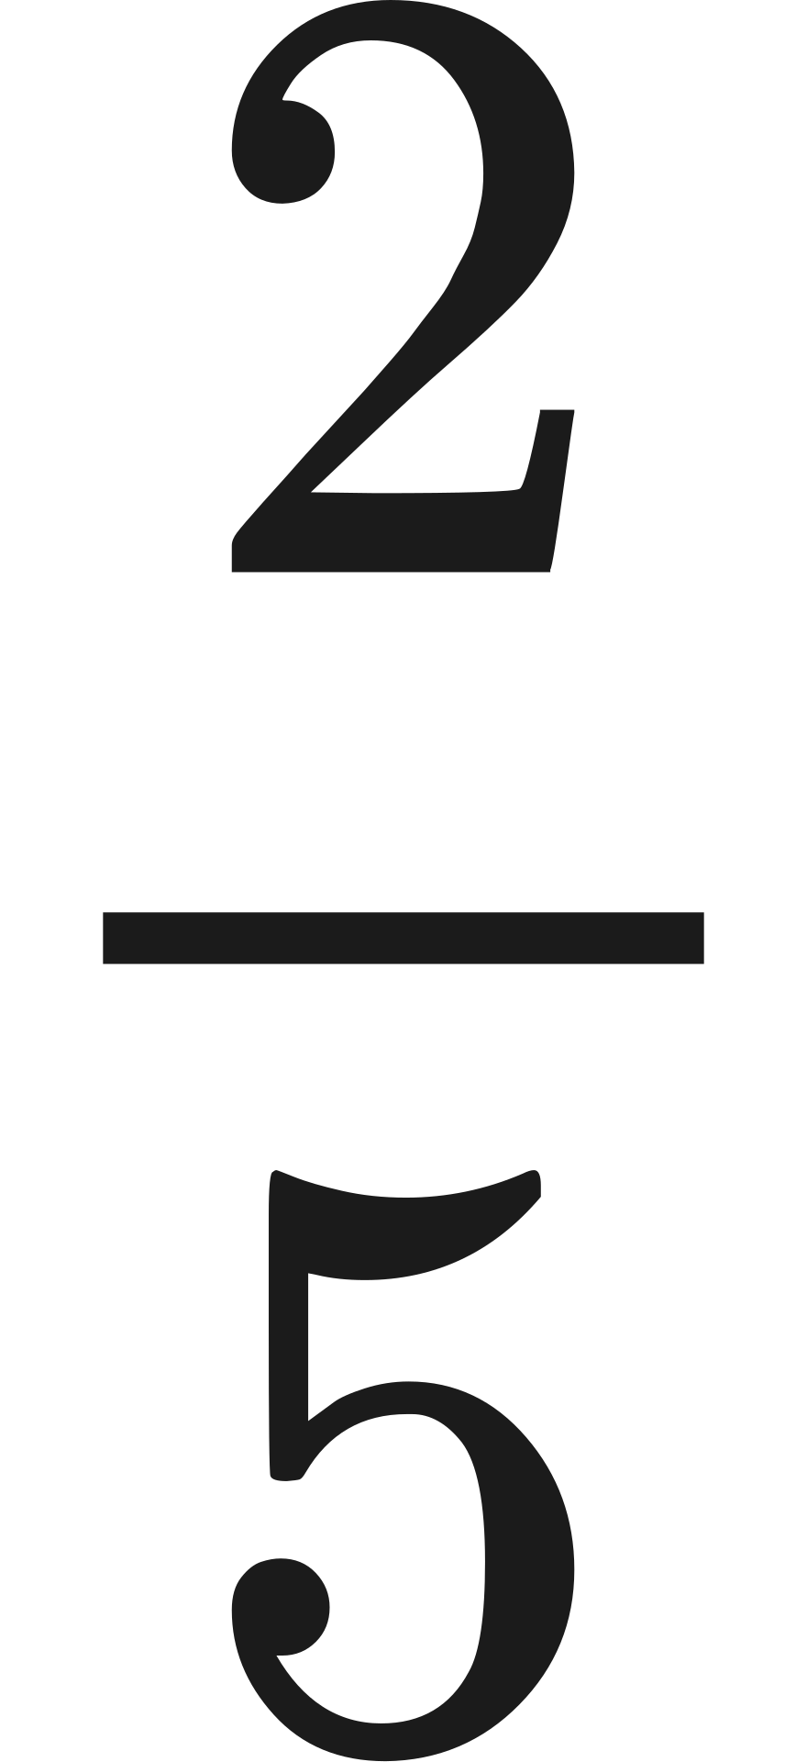
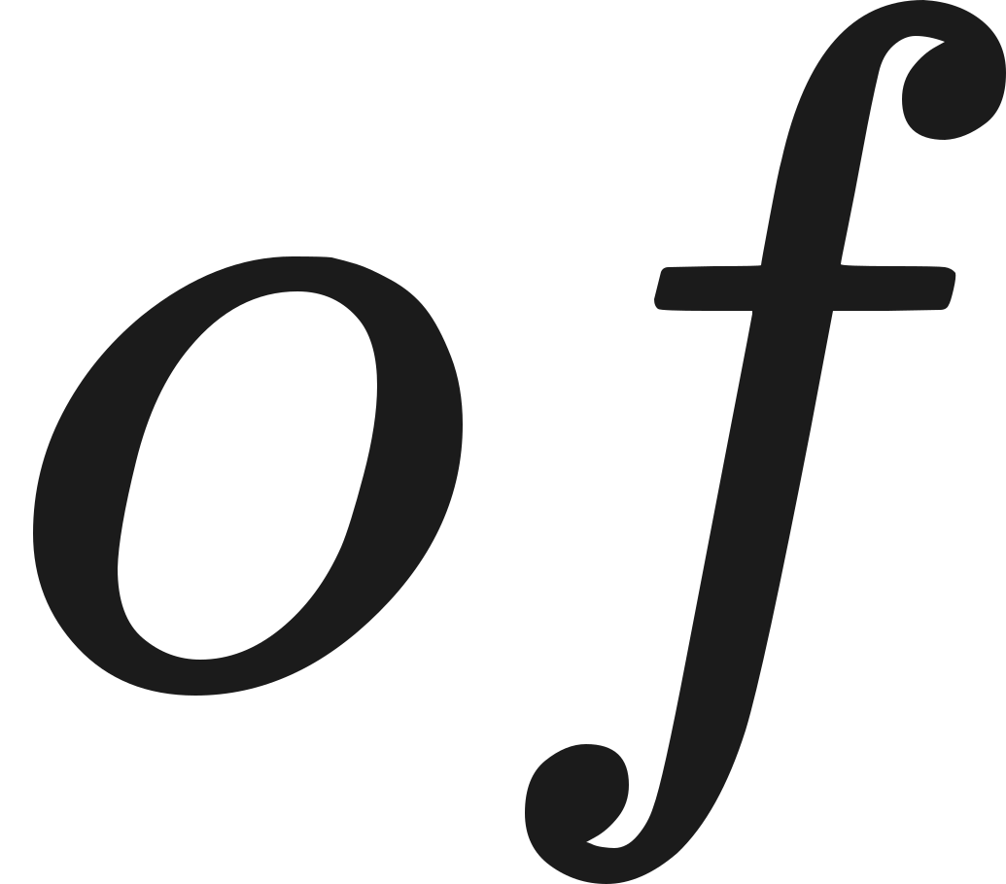






When calculating the fraction of an amount, ‘of’ means multiply.

Slide 7
Which method did you prefer?

Slide 8


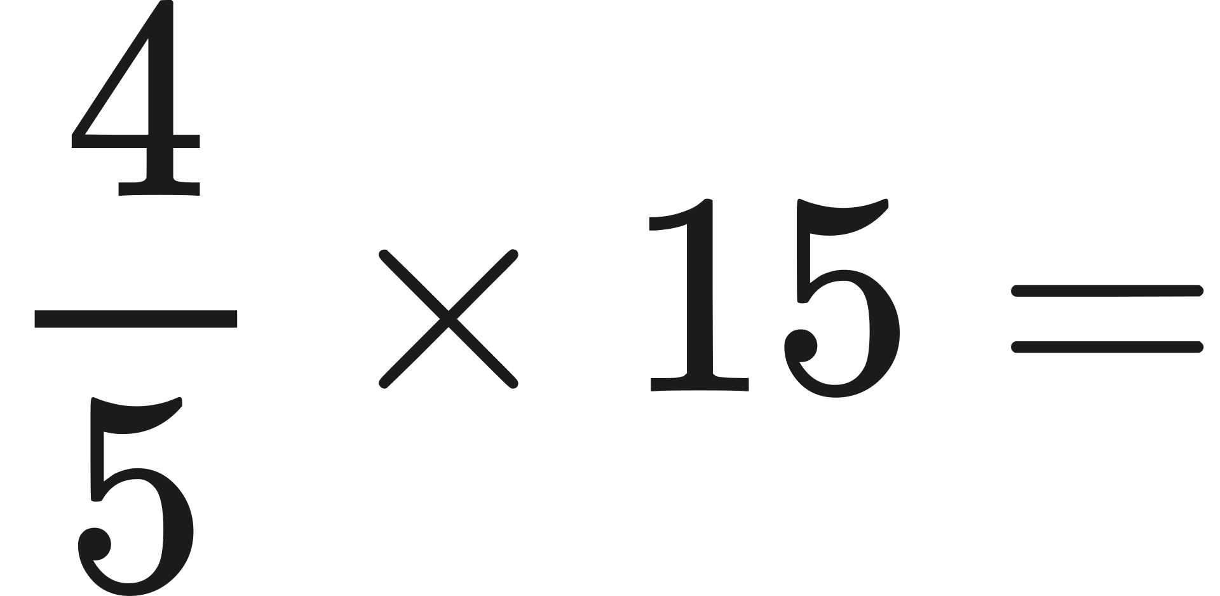
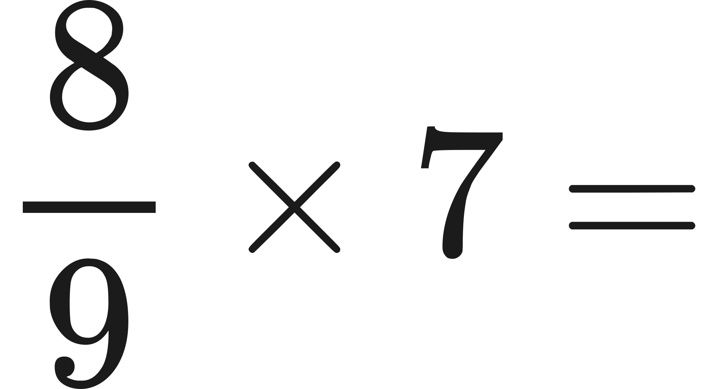
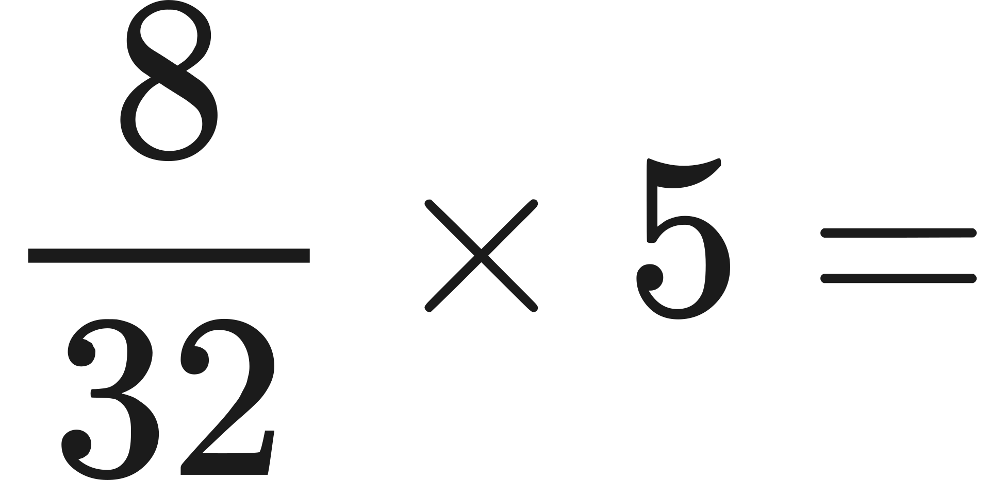
1.
Practice Questions
2.
Complete the questions using the most effective approach.
3.

Slide 9
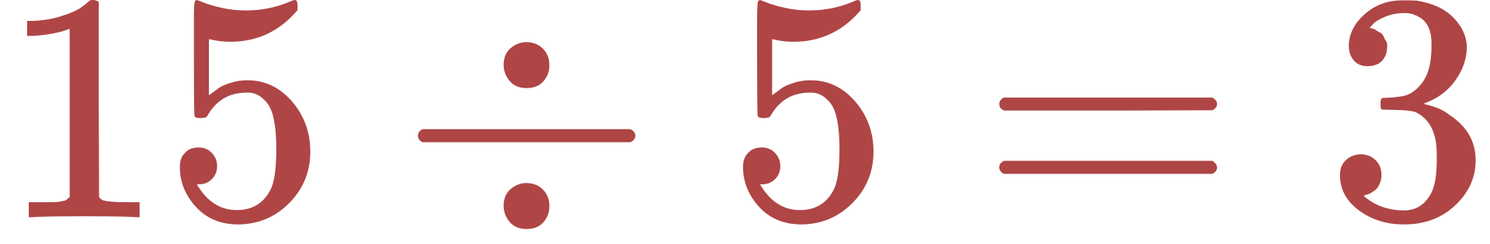
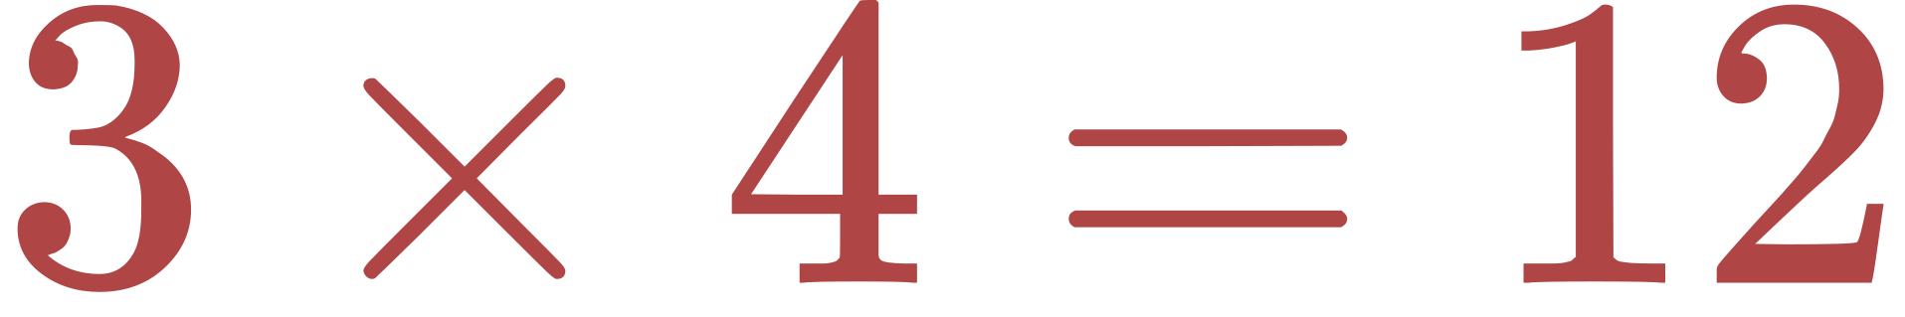
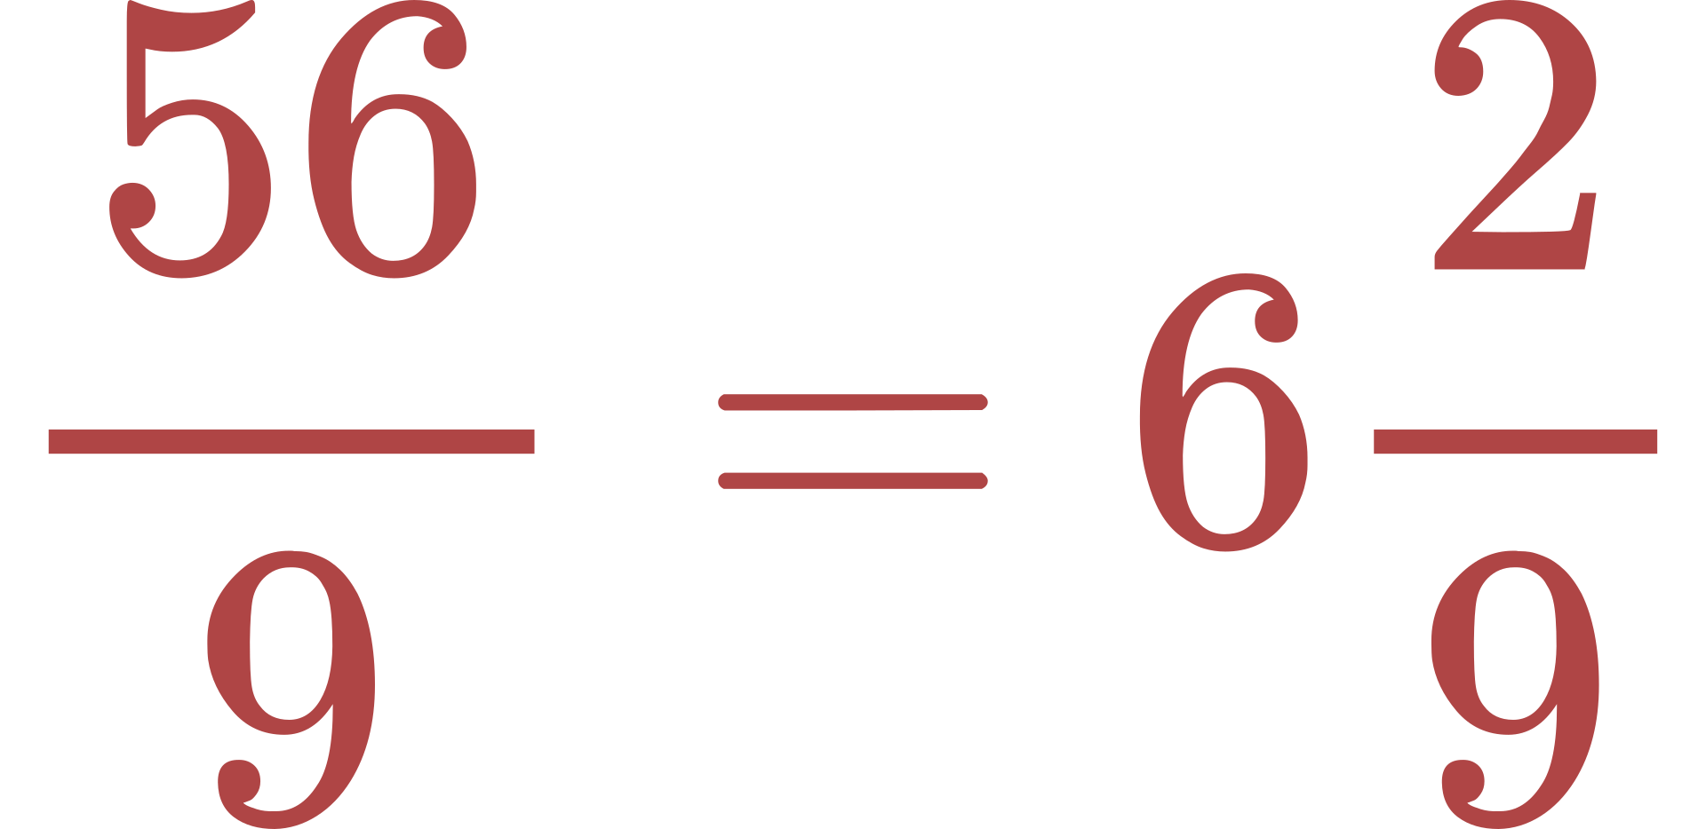


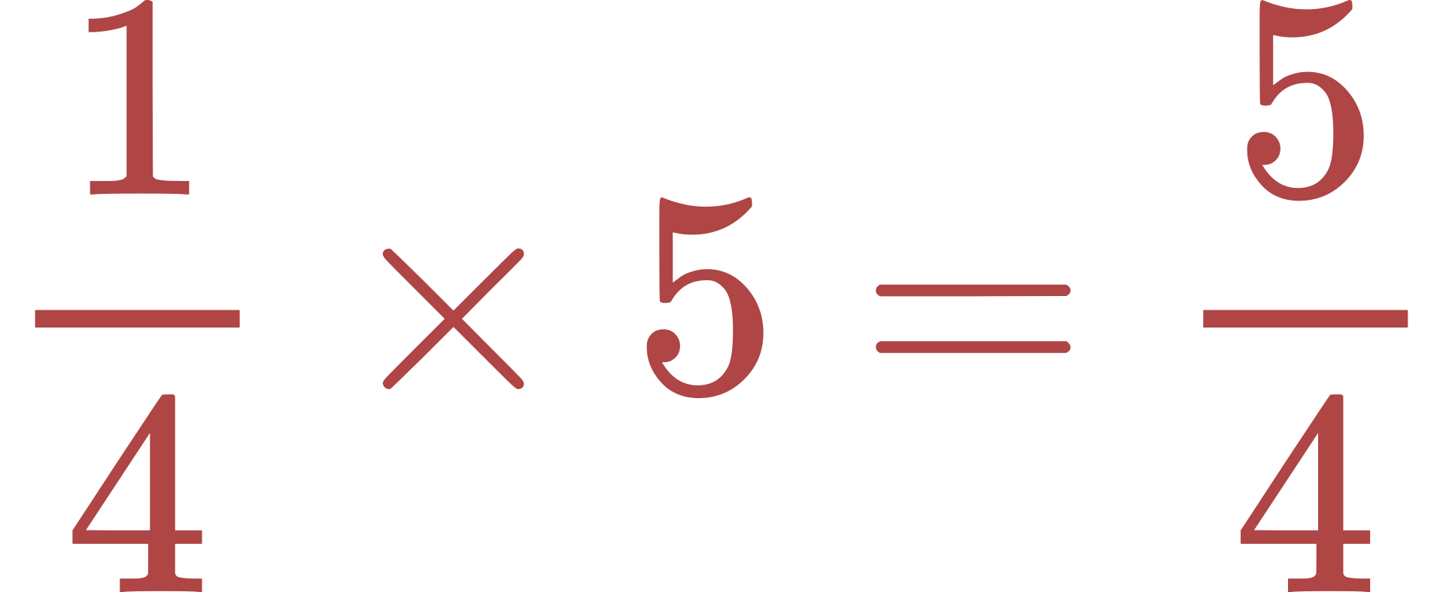
Answer
Key
1.
2.
3.

Slide 10


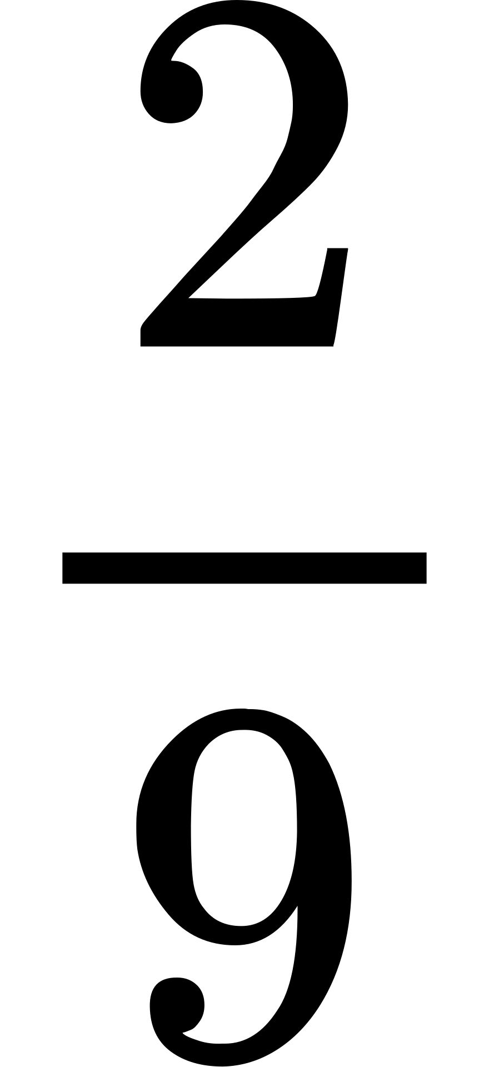
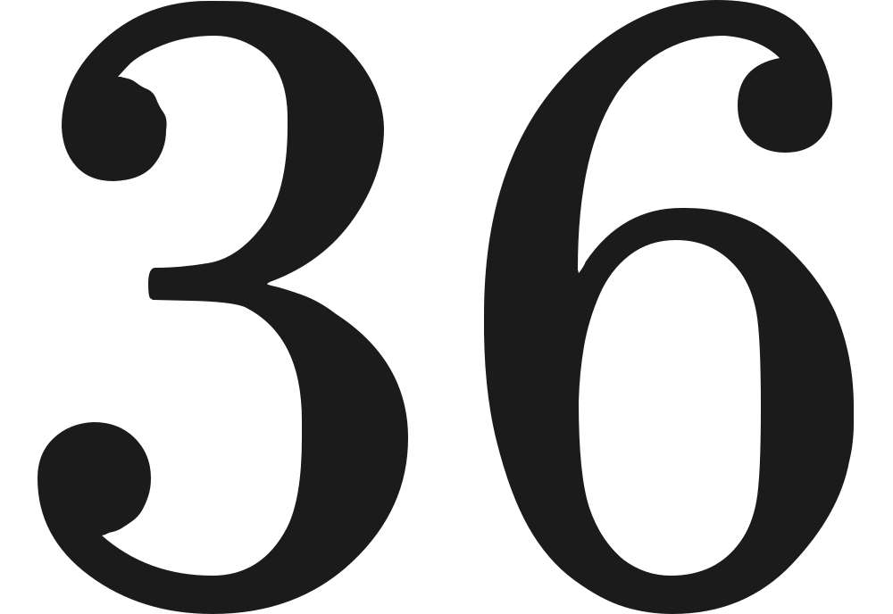
Worded Problem
Olivia has baked 36 cupcakes for a school bake sale. She wants to keep for her family. How many cupcakes will she keep for her family?

Slide 11

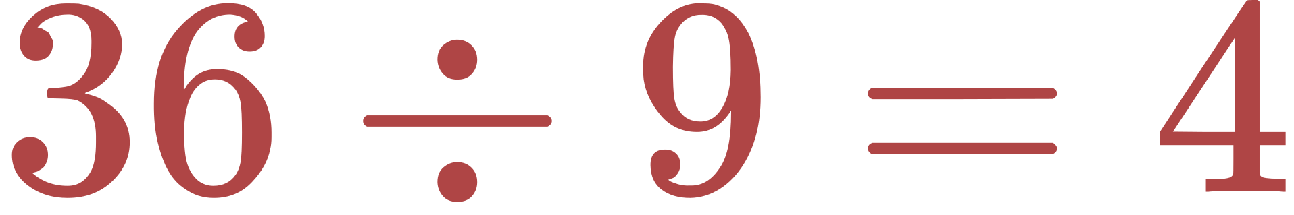

Worded Problem:
Answer
Olivia has baked 36 cupcakes for a school bake sale. She wants to keep for her family. How many cupcakes will she keep for her family?

Slide 12



Thank you for listening.
Any Questions?

