Slide 1
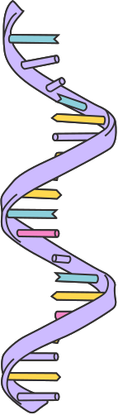
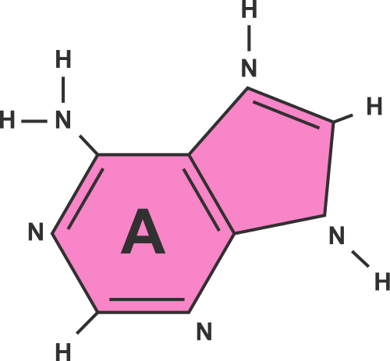
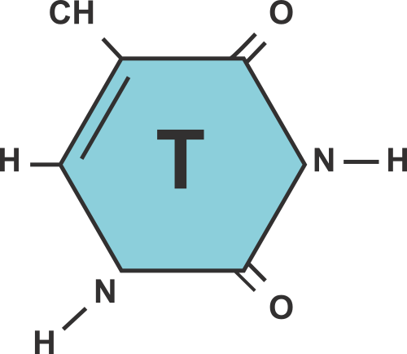
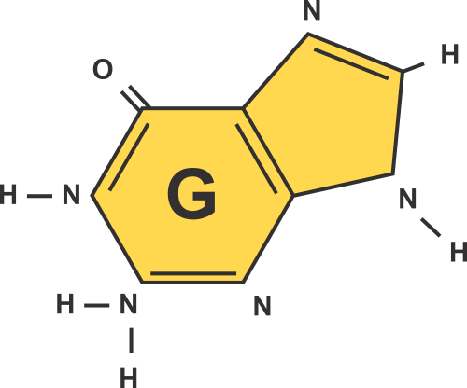
Генетикалық әртүрлілік
Генетикалық мутация және табиғи сұрыпталу қалай жүзеге асады?

Slide 2
Қайталау:
Сіз келесі ұғымдардың хромосома, ДНҚ (дезоксирибонуклеин қышқылы) немесе генге қатысты екенін анықтай аласыз ба?
ДНҚ
(дезоксирибонуклеин қышқылы)
Ген
Хромосома
Ол организмнің өсуі, дамуы үшін қажетті генетикалық ақпаратты сақтайды және бередіжәне көбею.
Бұл хромосомаға қатысты, өйткені ол жасушаның бөлінуі кезінде генетикалық материалдың репликациясы мен таралуына жауап береді.
Бұл организмдегі белгілер мен функцияларды белгілейтін тұқым қуалаушылық бірлігі.

Slide 3

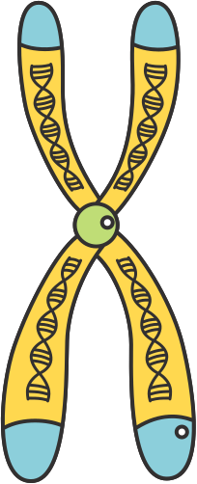
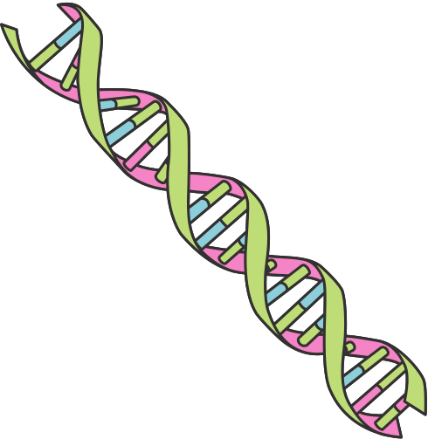
ЖАУАП
Қайталау:
gene
Ескеріңіз: Ген – ДНҚ-ның кішкене бөлігі, ал ДНҚ біздің ағзамыздағы хромосомаларды құрайды.
Chromosome
DNA
Ген
ДНҚ
(Дезоксирибонуклеин қышқылы)
Хромосома
Ол ағзаның өсуі, дамуы және көбеюі үшін маңызды генетикалық ақпаратты (гендерді) сақтайды және тасымалдайды.
Ол жасушаның бөлінуі кезінде генетикалық материалдардың (ДНҚ) көшіруі мен таралуына жауап береді.
Ол ағзадағы ақуыздарды жасау қасиеттері мен функцияларын анықтайды.

Slide 4
ОҚУ НӘТИЖЕЛЕРІ
Осы сабақтың соңында сіз мыналарды үйренесіз:
1
"геном"терминін анықтаңыз;
геномның гендермен байланысын түсіндіріңіз, ДНҚ және хромосомалар
2
генетикалық және қоршаған ортаның өзгеруін ажыратыңыз
3
4
генетикалық мутацияны түсіндіріңіз
генетикалық вариацияның табиғи сұрыпталуға әсерін тану
5

Slide 5
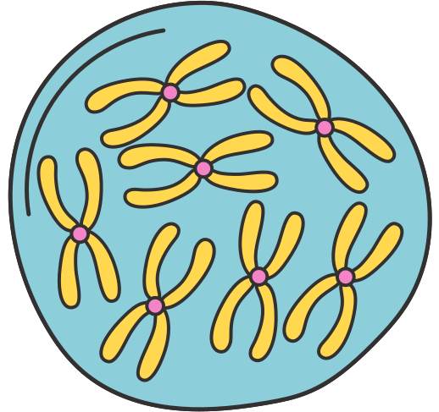
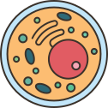
ГЕНОМ ДЕГЕНІМІЗ НЕ?
Геном-организмнің толық генетикалық материалы. Бұл организмдердің генетикалық ақпаратын, соның ішінде кодталатын және кодталмайтын тізбектерді тасымалдайтын ДНҚ-дан тұрады.
ГЕН
Жасуша
Ядро
Хромосома
ДНҚ

Slide 6
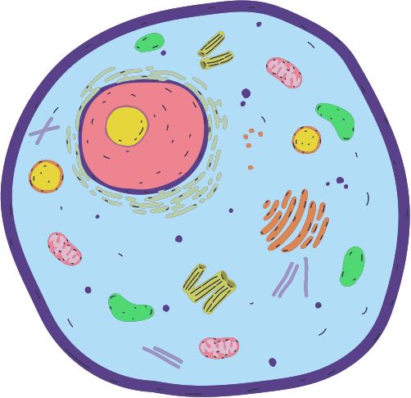
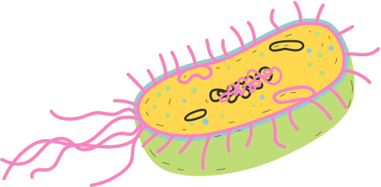
nucleus
EUKARYOTES
The genetic material in eukaryotes can be found in the nucleus.
PROKARYOTES
nucleoid
Their genetic material can
be found in the nucleoid. Several prokaryotes also have plasmids called circular DNA molecules.
GENOME IN ORGANISMS

Slide 7



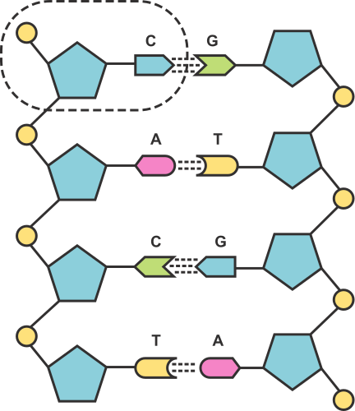
THE HUMAN GENOME
The study of the human genome or genomics is important in helping us learn about:
1
2
3
INHERITED DISORDERS AND HOW THEY CAN
BE TREATED
TRACING ANCESTRY THROUGH PATTERNS
IN THE GENES
GENES THAT ARE LINKED TO DISEASES

Slide 8
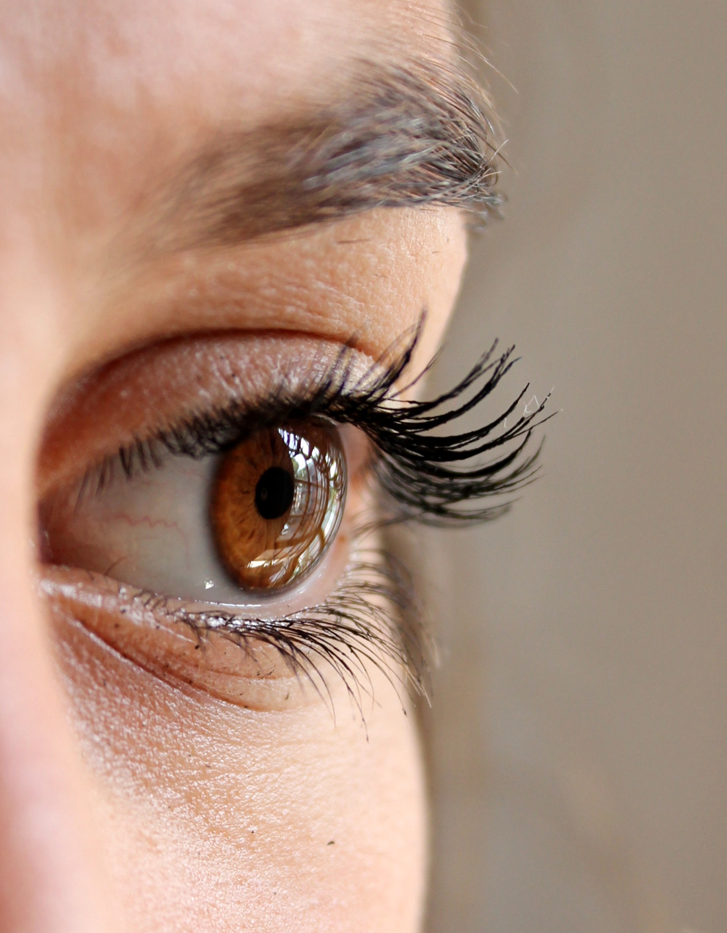
WHAT IS
A GENOME?
Notice that even though humans have several similar characteristics, we have differences, like the colour of our eyes. The differences in our DNA are called Variation.

Slide 9
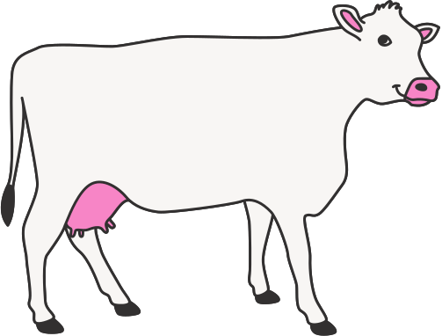
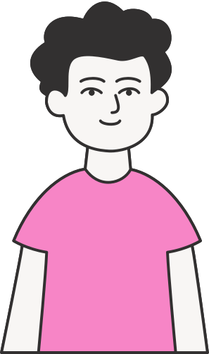
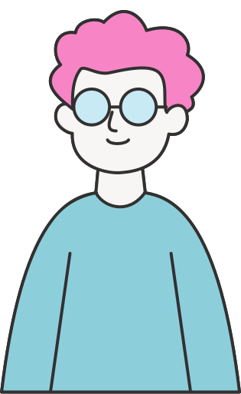
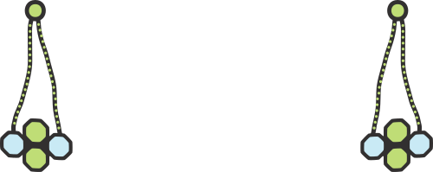
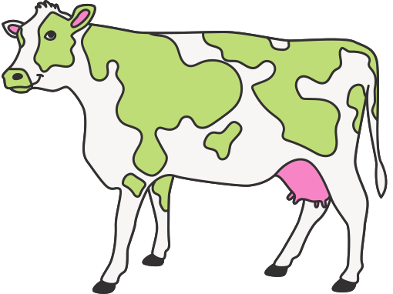
Genetic Variation
Environmental Variation
VARIATION
Variation is the differences
in characteristics within
a population of a species. Variation can be caused
by the following:
This is when environmental factors directly affect a characteristic of an individual or population.
This is the diversity in DNA between individuals or among a population.

Slide 10
TRY THIS!
GENETIC
ENVIRONMENTAL
Categorise the following characteristics on the
Venn diagram.
Hair Colour
Blood Group
Height
Gender
Haircut
Accent
Weight
Body Piercings
Inherited Disorders

Slide 11
GENETIC
ENVIRONMENTAL
ANSWER
Hair Colour
Accent
TRY THIS!
Inherited Disorders
Height
Haircut
Categorise the following characteristics on the
Venn diagram.
Weight
Blood Group
Body Piercings
Gender

Slide 12

GENETIC MUTATION
One way that genetic variation can occur is via genetic mutation. This is when a genetic code on a gene can either become damaged or the faulty gene is inherited.
New phenotypes can rarely occur from genetic mutations, but when this happens, it can cause continuous changes in the species.
Recall that phenotype refers to the physical characteristic of an organism
as influenced by the genome and environmental factors.

Slide 13
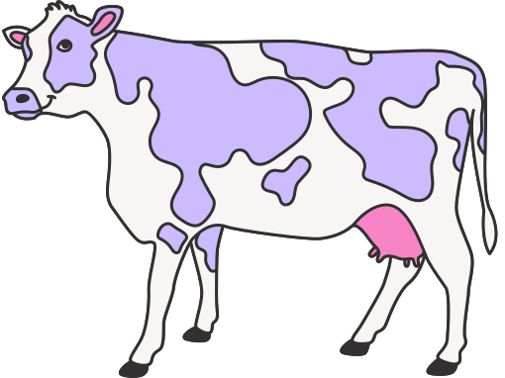
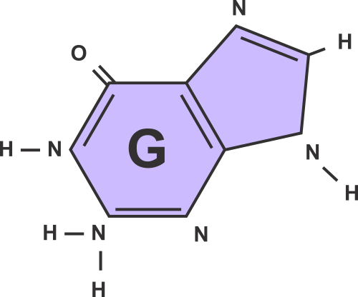
GENETIC MUTATION
An example of genetic mutation
is the pigmentation on cows.
The spots on the cow helps
them deter flies.

Slide 14

NATURAL SELECTION
Natural selection is the mechanism
by which organisms that are more suited to their environment survive
and reproduce.
Through natural selection, advantageous traits, such as spots on cows, are passed on to future generations, driving evolution.

Slide 15
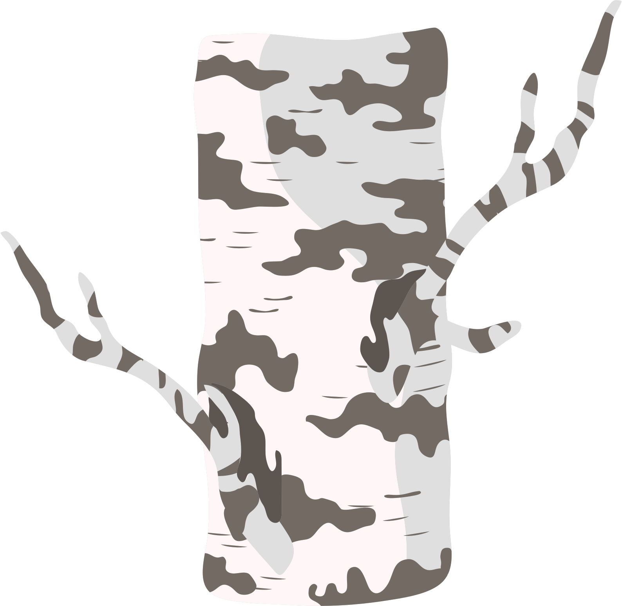
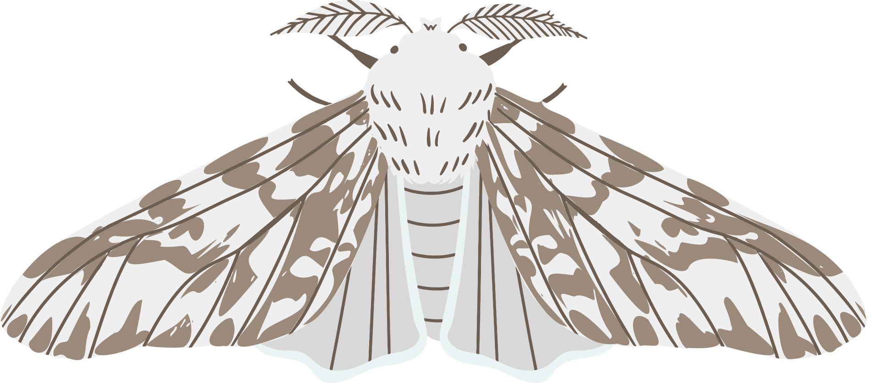
THE INDUSTRIAL REVOLUTION
NATURAL SELECTION
During the Industrial Revolution, factories produced large amounts of soot, which turned the bark of trees black.
Another example
is the white peppered moth turning into
a black moth.
WHITE PEPPERED MOTH
The peppered moths at that time were usually white with black speckles, but due to the change in their environment, they no longer had natural camouflage.

Slide 16
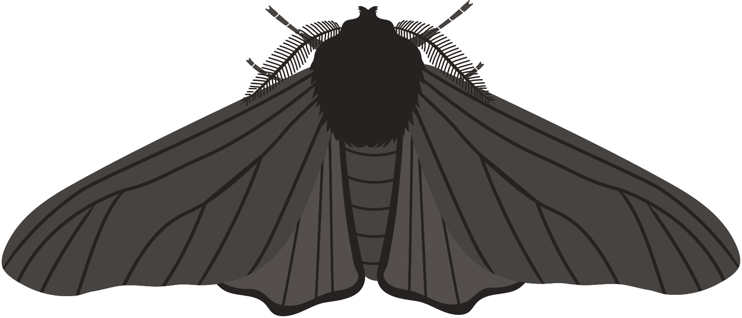
NATURAL SELECTION
At that time, peppered moths also had a naturally-occurring genetic mutation,
causing some of them to have black wings.
Their colour helped them better camouflage in blackened urban tree trunks, allowing them to survive and reproduce. Natural selection favoured the dark moths, leading to a rapid increase in their proportion within the population.

Slide 17
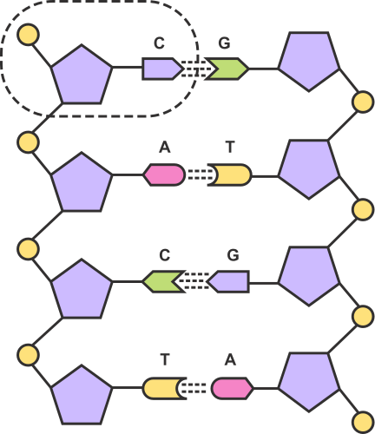
THINK
ABOUT IT!
How does not completing
a prescribed course of antibiotics demonstrate the principles of natural selection and mutation in the development of antibiotic resistance in bacteria?

Slide 18
Answer:
THINK
ABOUT IT!
Antibiotic resistance can arise when patients do not complete their prescribed course of antibiotics.
For instance, if a patient takes antibiotics for only 3 out of 5 prescribed days, some bacteria may survive. These surviving bacteria
can mutate, developing resistance
to the antibiotic.
How does not completing a prescribed course of antibiotics demonstrate the principles of natural selection and mutation in the development of antibiotic resistance in bacteria?

Slide 19
REVIEW AND SUMMARY
GENOME
VARIATION
Variation is the differences in characteristics within a population of a species. Variation can be caused by genetics and the environment.
Genome is the complete genetic material
of an organism.
GENETIC MUTATION
NATURAL SELECTION
Genetic mutation is when a genetic code on a gene can either become damaged or the faulty gene is inherited.
Natural selection is the mechanism by which organisms that are more suited to their environment survive and reproduce.

Slide 20
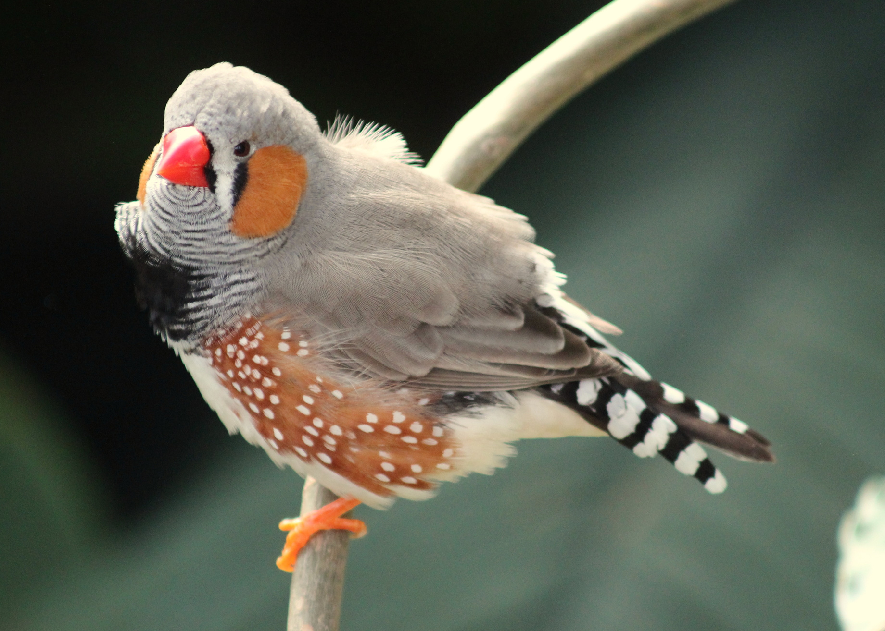
RESEARCH ABOUT HOW CHARLES DARWIN DOCUMENTED THE EVOLUTION OF THE FINCH SPECIES AND EXPLAIN HOW VARIATION AND NATURAL SELECTION OCCURRED.

Slide 21
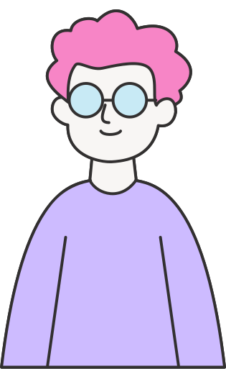
RESOURCE
Page
Use these icons and illustrations in your Canva Presentation. Happy designing! Don't forget to delete this page before presenting.

Slide 22
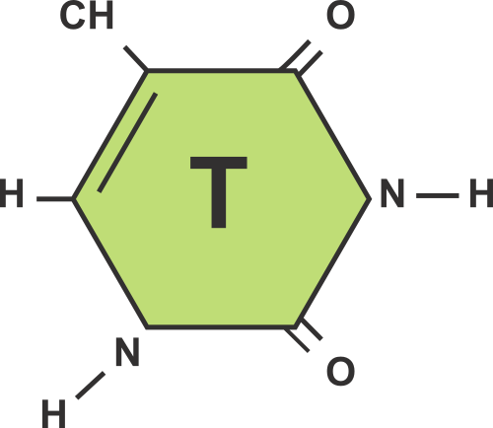
Try this background for online class.
*Please delete this section before downloading.

Slide 23
B FOR BLUR
C FOR CONFETTI
PRESS THESE KEYS
while on Present mode
D FOR A DRUMROLL
M FOR MIC DROP
O FOR BUBBLES
Q FOR QUIET
U FOR UNVEIL
ANY NUMBER FROM 0-9
FOR A TIMER

