Slide 1


ФОТОСИНТЕЗ ПРОЦЕСІ

Slide 2


Фотосинтез процесі
Фотосинтезге әсер ететін факторлар
Температура
Жарық қарқындылығы
Көмірқышқыл газы және оттегі

Slide 3

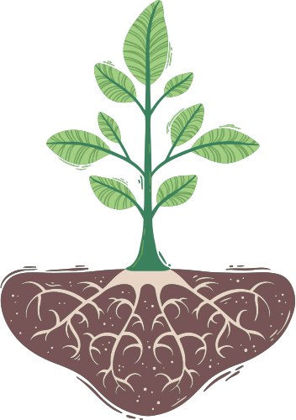
Жарық қарқындылығы, көмірқышқыл газының концентрациясы және температура сияқты қоршаған орта факторларының өзгеруі фотосинтездің тиімділігіне қалай әсер етуі мүмкін?

Slide 4


Оқыту нәтижелері
Фотосинтездің жалпы процесін сипаттаңыз.
Процесстегі хлоропласттардың маңызын түсініңіз.
Фотосинтезде температураның, жарық қарқындылығының және көмірқышқыл газының мөлшеріне әсерін талдаңыз.

Slide 5

O
2
Фотосинтез
Фотосинтез - өсімдіктер жарық энергиясын пайдаланып көмірсулар түзетін химиялық процесс.
Фотосинтез - бұл эндотермиялық реакция, яғни химиялық реакция жүруі үшін жарық энергиясы сумен (H₂O) және көмірқышқыл газымен (CO₂) бірге жұтылуы керек.
CO
2
H O
2

Slide 6
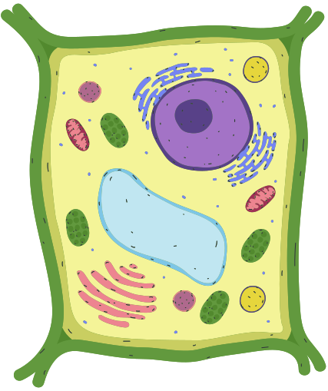


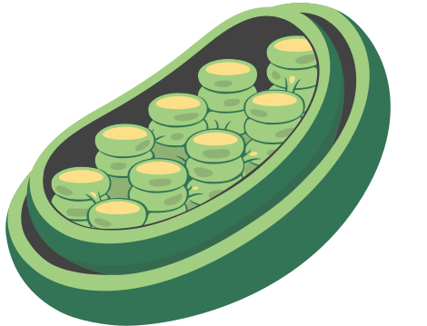
Фотосинтез орны – хлоропласт
Фотосинтез ең алдымен өсімдіктердің жапырақтарында, әсіресе хлоропласт деп аталатын арнайы жасуша құрылымдарында жүреді.
Хлоропласттар - бұл хлорофиллден тұратын органеллалар, ол Күннен жарық энергиясын қабылдайтын жасыл пигмент.
Хлоропластар жапырақтың мезофилл жасушаларында көптеп кездеседі, олар жарық қабылдауға жақсы орналасады.

Slide 7



ФОТОСИНТЕЗ
Фотосинтез процесінде сіңірілген жарық энергиясы көмірқышқыл газы мен суды глюкозаға айналдырады, оттегі жанама өнім ретінде бөлінеді.
Хлорофилл
(l)
Күн сәулесі
(g)
(g)
(aq)
Көмірқышқыл газы
Су
Глюкоза
Оттегі

Slide 8

Purposes
of Glucose
Energy source
Glucose is broken down for respiration,
and other cellular activities.
Energy Storage
Glucose can be used to form starch for energy storage.
Formation of Complex Carbohydrates
Glucose can be used to form complex carbohydrates like cellulose which is used to build the plant’s cell wall.
Synthesis of other compounds
Glucose is used to synthesise complex organic molecules like carbohydrates, proteins and lipids.

Slide 9
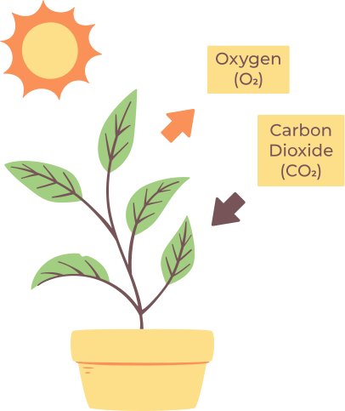

Biomass
Biomass is an organic material from plants and animals used to produce energy.
It stores chemical energy in the form of carbohydrates, lipids and proteins, which are produced through photosynthesis.

Slide 10
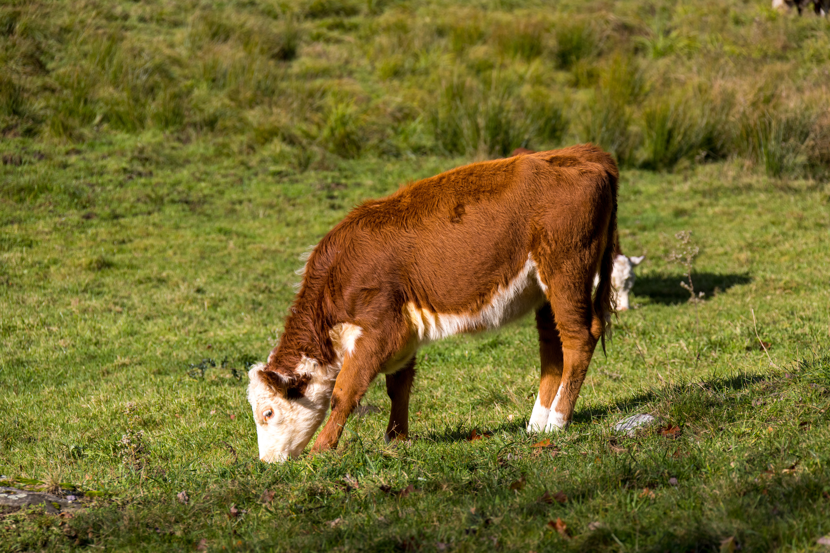
Biomass
When animals consume plants, they transfer this energy up the food chain.
The energy captured through photosynthesis supports entire ecosystems, making it the foundation for almost all life on Earth.

Slide 11
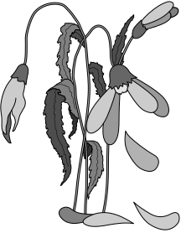
Try this!
The image shows a dying plant.
Explain some of the possible reasons this plant is dying.

Slide 12


Possible reasons are:
Overwatering
Excessive moisture can cause the suffocation and rotting of roots.
Poor soil quality
Soil lacking essential nutrients or with improper pH levels can damage plants.
Lack of sunlight
Inadequate light can impede photosynthesis and weaken the plant.
Overcrowding
Competition for resources among neighboring plants can hinder growth.
Age
Plants naturally decline
as they age, with leaves turning yellow and stems weakening.
Environmental stress
Extreme temperatures, frost, or high winds can damage plant tissues.
Lack of water
Insufficient watering can lead to dehydration and wilting.

Slide 13


Limiting Factors
Limiting factors refer to the conditions or resources that are in low supply and reduce the rate of photosynthesis.
Temperature
Sunlight
Carbon dioxide

Slide 14
Temperature
Optimal Temperatire
Temperature influences photosynthesis rate by affecting enzyme activity.
Overly low temperatures can slow down enzyme reactions, limiting photosynthesis rate.
Rate of Photosynthesis
Higher temperatures generally increase enzyme activity, enhancing photosynthesis up to an optimal temperature.
Excessively high temperatures can denature enzymes, inhibiting photosynthesis and causing damage to plant tissues.
Temperature
The limiting factor for temperature would be the temperature at which enzymes responsible for photosynthesis operate optimally.

Slide 15
Light Intensity
Light is the limiting factor
Another factor has become limiting
Light intensity directly influences the rate of photosynthesis by providing energy for the process.
Higher light levels generally lead to an increased photosynthesis rate until reaching a saturation point.
Rate of Photosynthesis
SATURATION POINT
Insufficient light can limit photosynthesis, slowing the process and reducing plant growth.
Light Intensity
The limiting factor for light would be the point at which light intensity becomes insufficient to meet the energy requirements for photosynthesis. This threshold is known as the light saturation point.

Slide 16
Carbon Dioxide
CO₂ is the limiting factor
Another factor
is limiting
Carbon dioxide is used as a source of carbon for building organic molecules.
More carbon dioxide usually means plants can make more food.
Rate of Photosynthesis
SATURATION POINT
Too little carbon dioxide can limit the rate of photosynthesis because plants rely on carbon dioxide to produce sugars during the process.
Light Intensity
The limiting factor for the concentration of carbon dioxide would be the point at which carbon dioxide levels become insufficient to sustain optimal photosynthesis rates.

Slide 17
Learning Check
0.10% carbon dioxide
How does the interaction between light intensity and carbon dioxide concentration influence the rate of photosynthesis, as depicted in the graph?
Discuss the limiting factors and their effects on photosynthesis at different ranges of light intensity and carbon dioxide concentration.
Rate of Photosynthesis
0.03% carbon dioxide
1
2
3
4
5
6
7
8
Units of Light Intensity

Slide 18
Learning Check - Answer
Low Light Intensity | Moderate light intensity | High Light Intensity
At low light intensities (0 to 3.75 units), light is the limiting factor for photosynthesis. As light intensity increases, the rate of photosynthesis also increases until reaching a plateau. | At moderate light intensities (3.75 to 5.5 units), carbon dioxide is limiting, with a concentration of 0.03% insufficient to support increased photosynthesis. | At a higher concentration of 0.10%, photosynthesis continues to increase with light intensity. At high light intensities (5.5 units and above), carbon dioxide concentration is limiting.
In the range of 5 to 8 units of light intensity, carbon dioxide concentration is the limiting factor. Increasing carbon dioxide concentration from 0.03% to 0.10%

Slide 19
Summary
Photosynthesis | Photosynthesis involves converting sunlight, water, and carbon dioxide into glucose and oxygen. Biomass is the organic material produced through photosynthesis.
Chloroplasts | Chloroplasts, organelles within plant cells, are where photosynthesis takes place. These structures contain chlorophyll, the pigment responsible for capturing light energy used in photosynthesis.
Factors affecting Photosynthesis | Temperature, light intensity and carbon dioxide concentration all affect photosynthesis rate. Optimal conditions enhance photosynthesis, while extremes can limit it.

Slide 20
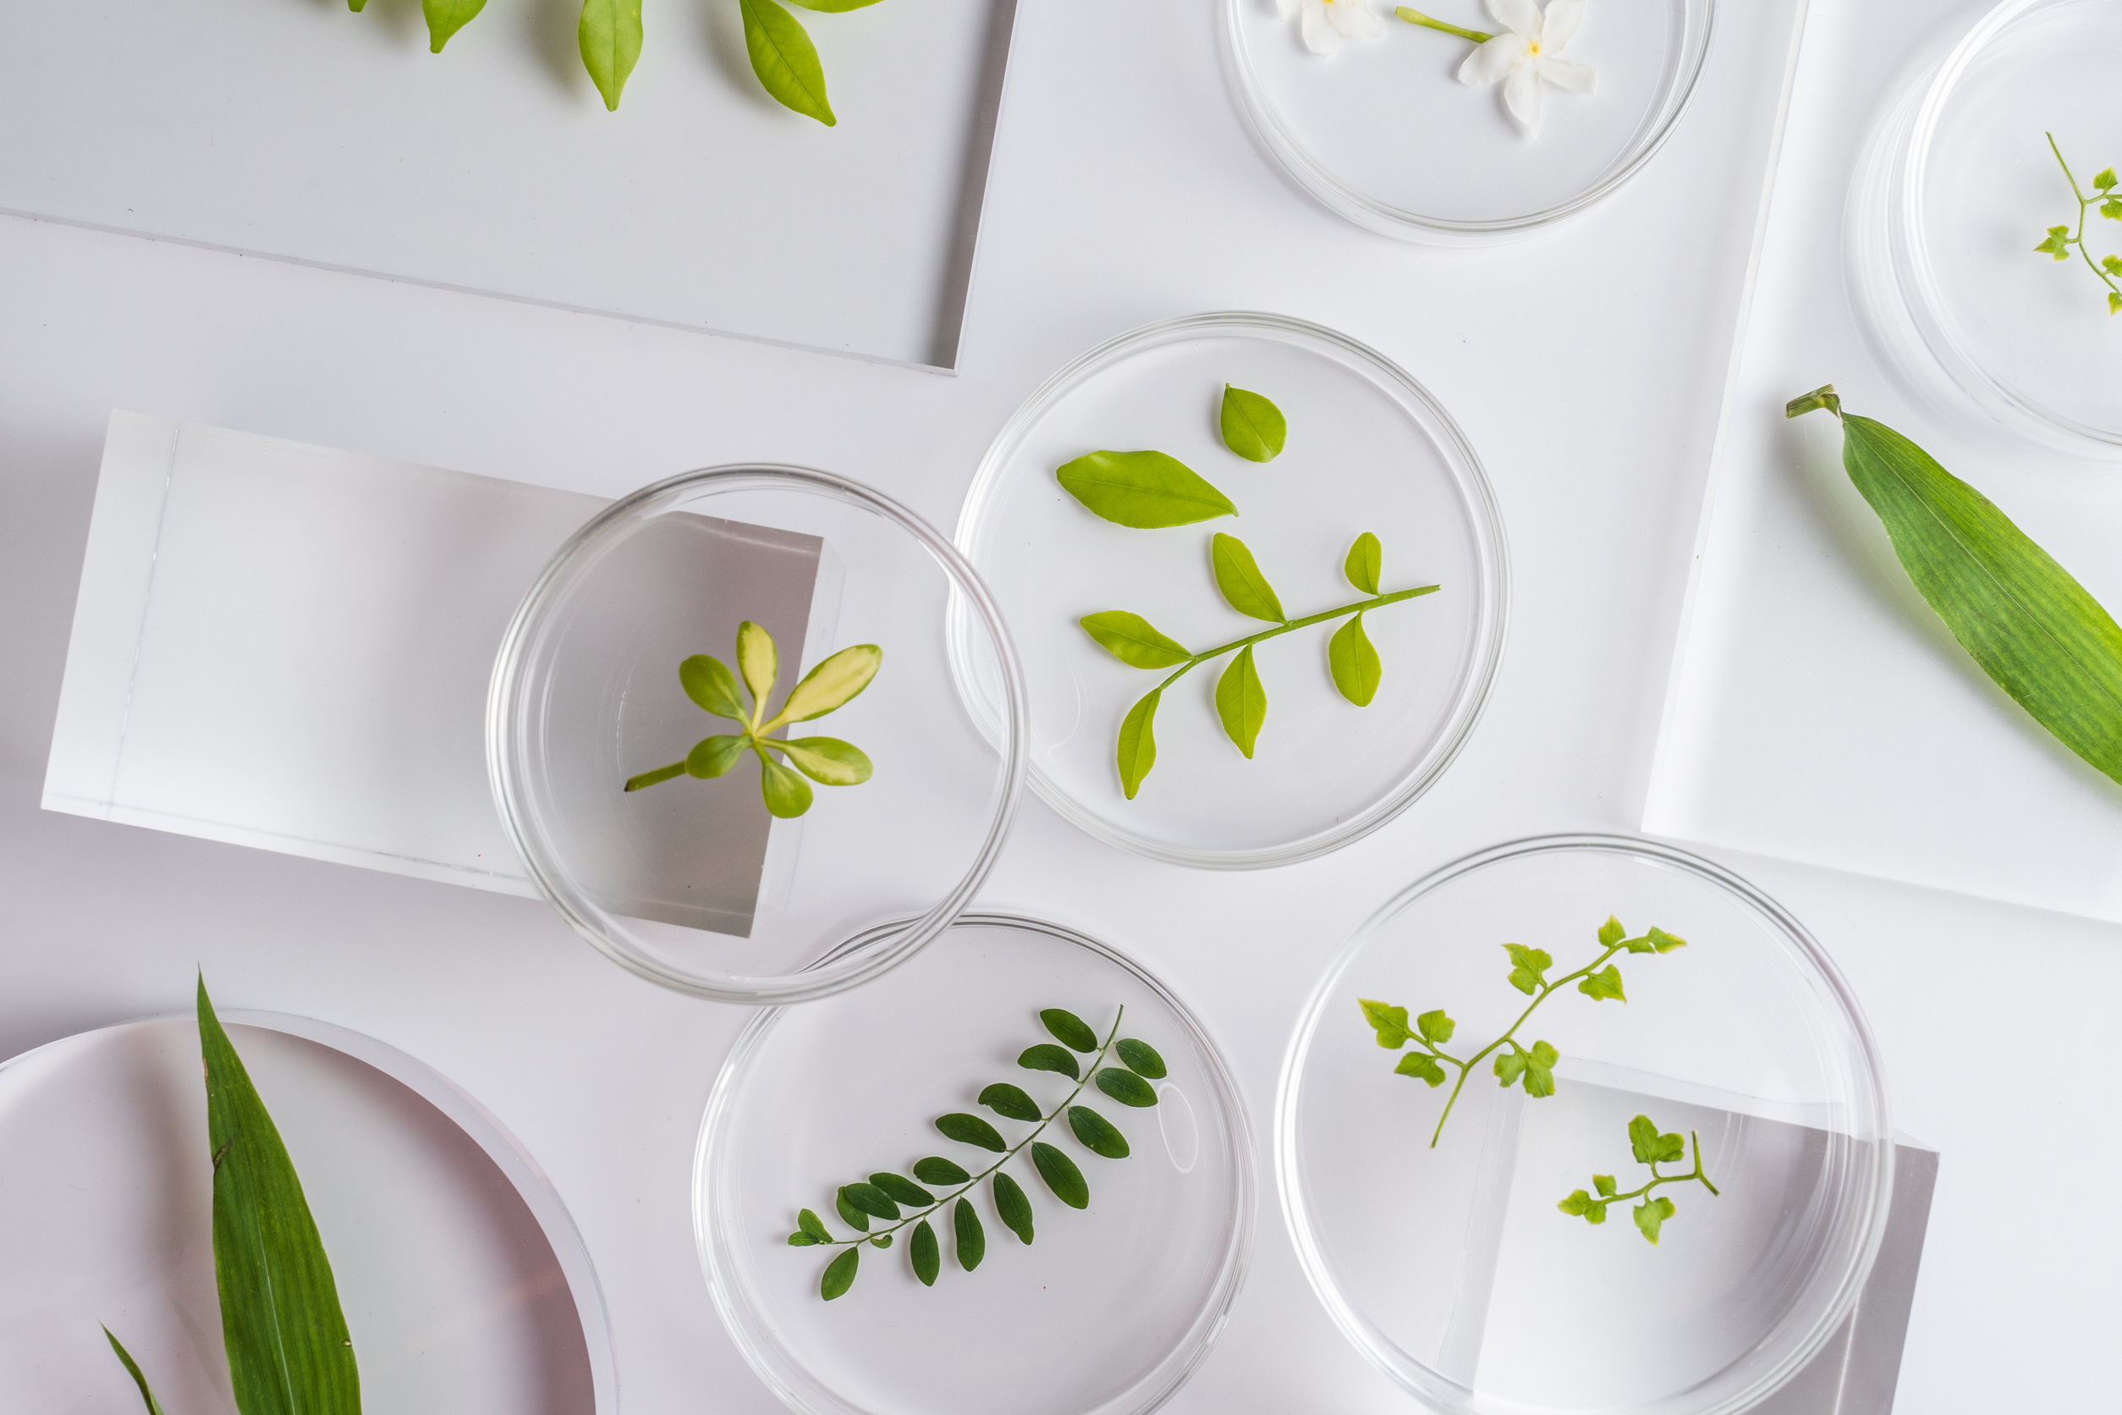
Assignment Task
Set up an experiment at home and create a hypothesis to test how light intensity affects the rate of photosynthesis.
Using Canva’s whiteboard function, compile a practical write-up for the experiment conducted.

Slide 21

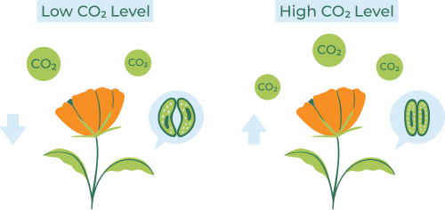

Resource
Page
Use these icons and illustrations in your
Canva Presentation.
Happy designing!
Don't forget to delete this page before presenting.

Slide 22


Try this background for online class.
*Please delete this section before downloading.

Slide 23
B for blur
C for confetti
Press these keys
while on Present mode!
D for a drumroll
M for mic drop
O for bubbles
Q for quiet
Any number from 0-9 for a timer
U for unveil

