Slide 1

Name
Бөлу
Ондық бөлшектер
Әрбір бөлу мәселесін шешіңіз. Өз жұмысыңызды көрсетуді ұмытпаңыз!
746.9÷9=
826.9 ÷2=
549.9÷3=
347.8 ÷4=
994.8÷6=
353.6 ÷2=
960.5 ÷7=
695.4÷5=

Slide 2
Dividing
Decimals
919.9 ÷9=
649.8 ÷2=
755.6 ÷4=
426.5 ÷3=
852.7 ÷3=
743.7÷6=
894.6 ÷3=
795.6 ÷7=
426.5 ÷5=

Slide 3

Name
Dividing
What is 689.6 ÷5 ?
137.9 r1
Decimals
5
689.6
5
18
15
39
35
4645
1
5
675.5
3
589.3
8
324.3
2
589.6
7
994.6
5
439.5
6
556.9
8
726.6

Slide 4

4
789.4
5
435.9
3
627.1
12
899.6
The largest pizza in the world had 987.9 individual slices of pizza. John and his five friends shared the slices amongst themselves. How many slices did each one eat? Show your work.

Slide 5

Name
Dividing
Decimals
Solve each division problem. Remember to show your work!
746.9÷9=
826.9 ÷2=
549.9÷3=
347.8 ÷4=
994.8÷6=
353.6 ÷2=
960.5 ÷7=
695.4÷5=

Slide 6
Dividing
Decimals
919.9 ÷9=
649.8 ÷2=
755.6 ÷4=
426.5 ÷3=
852.7 ÷3=
743.7÷6=
894.6 ÷3=
795.6 ÷7=
426.5 ÷5=

Slide 7
Name
Dividing
What is 689.6 ÷5 ?
137.9 r1
Decimals
5
689.6
5
18
15
39
35
4645
1
5
675.5
3
589.3
8
324.3
2
589.6
7
994.6
5
439.5
6
556.9
8
726.6

Slide 8
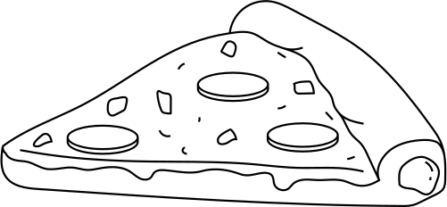
4
789.4
5
435.9
3
627.1
12
899.6
The largest pizza in the world had 987.9 individual slices of pizza. John and his five friends shared the slices amongst themselves. How many slices did each one eat? Show your work.

