Slide 1
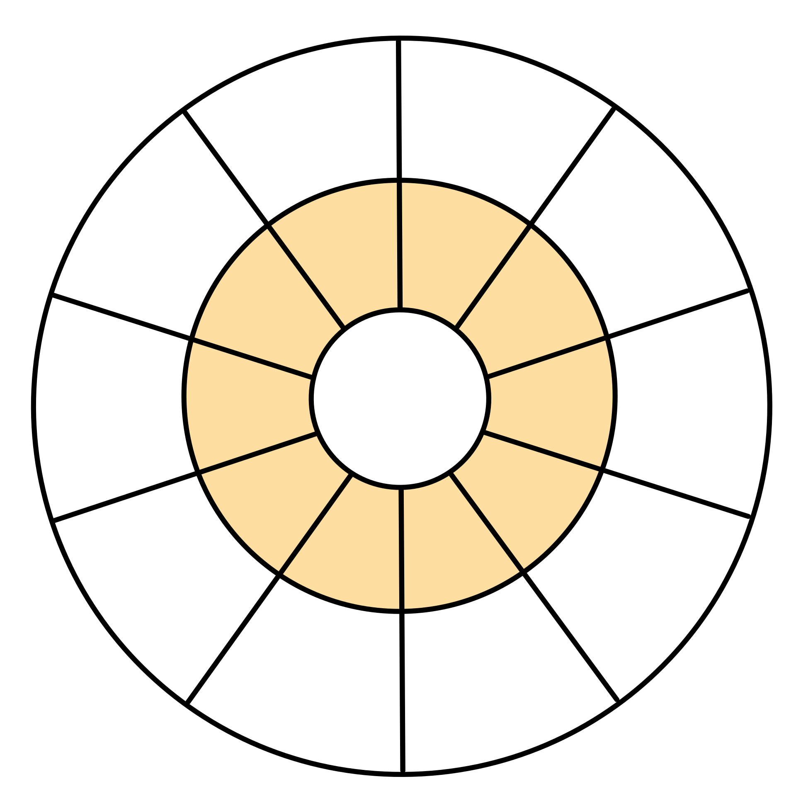
Name:
Date:
Көбейту
Көбейту шеңберлері 1-ден 9-ға дейін. Шеңберлерді аяқтаңыз.
1
20
30
3
9
10
1
2
1
6
1x
9
2x
2
9
3x
8
3
16
6
8
3
7
4
7
5
8
21
6
4
6
5
12
15
40
5
1
8
45
10
54
10
1
12
9
5x
2
8
4x
3
8
15
8
6x
3
28
5
16
35
6
4
7
5
24
24
25
36
7
8
9
63
10
72
10
1
16
81
10
7x
2
8x
9x
2
8
3
8
3
8
27
49
6
5
28
7
5
32
63
6
5
36
48

Slide 2
Name:
Date:
Multiplication
Multiplication circles 1 to 9. Complete the circles
10
1
20
2
30
3
9
10
1
2
18
10
1
4
27
10
1
6
9
1x
2
9
2x
2
9
3x
2
8
8
3
3
16
8
3
6
24
8
3
9
7
7
6
5
4
4
14
7
6
5
4
8
21
7
6
5
4
12
6
5
12
10
18
15
40
4
50
5
60
6
36
10
1
8
45
10
1
10
54
10
1
12
9
2
9
5x
2
9
2
32
8
4x
3
12
40
8
3
15
48
8
6x
3
18
28
7
6
5
4
16
35
7
6
5
4
20
42
7
6
5
4
24
24
20
30
25
36
30
70
7
80
8
90
9
63
10
1
14
72
10
1
16
81
10
1
18
9
2
9
8x
2
9
2
56
8
7x
3
21
64
8
3
24
72
8
9x
3
27
49
7
6
5
4
28
56
7
6
5
4
32
63
7
6
5
4
36
42
35
48
40
54
45

