Slide 1
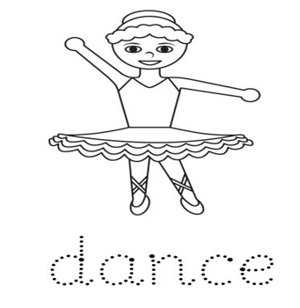
GRADE: 1
MODULE: 8
THEME:
A SPECIAL DANCE

Slide 2
LESSON OBJECTIVES
You will learn:
subject pronouns
You will be able to
use some short form answers

Slide 3
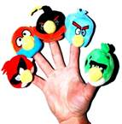
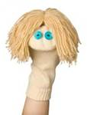
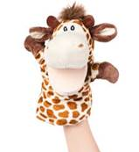
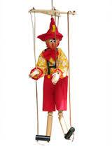
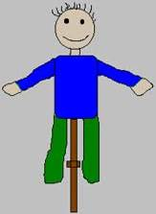
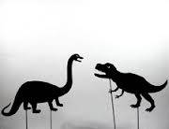
Revision
Types of puppets
Finger
Socks
hand
Shadow
MARIONNETE
Rod

Slide 4
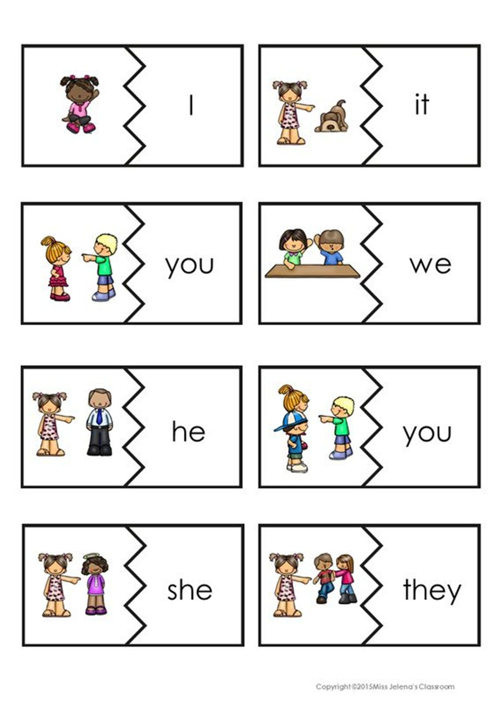
SUBJECT PRONOUNS

Slide 5
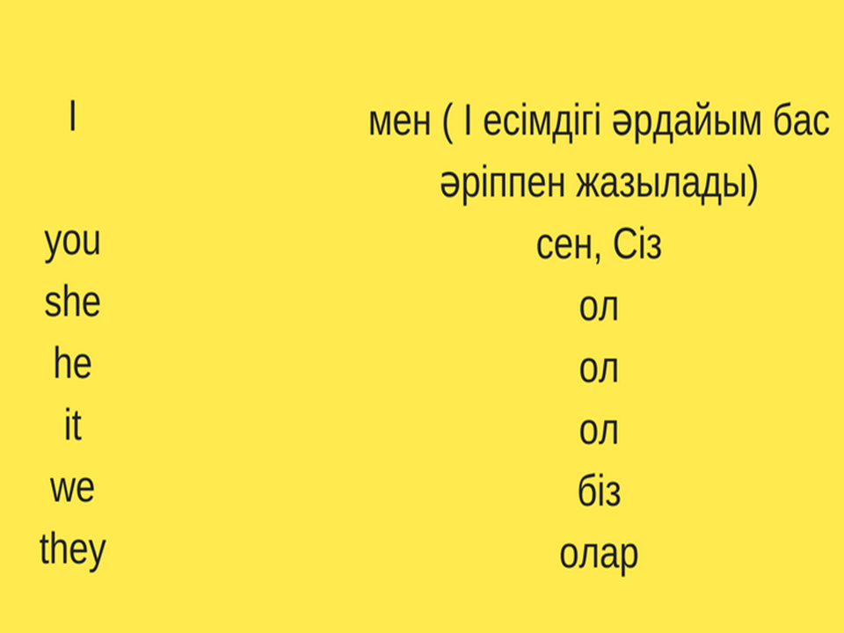

Slide 6
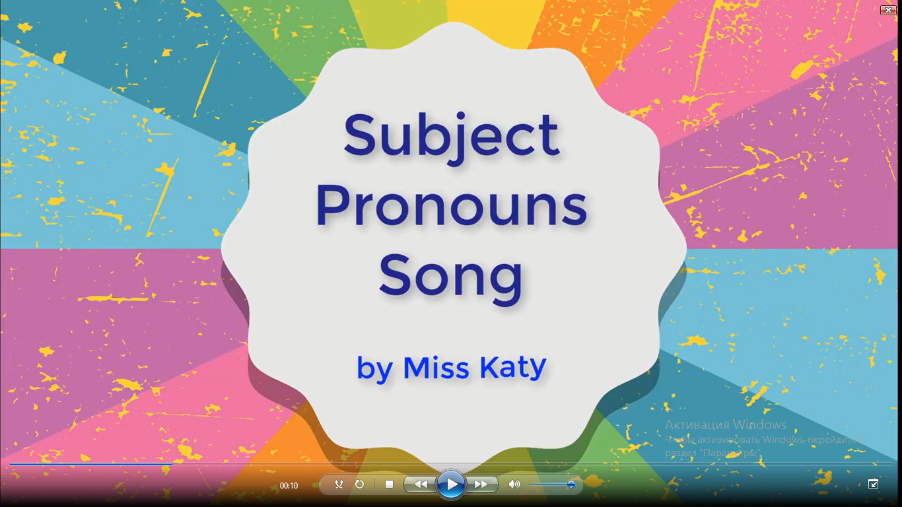

Let’s sing “Subject pronouns” song

Slide 7
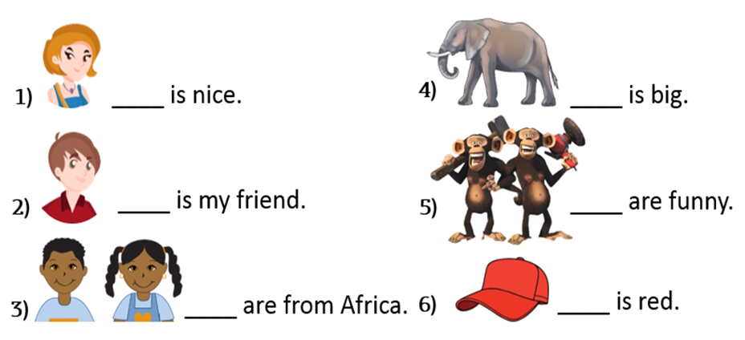
Look at the pictures and complete the sentences
She
It
He
They
We
It

Slide 8
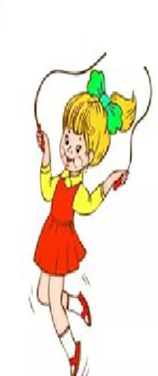
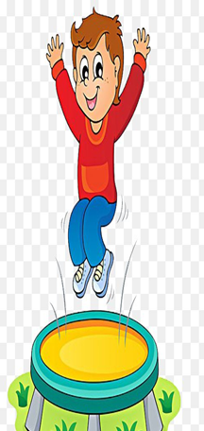
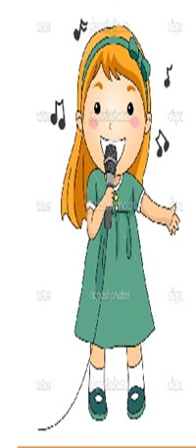
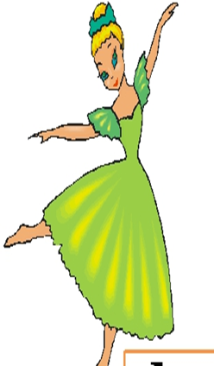
NEW WORDS
Dance Jump Sing Skip

Slide 9

-Can you dance?
-Yes, I can.
-No, I can’t.

Slide 10

Answer the questions
Can you skip?
-Yes, I can
-No, I can’t.

Slide 11

Answer the questions
Can you sing?
-Yes, I can
-No, I can’t.

Slide 12

Answer the questions
Can you jump?
-Yes, I can
-No, I can’t.

Slide 13
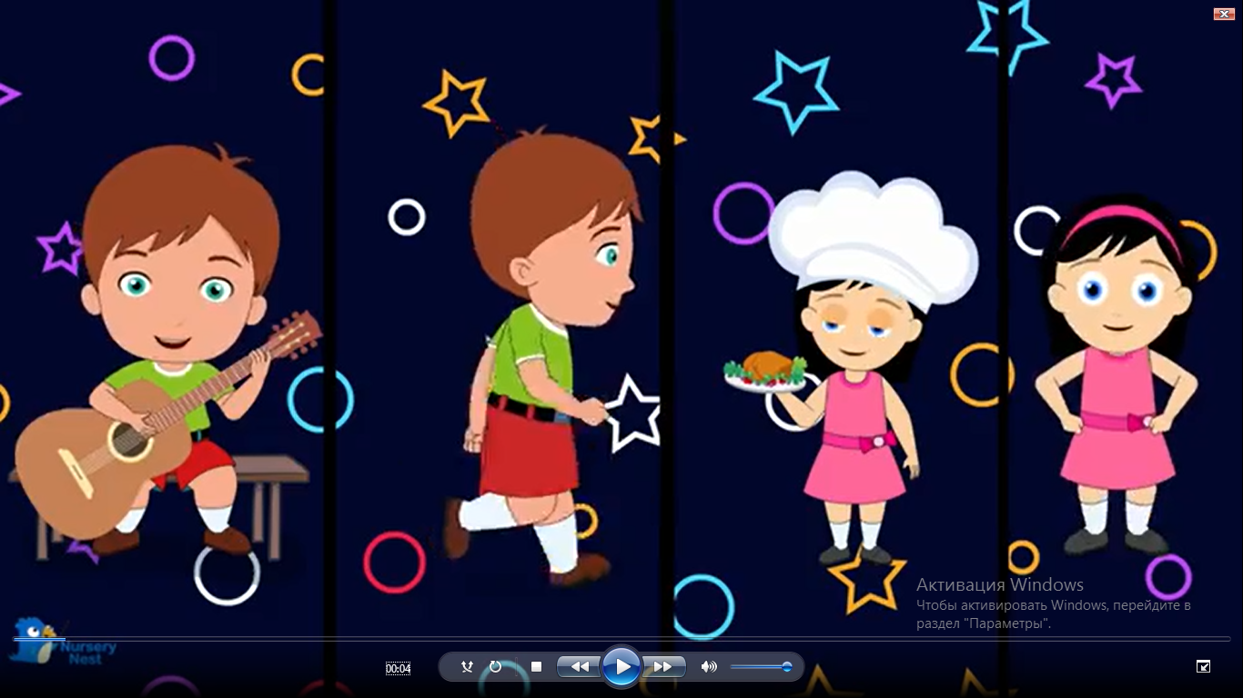
Let’s sing “Yes, I can” song

Slide 14
