Slide 1
Subject: English language
Grade:10
Module:9 Independent project
Progress Check 9

Slide 2
LEARNING OBJECTIVES(S)
10.4.1 - understand complex and abstract main points in extended texts on a wide range of familiar and unfamiliar general and curricular topics
10.4.3 - skim a range of lengthy texts with speed to identify content meriting closer reading on a range of more complex and abstract, general and curricular topics
10.4.4 - read a wide range of extended fiction and non-fiction texts on a variety of more complex and abstract general and curricular topics
10.3.1 - use formal and informal language registers in talk on a range of general and curricular topics, including some unfamiliar topics
10.2.2 - understand specific information in unsupported extended talk on a wide range of general and curricular topics, including talk on a growing range of unfamiliar topics
10.2.3 - understand the detail of an argument in unsupported extended talk on a wide range of general and curricular topics, including talk on a growing range of unfamiliar topics
10.5.2 - use a wide range of vocabulary, which is appropriate to topic and genre, and which is spelt accurately
10.1.5 - use feedback to set personal learning objectives
10.6.6 - use a growing variety of impersonal and cleft structures on a wide range of general and curricular topics
10.6.7 - use a wide variety of simple perfect active and passive forms and a variety of perfect continuous forms on a wide range of general and curricular topics
10.5.1 - plan, write, edit and proofread work at text level independently on a wide range of general and curricular topics
10.5.3 - write with grammatical accuracy on a wide range of general and curricular topics
10.5.4 - use style and register to achieve an appropriate degree of formality in a wide variety of written genres on general and curricular topics
10.5.6 - write coherently at text level using a variety of connectors on a wide range of familiar general and curricular topics
10.5.9 - punctuate written work at text level on a wide range of general and curricular topics with a good degree of accuracy

Slide 3
Descriptor: Read the text and translate it

Slide 4
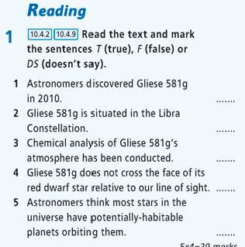
Descriptor:
Read the text again and mark the sentence
T (True)
F (False) or
DS ( Doesn't say)
EX 1 at page 123
Answer Key
1T, 2T, 3F, 4DS, 5F

Slide 5
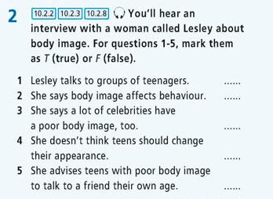

Descriptor: Listen and do the task
EX 2 at page 123
Answer Key
1 T 2T 3F 4 F 5 F

Slide 6
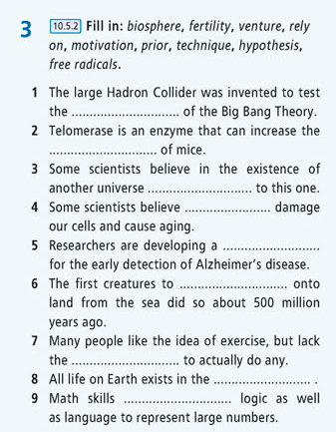
Descriptor: Complete the sentences.
EX 3 at page 124
Answer Key
1 | hypothesis | 4 | free radicals | 7 | motivation
2 | fertility | 5 | technique | 8 | biosphere
3 | prior | 6 | venture | 9 | rely on

Slide 7
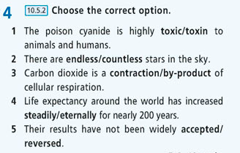
Descriptor: Choose the correct options
EX 4 at page 124
Answer Key
1 toxic 3 by-product 5 accepted
2 countless 4 steadily

Slide 8
Descriptor: Choose the correct preposition
EX 5 at page 124
Answer Key
1 to 2 of 3 in, to 4 on

Slide 9
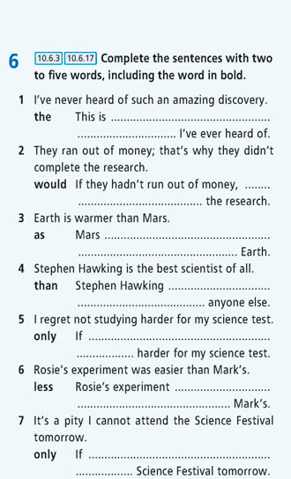
Descriptor: Complete the sentences with two to five words, including the word in bold.
EX 6 at page 124
Answer Key
1,the most amazing discovery
2,they would have completed
3,is not as warm as
4,is a better scientist than
5,only I had studied
6,was less difficult than
7,only I could attend the

Slide 10
H O M E W O R K
Write an opinion essay answering questions “Should the government spend money on anti-aging research?
(120-180) words

