Slide 1
Алгебра және анализ бастамалары
Пәні:
Сынып:
11
Тоқсан:
IІІ
Ұстаздың аты-жөні:

Slide 2

Логарифмдік теңсіздіктер
Бүгінгі сабақта:
логарифмдік теңсіздіктерді шешуді үйренесіздер

Slide 3
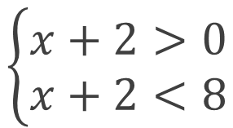





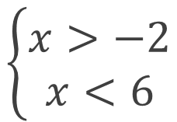
Тапсырма. Теңсіздікті шешіңіз.
$\log_{0,5}\left(x+2\right)+\log_{\sqrt{2}}\left(x+2\right)+\log_{2}\left(x+2\right)<6$
Шешуі.
$$\log_{0,5}\left(x+2\right)+\log_{\sqrt{2}}\left(x+2\right)+\log_{2}\left(x+2\right)<6;$$
$$\log_{2^{−1}}\left(x+2\right)+\log_{2^{\frac{1}{2}}}\left(x+2\right)+\log_{2}\left(x+2\right)<6;$$
$${−log}_{2}\left(x+2\right)+2\log_{2}\left(x+2\right)+\log_{2}\left(x+2\right)<6;$$
$$2\log_{2}\left(x+2\right)<6;$$
$$\log_{2}\left(x+2\right)<3;$$
$$\left\{\begin{aligned}x+2>0 \\ x+2<8\end{aligned}\right.$$
$$\left\{\begin{aligned}x>−2 \\ x<6\end{aligned}\right.$$
$$x∈\left(−2;6\right)$$
Жауабы: $(−2;6)$

Slide 4
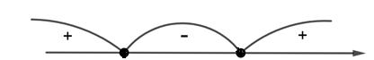


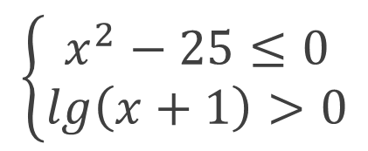









Тапсырма. Теңсіздіктер жүйесін шешіңіз. $\left\{\begin{aligned}x^{2}−25≤0 \\ lg\left(x+1\right)>0\end{aligned}\right.$
$$\left\{\begin{aligned}x^{2}−25≤0 \\ lg\left(x+1\right)>0\end{aligned}\right.$$
Шешуі.
$$x^{2}−25=0;$$
$$x^{2}=25;$$
$$x_{1}=−5; x_{2}=5$$
$$\left[−5;5\right]$$
-5
5
$$lg\left(x+1\right)>0;$$
$$x+1>1;$$
$$x>0;$$
///////////////////////
$$x∈(0;5]$$
/////////////////////
$$−5$$
0
5
Жауабы: $(0;5]$

Slide 5


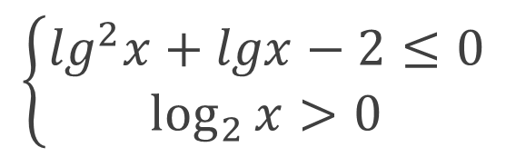

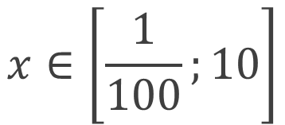



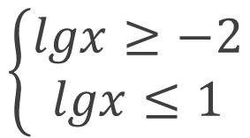





Тапсырма. Теңсіздіктер жүйесін шешіңіз. $\left\{\begin{aligned}\lg^{2}x+lgx−2≤0 \\ \log_{2}{x}>0\end{aligned}\right.$
Шешуі.
$$\left\{\begin{aligned}\lg^{2}x+lgx−2≤0 \\ \log_{2}{x}>0\end{aligned}\right.$$
$$\lg^{2}x+lgx−2≤0;$$
$$lgx=a;$$
$$a^{2}+a−2≤0;$$
$$a^{2}+a−2=0$$
$$a_{1}=−2; a_{2}=1;$$
$$a∈\left[−2;1\right]$$
-2
1
$$\left\{\begin{aligned}lgx≥−2 \\ lgx≤1\end{aligned}\right.$$
$$x∈\left[\frac{1}{100};10\right]$$
$$x>1$$
$$x∈(1;10]$$
$$\log_{2}{x}>0;$$
Жауабы: $(1;10]$

Slide 6
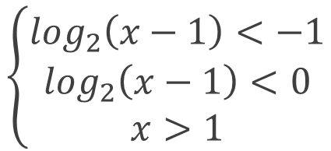
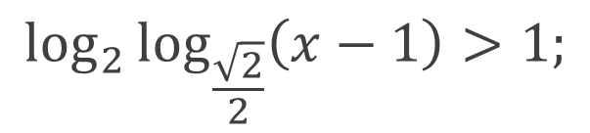
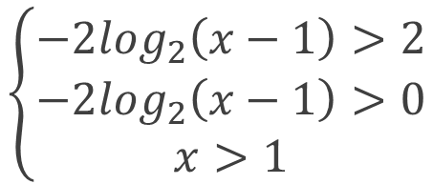
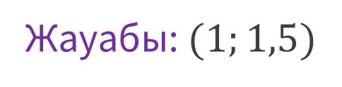
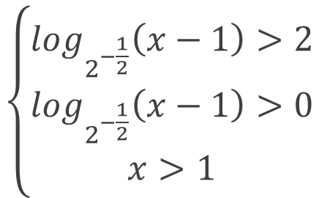

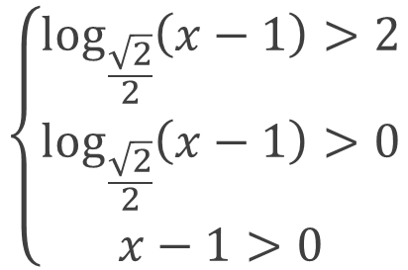
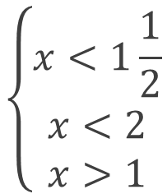
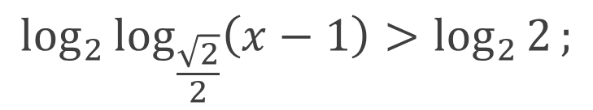
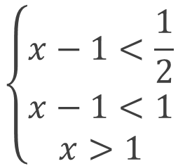
Тапсырма. Теңсіздікті шешіңіз. $\log_{2}{\log_{\frac{\sqrt{2}}{2}}\left(x−1\right)}>1$
Шешуі.
$$\log_{2}{\log_{\frac{\sqrt{2}}{2}}\left(x−1\right)}>1;$$
$$\log_{2}{\log_{\frac{\sqrt{2}}{2}}\left(x−1\right)}>\log_{2}{2};$$
$$\left\{\begin{aligned}\log_{\frac{\sqrt{2}}{2}}\left(x−1\right)>2 \\ \log_{\frac{\sqrt{2}}{2}}\left(x−1\right)>0 \\ x−1>0\end{aligned}\right.$$
$$\left\{\begin{aligned}\log_{2^{−\frac{1}{2}}}\left(x−1\right)>2 \\ \log_{2^{−\frac{1}{2}}}\left(x−1\right)>0 \\ x>1\end{aligned}\right.$$
$$\left\{\begin{aligned}−2\log_{2}\left(x−1\right)>2 \\ {−2log}_{2}\left(x−1\right)>0 \\ x>1\end{aligned}\right.$$
$$\left\{\begin{aligned}x−1<\frac{1}{2} \\ x−1<1 \\ x>1\end{aligned}\right.$$
$$\left\{\begin{aligned}x<1\frac{1}{2} \\ x<2 \\ x>1\end{aligned}\right.$$
$$\left\{\begin{aligned}\log_{2}\left(x−1\right)<−1 \\ \log_{2}\left(x−1\right)<0 \\ x>1\end{aligned}\right.$$
$$x∈\left(1;1,5\right)$$
Жауабы: $(1;1,5)$

Slide 7

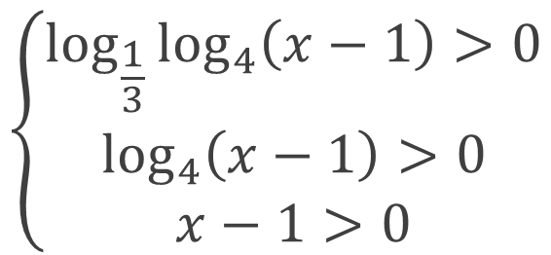
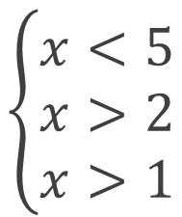

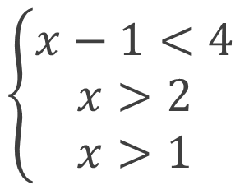
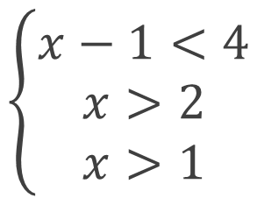
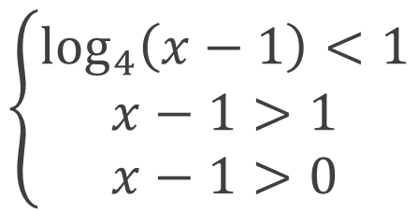

Тапсырма. Функцияның анықталу облысын табыңыз.
$y=\log_{2}{\log_{\frac{1}{3}}{\log_{4}\left(x−1\right)}}$
Шешуі.
$$\left\{\begin{aligned}\log_{\frac{1}{3}}{\log_{4}\left(x−1\right)}>0 \\ \log_{4}\left(x−1\right)>0 \\ x−1>0\end{aligned}\right.$$
$$\left\{\begin{aligned}\log_{4}\left(x−1\right)<1 \\ x−1>1 \\ x−1>0\end{aligned}\right.$$
$$\left\{\begin{aligned}x−1<4 \\ x>2 \\ x>1\end{aligned}\right.$$
$$\left\{\begin{aligned}x−1<4 \\ x>2 \\ x>1\end{aligned}\right.$$
$$\left\{\begin{aligned}x<5 \\ x>2 \\ x>1\end{aligned}\right.$$
$$x∈\left(2;5\right)$$
Жауабы: $(2;5)$

Slide 8


Тапсырма. Теңсіздікті шешіңіз. $\log_{x+2}\left(5−x\right)<1$
Шешуі.
$$\log_{x+2}\left(5−x\right)<\log_{x+2}\left(x+2\right)$$
$$\left\{\begin{aligned}x+2>1 \\ 5−x<x+2 \\ 5−x>0\end{aligned}\right.$$
$$\left\{\begin{aligned}x>1−2 \\ −x−x<2−5 \\ −x>−5\end{aligned}\right.$$
$$\left\{\begin{aligned}x>−1 \\ −2x<−3 \\ x<5\end{aligned}\right.$$
$$\left\{\begin{aligned}x>−1 \\ x>1,5 \\ x<5\end{aligned}\right.$$
$$x∈\left(1,5;5\right)$$
$$\left\{\begin{aligned}0<x+2<1 \\ 5−x>x+2 \\ 5−x>0\end{aligned}\right.$$
$$\left\{\begin{aligned}−2<x<−1 \\ −x−x>2−5 \\ −x>−5\end{aligned}\right.$$
$$\left\{\begin{aligned}−2<x<−1 \\ −2x>−3 \\ x<5\end{aligned}\right.$$
$$\left\{\begin{aligned}−2<x<−1 \\ x<1,5 \\ x<5\end{aligned}\right.$$
$$x∈\left(−2;−1\right)$$
Жауабы$\left(−2;−1\right)∪\left(1,5;5\right)$

Slide 9

Тапсырма. Функцияның анықталу облысын табыңыз.
$$y=\sqrt{\log_{0,3}{\frac{x−1}{x+5}}}$$
Шешуі.
$$\left\{\begin{aligned}\log_{0,3}{\frac{x−1}{x+5}}≥0 \\ \frac{x−1}{x+5}>0\end{aligned}\right.$$
$$\left\{\begin{aligned}\frac{x−1}{x+5}≤1 \\ \frac{x−1}{x+5}>0\end{aligned}\right.$$
$$\left\{\begin{aligned}\frac{x−1}{x+5}−1≤0 \\ \frac{x−1}{x+5}>0\end{aligned}\right.$$
$$\left\{\begin{aligned}\frac{−6}{x+5}≤0 \\ \frac{x−1}{x+5}>0\end{aligned}\right.$$
$$\left\{\begin{aligned}x+5>0 \\ \frac{x−1}{x+5}>0\end{aligned}\right.$$
$$\left\{\begin{aligned}x>−5 \\ x∈\left(−∞−5\right)∪\left(1;+∞\right)\end{aligned}\right.$$
/////////////////////////////////
///////////
//////////////
Жауабы $\left(1;+∞\right)$
$$−5$$
$$1$$

Slide 10

Қорытынды:
логарифмдік теңсіздіктерді шешуді үйрендіңіздер.

