Slide 1
Inequality involving absolute value
ALGEBRA
CHAPTER no 4

Slide 2
CHAPTER no 4
Absolute value of Inequalities.
You will be able to:
Know the definition of absolute value of a function.
Identify what the absolute value inequality is set “equal” to…
Graph the answer on a number line and write the answer in interval notation.
ALGEBRA | 4-term | Week no 2 | 2019-2020

Slide 3

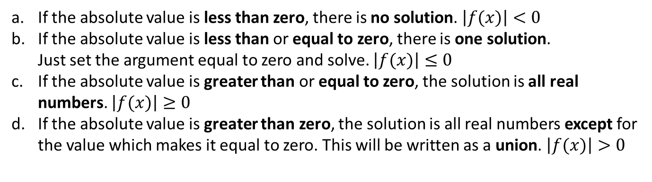
CHAPTER no 4
Absolute value of Inequalities
Definition 1: Identify what the absolute value inequality is set “equal” to 0 “zero”
If the absolute value is less than zero, there is no solution. $\left|f(x)\right|<0$
If the absolute value is less than or equal to zero, there is one solution. Just set the argument equal to zero and solve. $\left|f(x)\right|≤0$
If the absolute value is greater than or equal to zero, the solution is all real numbers. $\left|f(x)\right|≥0$
If the absolute value is greater than zero, the solution is all real numbers except for the value which makes it equal to zero. This will be written as a union. $\left|f(x)\right|>0$
ALGEBRA | 4-term | Week no 2 | 2019-2020

Slide 4
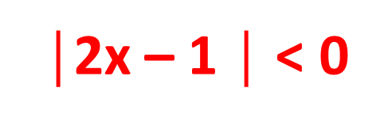

CHAPTER no 4
Absolute value of Inequalities
Example 1:
Solve the inequality $\text{│}\text{2}$x – 1 $\text{│}$ + 4 < 4
$\text{│}\text{2}$x – 1 $\text{│}$ < 0
No Solution
ALGEBRA | 4-term | Week no 2 | 2019-2020

Slide 5

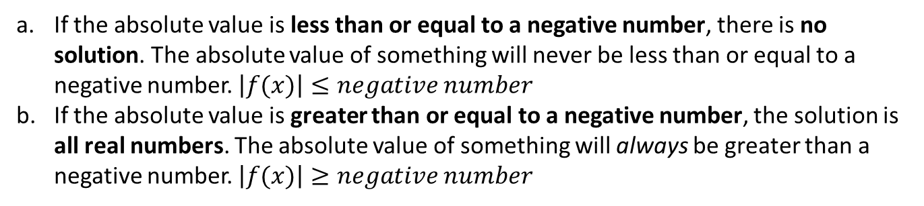
CHAPTER no 4
Absolute value of Inequalities
Definition 2: Identify what the absolute value inequality is set “equal” to “negative” number
If the absolute value is less than or equal to a negative number, there is no solution. The absolute value of something will never be less than or equal to a negative number. $\left|f(x)\right|≤negative number$
If the absolute value is greater than or equal to a negative number, the solution is all real numbers. The absolute value of something will always be greater than a negative number. $\left|f(x)\right|≥negative number$
ALGEBRA | 4-term | Week no 2 | 2019-2020

Slide 6
CHAPTER no 4
Absolute value of Inequalities
Example 2:
Solve the inequality |3x + 4| + 5 ≤ 3
|3x + 4| ≤ −2
No Solution
ALGEBRA | 4-term | Week no 2 | 2019-2020

Slide 7

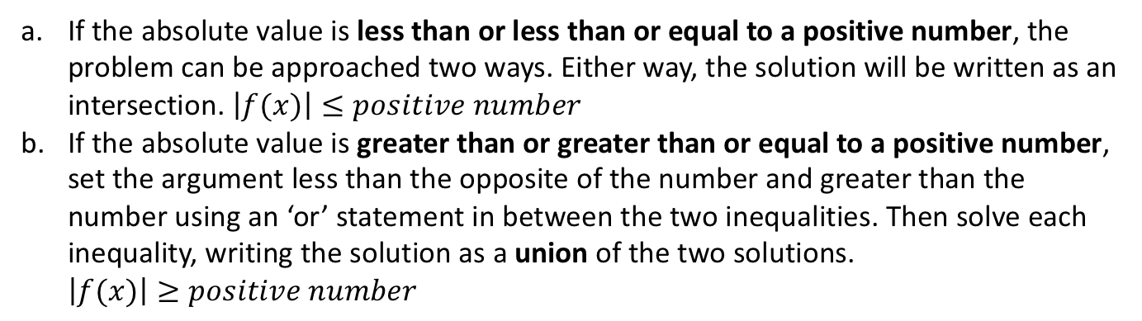
CHAPTER no 4
Absolute value of Inequalities
Definition 3: Identify what the absolute value inequality is set “equal” to “positive” number
If the absolute value is less than or less than or equal to a positive number, the problem can be approached two ways. Either way, the solution will be written as an intersection. $\left|f(x)\right|≤positive number$
If the absolute value is greater than or greater than or equal to a positive number, set the argument less than the opposite of the number and greater than the number using an ‘or’ statement in between the two inequalities. Then solve each inequality, writing the solution as a union of the two solutions. $\left|f(x)\right|≥positive number$
ALGEBRA | 4-term | Week no 2 | 2019-2020

Slide 8
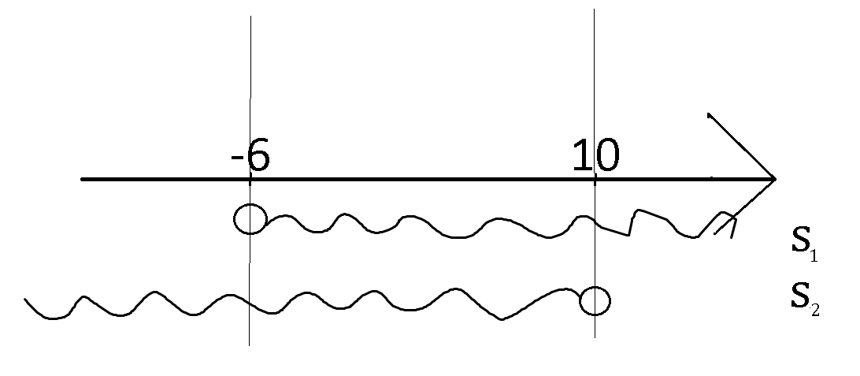
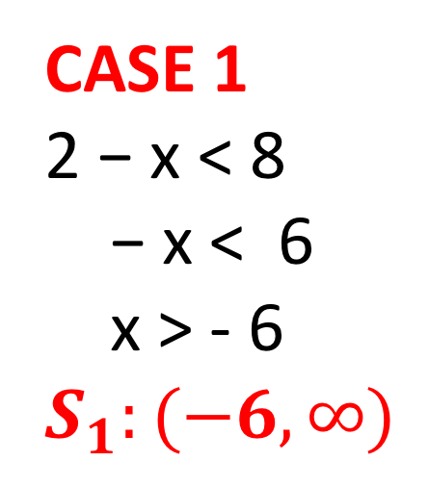


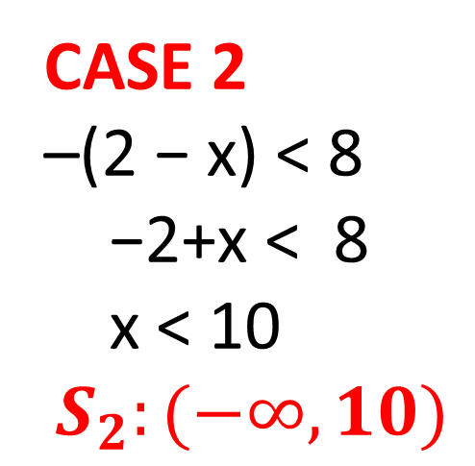
CHAPTER no 4
Absolute value of Inequalities
Example 3a:
Solve the inequality |2 − x| < 8
CASE 1
2 − x < 8
− x < 6
x > - 6
$$S_{1}:(−6, ∞)$$
CASE 2
–(2 − x) < 8
−2+x < 8
x < 10
$$S_{2}:(−∞, 10)$$
$${S=S_{1}∩S}_{2}$$
Solution: ${S=S_{1}∩S}_{2}=$(-6,10)
ALGEBRA | 4-term | Week no 2 | 2019-2020

Slide 9
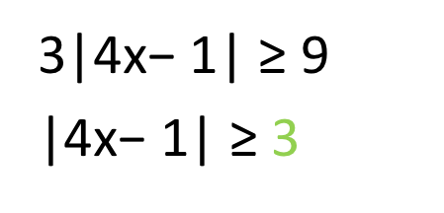
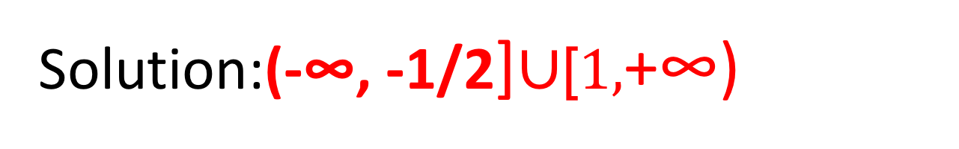
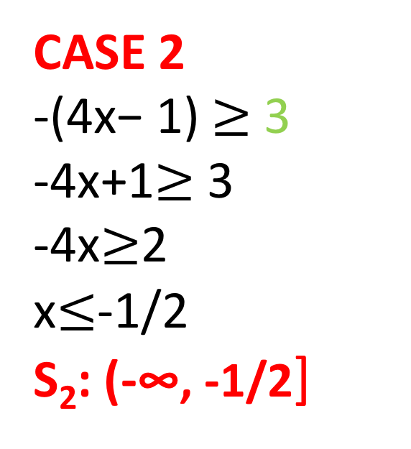
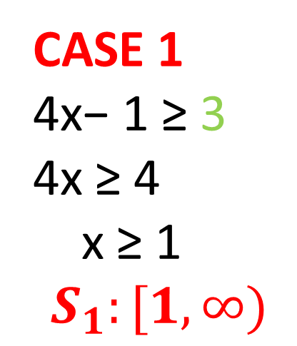
CHAPTER no 4
Absolute value of Inequalities
Example 3b:
Solve the inequality 3|4x − 1| $\text{≥}$ 9
CASE 1
4x− 1 $\text{≥}$ 3 4x $\text{≥}$ 4
x $\text{≥}$ 1
$$S_{1}:[1, ∞)$$
CASE 2
-(4x− 1) $≥$3 -4x+1$≥$3
-4x$≥$2 x$≤$-1/2
S₂: (-∞, -1/2]
3|4x− 1| $\text{≥}$ 9
|4x− 1| $\text{≥}$ 3
Solution:(-∞, -1/2]∪$\text{[}1,$+∞)
ALGEBRA | 4-term | Week no 2 | 2019-2020

Slide 10
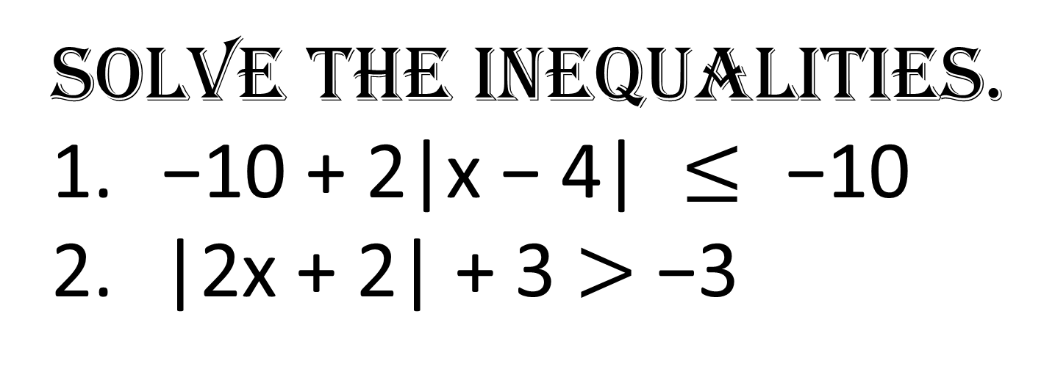
CHAPTER no 4
Absolute value of Inequalities
Activity:
Solve the inequalities.
$\text{−10 + }\text{2}\text{|}\text{x}\text{ − 4| }≤\text{ −10}$
|2x + 2| + 3 $>$ −3
ALGEBRA | 4-term | Week no 2 | 2019-2020

Slide 11
CHAPTER no 4
Absolute value of Inequalities
Resources:
https://www.khanacademy.org/math/algebra-home/alg-absolute-value/alg-absolute-value-inequalities/v/absolute-value-inequalities
https://www.mathsisfun.com/definitions/absolute-value.html
https://www.mathsisfun.com/links/core-high-school-functions.html
https://www.mathsisfun.com/links/core-high-school-algebra.html
https://www.mathsisfun.com/numbers/absolute-value.html
ALGEBRA | 4-term | Week no 2 | 2019-2020

