Slide 1
Random Variables. Discrete and Continuous RV. Distribution of RV.
ALGEBRA
CHAPTER no 6

Slide 2
CHAPTER no 6
Random Variables. Discrete and Continuous RV. Distribution of RV.
You will be able to:
know the definition of Random Variables
distinguish Discrete and Continuous Random Variables
know the Distribution of Random Variables
ALGEBRA | 4-term | Week no 4 | 2019-2020

Slide 3
CHAPTER no 6
Random Variables
Definition
Random variable is a set of possible values from a random experiment.
We are just mapping outcomes of that experiment to numbers.
We usually denote Random Variables by capital letters like X, Y, Z etc.
ALGEBRA | 4-term | Week no 4 | 2019-2020

Slide 4


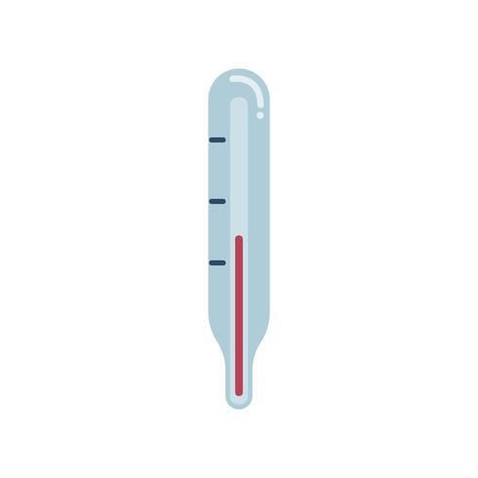
CHAPTER no 6
Random Variables
Real Life application
Let’s assume that ‘flipping a coin’ is X-experiment, ‘the sum of the numbers in rolling a pair of die’ is Y-experiment and ‘measuring a body temperature’ is Z-experiment.
Now, in instead of writing “What is the probability of making a sum of 9 in rolling a pair of die?”, you can simply write “What is P(Y=9)?”.
ALGEBRA | 4-term | Week no 4 | 2019-2020

Slide 5


CHAPTER no 6
Discrete and Continuous RV
Definition
A random variable is discrete if the set of values it takes is finite, or can be organized as a list.
A random variable that can vary continuously, or, in other words, can take any value in an interval, is continuous.
ALGEBRA | 4-term | Week no 4 | 2019-2020

Slide 6
CHAPTER no 6
Discrete and Continuous RV
Example
A probability teacher is rolling a die. Y is the square root of the number that comes up. Is the random variable Y discrete or continuous?
Solution: Y is a discrete random variable. Its possible values can be listed. They are the square roots of the different numbers on the die.
A probability teacher is rolling a die. Z is the distance it lands from the teacher. Is the random variable Z discrete or continuous?
Solution: Z is a continuous random variable. The distance between the die and the teacher can vary continuously. All possible distances cannot be listed.
ALGEBRA | 4-term | Week no 4 | 2019-2020

Slide 7
CHAPTER no 6
Distribution of Random Variables
Write the probability distribution for a game of chance
For a fundraiser, there is a raffle with 1,000 tickets. One ticket will win a $620 prize, one ticket will win a $190 prize, one ticket will win a $60 prize, and the rest will win nothing. X is the payoff for one ticket in the raffle. Write the probability distribution of X in the table below.
Write each probability as an exact decimal.
X | P(X)
$
$
$
$
620
0.001
190
0.001
60
0.001
0
0.997
ALGEBRA | 4-term | Week no 4 | 2019-2020

Slide 8
CHAPTER no 6
Distribution of Random Variables
Expected value for a game of chance
At a carnival, there is a raffle with 1,000 tickets. One ticket will win a $420 prize, three tickets will win a $180 prize, nine tickets will win a $70 prize, and the remaining tickets will win nothing. If you have a ticket, what is the expected payoff?
X | P(X) | E(X) = X·P(X)
$
$
$
$
420
0.001
0.42
180
0.003
0.54
70
0.009
0.63
0
0.987
0
The expected payoff is E(X) = 0.42 + 0.54 + 0.63 + 0 = 1.59 $
ALGEBRA | 4-term | Week no 4 | 2019-2020

Slide 9

CHAPTER no 6
Distribution of Random Variables
Activity
Imagine that you are participating in a TV show and the emcee is asking you to choose one of three doors. One of the doors hides a prize and the other two doors have no prize. You state out loud which door you pick, but you don’t open it right away.
Emcee opens one of the other two doors, and there is no prize behind it.
At this moment, there are two closed doors, one of which you picked. The prize is behind one of the closed doors, but you don’t know which one. Emcee asks you, “Do you want to switch doors?”
Time to shatter this illusion with the truth! If you switch doors, you double your probability of winning!
What?! A solution to this problem can be found here.
Let's now conduct and test this experiment at home. Details will be given to you by your teacher.
ALGEBRA | 4-term | Week no 4 | 2019-2020

Slide 10
CHAPTER no 6
Distribution of Random Variables
Resources
https://www.mathsisfun.com/data/random-variables.html
https://www.khanacademy.org/math/statistics-probability/random-variables-stats-library/random-variables-discrete/v/random-variables?modal=1
https://www.khanacademy.org/math/statistics-probability/random-variables-stats-library/random-variables-discrete/v/discrete-and-continuous-random-variables?modal=1
https://www.youtube.com/watch?v=mhlc7peGlGg
https://statisticsbyjim.com/fun/monty-hall-problem/
ALGEBRA | 4-term | Week no 4 | 2019-2020

