Slide 1
Independent and Dependent Events. Conditional Probability.
ALGEBRA
CHAPTER no 6

Slide 2
CHAPTER no 6
Independent and Dependent Events.
Conditional Probability.
You will be able to:
know the definition of Independent and Dependent Events.
know the rules of addition and multiplication of probabilities
know and apply the definition of Conditional Probability
ALGEBRA | 4-term | Week no 3 | 2019-2020

Slide 3
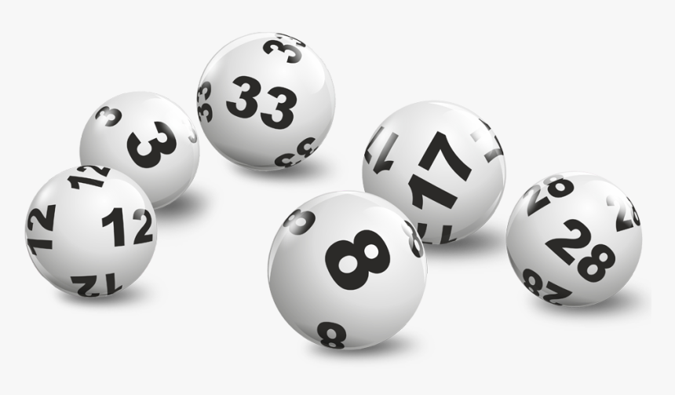


CHAPTER no 6
Independent and Dependent Events.
Conditional Probability.
Warm-up:
Imagine that every tenth citizen of your city decided to participate in the lottery. Three participants will get the main prize, and another one hundred people will receive consolation prizes. If you participate in the lottery, what is the probability that you will win the main prize? Consolation prize?
For Nur-Sultan city:
Population $\sim$ 1.200.000 people
Number of participants $\sim$120.000 people
P(winning the main prize)$≅\frac{3}{120000}=0.0025 \%$
P(winning the consolation prize)$≅\frac{100}{120000}≅0.083 \%$
ALGEBRA | 4-term | Week no 3 | 2019-2020

Slide 4

CHAPTER no 6
Independent and Dependent Events
Definition:
Imagine that we draw two cards one after the other from a well-shuffled deck of cards.
Then the outcome of the second draw will be influenced by the outcome of the first, since the deck will be different on the second draw.
We can say that these two events are dependent.
ALGEBRA | 4-term | Week no 3 | 2019-2020

Slide 5

CHAPTER no 6
Independent and Dependent Events
Definition:
Now consider the example of rolling a die twice.
The number we roll first has no effect on the number we roll after it.
We say that these events are independent.
ALGEBRA | 4-term | Week no 3 | 2019-2020

Slide 6


CHAPTER no 6
Independent and Dependent Events
Rule:
You add probabilities when the events can not happen at the same time:
$$P\left(A+B\right)=P\left(A\right)+P(B)$$
You multiply probabilities when you want two or more different events to happen “at the same time” or “consecutively”:
$$P\left(A⋅B\right)=P\left(A\right)⋅P(B)$$
NOTE: In other words, ‘or’ between events means ‘addition’ and ‘and’ means ‘multiplication’.
ALGEBRA | 4-term | Week no 3 | 2019-2020

Slide 7

CHAPTER no 6
Independent and Dependent Events
Example:
A die is rolled. Find the probability that it shows 3 or 5.
Solution: It is necessary to find the probability that a die will show 3 or 5.
In this case, we add probabilities, since these events cannot happen at the same time.
We get: $\frac{1}{6}+\frac{1}{6}=\frac{1}{3}.$ So the probability is $\frac{1}{3}.$
ALGEBRA | 4-term | Week no 3 | 2019-2020

Slide 8

CHAPTER no 6
Independent and Dependent Events
Example:
A die is rolled and a coin is tossed. Find the probability that a die shows 5 and a coin shows a head.
Solution: It is necessary to find the probability that a die will show 5 and a coin will show a head.
In this case, we multiply probabilities, since these events can happen at the same time.
We get: $\frac{1}{6}⋅\frac{1}{2}=\frac{1}{12}.$ So the probability is $\frac{1}{12}.$
ALGEBRA | 4-term | Week no 3 | 2019-2020

Slide 9


CHAPTER no 6
Conditional Probability
Definition:
Sometimes the outcome of an experiment is affected by a related event or by some additional conditions.
Let A and B be two events in an experiment such that $P(B)≠0$ and B has already occurred.
Then the probability that the event A will occur is called the conditional probability of event A, written as
$$P\left(A | B\right)=\frac{P(A∩B)}{P(B)}$$
ALGEBRA | 4-term | Week no 3 | 2019-2020

Slide 10

CHAPTER no 6
Conditional Probability
Example:
A pair of the die is rolled twice. What is the probability that the sum of the numbers rolled is 9 if it is known that one of the numbers is 4?
Solution: Let A be the event that the sum of the numbers is 9 and let B be the event that one of the numbers is 4.
Then A = {(3, 6),(6, 3),(4, 5),(5, 4)} and B = {(1, 4), (4, 1), (2, 4), (4, 2),
(3, 4), (4, 3), (4, 4), (4, 5), (5, 4), (4, 6),(6, 4)}.
We can see that A$∩$B = {(4, 5), (5, 4)}.
So, $P\left(A | B\right)=\frac{P(A∩B)}{P(B)}={\frac{2}{36}}/{\frac{11}{36}}=\frac{2}{11}$
ALGEBRA | 4-term | Week no 3 | 2019-2020

Slide 11
CHAPTER no 6
Conditional Probability
Activity:
Can you solve it? The two child problem. Here are two questions. They sound very similar. But be careful. They are not.
Mrs. Smith has two children. The eldest one is a boy. What’s the chance that both are boys?
Mrs. Jones has two children. At least one is a boy. What’s the chance that both are boys?
Can you explain the difference between questions and solve them?
ALGEBRA | 4-term | Week no 3 | 2019-2020

Slide 12
CHAPTER no 6
Conditional Probability
Resources:
https://www.mathsisfun.com/data/probability-events-independent.html
https://www.mathsisfun.com/data/probability-events-conditional.html
https://www.theguardian.com/science/2019/nov/18/did-you-solve-it-the-two-child-problem
https://www.khanacademy.org/math/ap-statistics/probability-ap/probability-addition-rule/v/addition-rule-for-probability
https://www.khanacademy.org/math/precalculus/x9e81a4f98389efdf:prob-comb/x9e81a4f98389efdf:dependent-events-precalc/v/independent-events-1
https://www.khanacademy.org/math/statistics-probability/probability-library/conditional-probability-independence/v/calculating-conditional-probability
ALGEBRA | 4-term | Week no 3 | 2019-2020

