Slide 1

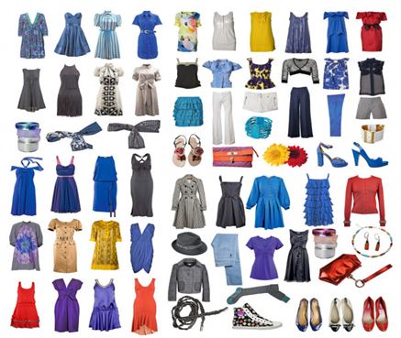
Grade: 11
Module 9
Lesson 4
Quality Control in the Fashion industry

Slide 2

11.6.6 – to use a growing variety of impersonal and cleft structures on a wide range of general and curricular topics; 11.6.11 – to use a wide variety of pre-verbal, post-verbal and end-position, adverbs/adverbial phrases on a wide range of general and curricular topics.
Learning objectives :

Slide 3



Assessment criteria
You will be able to:
revise and practice adjectives/ adverbs,
revise/practice position of adverbs;
learn/revise and practice comparisons/like/as, practice determiners, learn/revise and practice nominalisation, practice cleft sentences/impersonal structures.

Slide 4
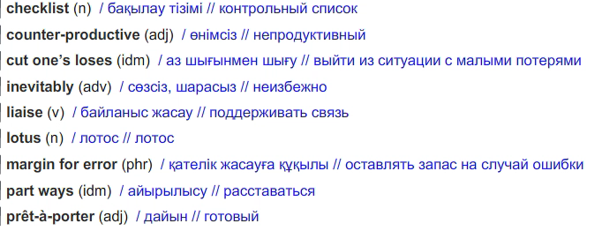
Glossary

Slide 5
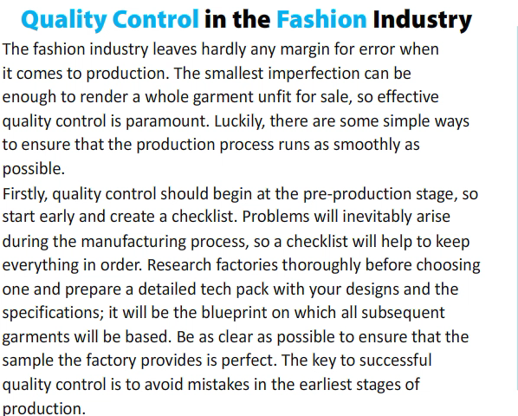

Slide 6

Read the text and look at the underlined adjectives. Which are gradable (they have comparative and superlative forms)? Which are nongradable? (they do not have comparative and superlative forms)?
Gradable: simple, detailed, clear, good, willing,
Non-gradable: whole, paramount, subsequent, perfect, regular, necessary, total, last, predermined

Slide 7
Identify two adverbs in the text from each category: frequency, sequence, time, manner, degree
Adverbs of:
-frequency: always, sometimes
-sequence: firstly, secondly
-time: early, beforehand
-manner: smoothly, thoroughly (also: inevitably, perfectly, certainly, unexpectedly)
-degree: hardly, strongly

Slide 8
Underline the correct item
1a I found the online knitting tutorial quite hard/hardly to understand.
B To be honest, I hard/hardly know how to hold a needle and thread!
2a The fashion show started rather late/lately.
B The prét-ä-porter fashion industry has been booming late/lately.
3a He always walks to the studio because it's quite near/ nearly.
B The designer visited the factory near/ nearly every day to check their progress.
4a His family always encouraged him to aim high/highly.
B She is considered a high/highly skilled fashion designer.
5 a Teenagers most/mostly wear fashionable yet comfortable clothes.
b Which of these fashion brands do you like most/mostly?

Slide 9
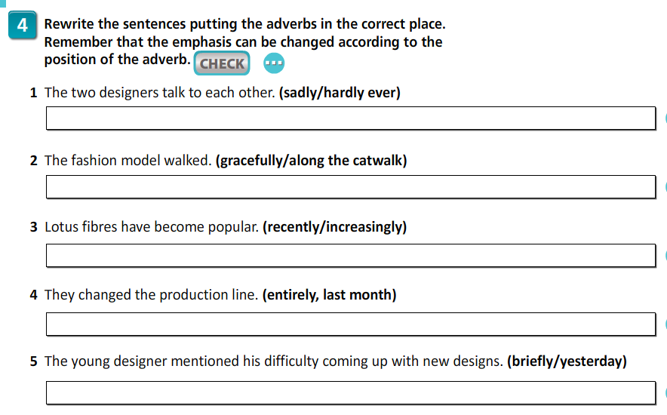

Slide 10
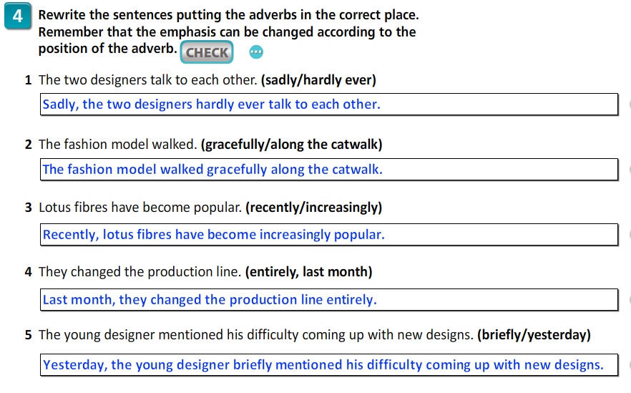

Slide 11
Comparisons//ike/as Look at the text in ex. 1 again. Underline examples of comparisons. How are they formed? Fill in: nowhere near, by far, just as, so much.
1 The new inspector is … just as … careful as the old one, so we didn't receive any defective sample products from the factory.
2 Aset is … by far … the greatest creative director the fashion house has ever had.
3 Berik is not … so much … creative as he is hard working.
4 Sadly, the collection was … nowhere near … as brilliant as the designer believed it to be.

Slide 12
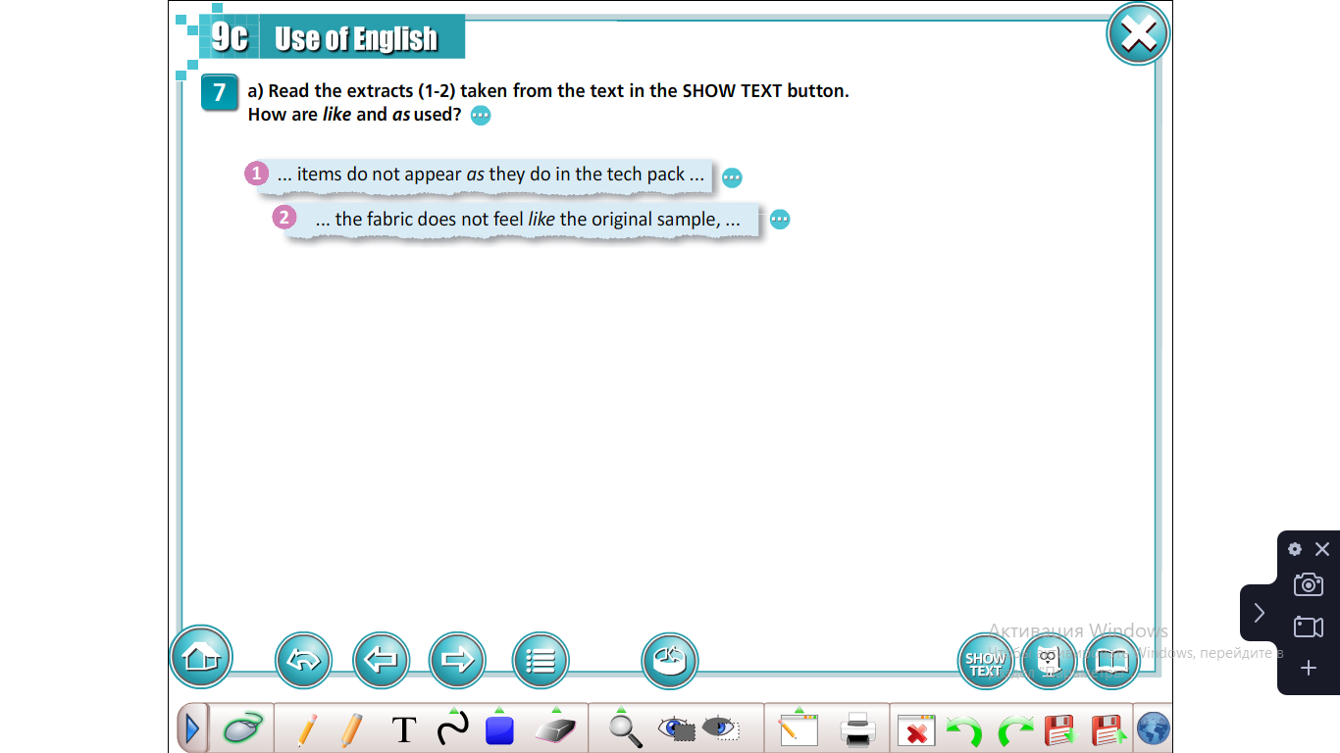

Slide 13
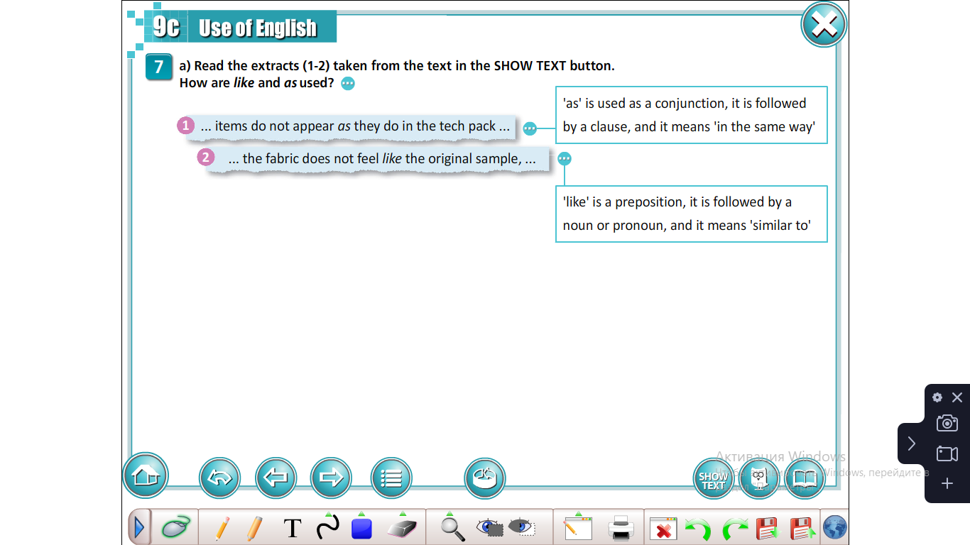

Slide 14
Fill in like or as.
1 He earns a living ...as... a shoes designer for a luxury brand.
2 Tazagul is a great stylist. No one can mix and match clothes …like…her!
3 She looked …like…a movie star in her evening gown.
4 Most people regard Ms Karimova …as… an excellent creative director.
5 There's nothing …like…achieving global success!

Slide 15
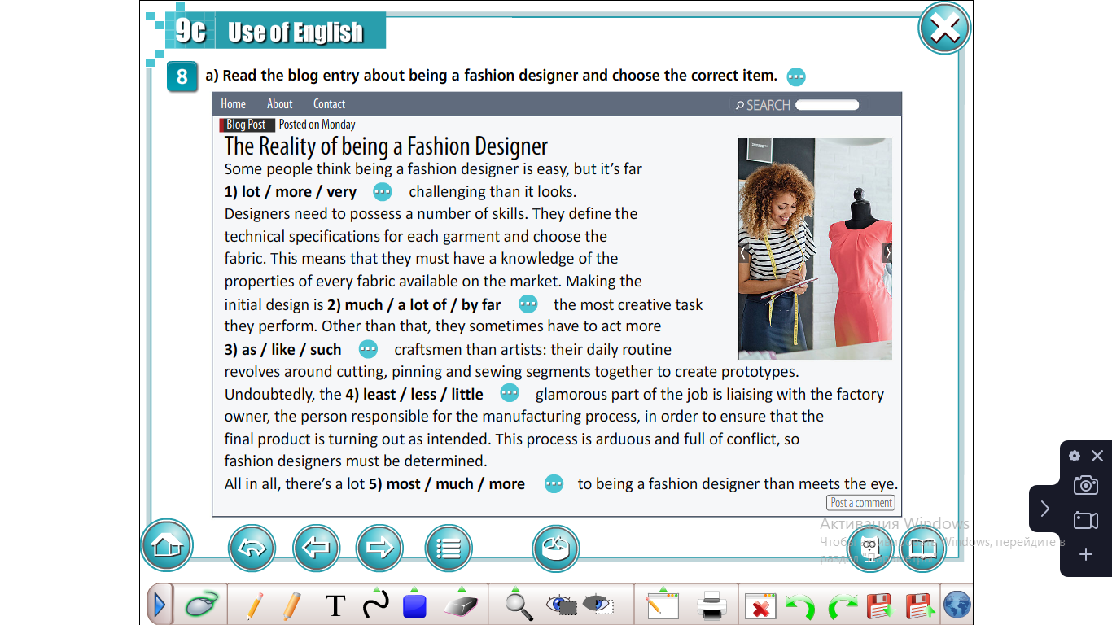
a)Read the blog entry about being a fashion designer and choose the correct item.

Slide 16


Slide 17
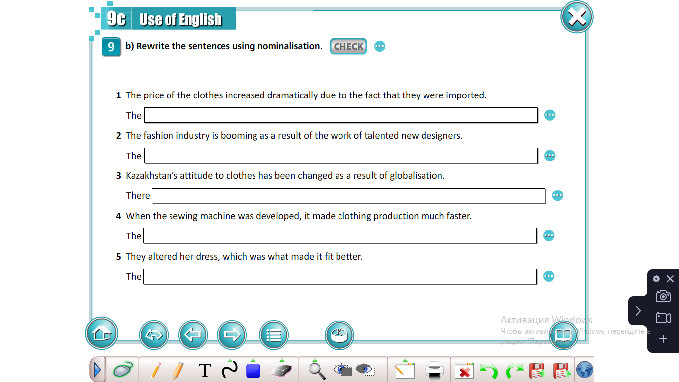

Slide 18
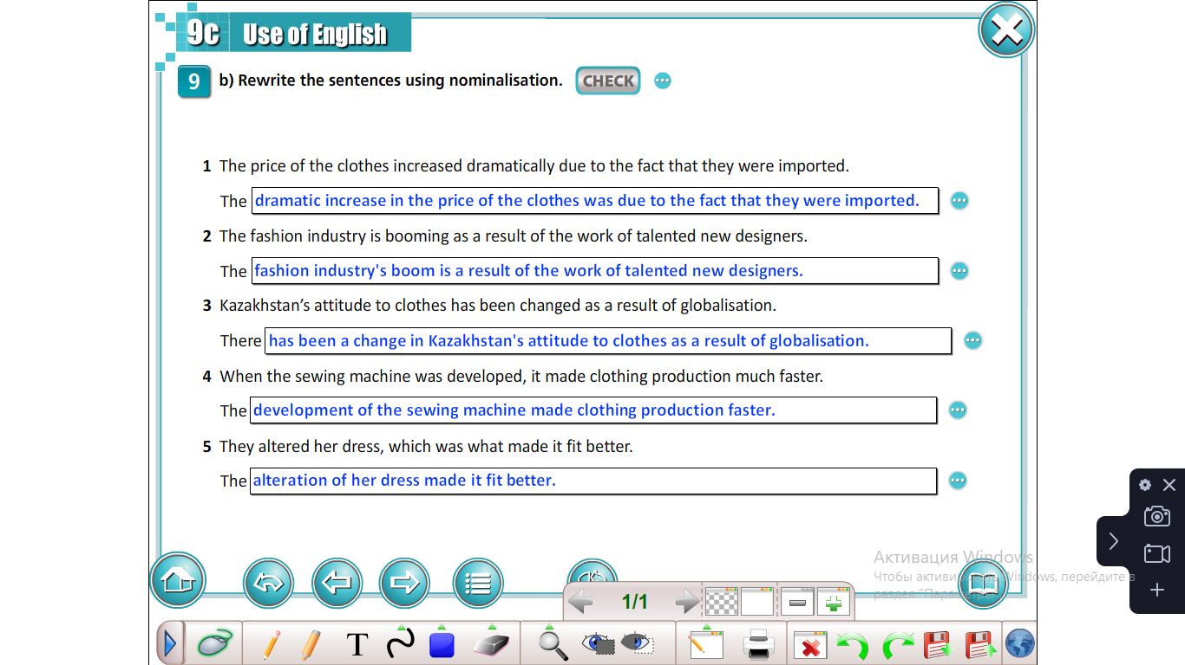

Slide 19
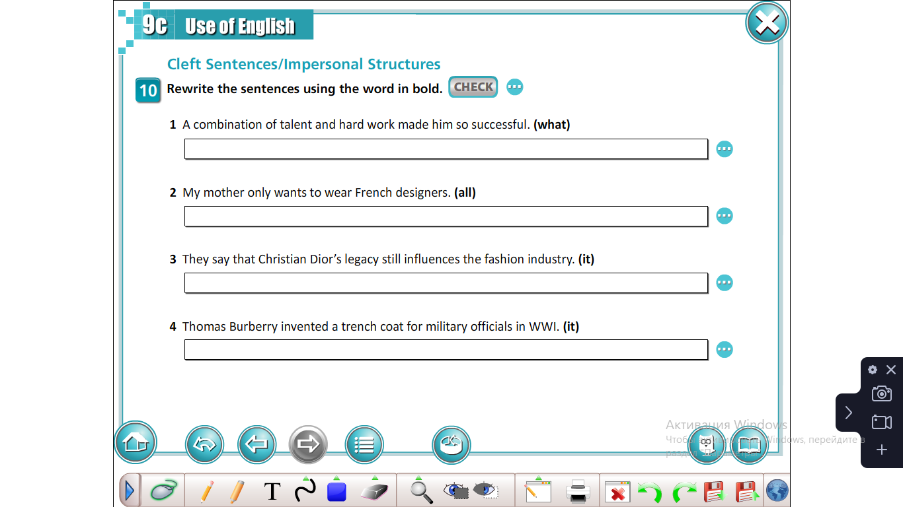

Slide 20
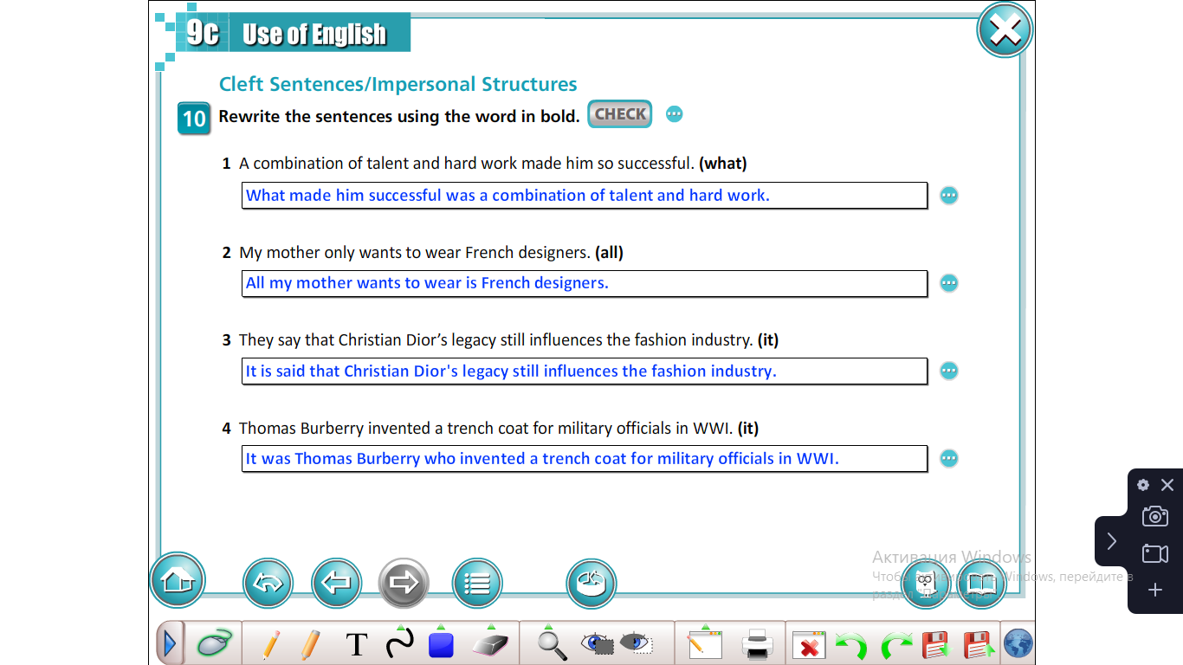

Slide 21

Recommended H/W:
to rewrite the sentences using nominalization (Grammar book); cleft/impersonal structures.

Slide 22


Conclusion
We have
revised and practiced adjectives/ adverbs, revised/practiced position of adverbs;
learned/revised and practiced comparisons/like/as, practiced determiners, learned/revised and practiced nominalisation, practiced cleft sentences/impersonal structures.

