Slide 1
Aspect 11 Grammar Schools Theme of the lesson: 8 E Writing: An Informal Leaflet p106

Slide 2
Lesson objectives:
to analyse a rubric;
to practise formal and informal styles;
to practise using the appropriate tenses in an information leaflet;

Slide 3
Theory box
Information leaflets are written in both formal and informal situations. The level of formality depends on the target reader, e.g. workplace regulations leaflet for company employees should be written in formal style, but a travel itinerary leaflet for a school trip should be written in an informal style.

Slide 4


Slide 5
Layout:
• a short and informative title to indicate the topic
• an introduction to attract the reader’s attention
• a main body divided into clearly labelled sections focusing on the relevant information in the rubric. The main body paragraphs should be organised according to the purpose of the text: by order of time, priority, etc.
• a conclusion to summarise the points or thank the readers or recommend action, etc.

Slide 6
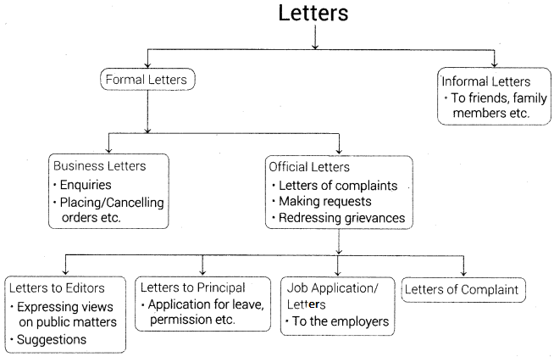
The main stylistic features of information texts include:

Slide 7
Ex 1 p106. Read the rubric and underline the key words. Then answer the questions.
You are a member of a
committee that has been
working on setting up a
range of extracurricular
activities for school children.
Prepare an information
leaflet that will be handed out
to the students with
information about what’s on
offer. (150-200 words)
1 Why are you preparing the information leaflet?
2 Who is going to read it?
3 What style will you write it in? Why?
4 What kind of activities would be suitable for the students?
5 How would you describe them so that they appeal to the students?

Slide 8
Suggested answer key
1 to provide information on extracurricular
activities
2 school children
3 informal, friendly; to attract the students
4 sports, hobbies, pastime activities
5 use friendly, light hearted tone to make
the activities sound fun and entertaining

Slide 9
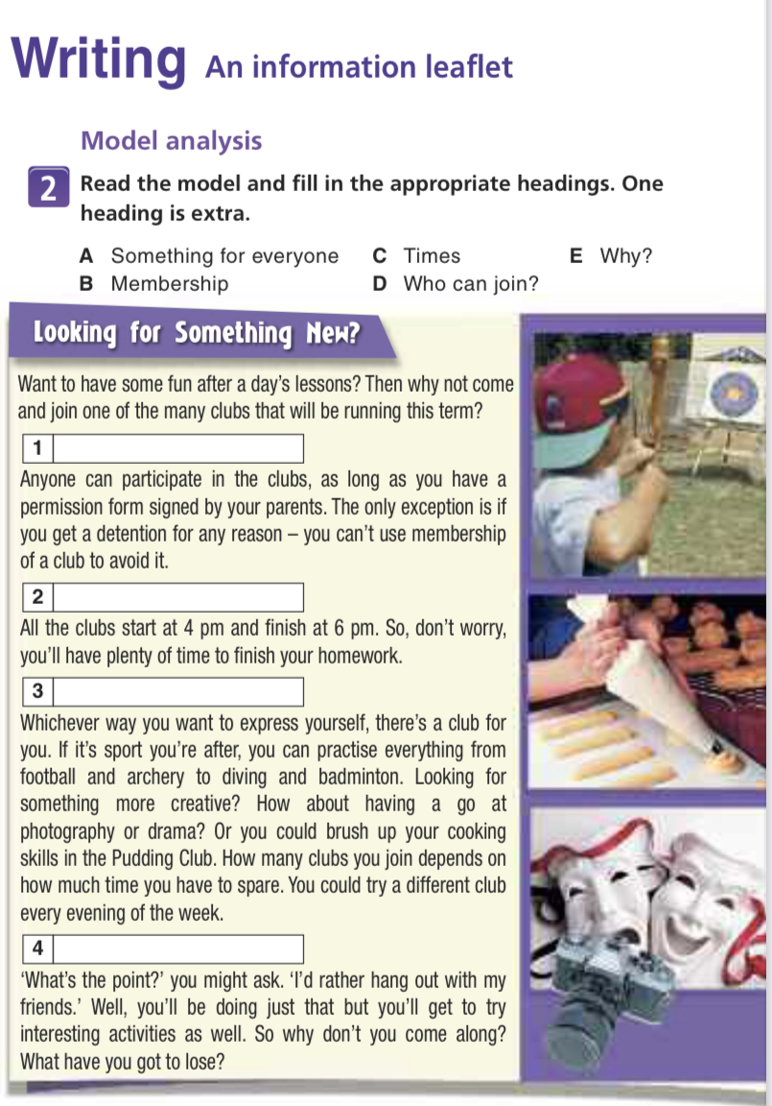

Slide 10
Suggested answer key
1 Who can join
2 Times
3 Something for everyone
4 Why?

Slide 11
Ex 3 a) p106 The extract below was written in a more formal style, appropriate for an information leaflet addressed to parents. Fill in the gaps with the following phrases:• be permitted • no later than • in question • to attend • on condition that • a variety of • draw your attention to
After-School activities
Commencing in the autumn term, the school will be offering 1)................................ extracurricular activities in the form of organised societies and clubs.
Membership
Your son/daughter will 2) .................................... to enrol in these clubs 3) .................................... you have signed the enclosed permission form. We would like to 4) .................................... the fact that students who have been punished with detention will not be allowed 5)................................... any of these activities on the day 6) .................................... .
Times
All activities begin at 4 pm and end 7) ................................... 6 pm.

Slide 12
Suggested answer key
1 a variety of
2 be permitted
3 on condition that
4 draw your attention to
5 to attend
6 in question
7 no later than

Slide 13
Ex 3 b) p106 In pairs, rewrite the last two paragraphs of the model in Ex. 2 in a formal style. You can use the prompts below as well as your own ideas.
• to suit (sb’s) interests/(to be) of interest to/to have an interest in/to be keen on/to be enthusiastic about/to participate in/to engage in
• improve/develop skills – broaden one’s horizons/knowledge

Slide 14
Suggested answer key
Activities on offer
As far as the activities on offer are concerned, they have been
specifically chosen to suit students’ interests. Those who are keen on
sports will be encouraged to participate in various activities,ranging
from archery to diving. Other planned activities include cookery and
photography, and it is hoped that students will take advantage of the
opportunity to engage in a variety of activities.
Benefits
It is the intention of the school to encourage our students to improve
and develop their skills in a wide range of activities. We hope that your
son/daughter will enjoy this opportunity to broaden their horizons and
pick up new skills.

Slide 15
Home-task:
W&GB
Page 47 ex.1
(at Teacher’s discretion)

Slide 16
Conclusion What have you learned today?
We have learned the main stylistic features of information texts;
We have analysed a rubric and a model;
We have practised using formal and informal style writing;

Slide 17


