Slide 1
Theme: Special Days

Slide 2




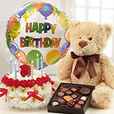
1.New Year
2. Nauryz
3. Victory Day
4. Birthday

Slide 3

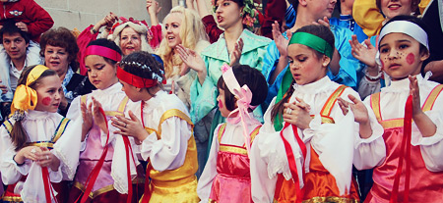
New words
give [giv] - беру
coin [kɔin] – тиын (монета)
pancake [ˈpankeik] – құймақ (блин)
celebration [sɛlɪˈbreiʃn]– мереке
celebrate [ˈsɛlɪbreit]– – мерекелеу, тойлау
young [jᴧη]- жас
colourful [kᴧləfʊl]– түрлі түсті
Easter [ˈi:stə]– Пасха (христиан дінінің ежелгі әрі ең маңызды мейрамы)
Maslenitsa – Масленица (христиан дінінің өте ұлы мейрамы)

Slide 4
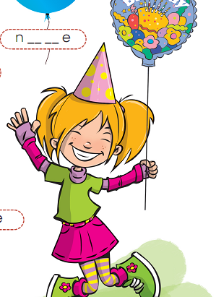
Watch the video about Lilly’s birthday party and read (Ex.9, p.75).

Slide 5


Slide 6
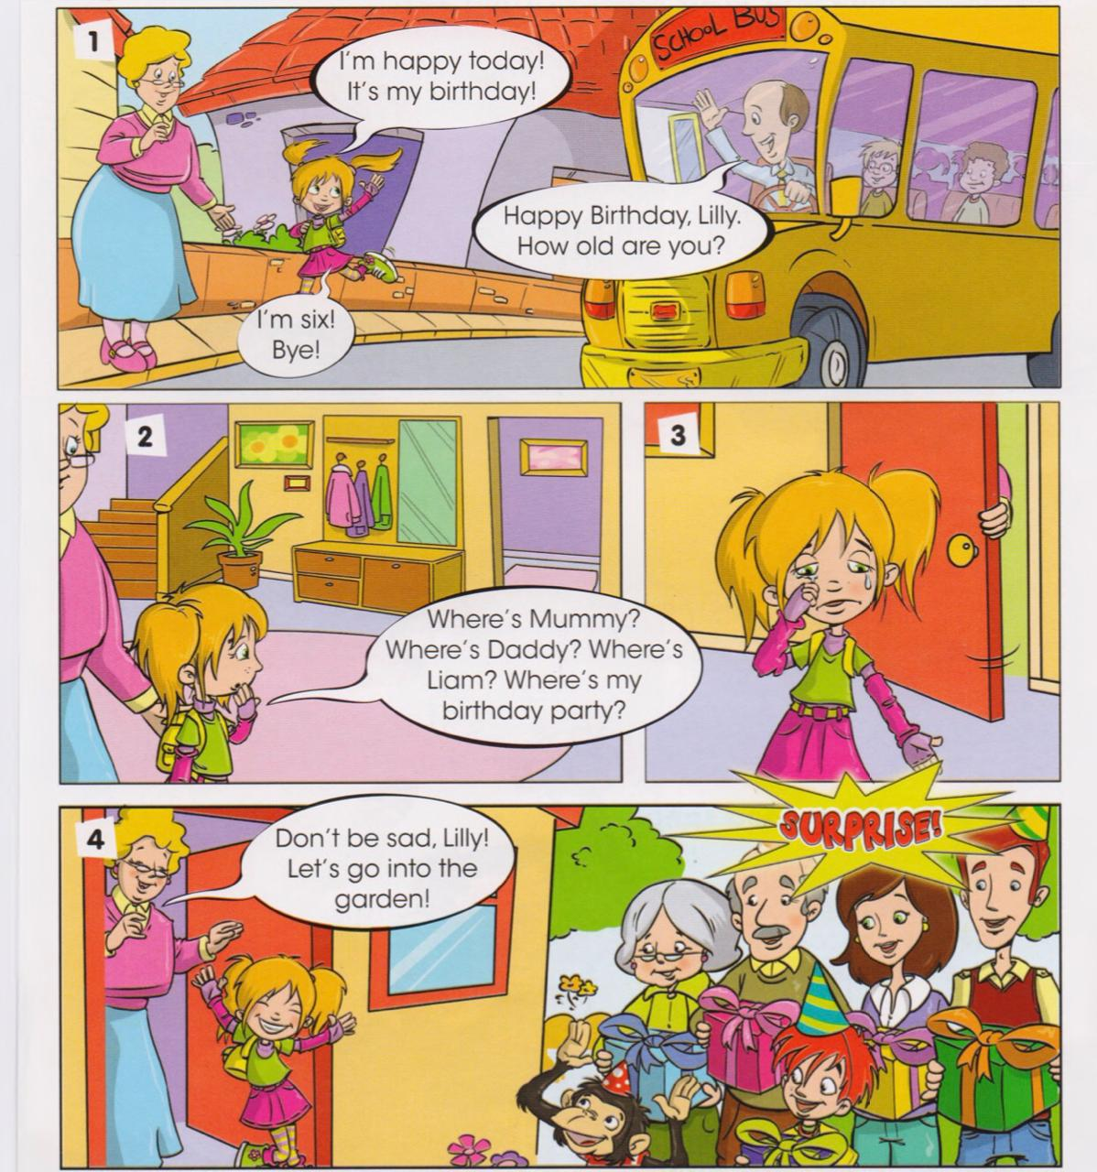
Listen and read.

Slide 7
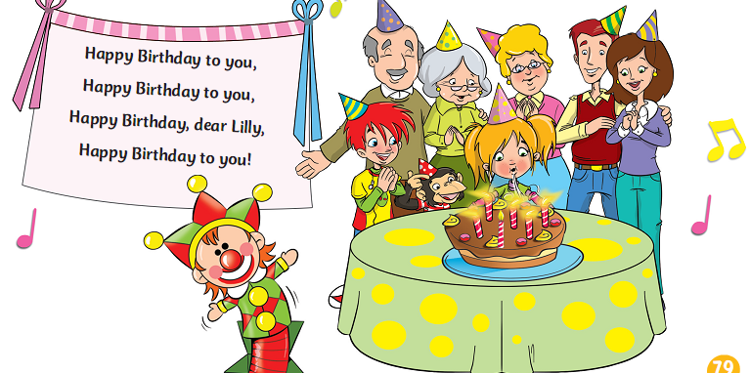

Slide 8
Read and choose.
It’s Lilly’s birthday today. True/False.​
She is seven years old. True/False.​
They celebrate Lilly’s birthday party in the garden. True/False.​
Lilly doesn’t like chips. True/False.​
Charlie gives her sandwiches. True/False.

Slide 9
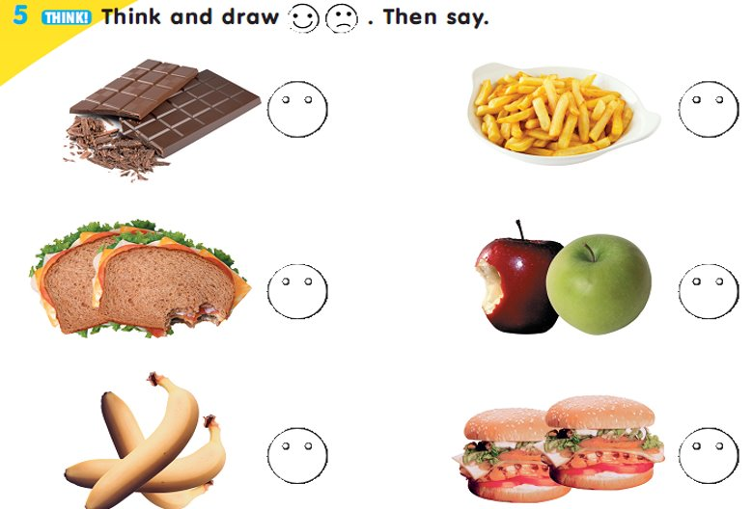
I like/ I don't like.

Slide 10



Reflection
Green – no problems. All is clear.
Yellow – I have some little problems.
Red – I don’t understand many tasks. I need one’s help

