Slide 1
The topic of the lesson:"Home cooking''

Slide 2
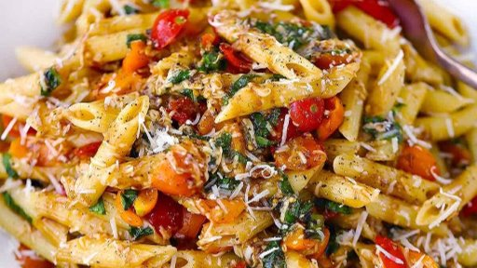
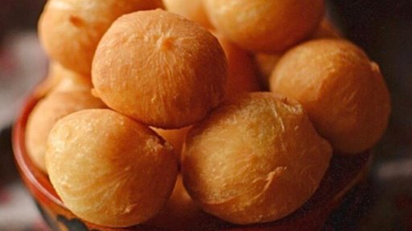
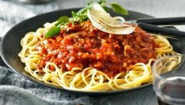
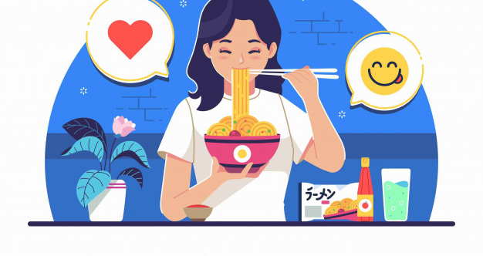

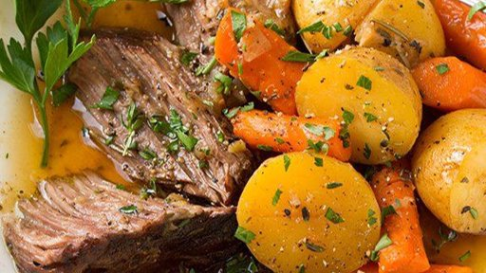
I'm Bianca. I'm from Italy.
My favourite food is spaghetti.

Slide 3
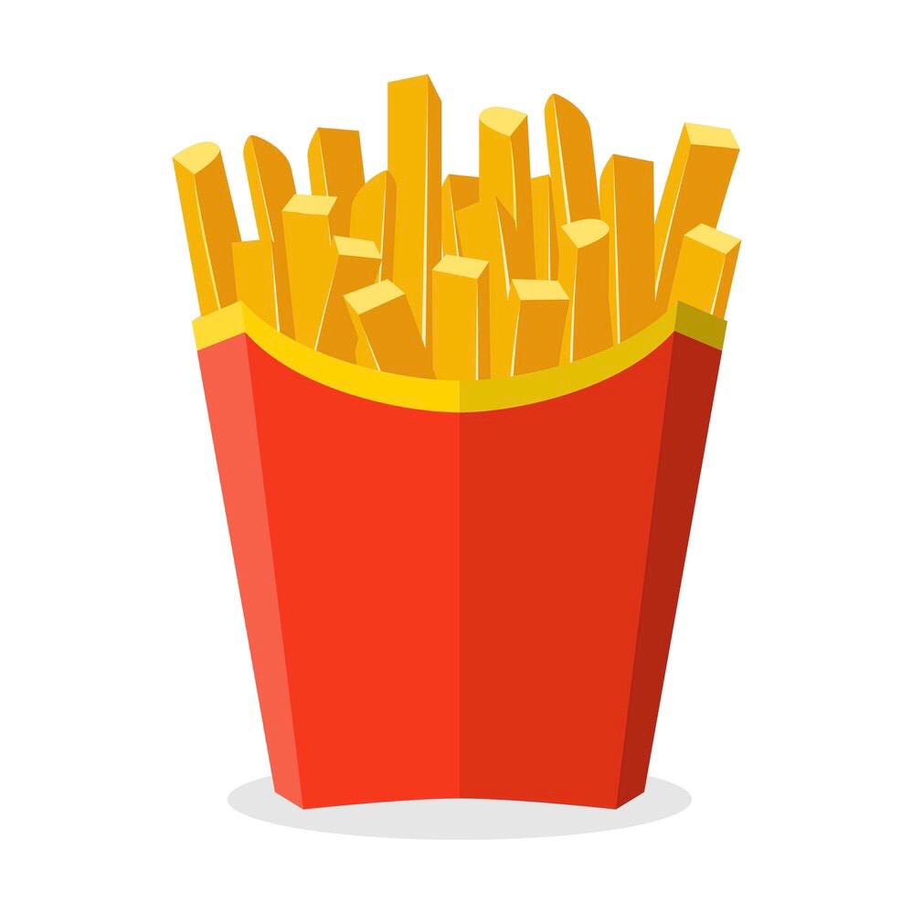
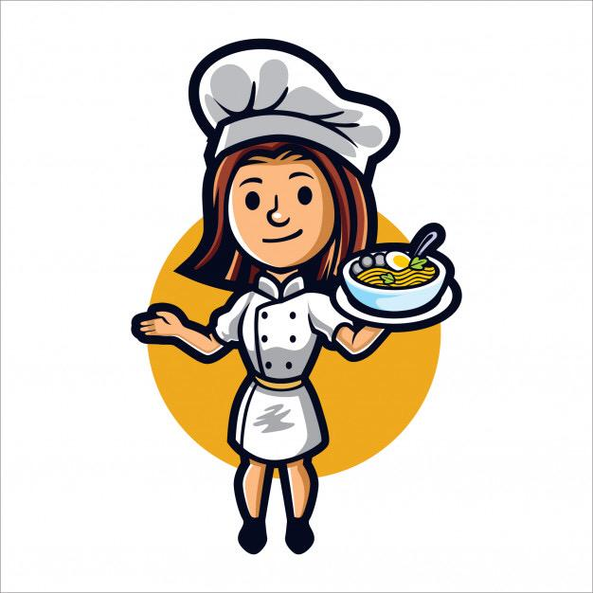
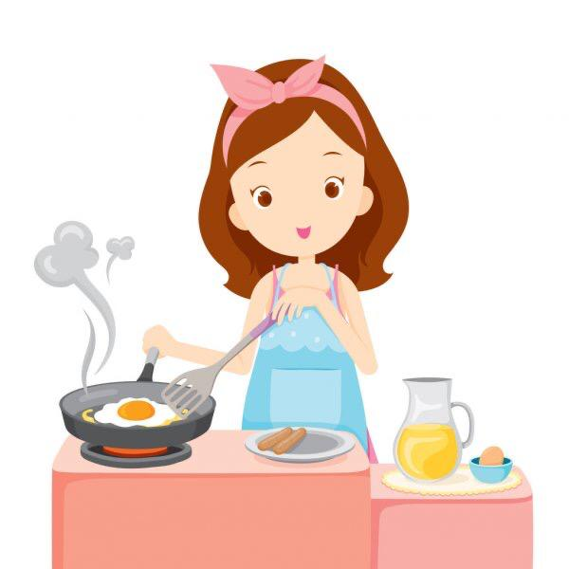
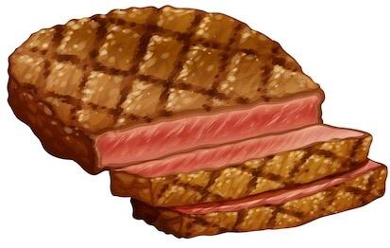
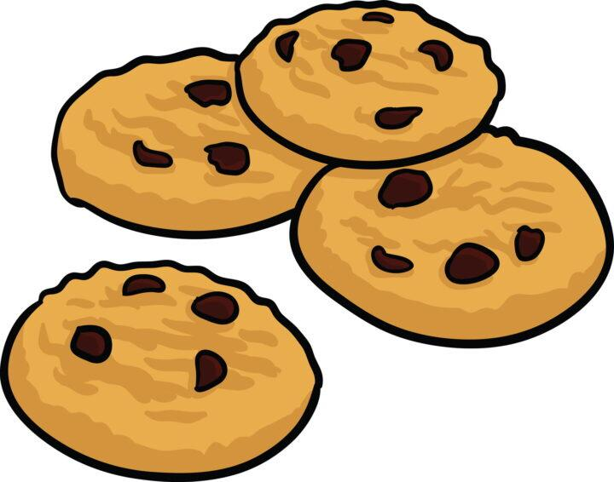
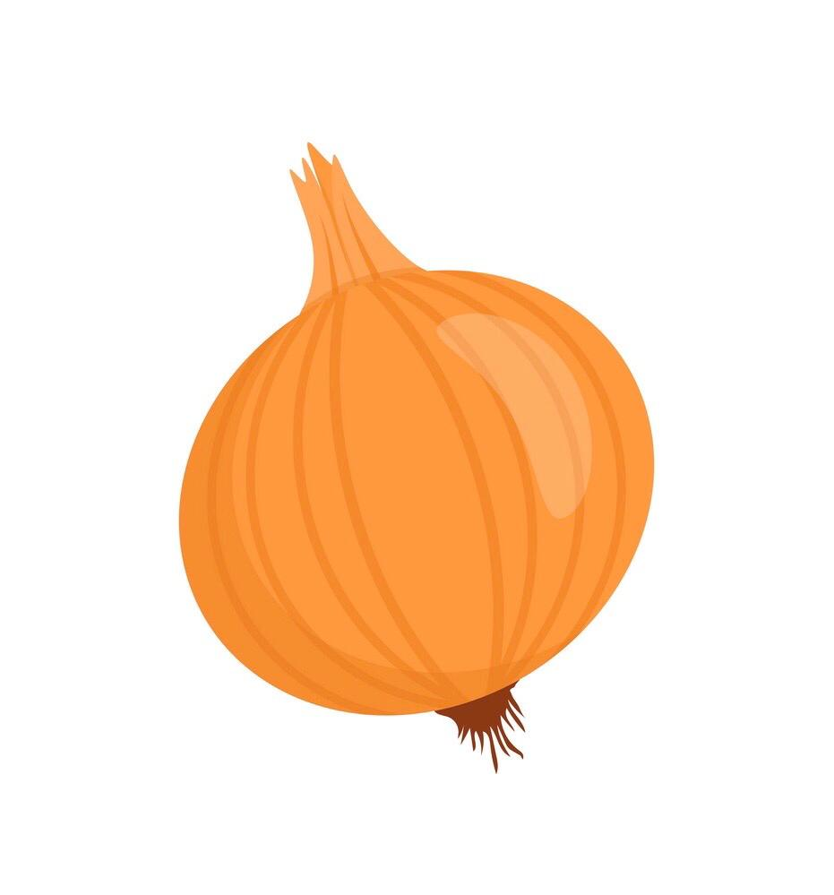
сook
аспаз
french fries
фри картобы
cookies
steak
печенье
стейк
an onion
пияз

Slide 4
Complete the missing letters. Write.
1. s
a
k
n
t
e
2. o
i
o
n
3. c
o
o
i
s
k
e
c
r
i
e
s
5. c
4. f
h
f
o
r
e
n
o
k

Slide 5
Listen and complete the sentences.
My elder sister likes making a ....
She uses ….. to make a cake.
My favourite food is french …..
I don't like .....
cake
milk
fries
an onion

Slide 6
Read the text and choose.
Hi, my name is Aidar. I'm eight years old, and I live in Nur-Sultan. For breakfast I usually eat bread with jam or honey and I drink some milk or homemade juice. My mother buys some oranges to make orange juice. At the weekends, we usually have samsa with meat, chicken or cheese at home. My sister cooks it very well.
Choose the correct answer:
1.Usually he eats bread with jam or honey for breakfast. Yes / No.
2.He drinks some juice or homemade milk. Yes / No.
3.His mother buys some oranges to make orange juice. Yes /No.

Slide 7


Feedback
Samsa with meat (cheese, chicken)
Cake

