Slide 1
Unit 5. Health and body
2nd grade
III term
Lesson 5: Hats and Bats
Learning objectives(s) that this lesson is contributing to (link to the Subject programme):
Sport
is a preserver of health.
~ Hippocrates
2.R4 begin to use with support a simple picture dictionary
2.R1 Read and spell out words for others
Assessment criteria:
Read and spell out words for others
Use a picture dictionary with support
You will know the names of sport
You will learn to spell out and write missing letters in the words
Teacher: Askarova Saule Amangeldievna
School № 50 “Kazgarish” named after Raiymbek Batyr

Slide 2


Unit 5: Health and Body
Lesson 5:
Hats and Bats
Sound spot
al [ɔ:]
All
Ball
Fall
Small
Football
ng [ŋ]
Swimming
Cycling
Skiing
Skating

Slide 3
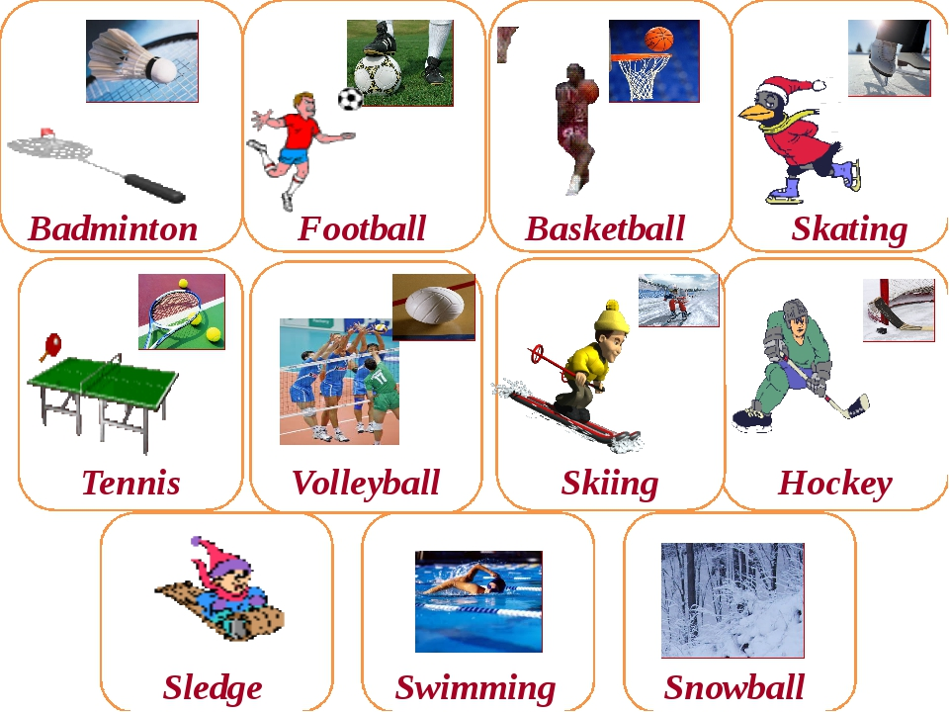
Vocabulary: Sport
Unit 5: Health and Body
Lesson 5:
Hats and Bats

Slide 4
Unit 5: Health and Body
Lesson 5:
Hats and Bats
Fill in the first letters in the names of sports.
Read and spell the words.
_ootball
_asketball
_kating
_olleyball
_ockey
_ennis

Slide 5
Unit 5: Health and Body
Lesson 5:
Hats and Bats
Check your answers
Football
Basketball
Skating
Volleyball
Hockey
Tennis

Slide 6
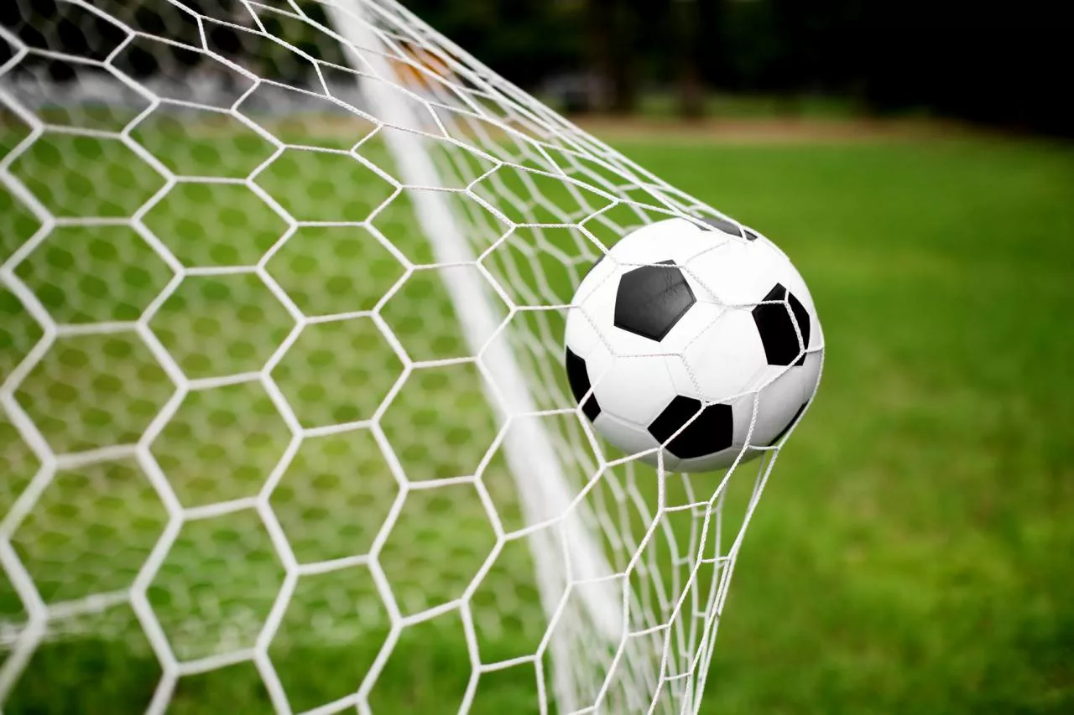
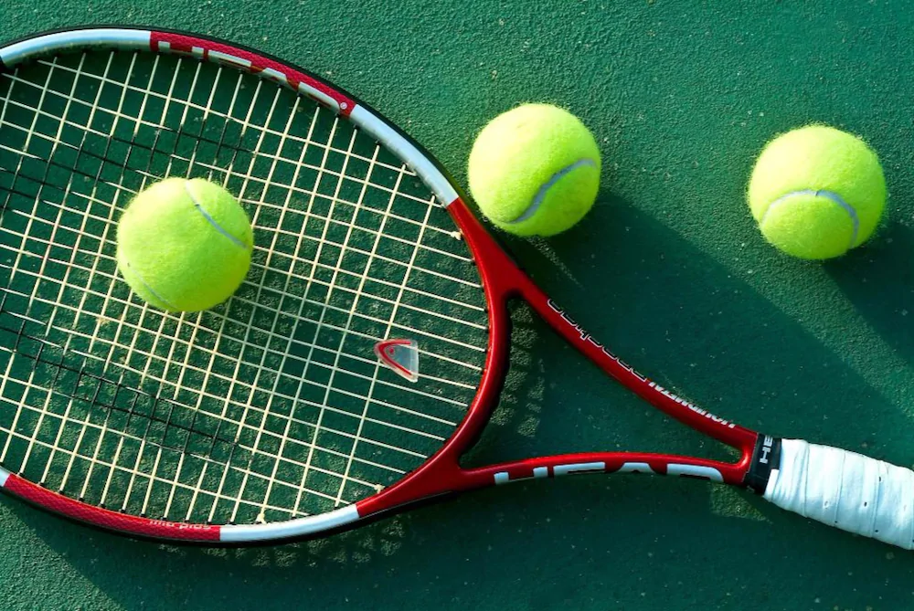
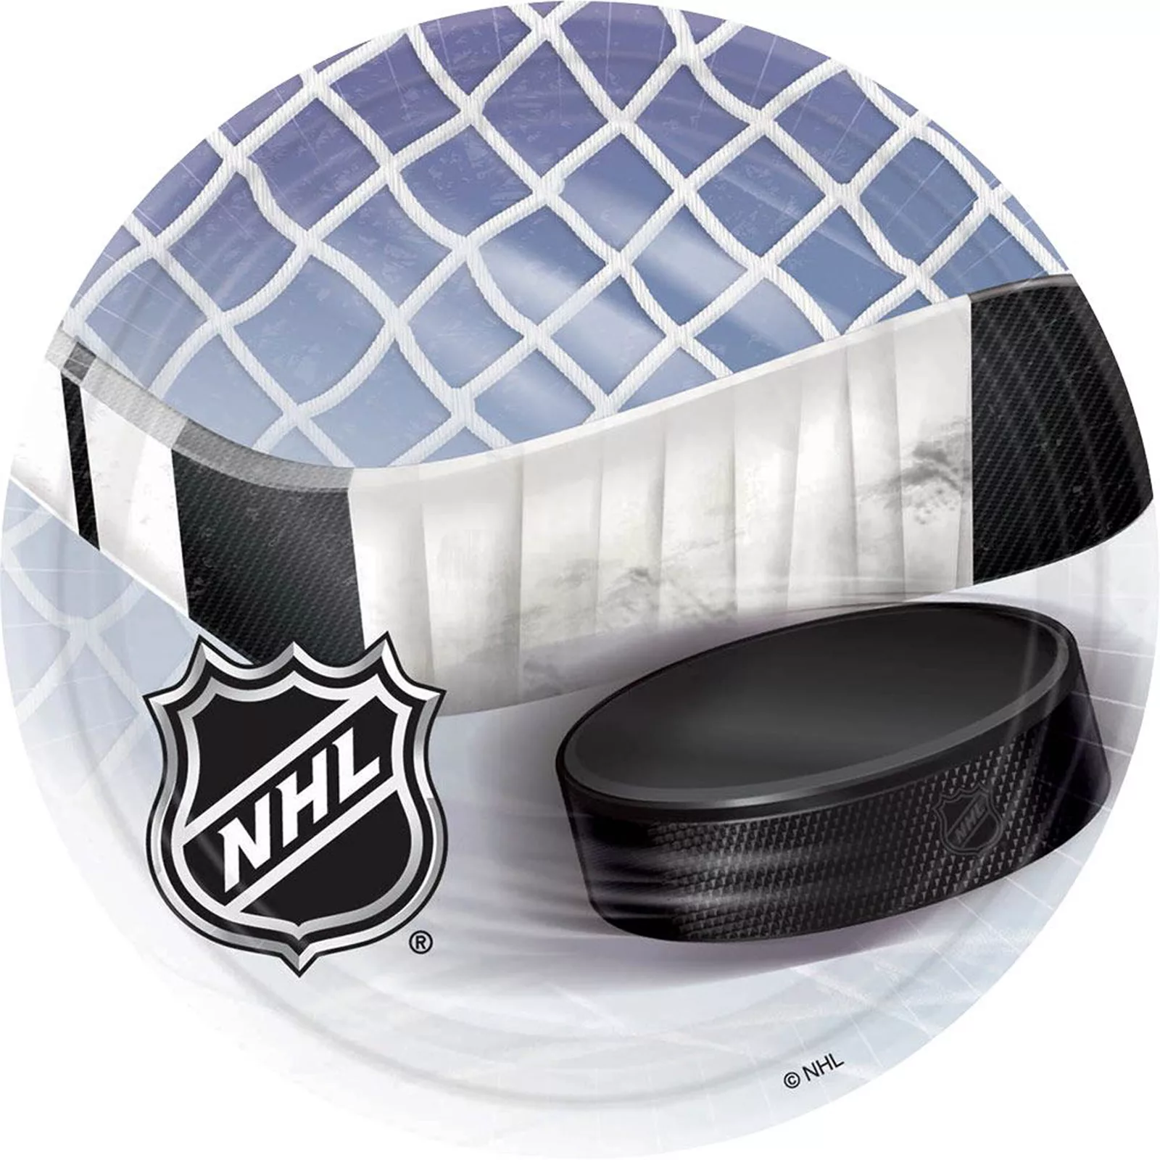
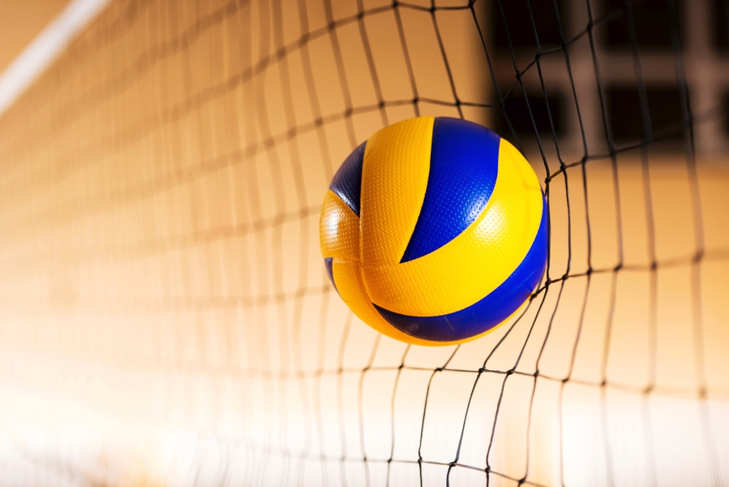
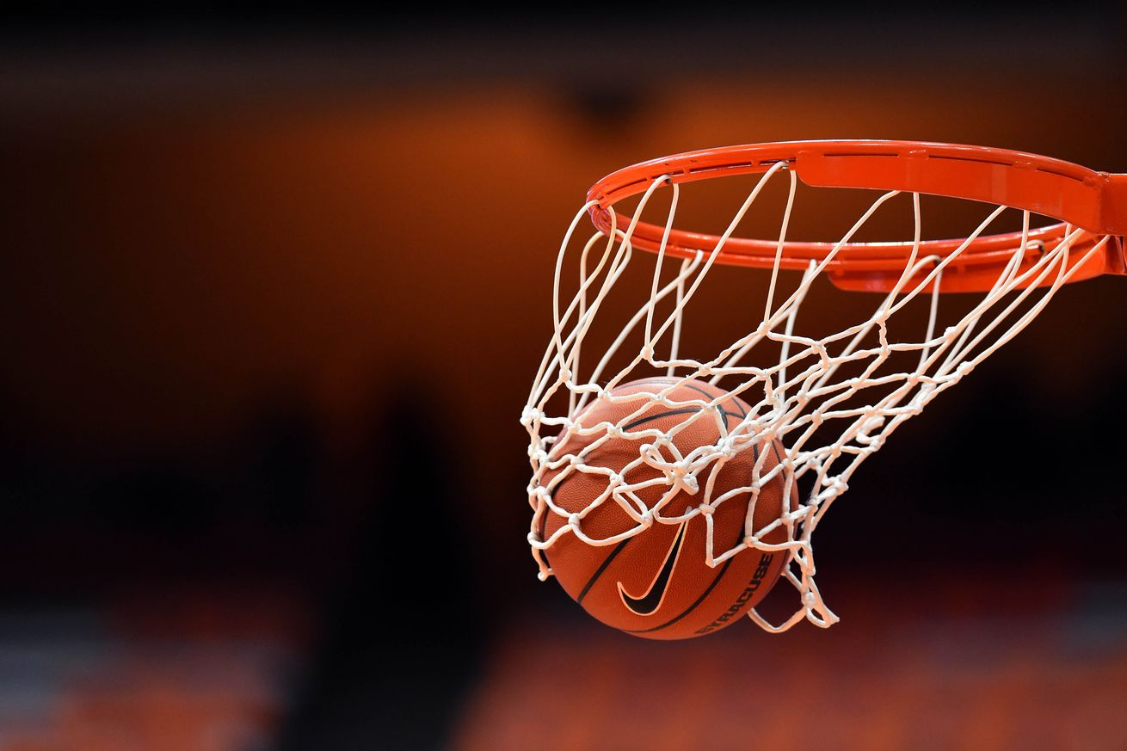
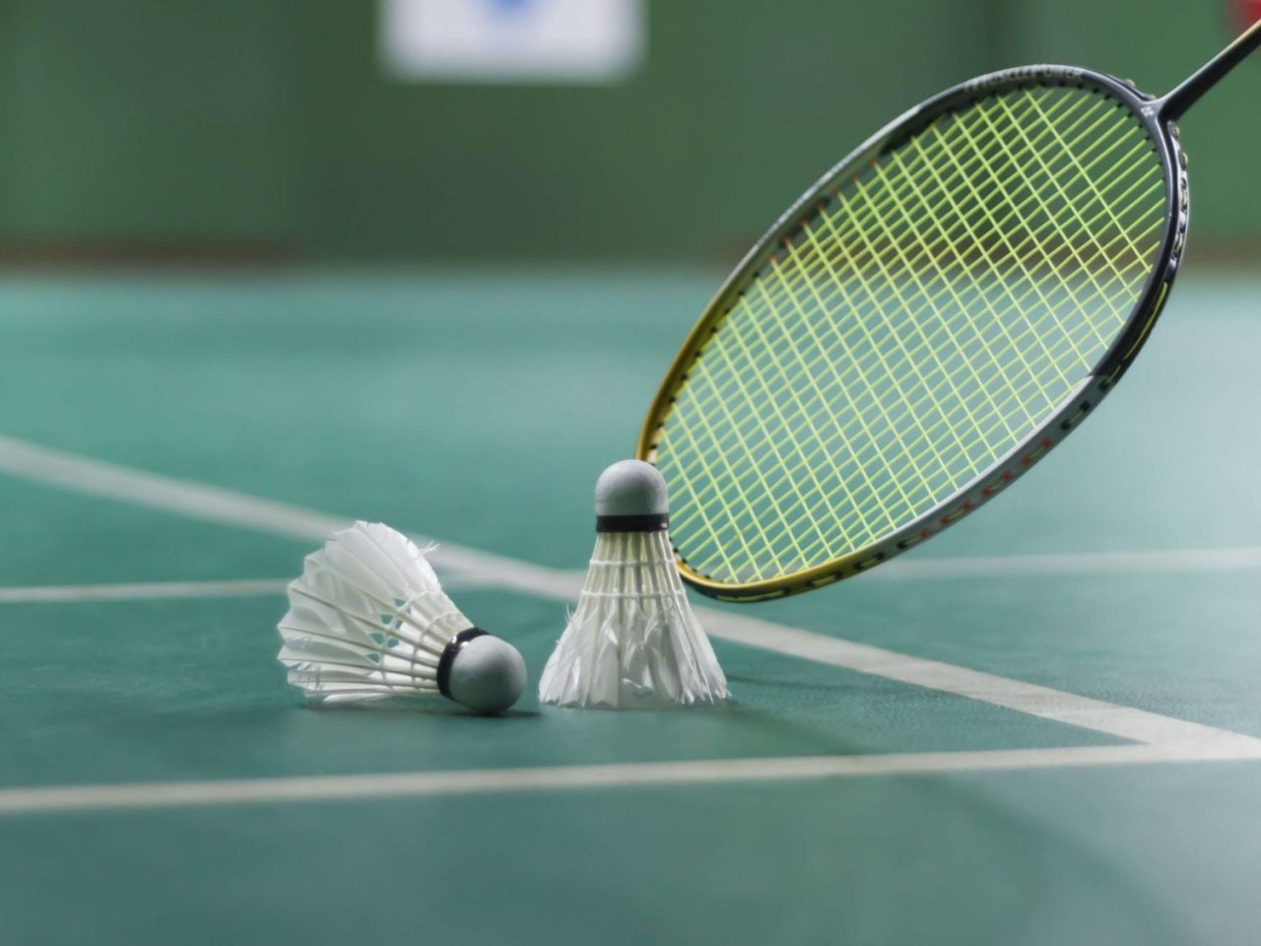
Unit 5: Health and Body
Lesson 5:
Hats and Bats
Look at the pictures and say names of sport
1
2
3
4
5
6

Slide 7
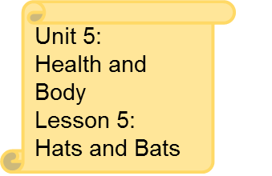
Look at the pictures and say names of sport
1 football
2 tennis
3 hockey
4 volleyball
5 basketball
6 badminton

Slide 8
Today
you have known the new words about sport.
What is your favorite sport?
Answer the questions using the following constructions: I like _________, or
My favourite sport is ________

