Slide 1
Unit 5. Health and body
2nd grade
III term
Lesson 6: Hats and Bats
Learning objectives(s) that this lesson is contributing to (link to the Subject programme):
The ball always looks for the best player. ~French Proverb
2.L4 Recognize with support short basic questions relating to
features such as color and number
2.S8 Give simple instructions for others to follow
Assessment criteria:
• Identify basic questions with support • Recognize colour and number
• Give simple commands
• Follow commands
You will know the specific details of different sports
You will learn to give and follow simple instructions belong to sport
Teacher: Kamalova Dilfuza
School № 50 “Kazgarish” named after Raiymbek Batyr

Slide 2

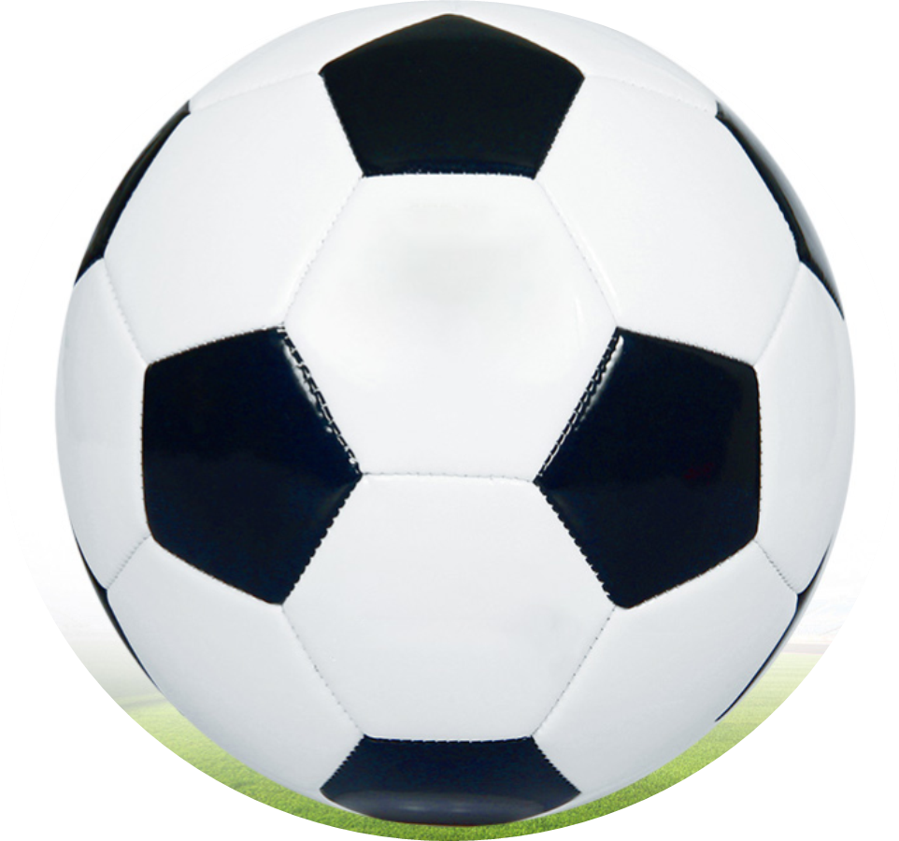
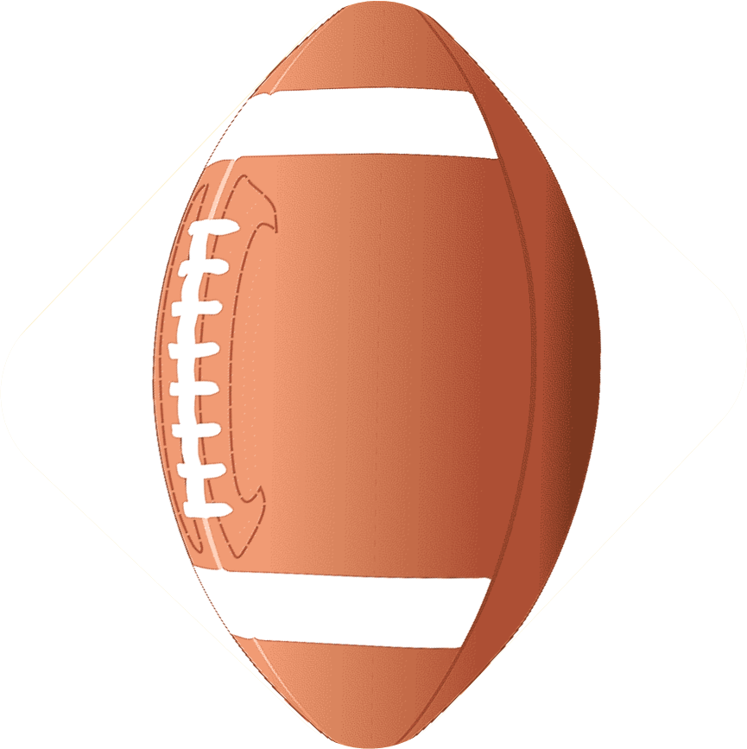
Unit 5: Health and Body
Lesson 6:
Hats and Bats
[u]
Book
Cook
Look
Foot
Put
[u:]
School
food
Blue
Choose
Do

Slide 3
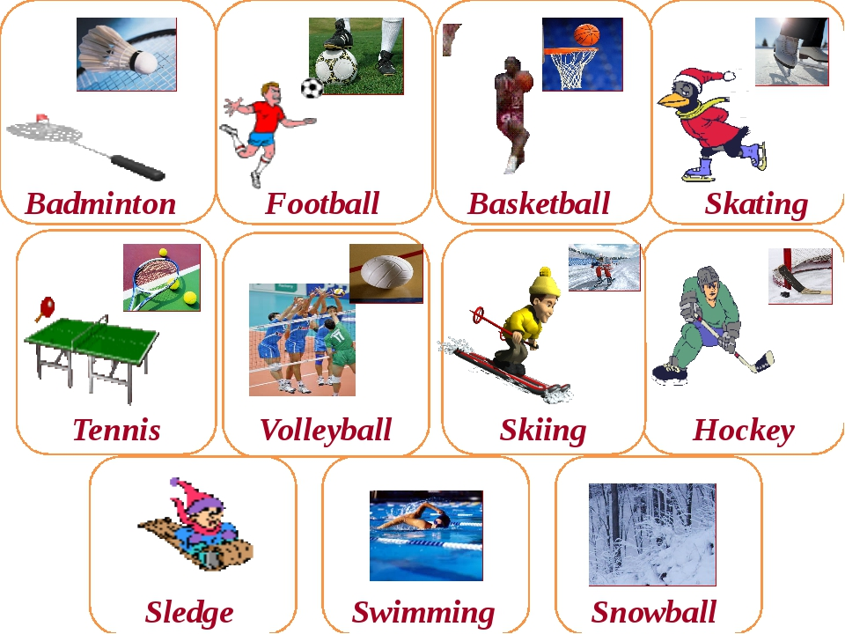
Vocabulary: Sport
Unit 5: Health and Body
Lesson 6:
Hats and Bats

Slide 4
Listen to the teacher and circle the correct answer.
Unit 5: Health and Body
Lesson 6:
Hats and Bats
What colours is the football?
a)brown and white b)black and white c)blue and yellow
2. How many players are in a football team?
a)12 b)11 c)15
3. How many goalkeepers are in a team?
a)2 b)1 c)3
4. How many players are in a basketball team?
a)5 b)7 c)11
5. What colour is the costume of Kazakhstan’s cycling team?
a)black and white b)blue and red c)blue and yellow

Slide 5
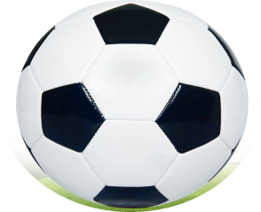
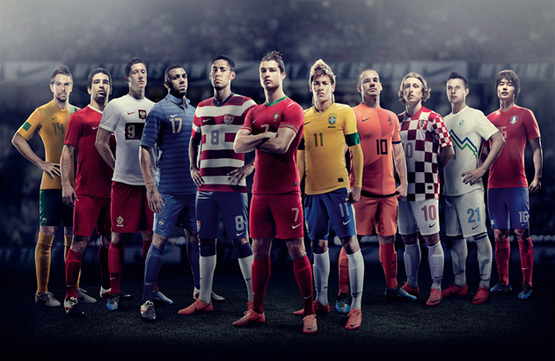
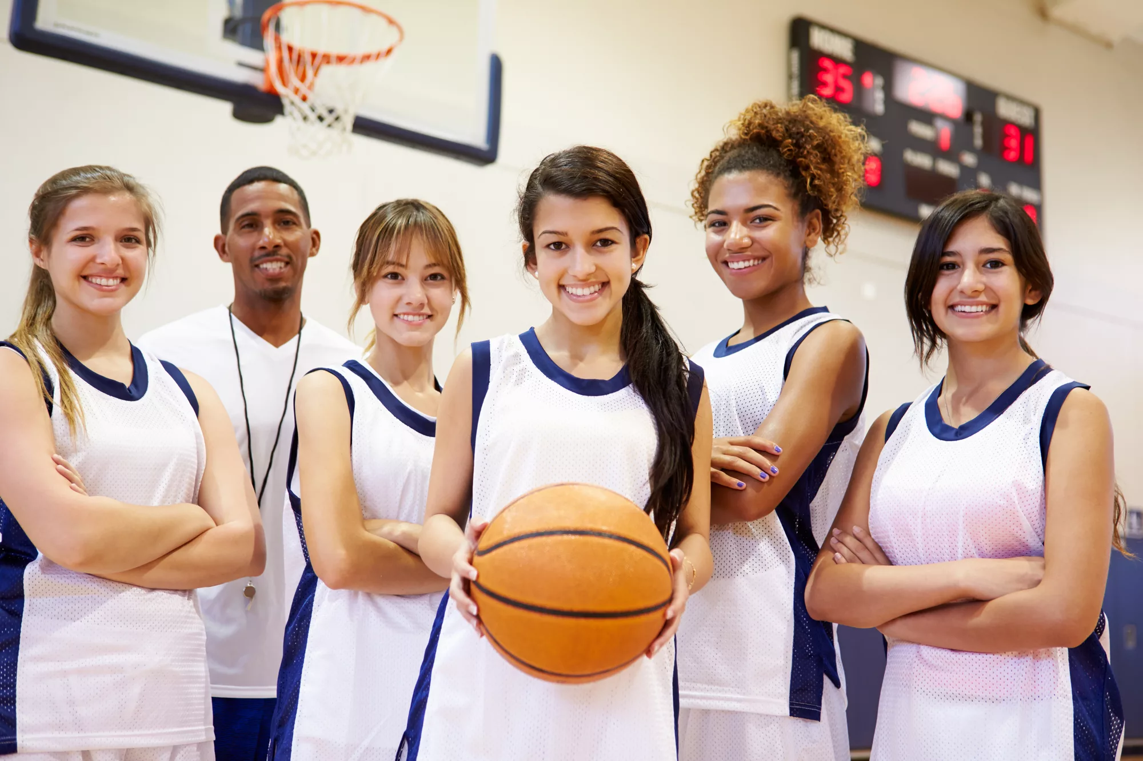
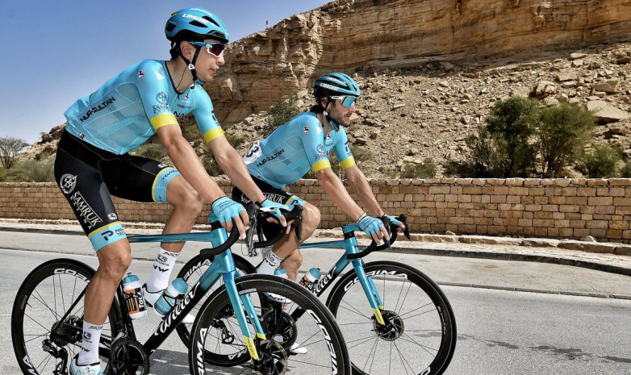
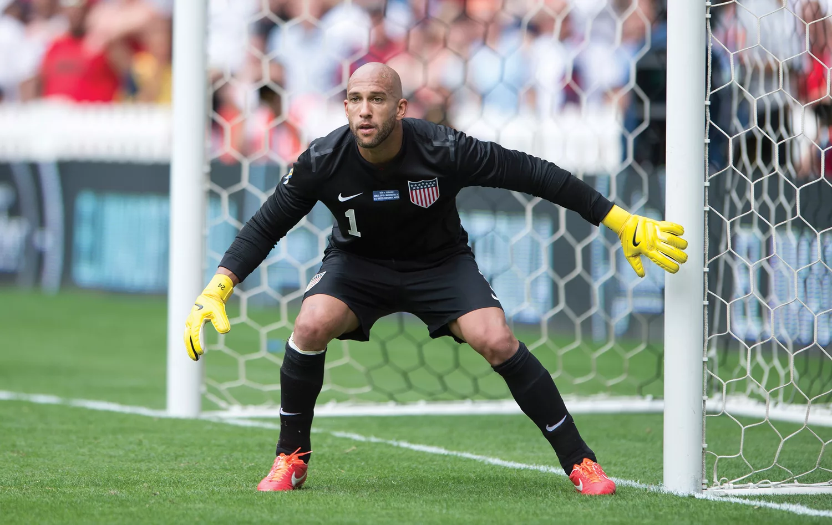
Check your answers
Unit 5: Health and Body
Lesson 6:
Hats and Bats
1. b) black and white
2. b) 11
4. a) 5
5 c) blue and
yellow
3. b) 1

Slide 6
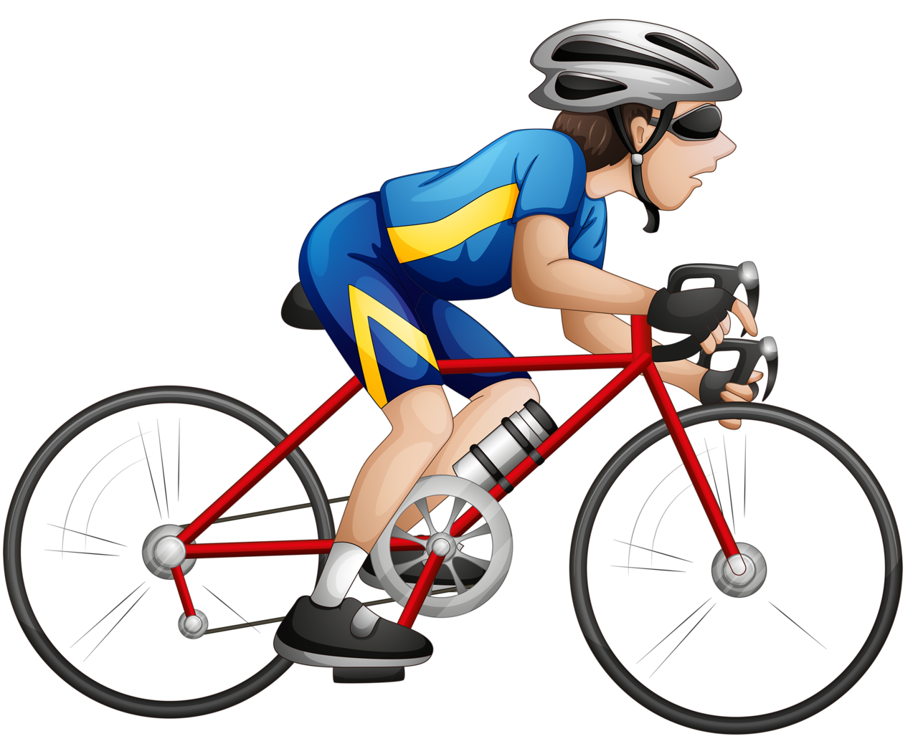
Unit 5: Health and Body
Lesson 6:
Hats and Bats
Listen to teacher and match commands with pictures
Go swimming!
Ride a bike
Kick the ball
Jump a rope
Throw me ball
b
d
a
c
e

Slide 7
Unit 5: Health and Body
Lesson 6:
Hats and Bats
Check your answers
3. Kick the ball
1. Go swimming!
5. Throw me ball
a
b
d
2. Ride a bike
4. Jump a rope
c
e

Slide 8
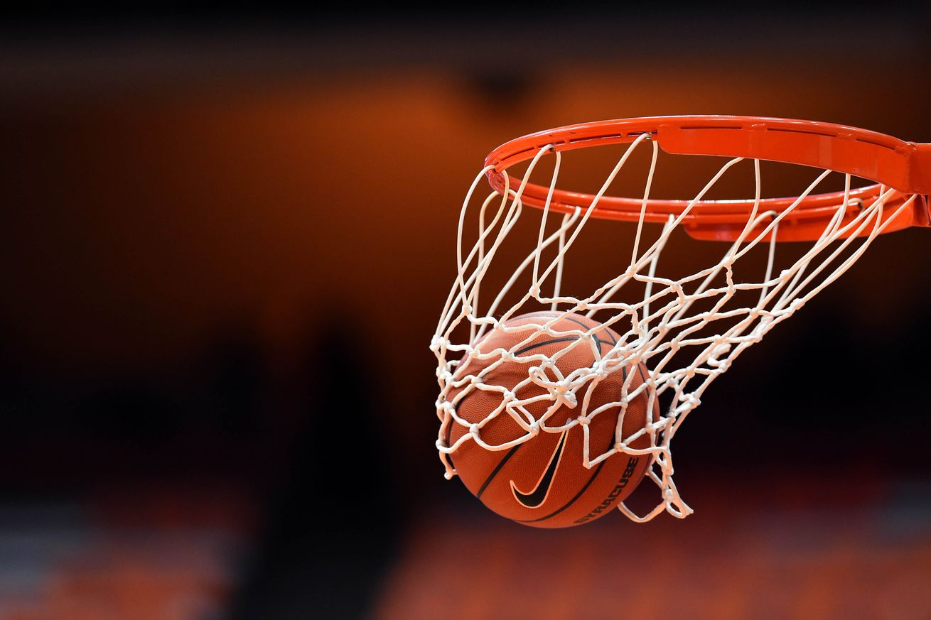
Unit 5: Health and Body
Lesson 6:
Hats and Bats
Today you have known the specific details of different sports.
Can you answer the questions?
What is your favorite sport?
How many players in the team?
What can you do in this sport?
Hello! My name is Marat.
I am 8 years old.
My favourite sport is football.
There are 11 players in the team.
I can run, kick the ball and throw the ball.

