Slide 1

Unit 5. Health and Body
2-nd
Grade
III
term
Lesson 7: Altogether Now
Learning objectives(s) that this lesson is contributing to (link to the Subject programme):
2.R3 Read and follow with considerable support simple, words,
phrases and sentences on familiar topics
2.W3 Write short phrases to identify people, place and objects
Assessment criteria:
• Read and follow words, phrases and sentences with considerable support
• Identify people, places and objects;
• Write short phrases
You will know some verbs belong to sport
You will learn to write phrases and sentences to describe pictures with sport
Teacher: Taibuldinova Saniya Abylaevna
School № 50 “Kazgarish” named after Raiymbek Batyr

Slide 2


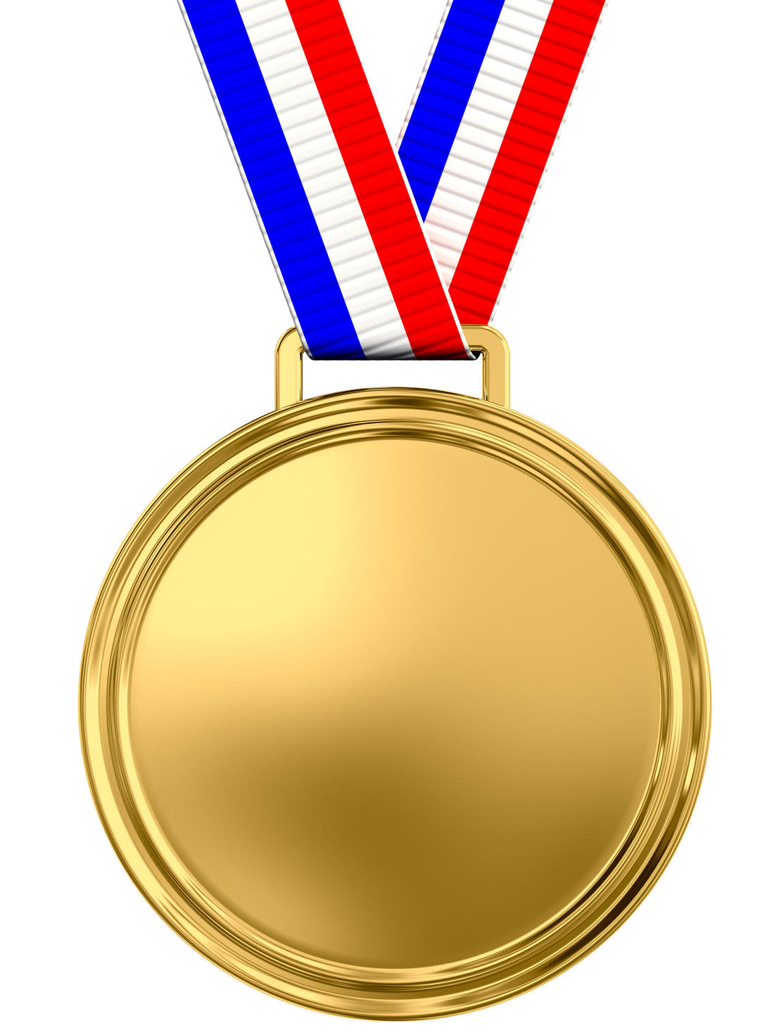
Unit 5
Lesson7
Altogether
now
C – [k]
Can
Clap
Catch
Compete
Practice
C - e, y, i
[s]
Center
Cycling
Practice
Dancing

Slide 3
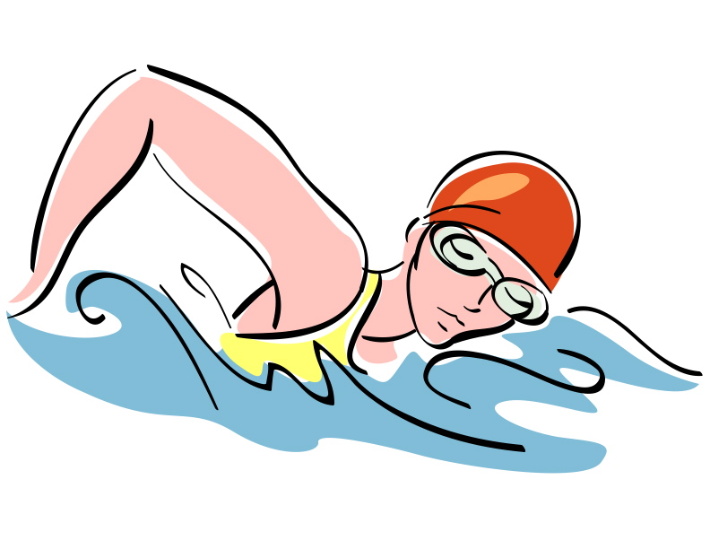
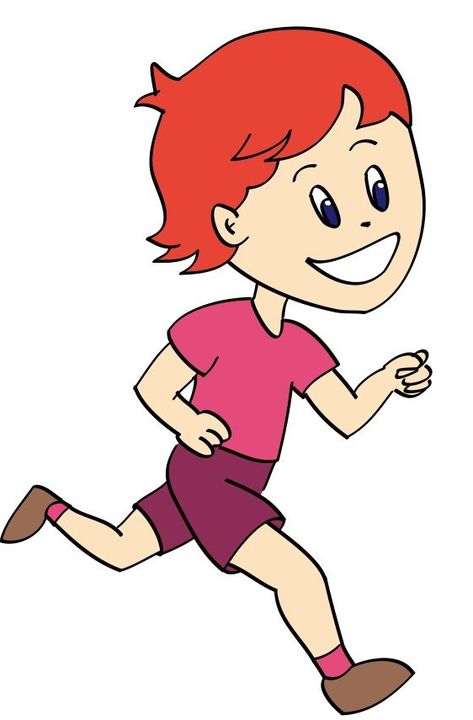
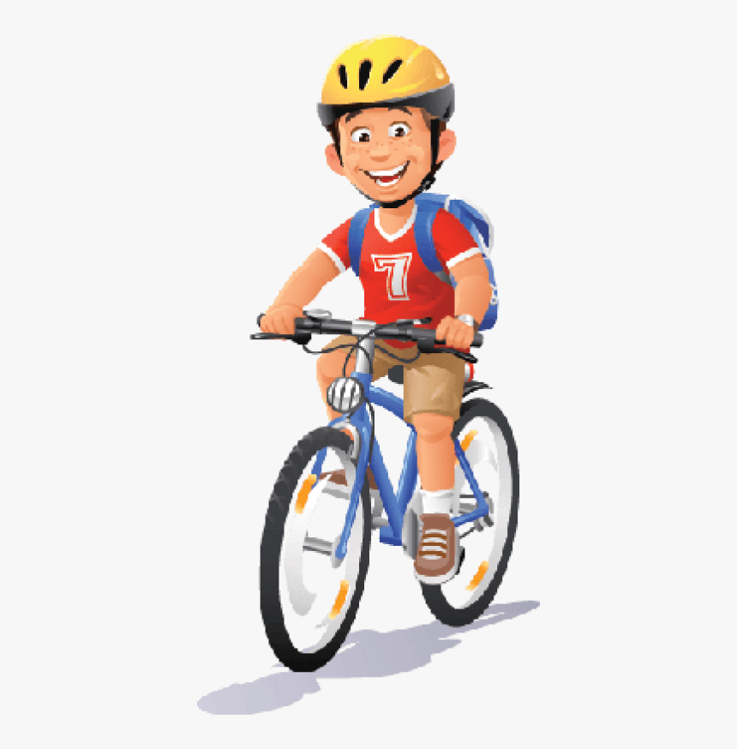

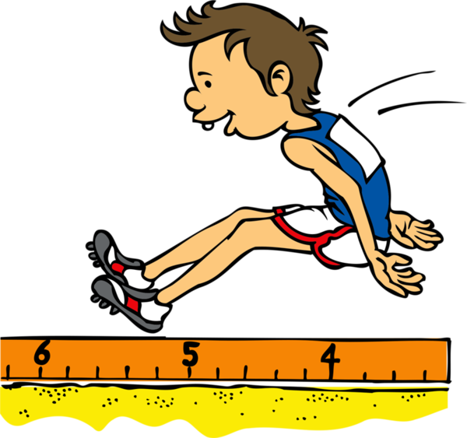
Vocabulary: Sport verbs
Unit 5
Lesson7
Altogether
now
Read and match verbs with pictures
d
1.Skate 2.Run 3.Jump 4. Ride 5. Swim
a
b
c
e

Slide 4
Check together
Unit 5
Lesson7
Altogether
now
d
Swim
Read and match verbs with pictures
a
b
c
Run
Ride
Skate
e
Jump

Slide 5
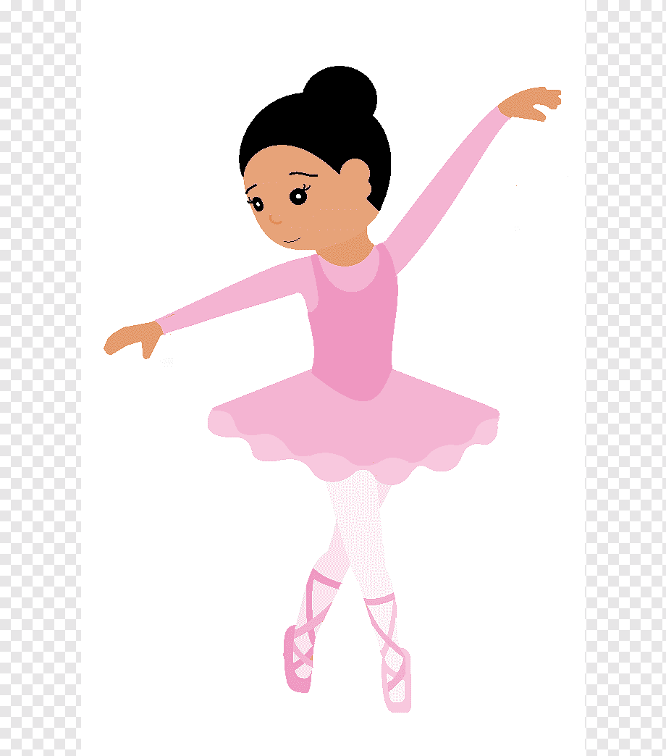
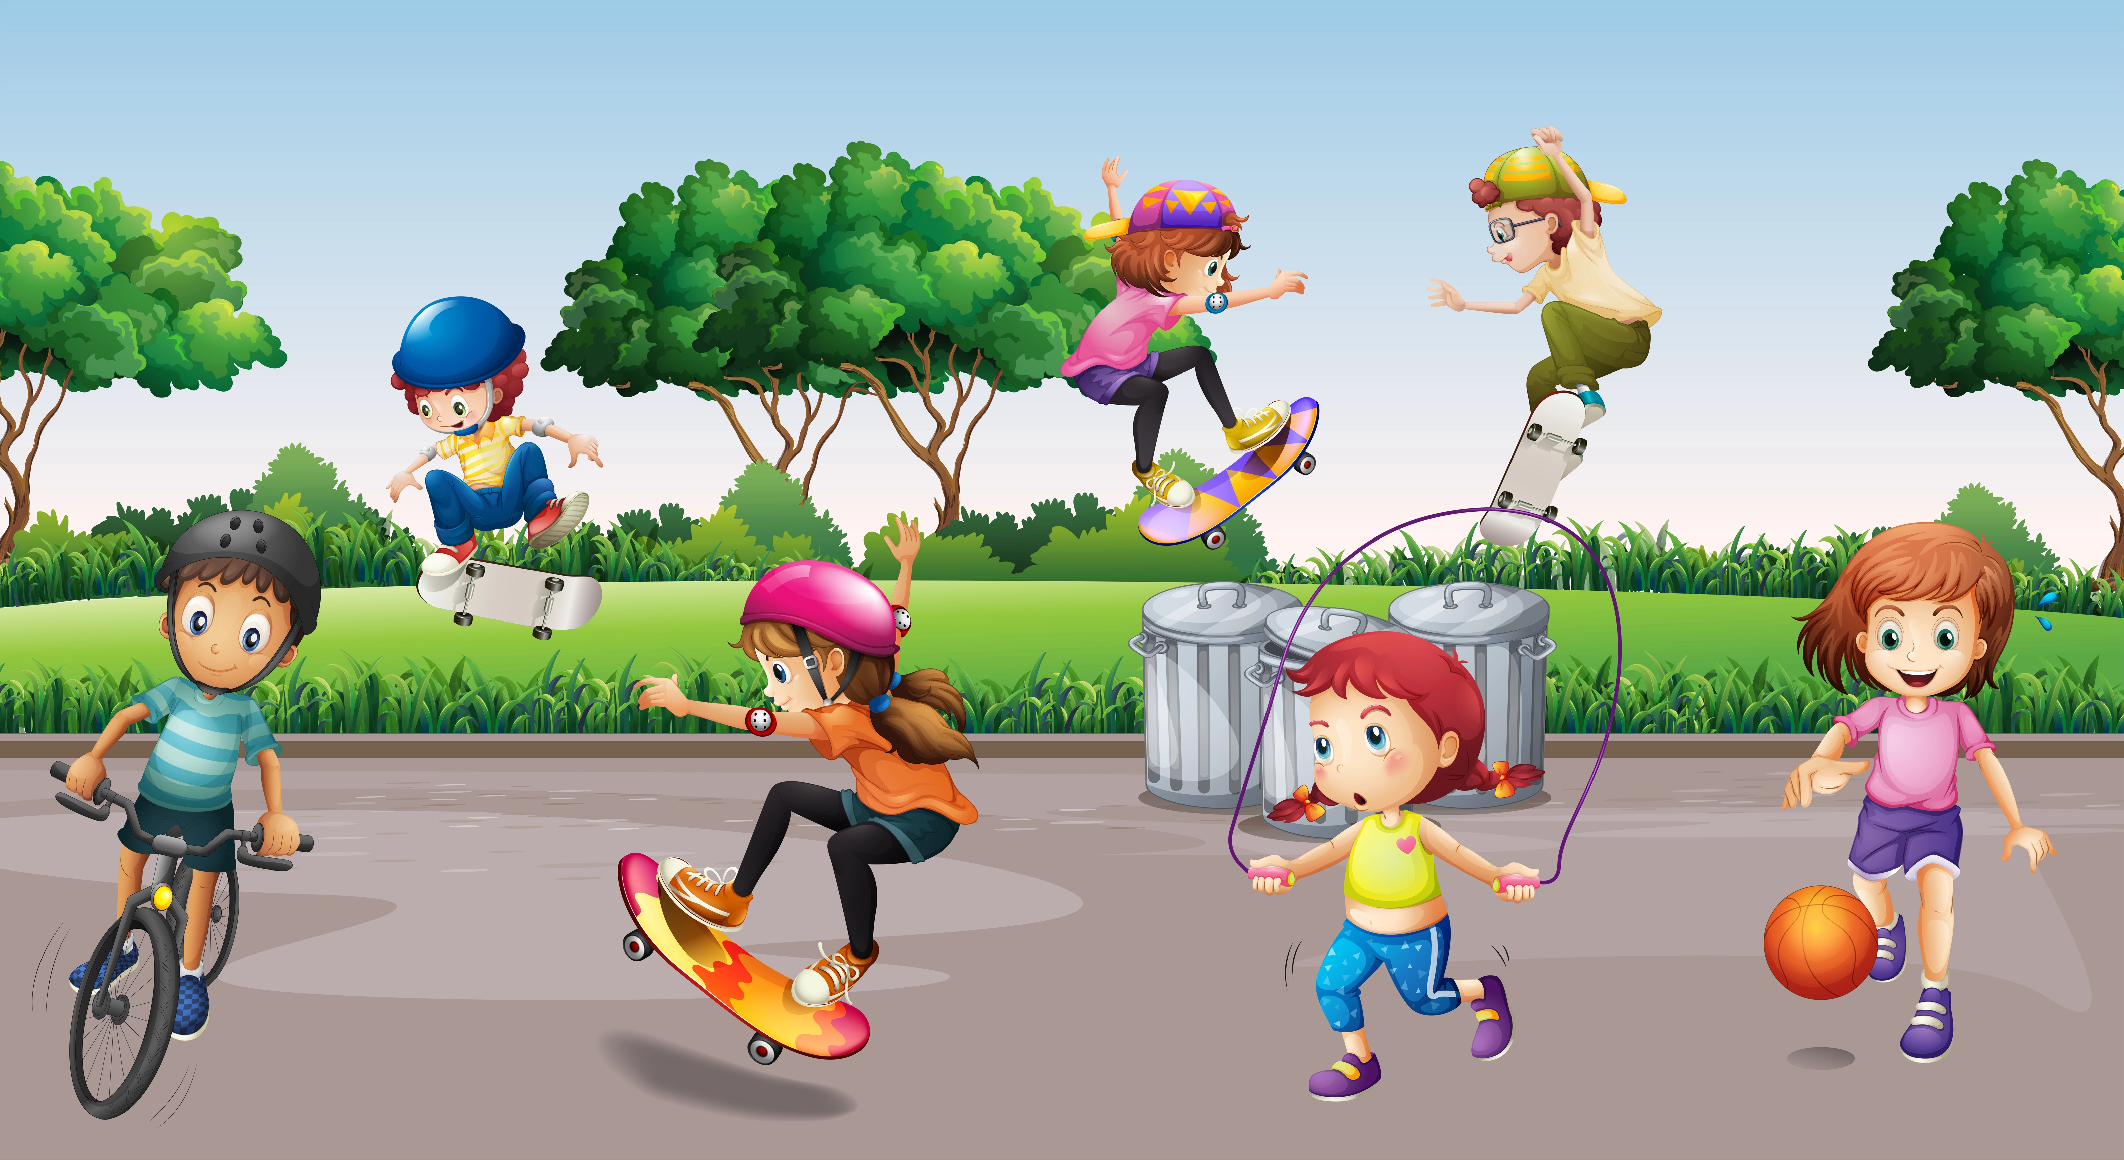
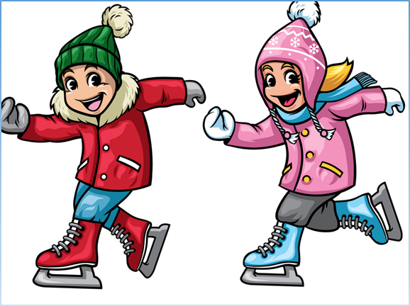
Look at the pictures and read short descriptions
Unit 5
Lesson7
Altogether
now
In this photo you
can see my sister.
She is dancing.
It is our playground.
I am riding a bike.
My brother is playing football.
My friends are scatting.
The girl is jumping a rope.
They are
ice scatting

Slide 6
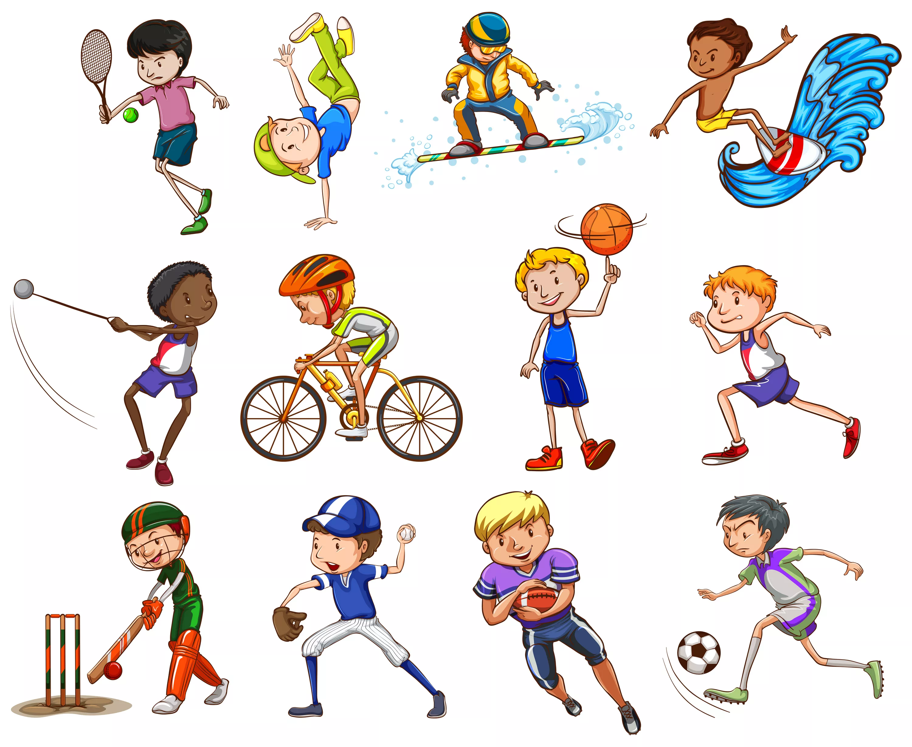
Unit 5
Lesson 7
Altogether
now
Read together
Sports
Sport is fun for girls and boys.
It's much better than the toys.
You can sledge and ski and skate
And play snowballs with Kate.
You can swim and play football,
Hockey, tennis, basketball.
You can jump and you can run.
You can have a lot of fun.

Slide 7
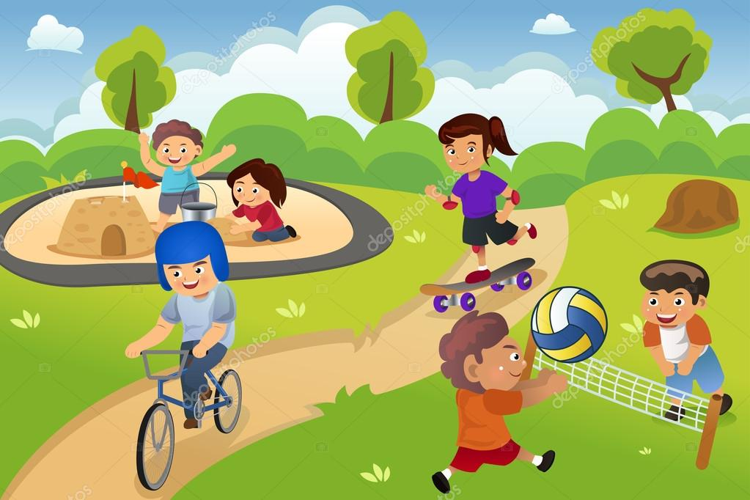
Unit 5
Lesson7
Altogether
now
Today you have known some verbs related with sports.
Can you describe the picture?
What can you see in the picture?
Write what boys and girls doing are in the picture.

