Slide 1

Unit 5. Health and Body
2-nd
Grade
III
term
Lesson 8: Altogether Now
Learning objectives(s) that this lesson is contributing to (link to the Subject programme):
2.S4 Respond to basic supported questions giving personal and factual information
2.UE13 Use can to talk about ability and to make requests and offers; use can / can’t
to talk about permission
Assessment criteria:
• Answer basic questions with support
• Provide personal information and facts
• Talk about ability, make requests and offers using can and can’t
You will know new words to describe abilities
You will learn to answer personal questions to describe abilities
Teacher: Askarova Saule Amangeldievna
School № 50 “Kazgarish” named after Raiymbek Batyr

Slide 2



Unit 5
Lesson 8
Altogether
now
u - [ʌ]
Up
Fun
Run
Jump
Much
u – [ju:]
Use
Unit
Duty
Music
Student

Slide 3
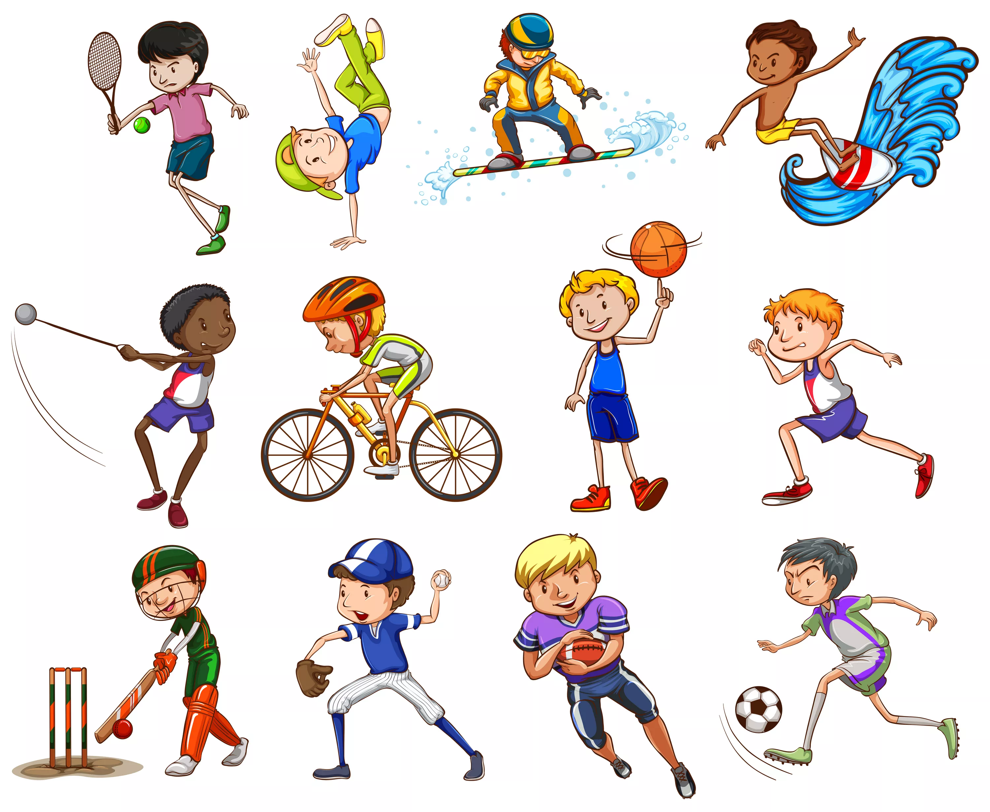
Unit 5
Lesson 8
Altogether
now
Sports
Sport is fun for girls and boys.
It's much better than the toys.
You can sledge and ski and skate
And play snowballs with Kate.
You can swim and play football,
Hockey, tennis, basketball.
You can jump and you can run.
You can have a lot of fun.

Slide 4
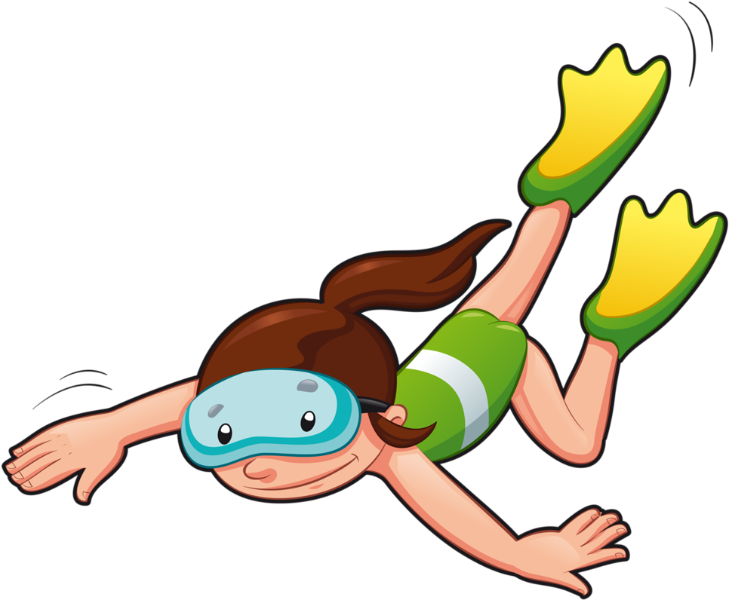
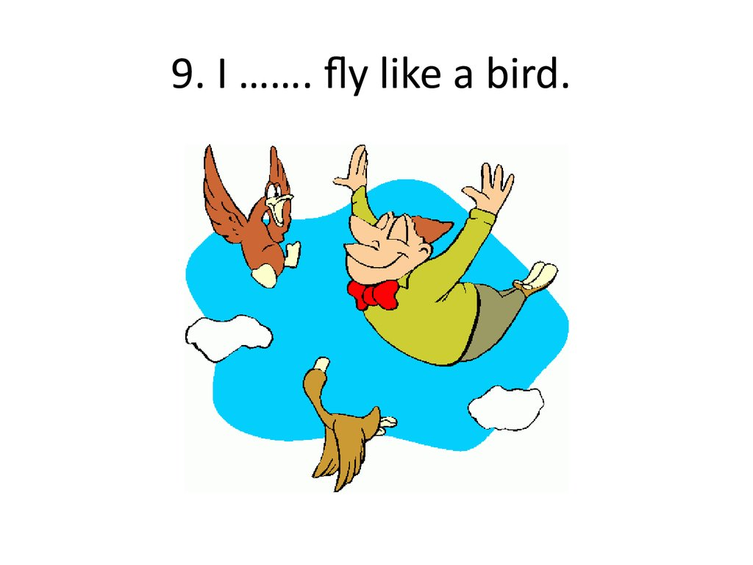

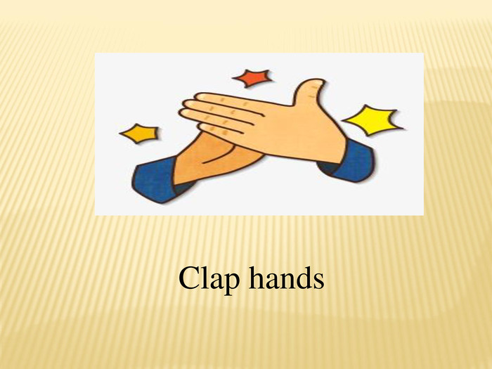
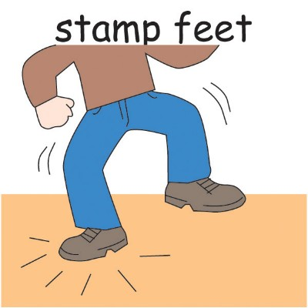
Read and match sentences with pictures
Unit 5
Lesson 8
Altogether
now
1. I can see with my eyes
2. I can clap with my hands
3. I can step with my feet
4. I can swim as a fish
5. I can’t fly as a bird

Slide 5
Check together
Unit 5
Lesson 8
Altogether
now
1. I can see with my eyes
2. I can clap with my hands
3. I can step with my feet
4. I can swim as a fish
5. I can’t fly as a bird

Slide 6
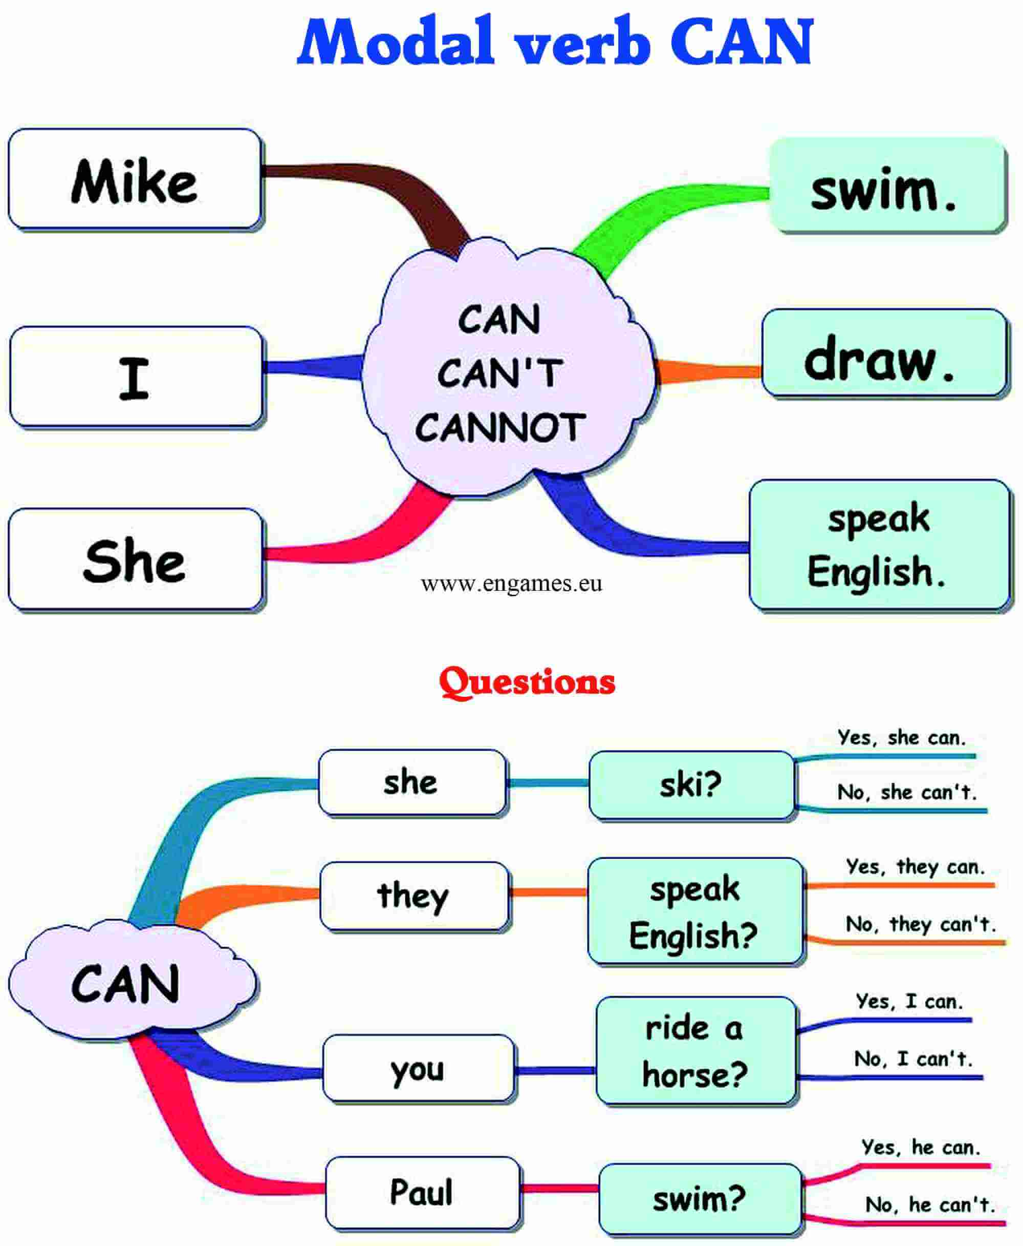
Unit 5
Lesson 8
Altogether
now

Slide 7

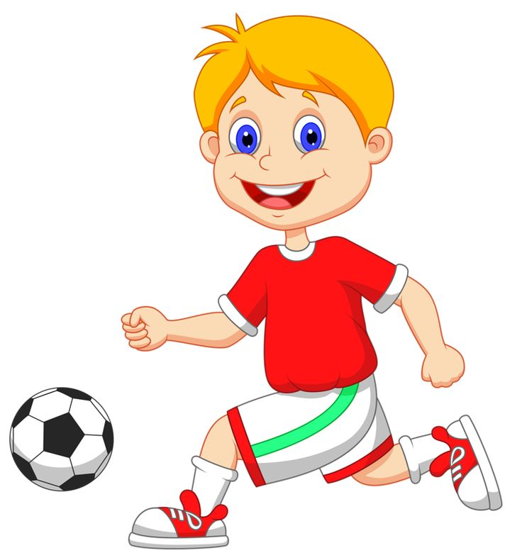


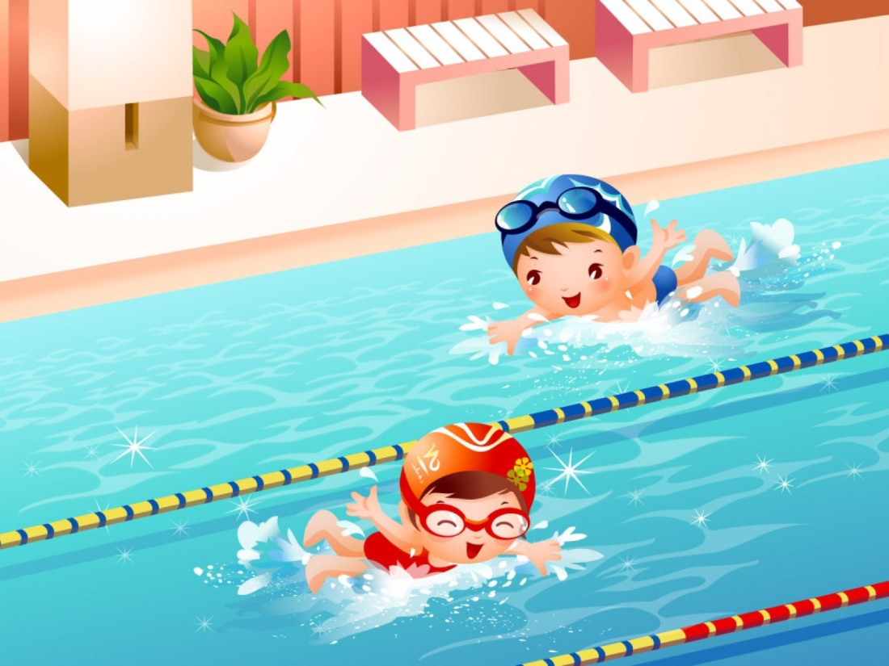
Read and fill in the gaps with following words:
cook, jump, run, swim, speak
Unit 5
Lesson 8
Altogether
now
1. I play football. I can ……. fast.
2. She plays basketball well. She can …… high.
3. They go to the pool. They can ……
4. It is my dog. It can’t ……..
5. My mom can ……. a cake.

Slide 8
Unit 5
Lesson 8
Altogether
now
Check together
1. I play football. I can run fast.
2. She plays basketball well. She can jump high.
3. They go to the pool. They can swim.
4. It is my dog. It can’t speak.
5. My mom can cook a cake.

Slide 9
Listen to the teacher and answer the questions.
Unit 5
Lesson 8
Altogether
now
Today you have known some words
to describe abilities. Read and answer the questions.
1. What is your name?
2. How old are you?
3. Can you play football?
4. Can you swim?
6. What is your favourite sport?
6. Can you cook pizza?
7. What can you cook together with your mum?

