Slide 1

English
Grade 2
Unit 8: Travel
Lesson 4:Types of vehicle

Slide 2

By the end of the lesson learners will be able to:
use can / can’t to describe ability,
pronounce basic words and expressions intelligibly.

Slide 3
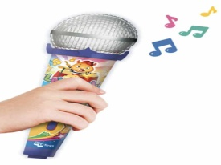
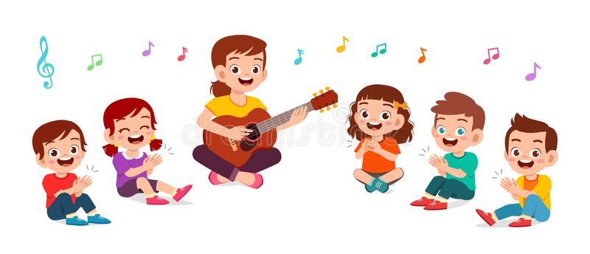
Let’s sing a song “hello ” together.
Hello! Hello!
Hello, how are you?
I'm good!
I'm great!
I'm wonderful!
Hello! Hello!
Hello, how are you?
I'm tired.
I'm hungry.
I'm not so good.
Hello! Hello!
Hello, how are you?

Slide 4
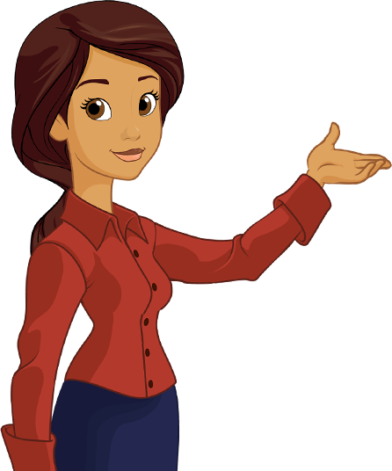
can/can’t

Slide 5

AFFIRMATIVE
I can
We can
You can
You can
He can
They can
She can
It can

Slide 6
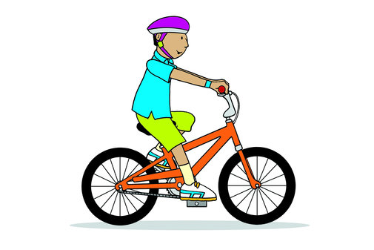
I can ride a bike

Slide 7
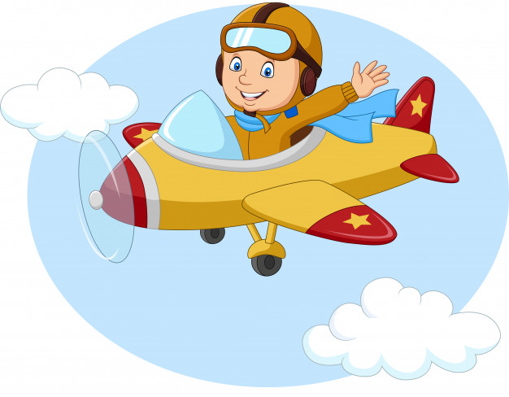
I can fly

Slide 8
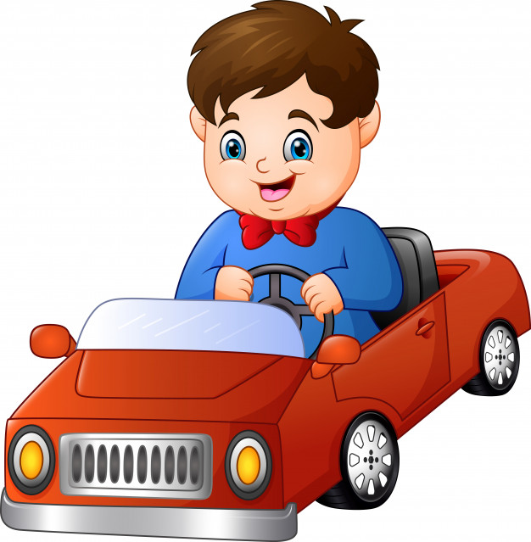
I can drive a car

Slide 9
NEGATIVE
I can’t
We can’t
You can’t
You can’t
He can’t
They can’t
She can’t
It can’t

Slide 10
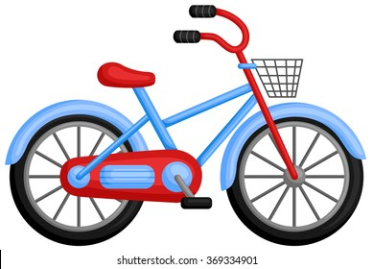

I can’t ride a bike

Slide 11

I can’t fly

Slide 12
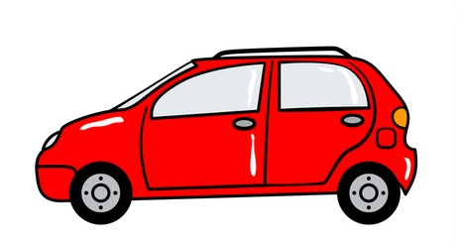
I can’t drive a car

Slide 13

INTERROGATIVE
QUESTIONS
SHORT ANSWERS
Can I?
I
can
?
Yes, I/you can
No, I/you can’t
Can you?
You
can
?
Can he?
He
can
?
Can she?
Yes, he/she/it can
No, he/she/it can’t
She
can
?
Can it?
It
can
?
Can we?
We
can
?
Can you?
Yes, we/you/they can
No, we/you/they can’t
You
can
?
Can they?
They
can
?

Slide 14
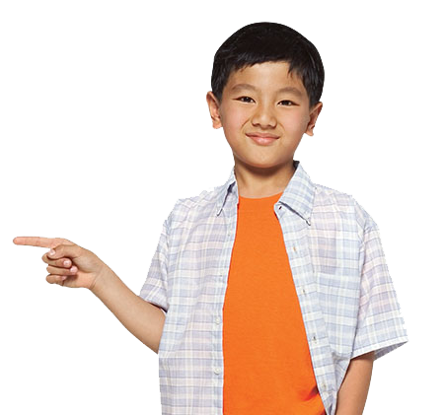
Can you ride a bike?
Yes, I can

Slide 15
Can you fly?
No, I can’t

Slide 16
Can you drive a car?
Yes, I can

Slide 17
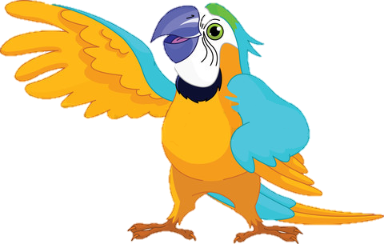
Well done!

Slide 18
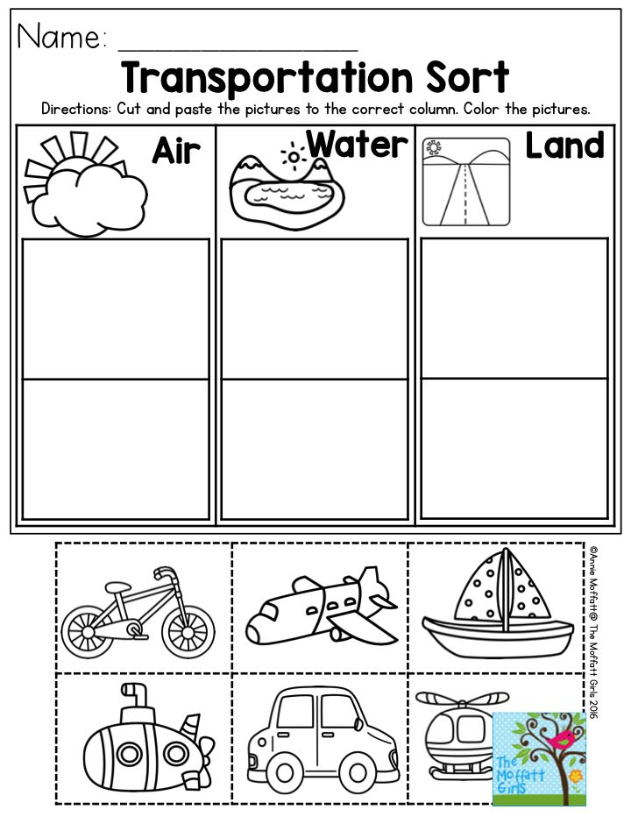
Look at the pictures and Divide into three groups

Slide 19

Now, let’s watch a video and sing
“Yes, I Can! ” together
https://youtu.be/_Ir0Mc6Qilo

Slide 20
PLAY A GAME

Slide 21

Identify the mode of transport and tick the correct answer
Land
Water
Air
NEXT

Slide 22
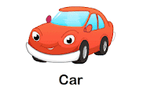
Identify the mode of transport and tick the correct answer
Water
Land
Air
NEXT

Slide 23
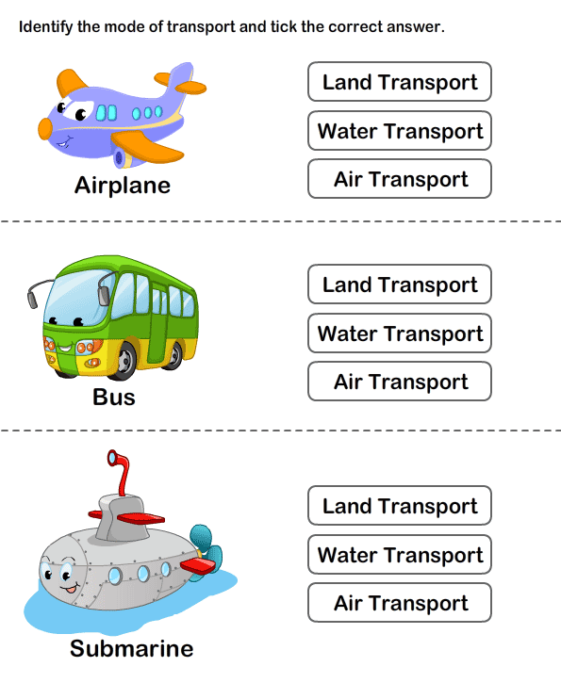
Identify the mode of transport and tick the correct answer
Land
Air
Water
NEXT

Slide 24
Identify the mode of transport and tick the correct answer
Water
Land
Air
NEXT

Slide 25
Read the words and fill in the blanks.
plane -train – bus -bike
This vehicle has wings and starts with p. It is a _______
A school ______is yellow.
This vehicle travels on tracks. It is a _________________
This vehicle has two wheels. It is a ________________

Slide 26
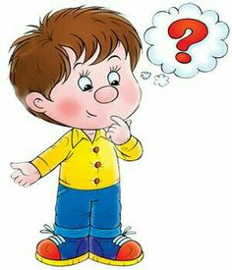



If you understand everything and you liked the lesson
Self- assessment
If you all understand but you have questions
if you don’t understand anything at all

Slide 27

The lesson is over!
See you next time!

