Slide 1
English
Grade 2
Unit 8: Travel
Lesson 6: A to B

Slide 2

Learners will be able to:
recognize subjects and school objects;
practice vocabulary with / without teacher’s support;
use spoken form of a limited range of everyday and classroom words
Use basic prepositions of location and position;at, behind, between, in, in front of, near, next to, on, to describe where people and things are; use prepositions of time; on, in and to talk about days and times

Slide 3

Do you know what is «preposition of place?»

Slide 4
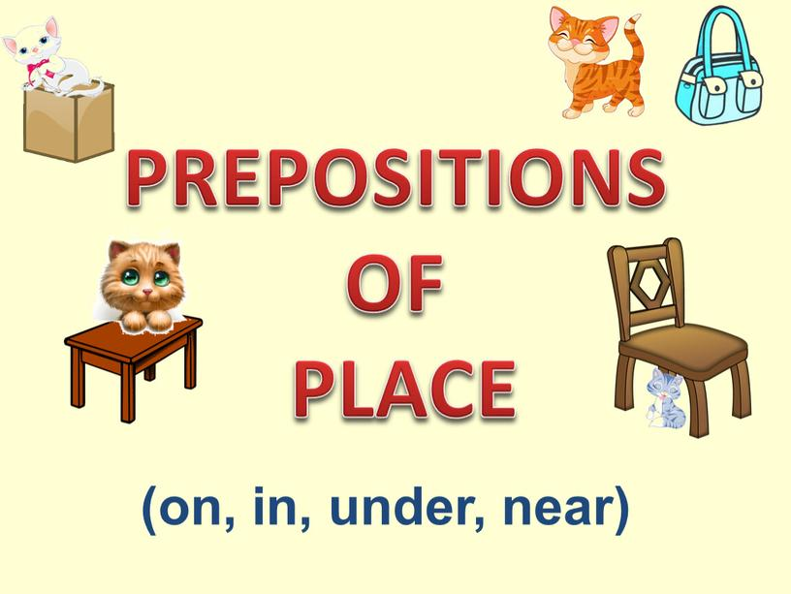

Slide 5
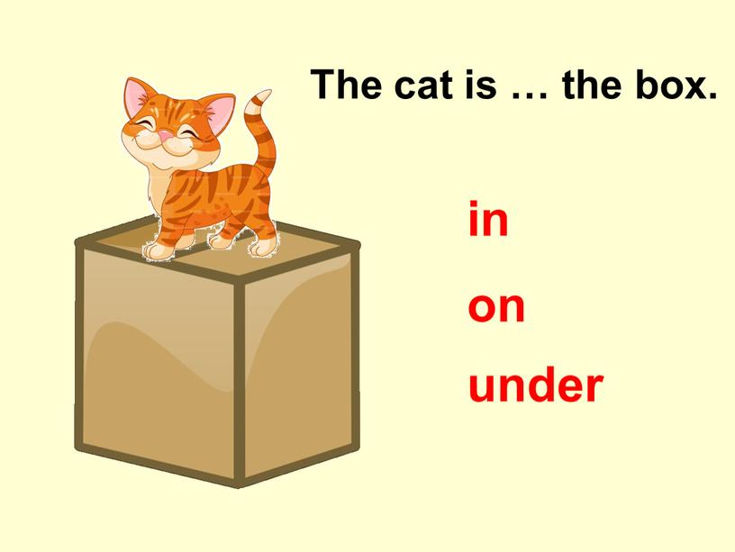

Slide 6
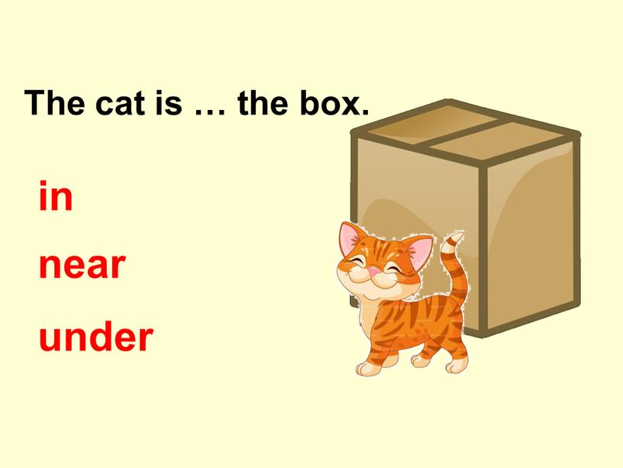

Slide 7
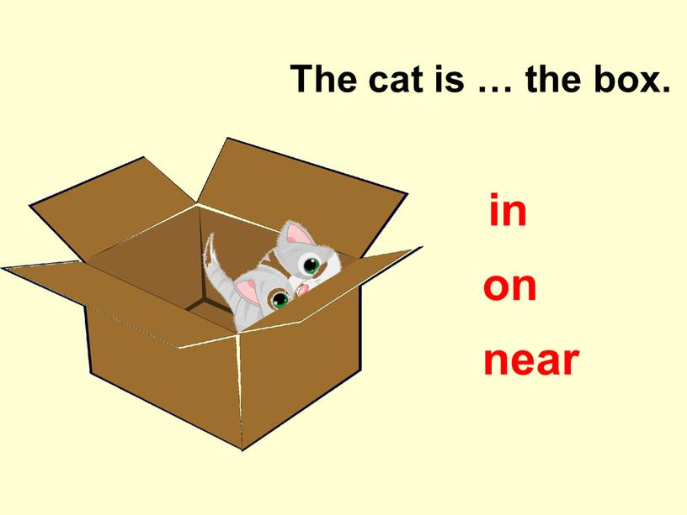

Slide 8
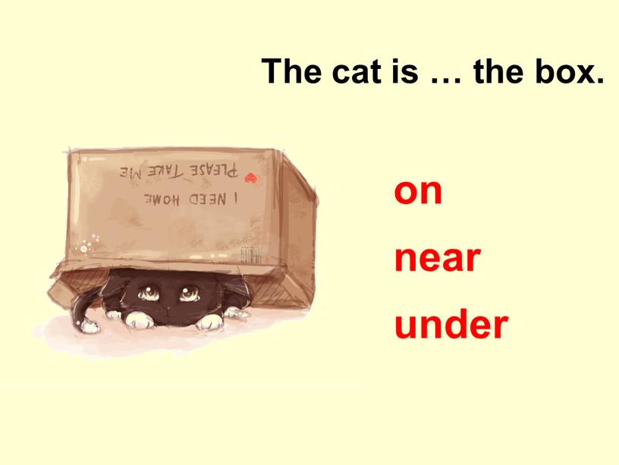

Slide 9
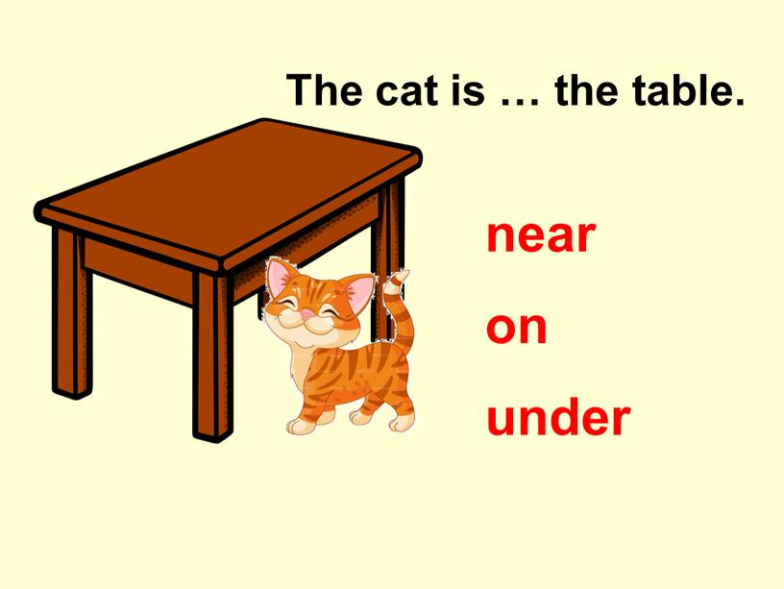

Slide 10
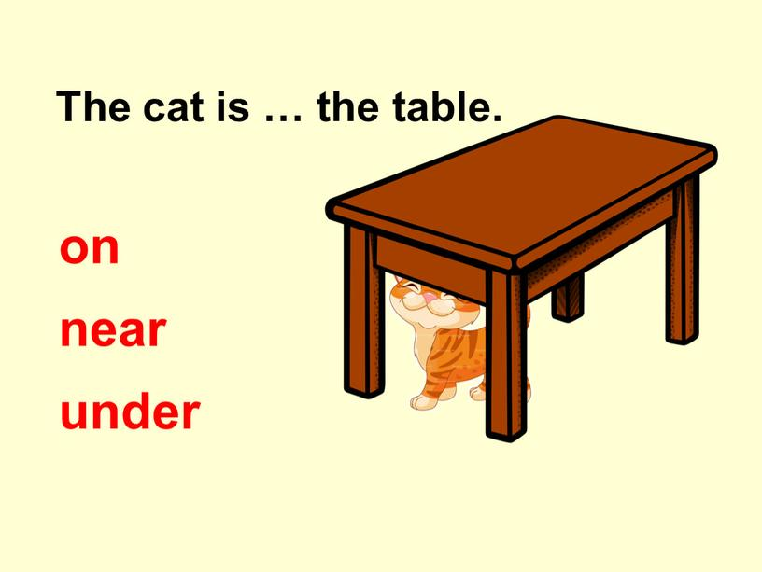

Slide 11
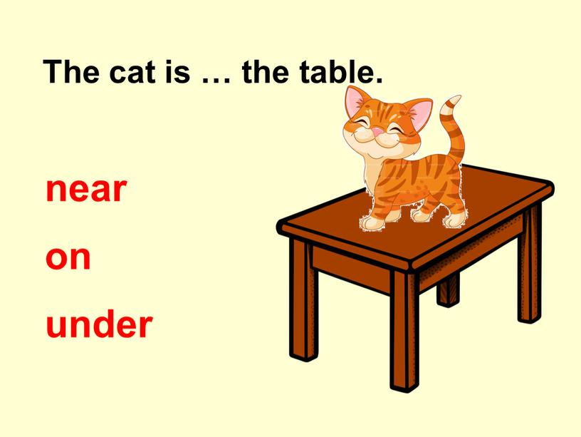

Slide 12
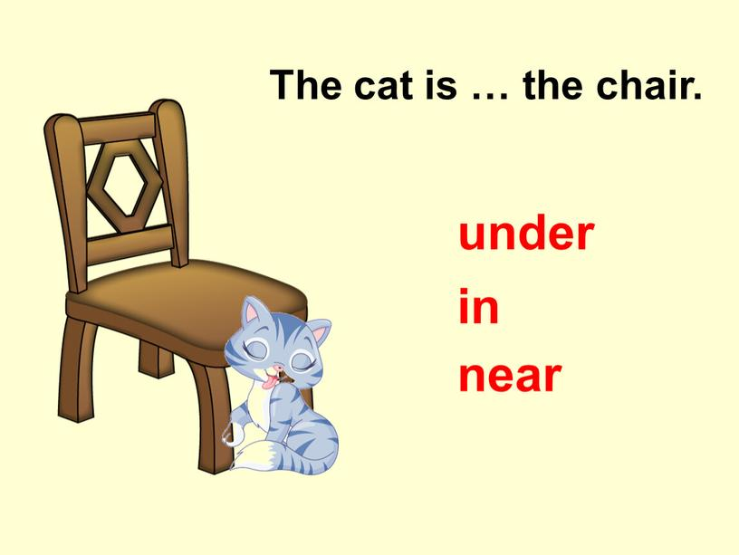

Slide 13
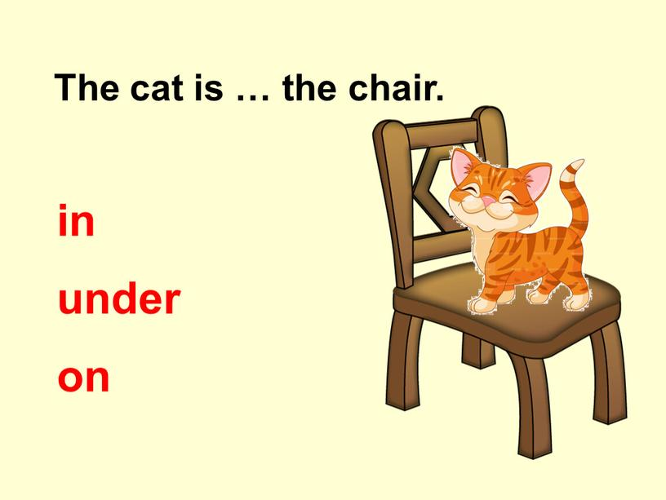

Slide 14
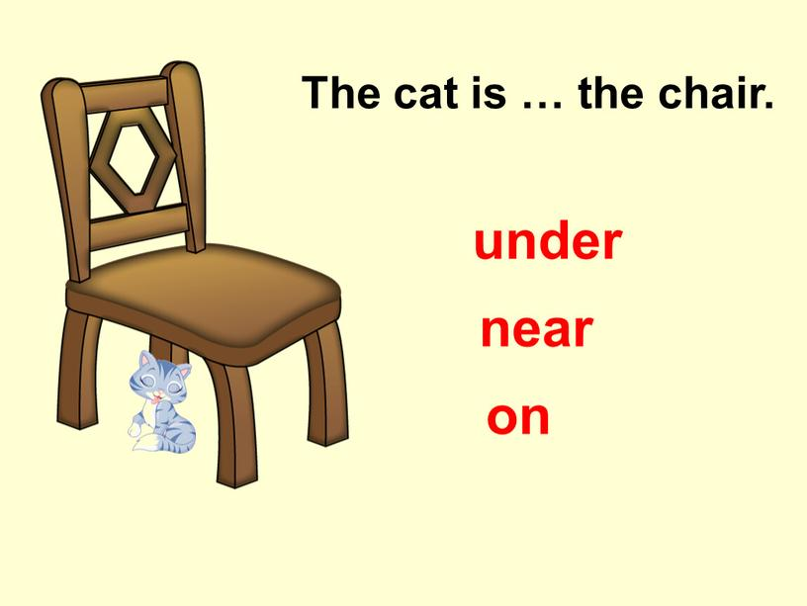

Slide 15
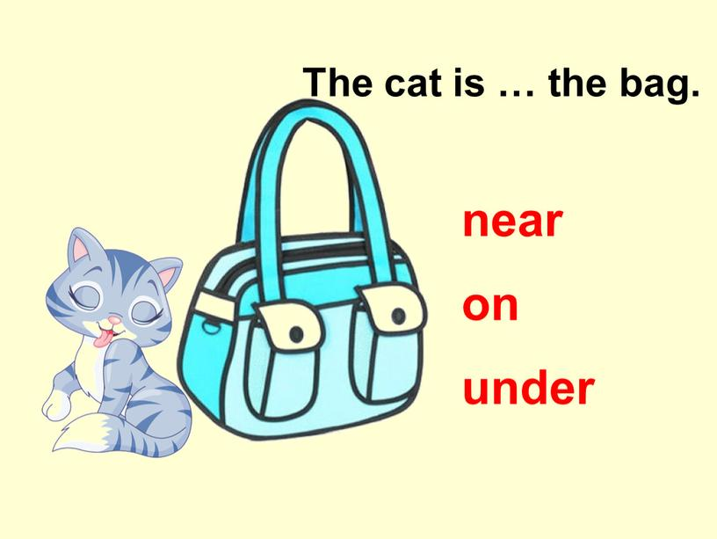

Slide 16
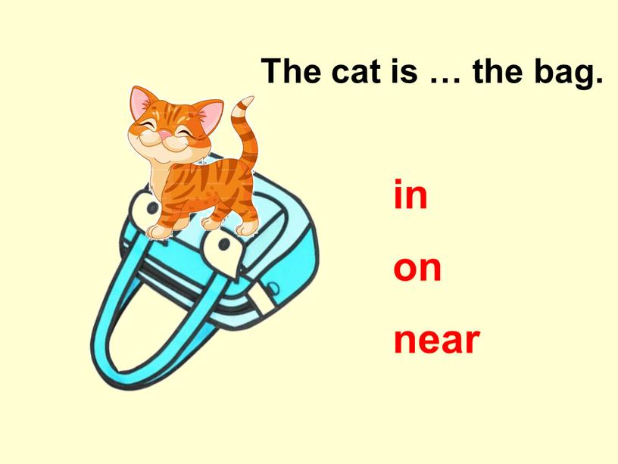

Slide 17


Slide 18
Ex.1
Where is the bird?

Slide 19
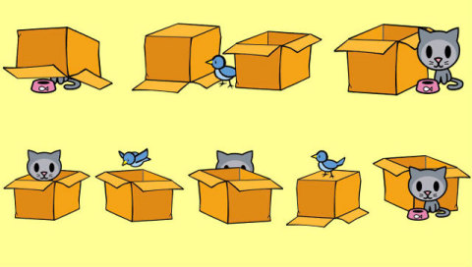
under
between
near
in
above
behind
on
In front of

Slide 20
Ex.2
Fill in the missing gaps with prepositions of place

Slide 21
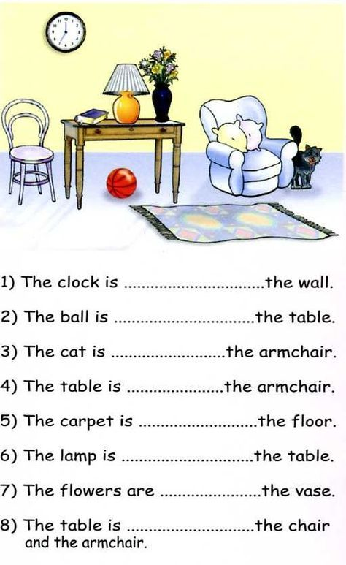

Slide 22

Homework:
Learn by heart the prepositions of place.
Describe the given picture using the prepositions

Slide 23


