Slide 1
English
Grade 2
Unit 8: Travel
Lesson 6: A to B

Slide 2

Learners will be able to:
recognize subjects and school objects;
practice vocabulary with / without teacher’s support;
use spoken form of a limited range of everyday and classroom words
Use basic prepositions of location and position;at, behind, between, in, in front of, near, next to, on, to describe where people and things are; use prepositions of time; on, in and to talk about days and times

Slide 3

Do you know what is «preposition of time?»

Slide 4

Have you ever been late?
ON
Or you always at time?

Slide 5
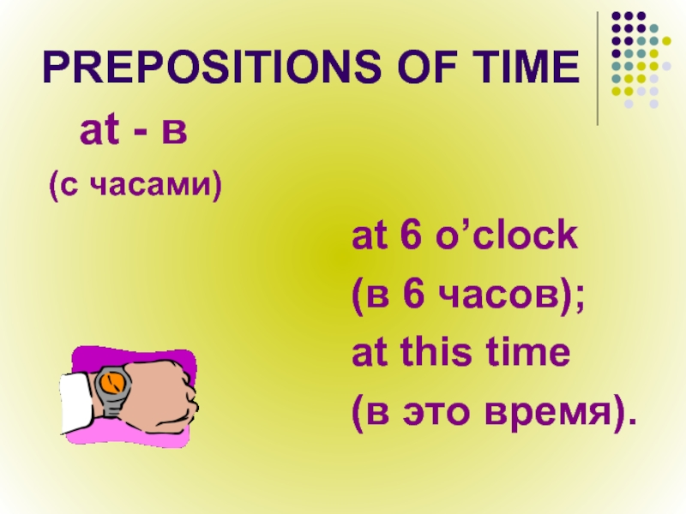

Slide 6
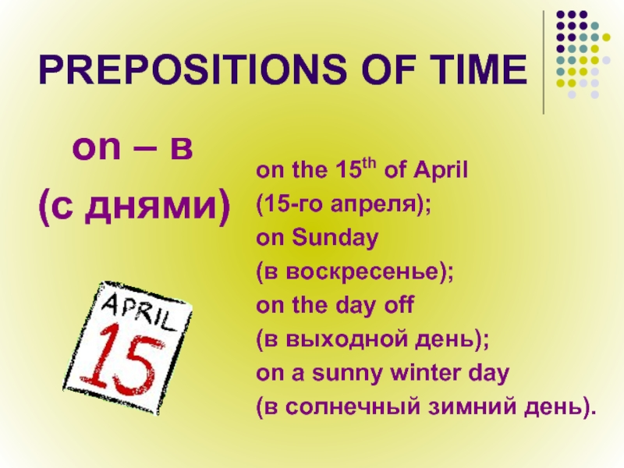

Slide 7
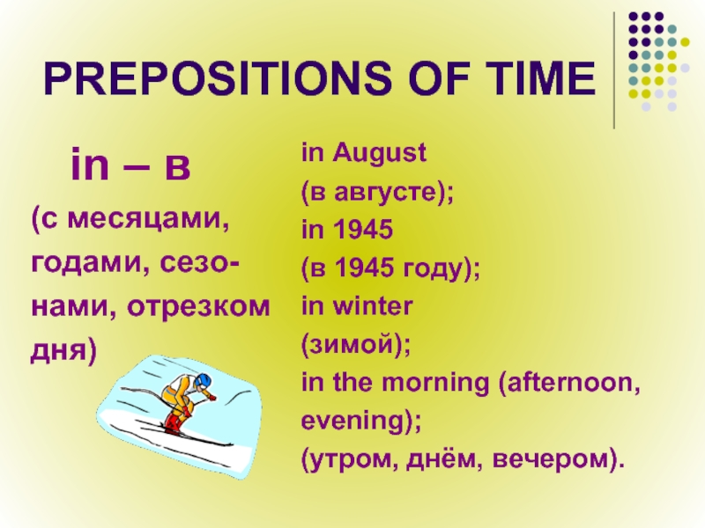

Slide 8
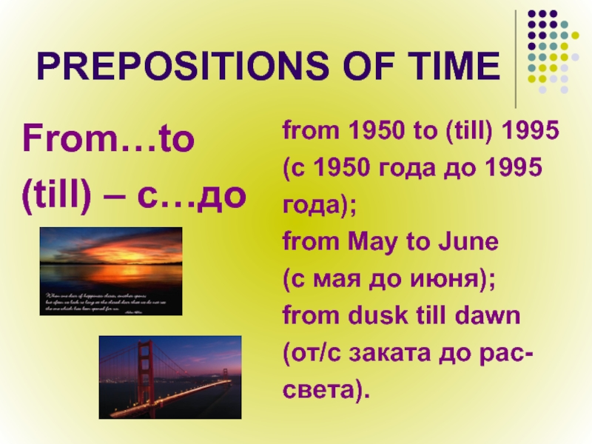

Slide 9
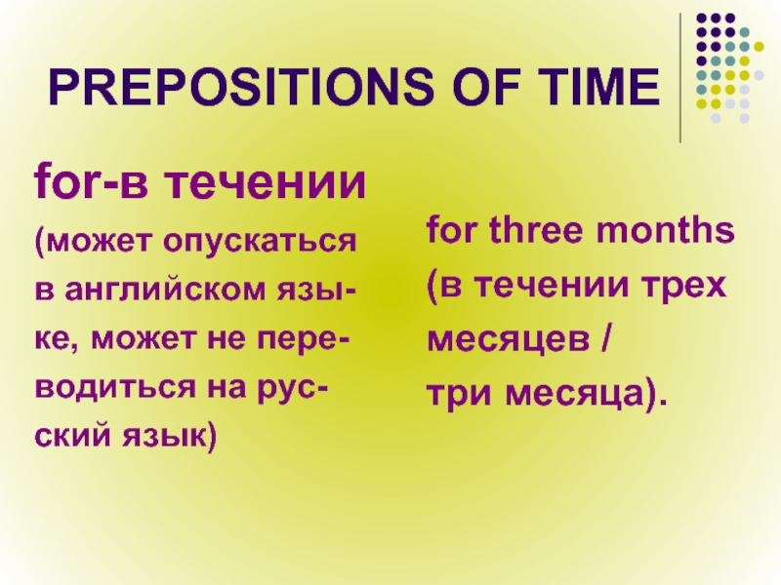

Slide 10
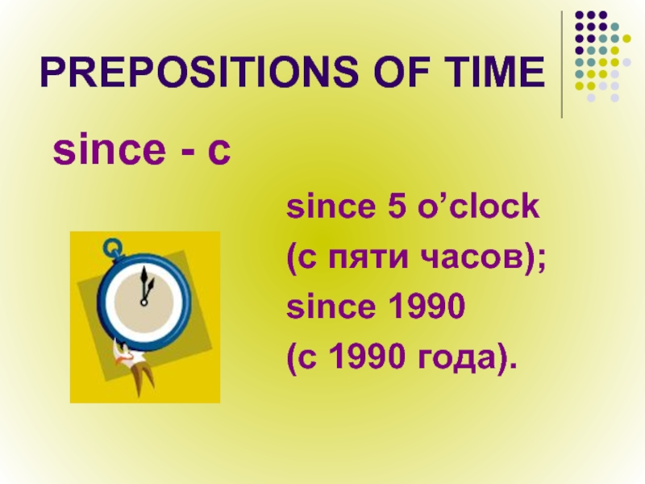

Slide 11
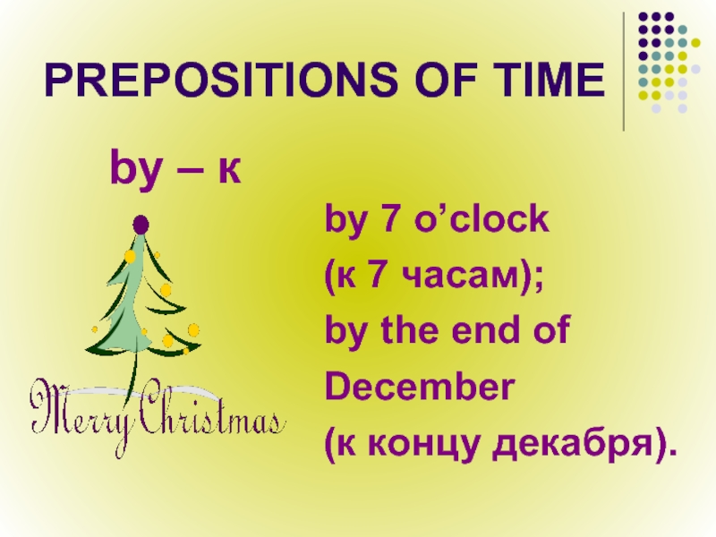

Slide 12
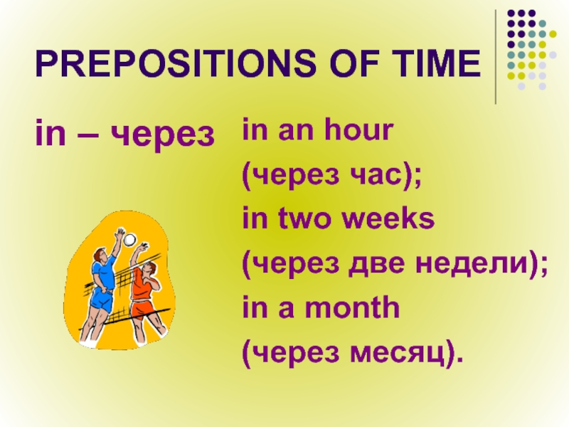

Slide 13
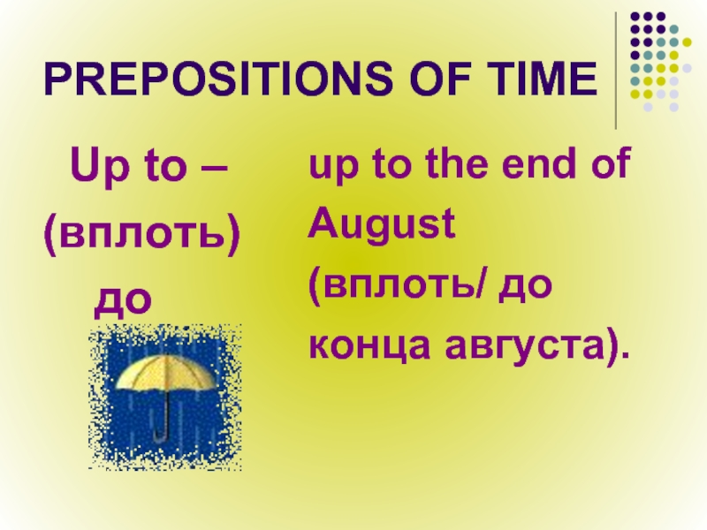

Slide 14
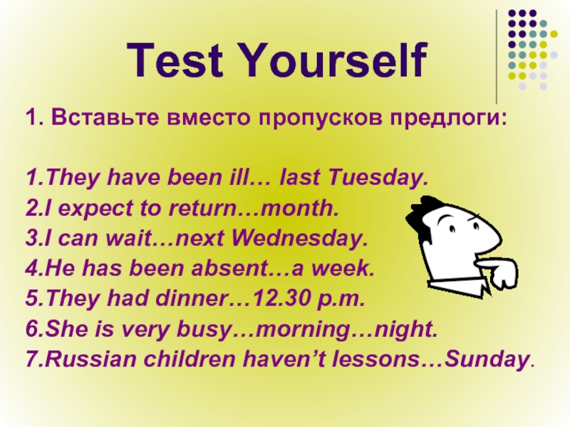

Slide 15
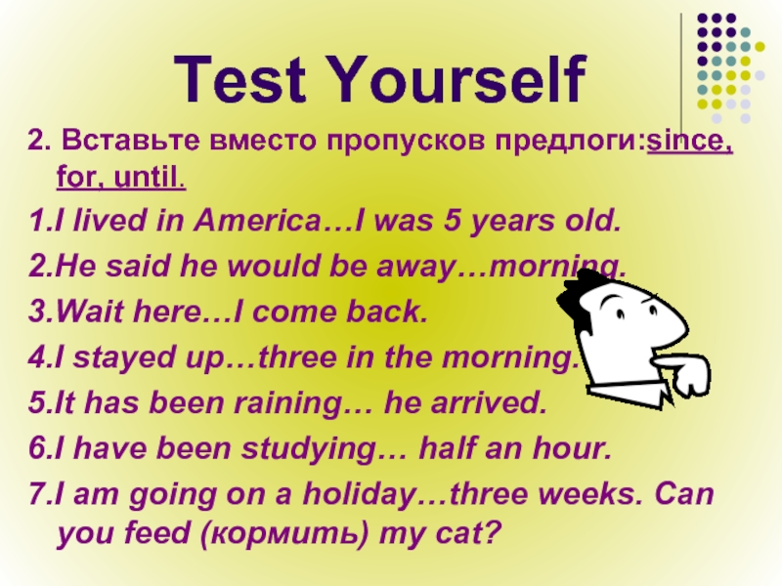

Slide 16


