Slide 1


Subject: English language
Grade: 4
The theme of the lesson: Save our
animals 2

Slide 2
New words
Destroy – жою
Forest – орман
Look – қарау
Shame – ұят
Protect – қорғау
Jungle – джунгли
Turtle – тасбақа
Sea - теңіз

Slide 3
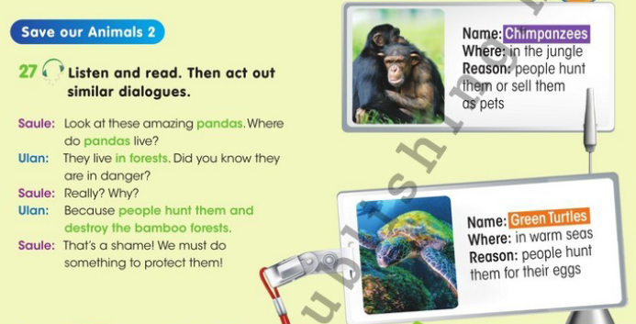
Ex.27,p.93 Listen and read. Then act out similar dialogues.

Slide 4
Ex.27,p.93 Listen and read. Then act out similar dialogues.
A: Look at these amazing chimpanzees. Where do chimpanzees live?
B: they live in the jungle. Do you know they are in danger?
A: Really? Why?
B: Because people hunt them or sell them as pets.
A: That`s a shame. We must do something to protect them.

Slide 5
Endangered animals
Today, it must be noted that human activities have a negative impact on nature, including Kazakhstan.Many animal species in danger of extinction, sometimes through direct destruction, so environmentalists all over the world are sounding the alarm for a long time, so in 1963, has been specially created Red Book of the International Union for Conservation of Nature. Kazakhstan also has a red book of animals Kazakhstan, which includes 40 mammals, 57 birds, 3 amphibians, 18 fish and 10 reptiles.
Animals Red Book of Kazakhstan subject to special protection. This is a rare and endangered species of animals .In the Red Book of Kazakhstan are included animals such as the snow leopard, sand cat, Pallas' cat, red wolf, cheetah, gazelle, argali, tugai deer, Tien Shan brown bear and other animals.

Slide 6
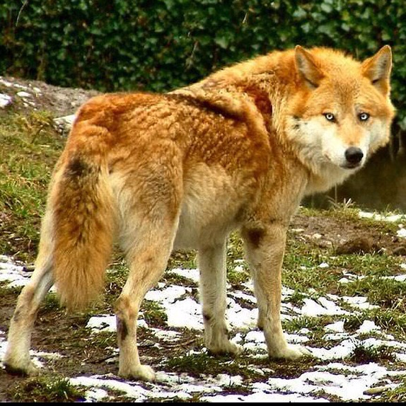
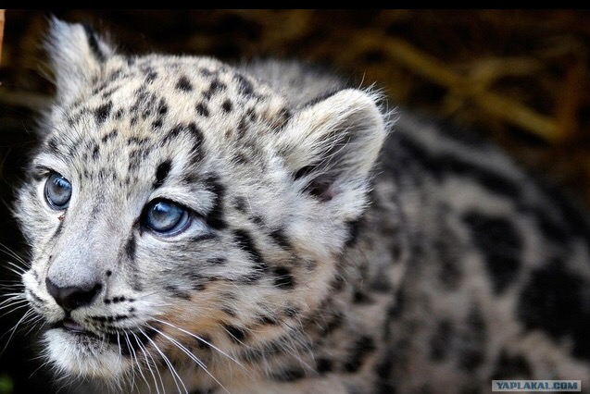
The snow leopard is listed in the Red Book of Kazakhstan as endangered, their habitat are thirteen states including Kazakhstan. Among the big cats he is the only permanent resident of the Central Asian mountains.
Red Wolf is the only representative of this genus in the nature of Kazakhstan and CIS countries. The red wolf lives in the mountains is probably why he almost did not come across a person.

Slide 7
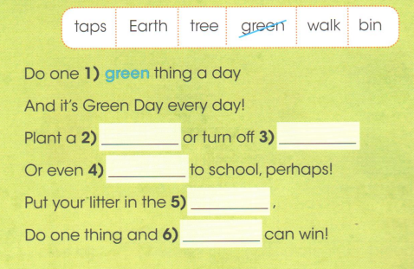
Ex.16,p.64 Activity book Complete the poem. Draw a picture to go with the poem.
tree
taps
walk
bin
Earth

Slide 8
