Slide 1


Subject: English language
Grade: 4
The theme of the lesson: Help the planet
2

Slide 2
New words
Fur – жүн
Beautiful – әдемі
Animal – жануар
Spot - нүкте
Litter – қоқыс
Stone – тас
Monument – ескеріткіш
Drop – тастау
Gum – сағыз

Slide 3
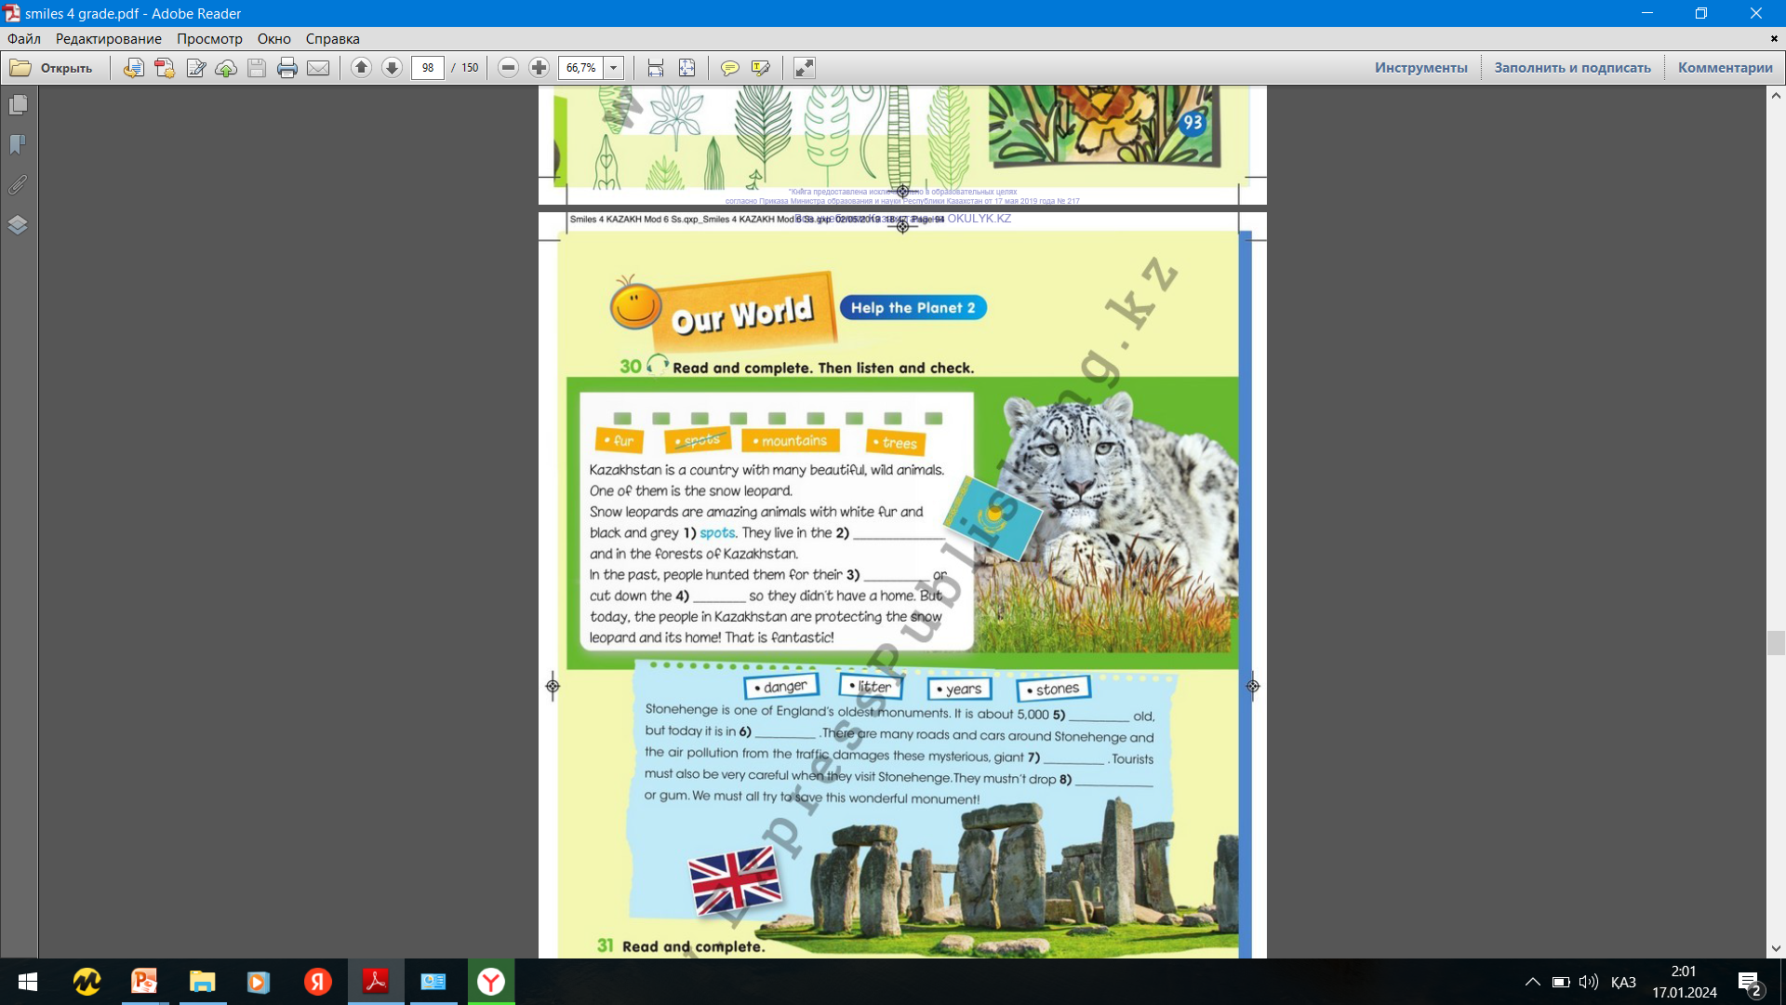
Ex.30,p.94
Read and complete. The listen and check.
2)mountains
3)fur
4)trees
5)years
6)danger
7)stones
8)litter

Slide 4
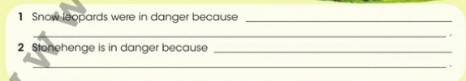
Ex.31,p.94
Read and complete.
1)Snow leopards were in danger because people hunted them for their furor cut down the trees so they didn`t have to home.
2)Stonehenge is in danger because the air pollution from the traffic damages the stones.

Slide 5
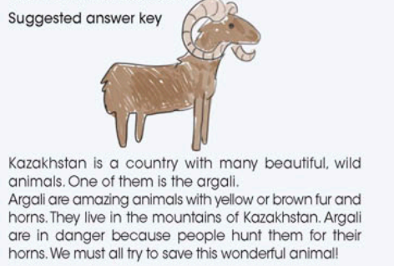
P.94
Do you know other places/animals that are in danger? Tell the class.

Slide 6
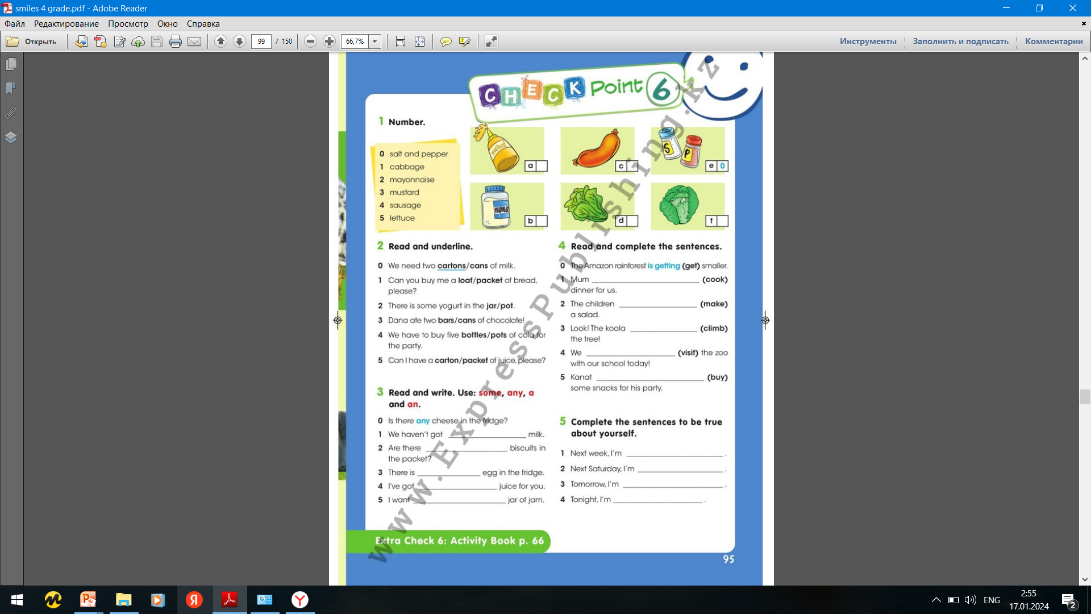
Ex.4,p.95
Read and complete the sentences.
1)Mum is cooking dinner for us.
2)The children are making a salad.
3)Look! The koala is climbing the tree.
4)We are visiting the zoo with our school today.
5)Kanat is buying some snacks for his party.

Slide 7
