Slide 1


Subject: English language
Grade: 4
The theme of the lesson: Snow and ice

Slide 2
New words
Summer – жаз
Scarf – шарф
Penguin – пингвин
Winter – қыс
Sunglasses – көзілдірік
Ice crystal – мұз кристалы
Beach – жағажай
Snowflake – қар бүршігі, қар ұнтағы
Igloo – иглу
Whale – кит

Slide 3
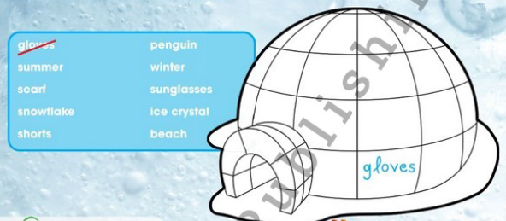
Ex.26,p.78 Choose and write on the igloo the words that have to do with snow and ice.
Scarf, snowflake,
penguin, winter, ice crystal.

Slide 4
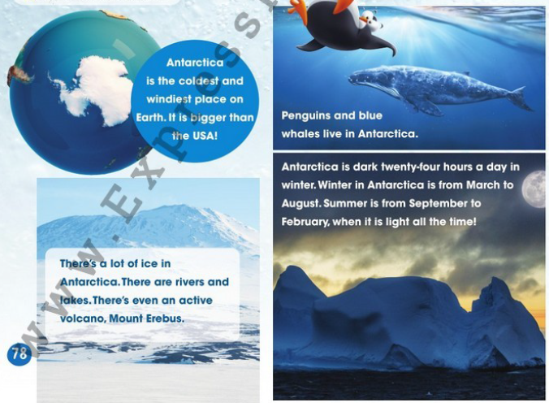
Ex.27,p.78 Listen and read.

Slide 5
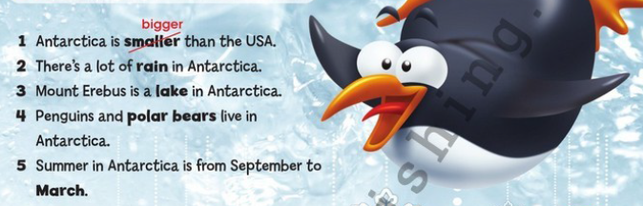
Ex.28,p.79 Read again and correct the sentences.
2)ice/snow
3)Volcano
4)Blue whales
5)February

Slide 6
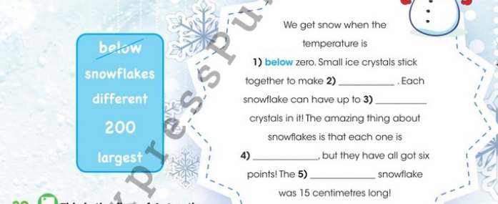
Ex.29,p.79 Read, choose and complete.
2)Snowflakes
3)200
4)Different
5)Largest

Slide 7
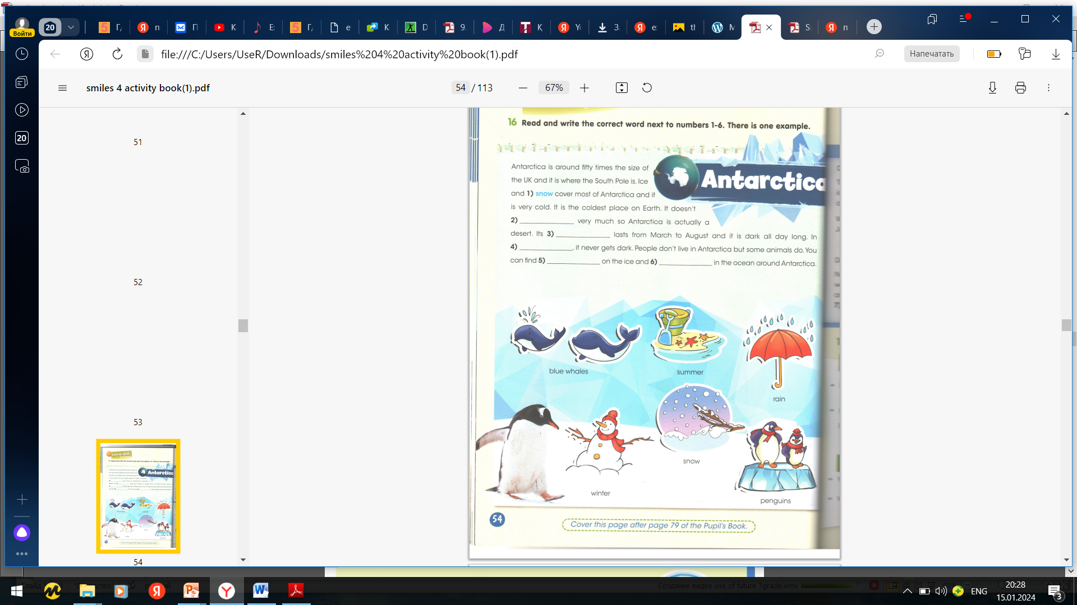
Ex.16,p.54 Activity book Read and write the correct word next to numbers 1-6. There is one example.
2)Rain
3)Winter
4)Summer
5)Penguins
6)Blue whales

Slide 8
