Slide 1
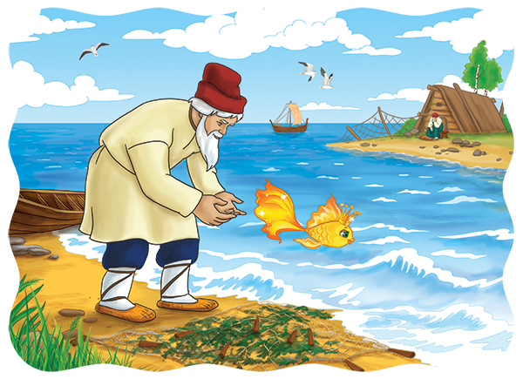
The fisherman and the fish

Slide 2


In today’s lesson you will:
learn new words and phrases
watch and read an animation of a fairytale written by Alexander Pushkin
Learn why adjectives are used to make a story more interesting.

Slide 3
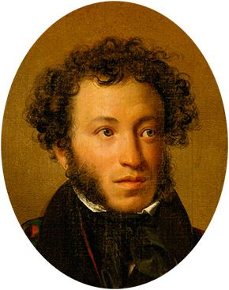

Who was Alexander Pushkin? Where was he from?
Read the biography to find out.
Alexander Pushkin (6th June 1799-10th February 1837) was a Russian poet, novelist and playwright. His most famous works are the novel Eugene Onegin and the play Boris Godunov. Pushkin wrote The Fisherman and the Fish in 1833. It is a fairy tale in verse.

Slide 4

The fisherman and the fish by Alexander Pushkin

Slide 5
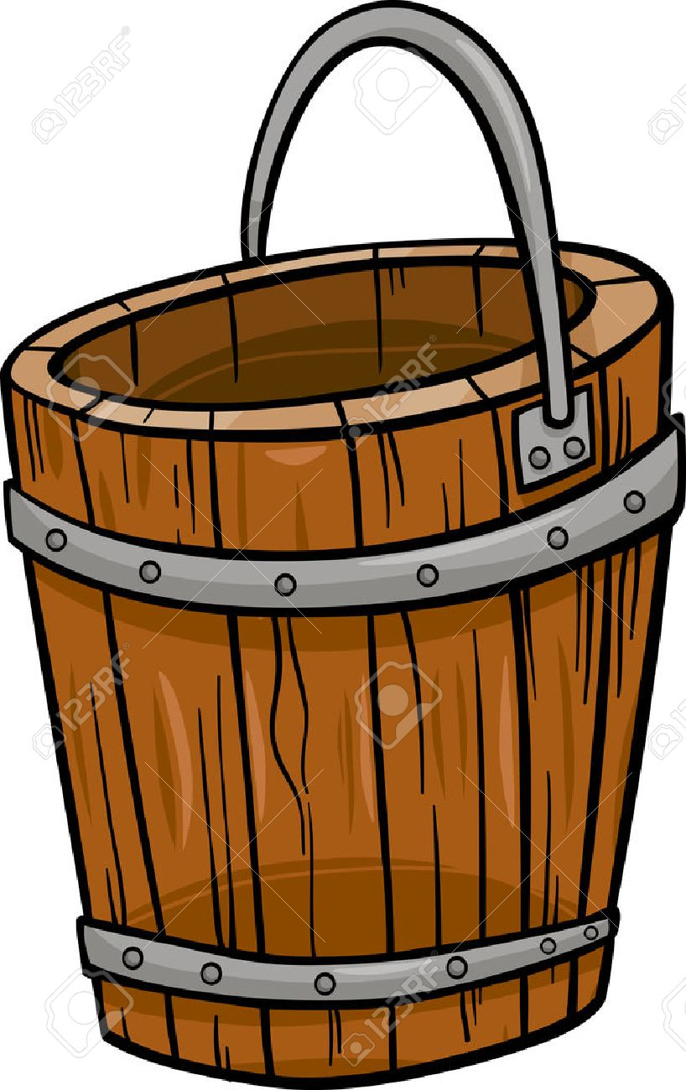


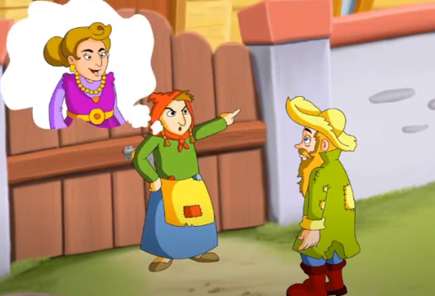
Learn new phrases
Have a wish
A huge house
A golden fish
A bucket

Slide 6
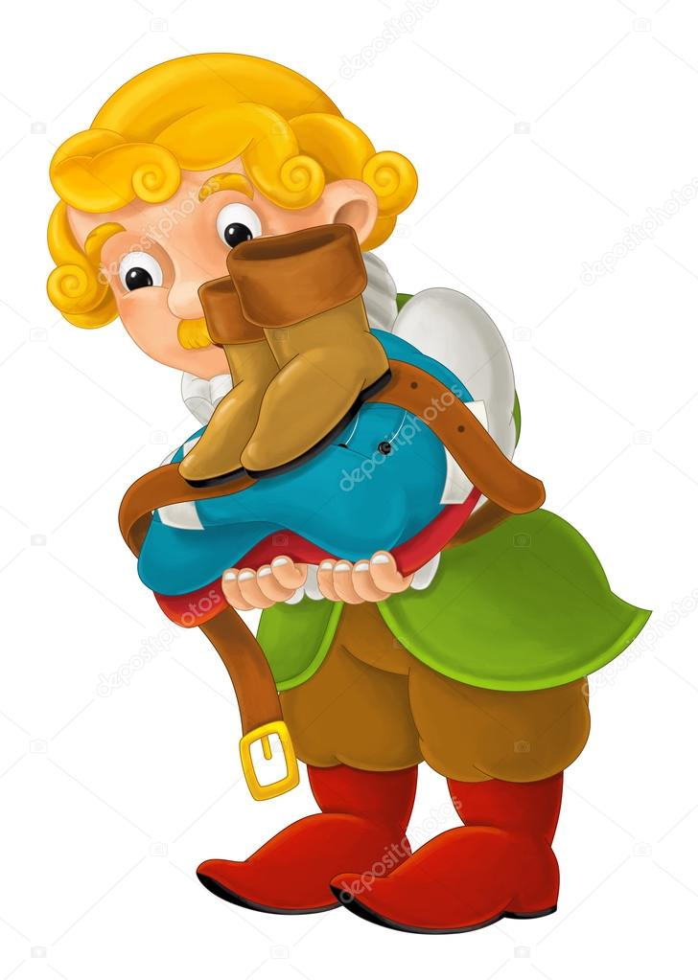
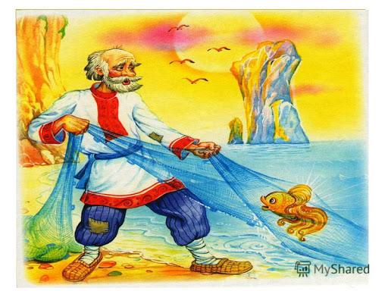

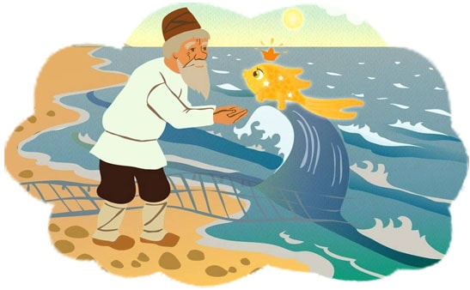
Learn new phrases
Grant a wish
Calm
A servant
Work hard

Slide 7

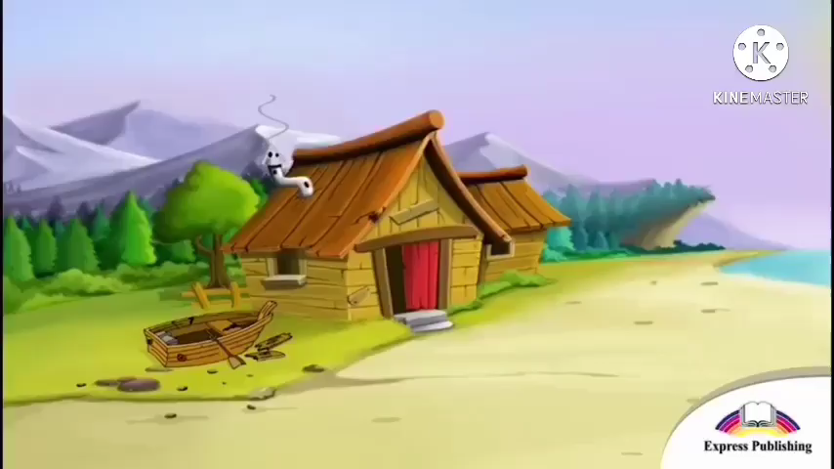
Watch a fairytale:
The fisherman and the fish

Slide 8
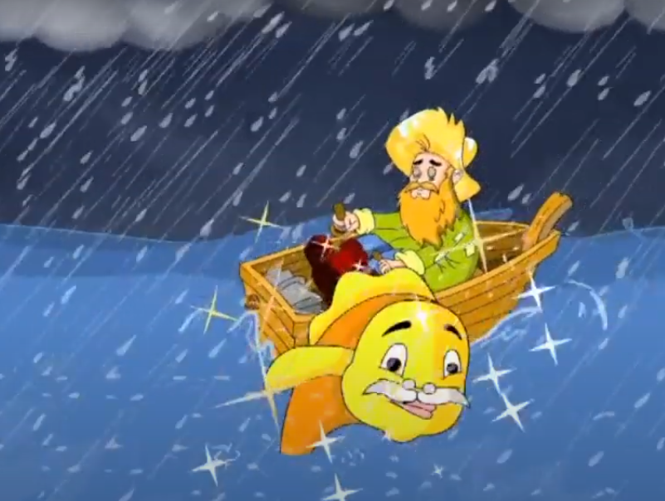
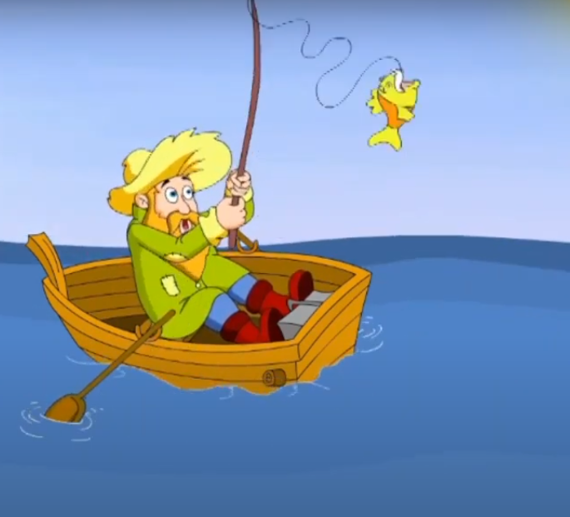
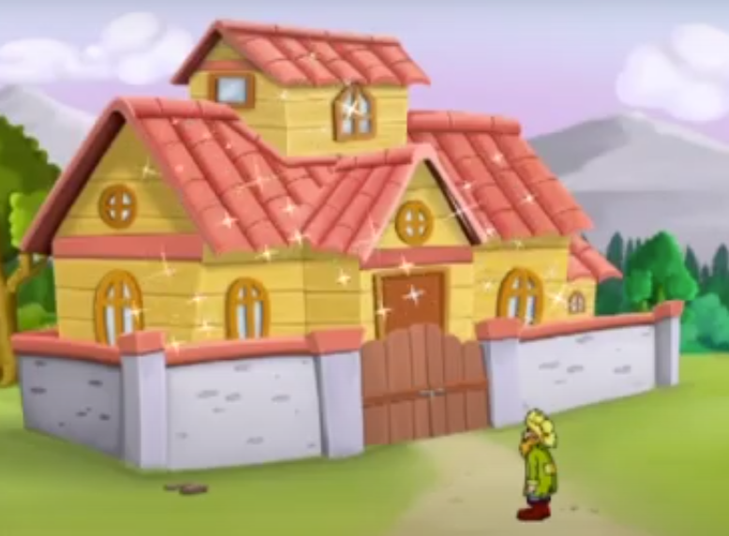
Look at the pictures. Which one shows:
3
a beautiful house?
a fisherman catching a fish?
dark sea and rain?
2
1
2
3
1

Slide 9
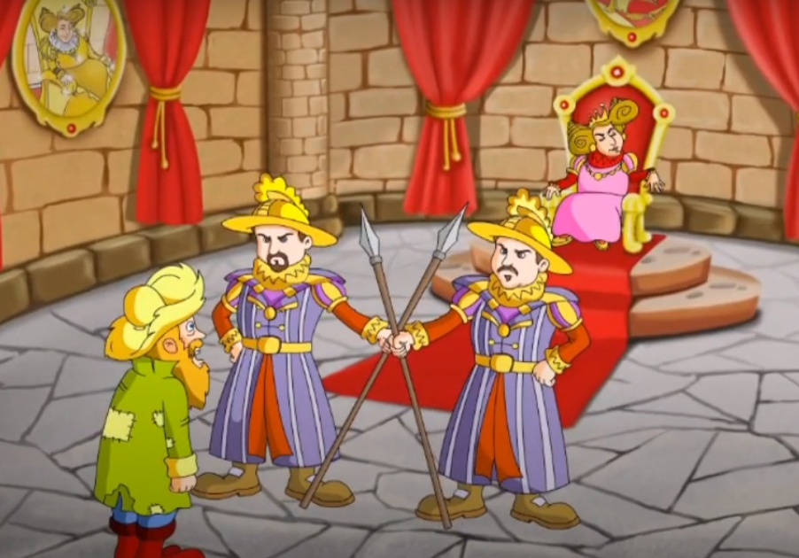
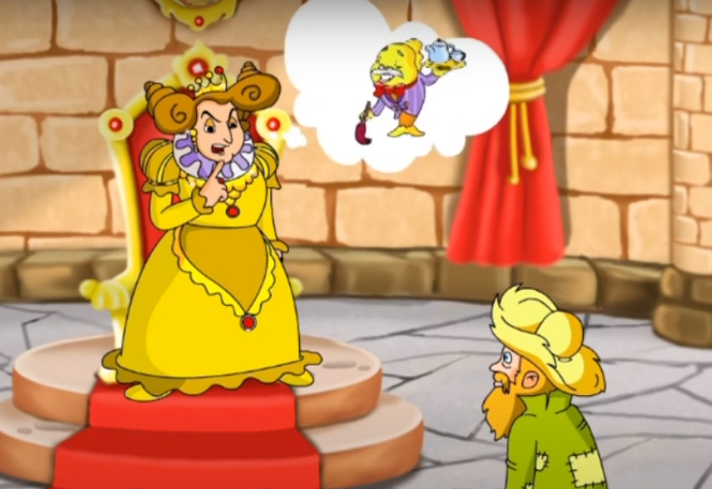
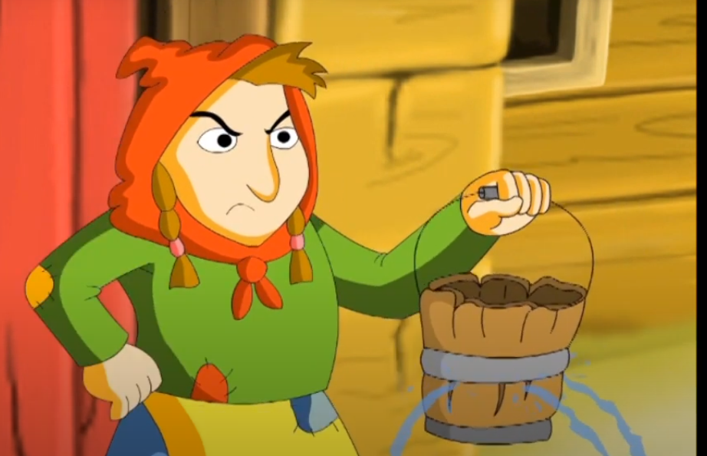
Look at the pictures. Which one shows:
6
an angry woman with a bucket?
a queen and her servants?
a queen and the golden fish as a servant?
4
5
4
5
6

Slide 10


Self-evaluation
The golden fish grants you:
3 wishes if you get 5-6 correct answers;
2 wishes if you get 3-4 correct answers;
1 wish if you get 1-2 correct answers.

Slide 11


Read the first passage of “the fisherman and the fish” story
An old fisherman and his wife lived in a small house near the sea. They were very poor. One day, ……………………… .
"Please let me go,"said the fish, "and you can have anything you wish! "The fisherman was very surprised. The fish
could speak!
"Dear little fish,"said the old man, "I don't want anything!"
…………………………….. . He told his wife about the fish.
"You fool!"she shouted. "We need a new bucket!
Go back and ask for a bucket!
"So the fisherman went back to the sea. It was calm. He called the golden fish and it swam up to him.
"What do you want, good man?"it asked.
"............................................ ,"said the fisherman.
"You can have your wish. Go home now,"said the fish and swam away.
Use the following sentences to complete the passage:
My wife wants a new bucket.
He let the fish go and walked home.
the fisherman caught a golden fish.

Slide 12
Read the first passage of “the fisherman and the fish” story
An old fisherman and his wife lived in a small house near the sea. They were very poor. One day, the fisherman caught a golden fish.
"Please let me go,"said the fish, "and you can have anything you wish! "The fisherman was very surprised. The fish
could speak!
"Dear little fish,"said the old man, "I don't want anything!"
………………………………... He told his wife about the fish.
"You fool!"she shouted. "We need a new bucket!
Go back and ask for a bucket!
"So the fisherman went back to the sea. It was calm. He called the golden fish and it swam up to him.
"What do you want, good man?"it asked.
".................................................," said the fisherman.
"You can have your wish. Go home now,"said the fish and swam away.
Use the following sentences to complete the passage:
My wife wants a new bucket.
He let the fish go and walked home.
the fisherman caught a golden fish.

Slide 13
Read the first passage of “the fisherman and the fish” story
An old fisherman and his wife lived in a small house near the sea. They were very poor. One day, the fisherman caught a golden fish.
"Please let me go,"said the fish, "and you can have anything you wish! "The fisherman was very surprised. The fish
could speak!
"Dear little fish,"said the old man, "I don't want anything!"
He let the fish go and walked home. He told his wife about the fish.
"You fool!"she shouted. "We need a new bucket!
Go back and ask for a bucket!
"So the fisherman went back to the sea. It was calm. He called the golden fish and it swam up to him.
"What do you want, good man?"it asked.
"................................................," said the fisherman.
"You can have your wish. Go home now,"said the fish and swam away.
Use the following sentences to complete the passage:
My wife wants a new bucket.
He let the fish go and walked home.
the fisherman caught a golden fish.

Slide 14
Read the first passage of “the fisherman and the fish” story
An old fisherman and his wife lived in a small house near the sea. They were very poor. One day, the fisherman caught a golden fish.
"Please let me go,"said the fish, "and you can have anything you wish! "The fisherman was very surprised. The fish
could speak!
"Dear little fish,"said the old man, "I don't want anything!"
He let the fish go and walked home. He told his wife about the fish.
"You fool!"she shouted. "We need a new bucket!
Go back and ask for a bucket!
"So the fisherman went back to the sea. It was calm. He called the golden fish and it swam up to him.
"What do you want, good man?"it asked.
"My wife wants a new bucket," said the fisherman.
"You can have your wish. Go home now,"said the fish and swam away.
Use the following sentences to complete the passage:
My wife wants a new bucket.
He let the fish go and walked home.
the fisherman caught a golden fish.

Slide 15
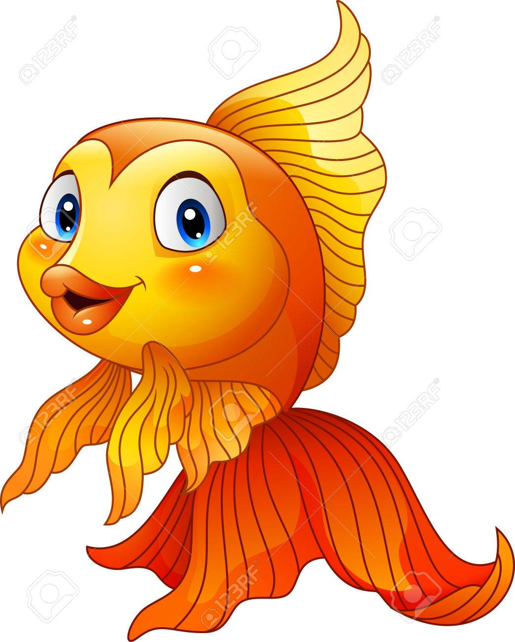


Evaluate yourself
2
3
1

Slide 16

Read the second passage of “the fisherman and the fish” story
The fisherman went home and saw a new bucket, but his wife was still angry. She wanted a new house. So the fisherman went back to the sea and called the golden fish again. This time the sea was not so calm.
The fish granted his wish and the fisherman went back home. He saw a beautiful new house, but his wife was still angry. She wanted to be rich with a huge house. So the fisherman went back to find the fish. The sea was dark now and the sky was grey. The fish granted her wish.
Study Skills
Adjectives are words that describe people, places and things. They make a story more interesting. For example, an old man, a shiny bucket, a beautiful house.

Slide 17

Complete the sentences with the adjectives from the text.
1
She didn’t want to keep her old bucket. She wished for a ….. bucket.
2
They lived in a small house, but she wanted to be a rich woman with a …….. house.
3
Once a fisherman went fishing and caught a ……. fish.

Slide 18
Complete the sentences with the adjectives from the text.
1
She didn’t want to keep her old bucket. She wished for a new bucket.
2
They lived in a small house, but she wanted to be a rich woman with a …….. house.
3
Once a fisherman went fishing and caught a ……. fish.

Slide 19
Complete the sentences with the adjectives from the text.
1
She didn’t want to keep her old bucket. She wished for a new bucket.
2
They lived in a small house, but she wanted to be a rich woman with a huge house.
3
Once a fisherman went fishing and caught a ……. fish.

Slide 20
Complete the sentences with the adjectives from the text.
1
She didn’t want to keep her old bucket. She wished for a new bucket.
2
They lived in a small house, but she wanted to be a rich woman with a huge house.
3
Once a fisherman went fishing and caught a golden fish.

Slide 21

Evaluate yourself
Amazing
If you completed all three sentences you’re
If you completed two sentences, you’re
If you answered only one question,

Slide 22
Evaluate yourself
If you completed all three sentences you’re
If you completed two sentences, you’re
Good
If you completed only one question,

Slide 23
Evaluate yourself
If you completed all three sentences you’re
If you completed two sentences, you’re
If you completed only one question,
Try again

Slide 24
Read the third passage of “the fisherman and the fish” story
The fisherman’s wife still wasn't happy. She wanted to be a queen with a palace and servants so she sent her husband back to find the fish. The fish granted her wish, but still she wasn't happy. She wanted to be the Queen of the Land and Sea, with the golden fish as her servant.
The fisherman went back to the sea and called the golden fish. The sea was stormy and there were clouds in the sky.
“I'm sorry, dear fish "he cried."Now my wife wants to be the Queen of the Land and Sea, and she wants you to be her servant.
The fish didn't answer. It turned and swam away. The fisherman went home. He couldn't see the palace or the servants. All he could see was his small house and his wife. She was poor again and in front of her was the old bucket.
Answer the given question:
Was the fisherman’s wife happy when she became a queen?
Answer:
No, she wasn’t.

Slide 25
Read the third passage of “the fisherman and the fish” story
The fisherman’s wife still wasn't happy. She wanted to be a queen with a palace and servants so she sent her husband back to find the fish. The fish granted her wish, but still she wasn't happy. She wanted to be the Queen of the Land and Sea, with the golden fish as her servant.
The fisherman went back to the sea and called the golden fish. The sea was stormy and there were clouds in the sky.
“I'm sorry, dear fish "he cried."Now my wife wants to be the Queen of the Land and Sea, and she wants you to be her servant.
The fish didn't answer. It turned and swam away. The fisherman went home. He couldn't see the palace or the servants. All he could see was his small house and his wife. She was poor again and in front of her was the old bucket.
Answer the given question:
What did the fisherman’s wife wish at last?
Answer:
She wished to be the queen of the Land and Sea.

Slide 26
Read the third passage of “the fisherman and the fish” story
The fisherman’s wife still wasn't happy. She wanted to be a queen with a palace and servants so she sent her husband back to find the fish. The fish granted her wish, but still she wasn't happy. She wanted to be the Queen of the Land and Sea, with the golden fish as her servant.
The fisherman went back to the sea and called the golden fish. The sea was stormy and there were clouds in the sky.
“I'm sorry, dear fish "he cried."Now my wife wants to be the Queen of the Land and Sea, and she wants you to be her servant.
The fish didn't answer. It turned and swam away. The fisherman went home. He couldn't see the palace or the servants. All he could see was his small house and his wife. She was poor again and in front of her was the old bucket.
Answer the given question:
What did the fisherman see when he came home?
Answer:
He saw his small house and his wife. She was poor again with the old bucket in front of her.

Slide 27


Mark the sentences with True or False.
The fisherman and his wife were rich.
The fisherman and his wife were poor.

Slide 28


Mark the sentences with True or False.
The fisherman and his wife were rich.
The golden fish could speak.

Slide 29
Mark the sentences with True or False.
The fisherman and his wife were rich.
The golden fish could speak.
The fisherman wished to be the king.
The fisherman’s wife wished to be the queen.

Slide 30
Mark the sentences with True or False.
The fisherman and his wife were rich.
The golden fish could speak.
The fisherman wished to be the king.
The golden fish made the fisherman’s wife the queen of the Land and Sea.

Slide 31
Mark the sentences with True or False.
The fisherman and his wife were rich.
The golden fish could speak.
The fisherman wished to be the king.
The golden fish made the fisherman’s wife the queen of the Land and Sea.
The golden fish didn’t make the fisherman’s wife the queen of the Land and Sea.

Slide 32

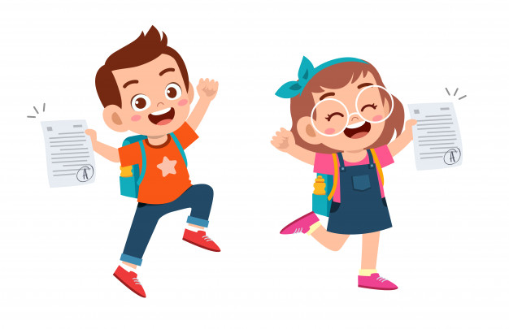
Homework
Imagine you met the golden fish. What would you wish for?
Write 2-3 sentences using the following structure:
I would wish………
For example: I would wish to have a new doll.

Slide 33
In today’s lesson you’ve:
learnt new words and phrases
watched and read an animation of a fairytale written by Alexander Pushkin
Learnt why adjectives are used to make a story more interesting.

