Slide 1
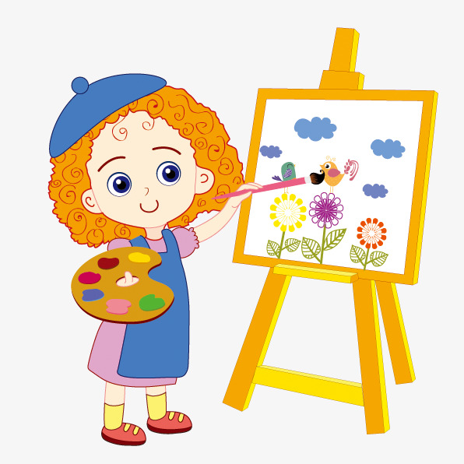
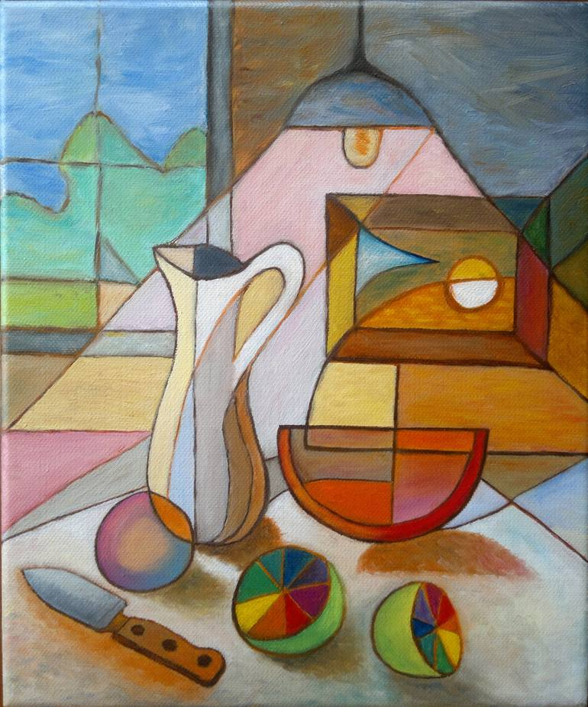
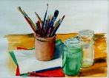


Slide 2
Theme of the lesson: Art
Lesson objectives:
• Identify common classroom commands with support
• Convey fantasy ideas including emotions and senses
• Provide unprepared speech to answer a variety of questions at sentence level with limited flexibility

Slide 3
Task 1. Listen to the teacher’s instructions and follow them.
1. Draw a square.
2. Colour the square in blue.
3. Add 2 rocks and 5 stones in it.
4. Erase 1 rock and 2 stones.
5. At the bottom of the square draw some sand
6. Add some underwater plants.
7. Colour them in green.
8. Draw some fish.
Descriptor A learner
• illustrates the proper actions;
• uses imagination to draw a picture.

Slide 4

Check yourself

Slide 5
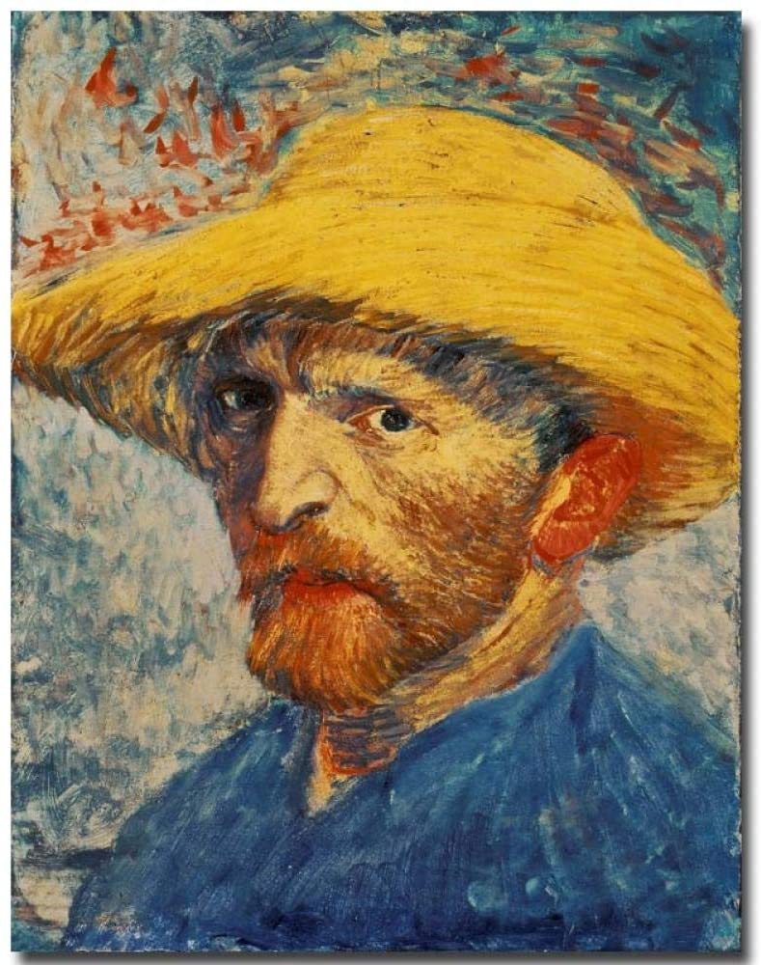
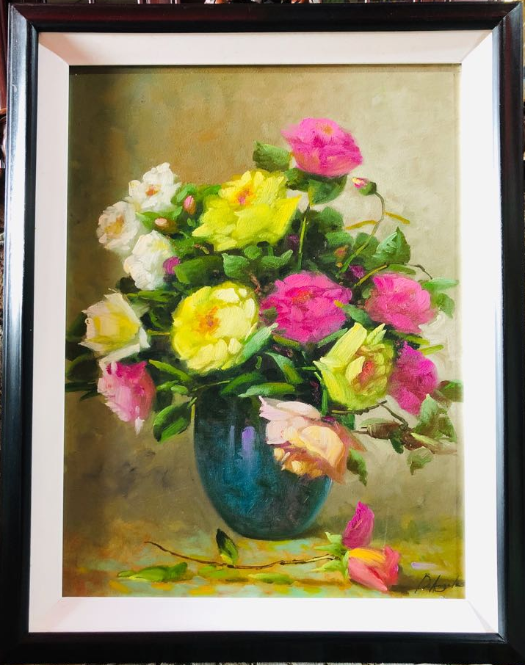

Task 2. Read the text and look and write the type of paintings.
Types of paintings
When you visit an art gallery, there are different types of paintings. These include portraits, landscape and still life paintings. Portraits are paintings are view of the countryside. Still life paintings show objects, flowers, fruit or vegetables.

Slide 6
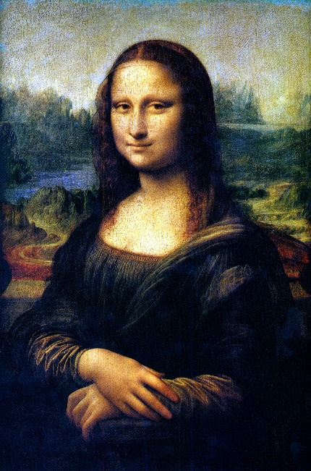
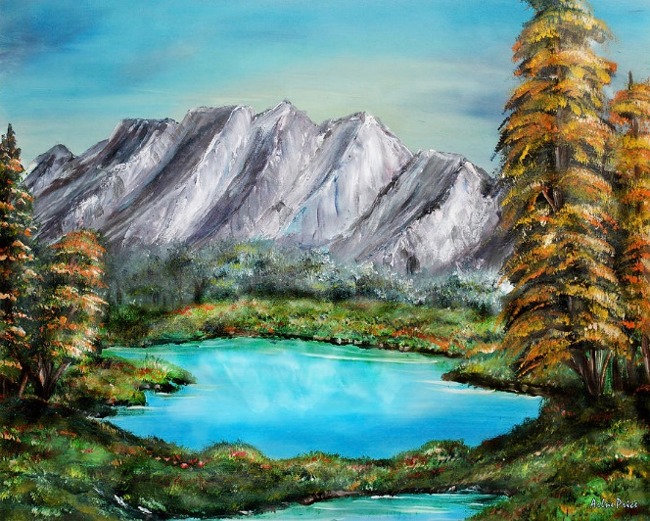
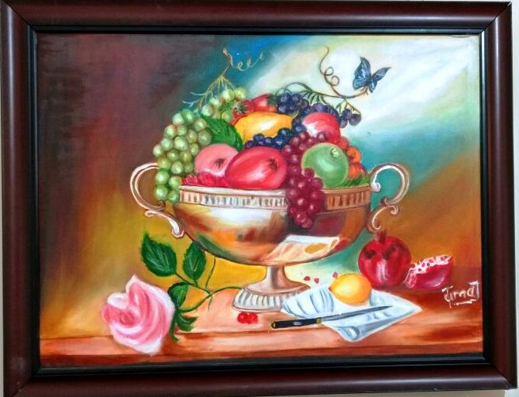
Task 2. Read the text and look and write the type of paintings.
1
2
3
Descriptor A learner
• read the text and understand it;
• write the type of paintings.

Slide 7
Check yourself
1. Portrait
2. Landscape
3. Still life

Slide 8

The lesson is over!

