Slide 1

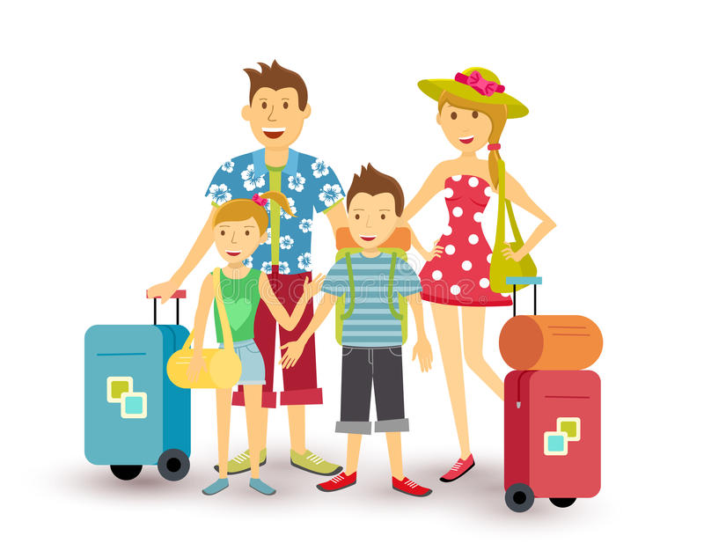
Destination

Slide 2
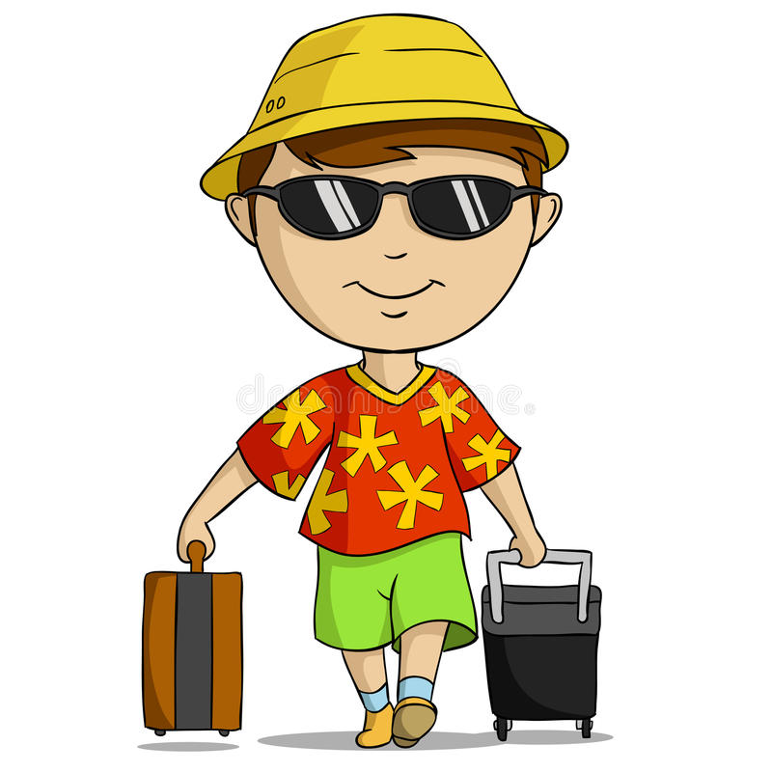

In today’s lesson we will:
learn new words
read the text “In all weathers”
answer the questions related to the text

Slide 3
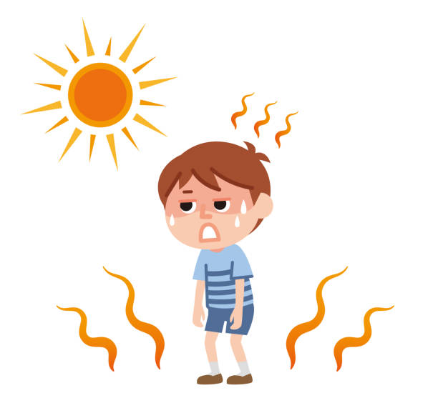

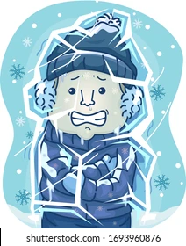

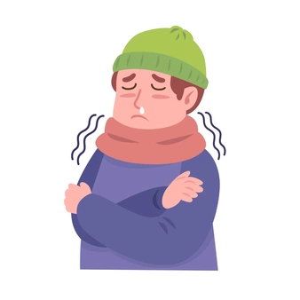
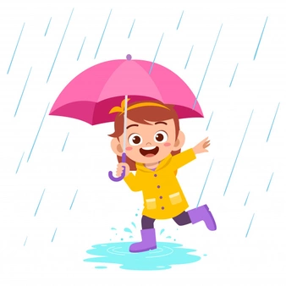
Look at the pictures and match them to the sentences
1
It’s hot
6
It’s sunny
4
It’s cold
1
3
2
2
It’s freezing
It’s cloudy
3
5
It’s rainy
4
5
6

Slide 4
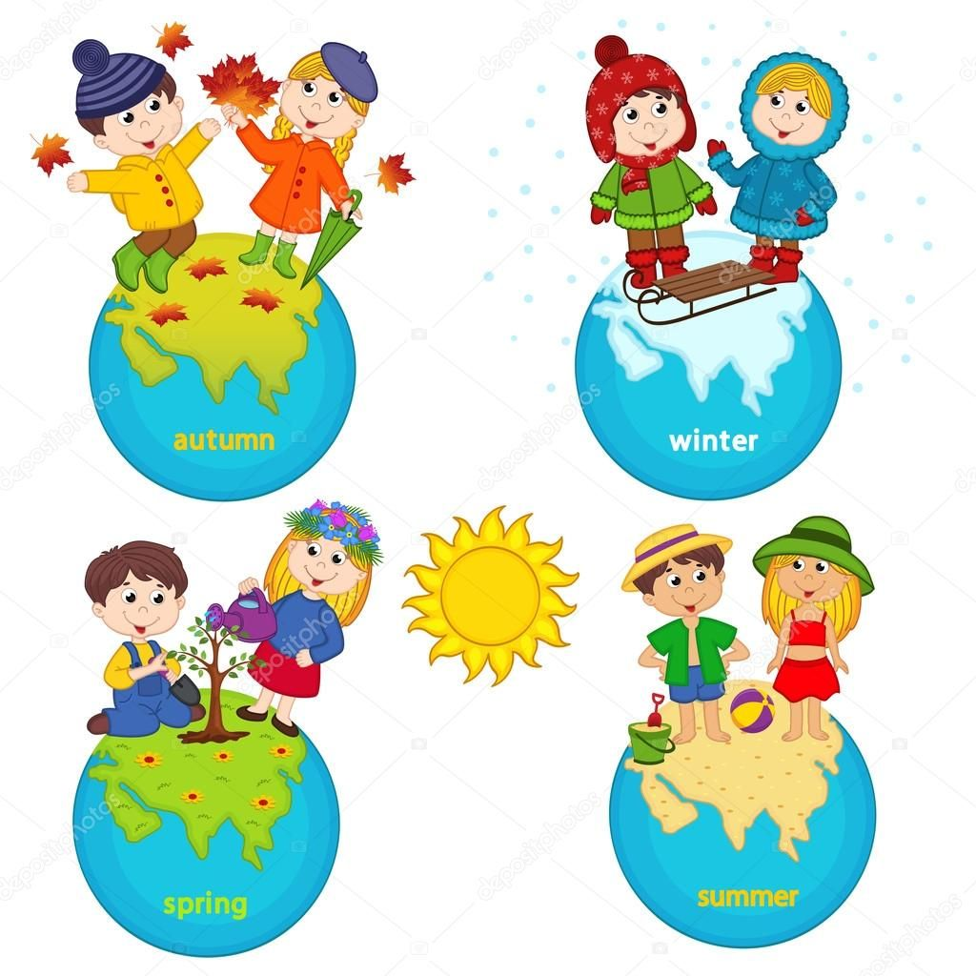
Complete the sentences
In my country it is cold in winter.
In spring it is ……. .
Summers are …….. .
In autumn it is usually …….. .

Slide 5
Complete the sentences
In my country it is cold in winter.
In spring it is sunny.
Summers are …….. .
In autumn it is usually …….. .

Slide 6
Complete the sentences
In my country it is cold in winter.
In spring it is sunny.
Summers are hot.
In autumn it is usually …….. .

Slide 7
Complete the sentences
In my country it is cold in winter.
In spring it is sunny.
Summers are hot.
In autumn it is usually cloudy.

Slide 8



Self-evaluation
If you completed all the sentences, you’re the shiny sun.
If you had some mistakes, you are the smiley sun.
If you couldn’t complete the sentences, please try again.

Slide 9

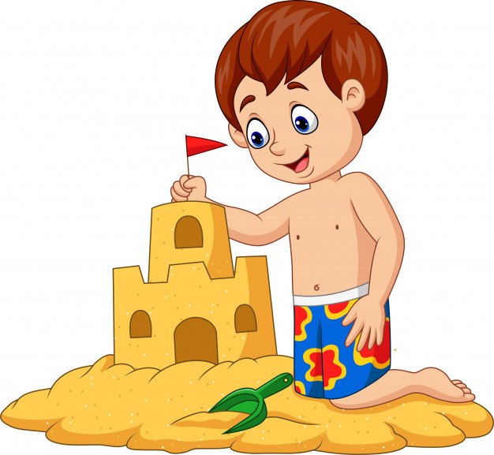
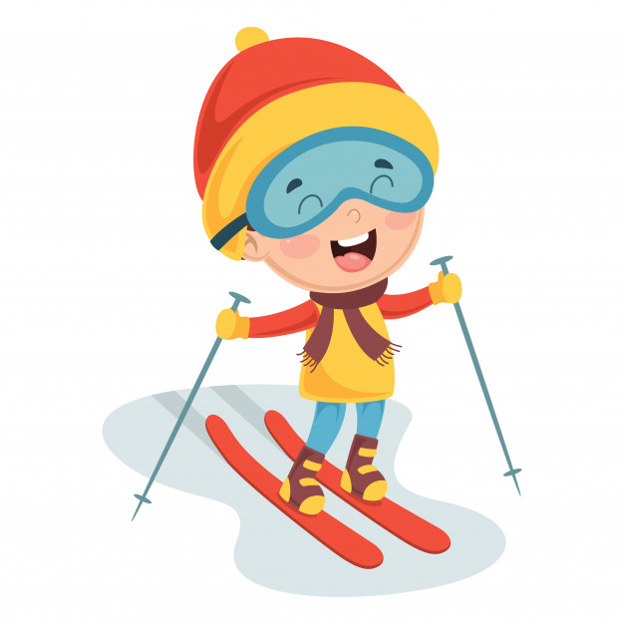
Check new words
Sunbathing
Sandcastle
Skiing

Slide 10
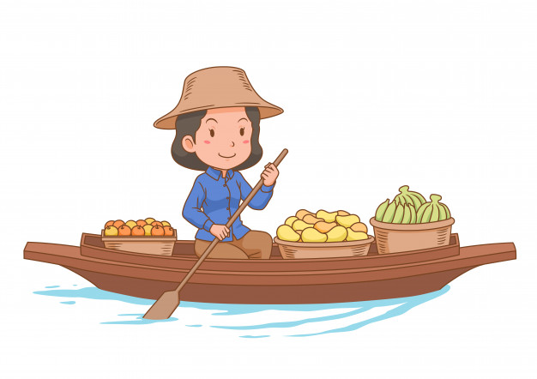
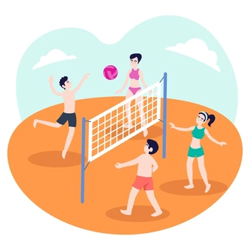

Check new words
Floating market
Playing beach voleyball
Swimming

Slide 11
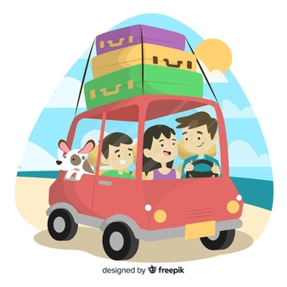
Watch and read the text
2
Saturday 11th July
Hi Barney,
Hello from Thailand. The weather's strange here but we're having а wonderful time. it's warm and sunny today, but it's often cloudy and rainy. Saule and Nurlan are visiting the floating market, and Nurzhan and I are having a snack. it's great. This is an amazing country. We love it. Take care,
Ruslan
VIDEO
In all Weathers
1
3
Sunday 27h December
Hi Moly,
Greetings from Australia. We're having a fantastic time here. Today, it's hot and sunny and we are at the beach. I'm sunbathing and my sisters are making a sandcastle. Dad and Meruert ore windsurfing. Some рeople are swimming and others are playing beach volleyball or sailing their boats. We all love it here. See you when we get back.
Lena
Monday 6th April
Hi Will,
We’re having wonderful time here at Shymbulak in the Zaili Alatau Mountains in Kazakhstan. It's a beautiful place and there is snow everywhere! It's freezing cold, but the sky is blue and the sun is shining. Assel and Sanzhar are skiing at the moment. My lesson is this afternoon, so I'm having a hot chocolate now. Were having lots of fun. Talk to you soon.
Berik

Slide 12
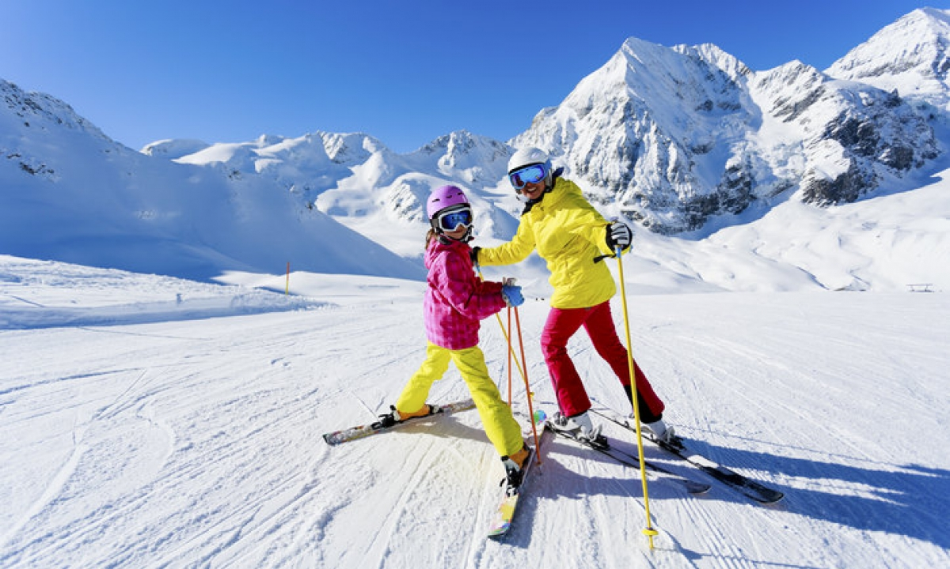
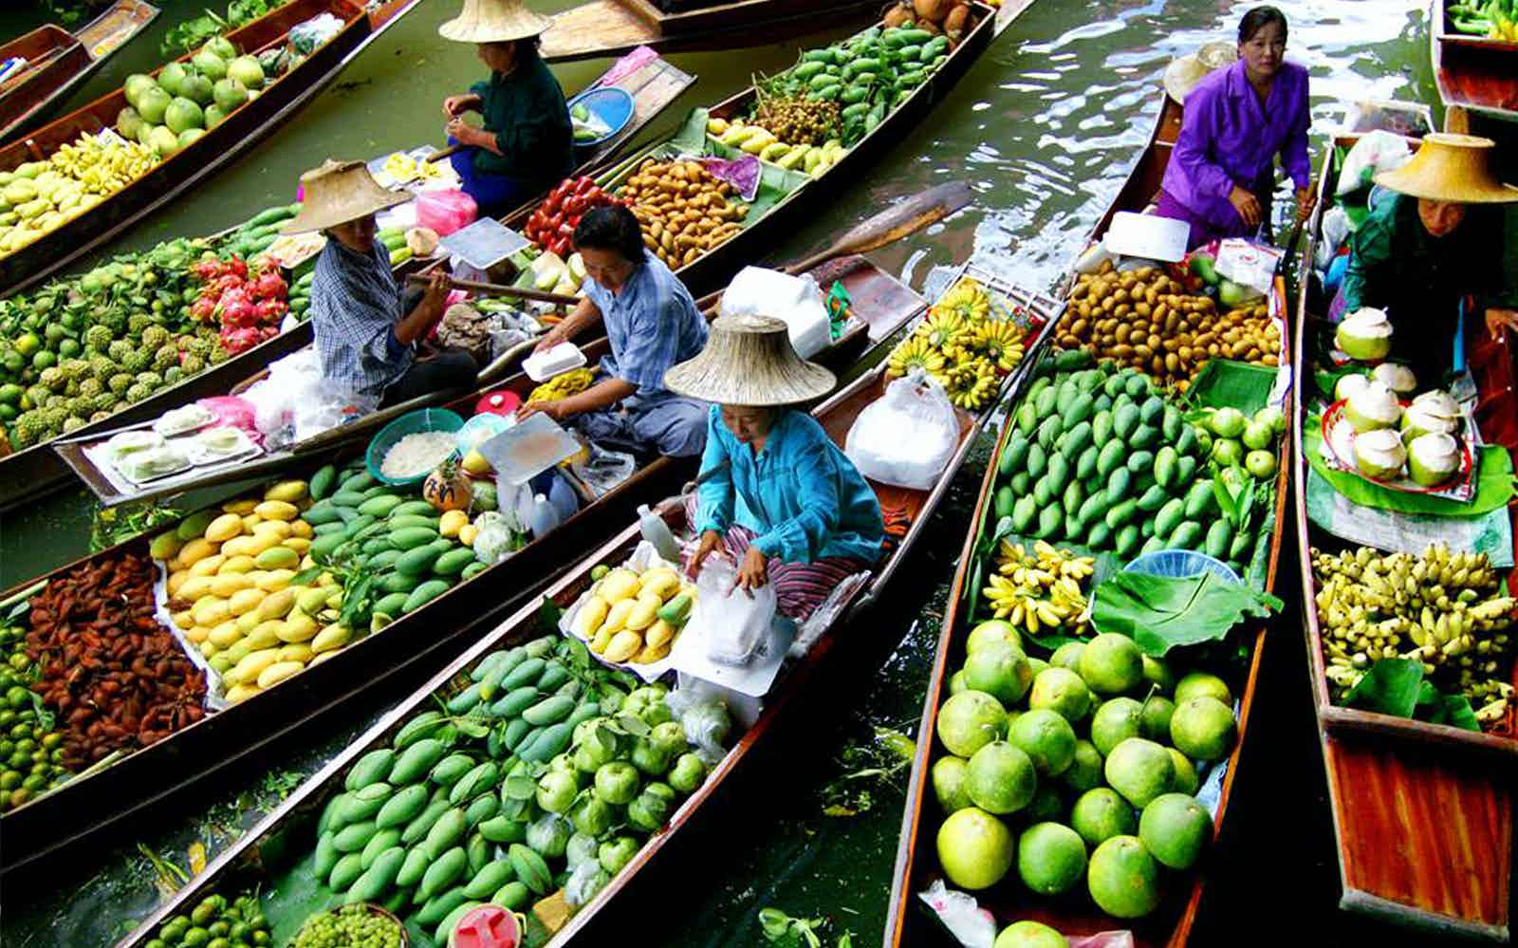
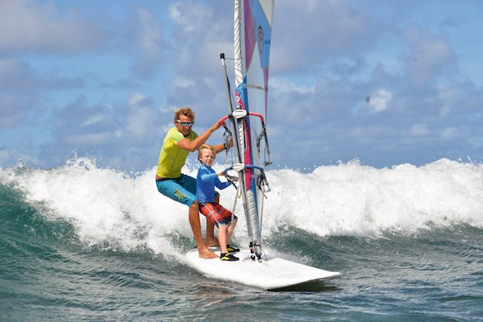
Find photos that children sent with their letters
Lena’s
Ruslan’s
Berik’s
B
A
C
A
C
B

Slide 13
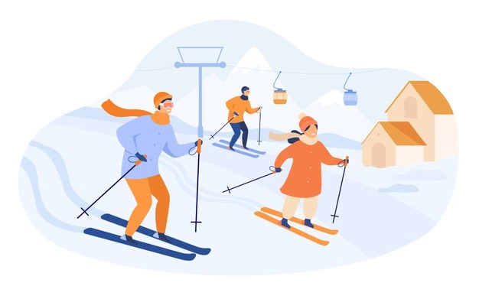
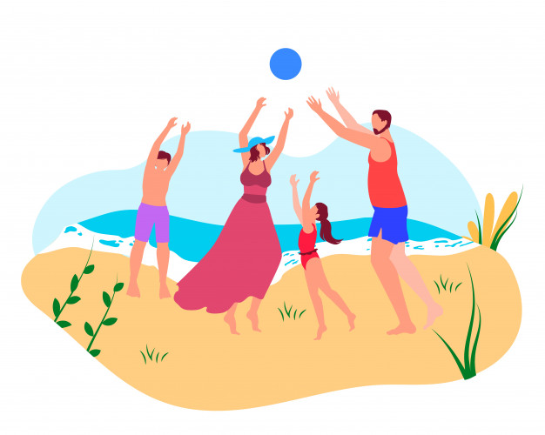
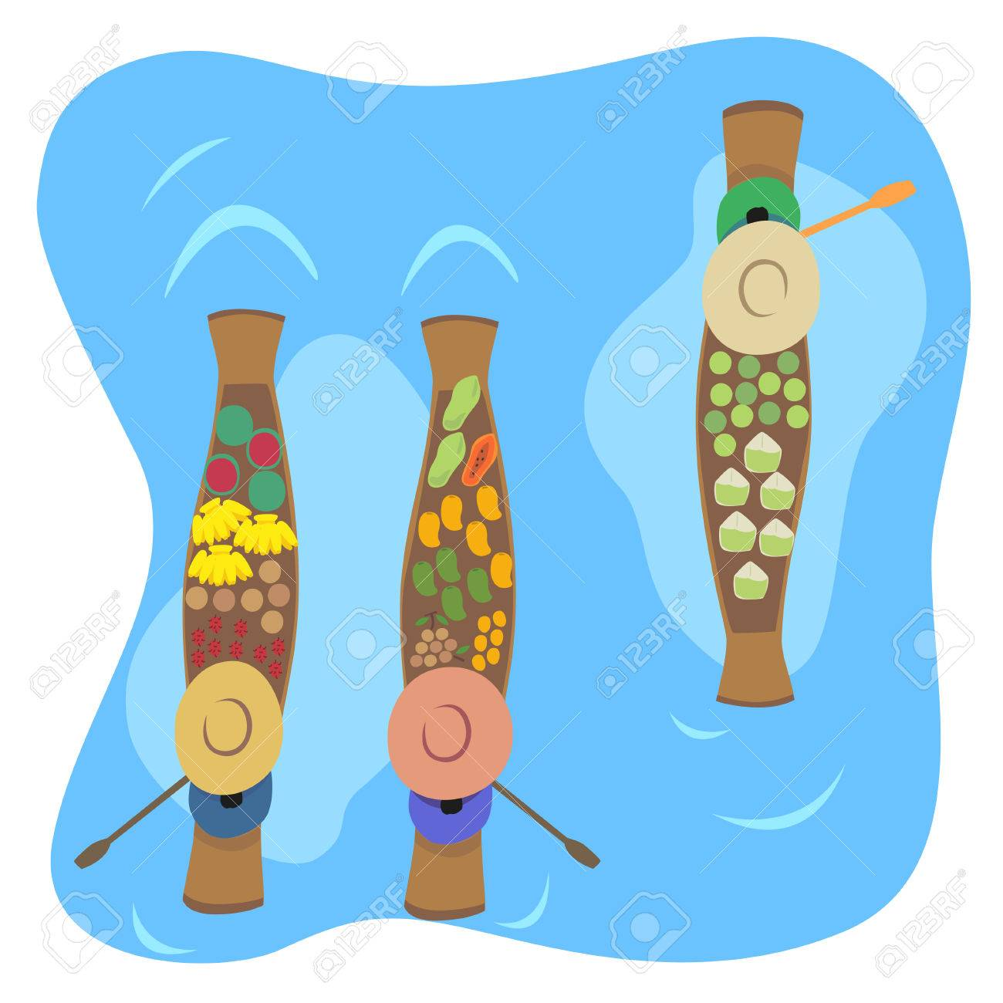
Answer the questions
Where is Lena?
Answer:
Lena is in Australia.

Slide 14
Answer the questions
2. What is Meruert doing?
Answer:
Meruert is windsurfing with her dad.

Slide 15
Answer the questions
3. Where is Ruslan?
Answer:
He is in Thailand.

Slide 16
Answer the questions
4. What is the weather like in Thailand?
Answer:
It's warm and sunny, but it's often cloudy and rainy.

Slide 17
Answer the questions
5. Where is Berik?
Answer:
Berik is at Shymbulak in the Zaili Alatau Mountains in Kazakhstan.

Slide 18
Answer the questions
6. What are Assel and Sanzhar doing?
Answer:
Assel and Sanzhar are skiing.

Slide 19
Answer the questions
7. What is the weather like in Shymbulak?
Answer:
It's freezing cold, but the sky is blue and the sun is shining.

Slide 20

Hometask
Imagine you are on holiday. Write where you are, what you do. Give details about the weather. Use words from today’s lesson.

Slide 21
In today’s lesson we’ve:
learnt new words
read the text “In all weathers”
answered the questions related to the text

