Slide 1
Destination
5 grade

Slide 2



In today’s lesson:
learn about new places to visit
describe holiday activities
talk about your holidays

Slide 3
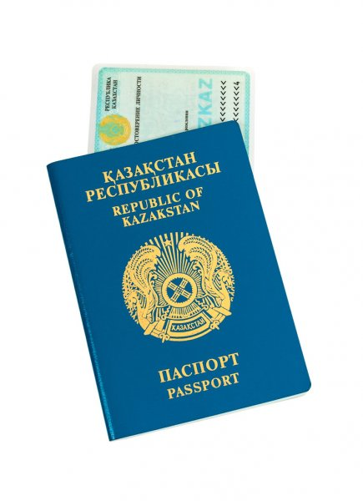
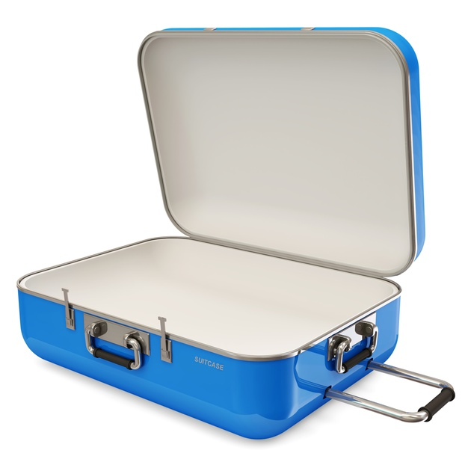

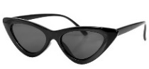
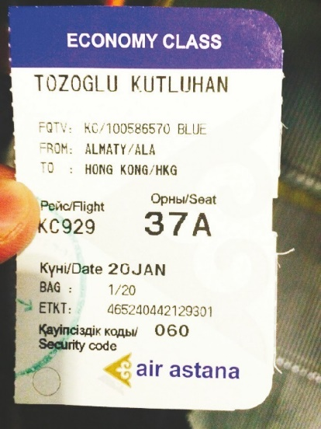
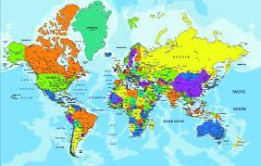



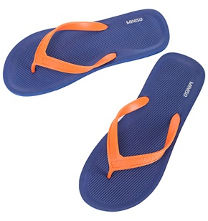
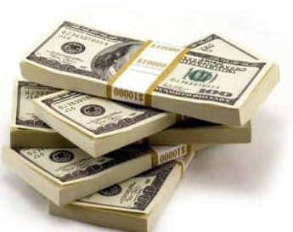


Let’s pack the suitcase
What do you need
for travelling?

Slide 4




What do you need
for travelling?

Slide 5

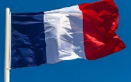



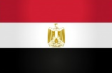

Where would you like to go?
I would like to go …
London
Paris

Slide 6


London is a capital of England.
Big Ben is not a popular clock.
There a lot of cinemas, museums and parks in London.
Madam Tussaud's Museum is in New York.
The population of Paris is 3,2 million.
You can see Eiffel tower in Paris.

Slide 7

Holiday activities
stay in a hotel
pack a bag
snorkel
go camping
take photos
play beach volleyball
make a sandcastle
go sightseeing
ride on a rollercoaster
write a postcard
have a picnic
row a boat

Slide 8
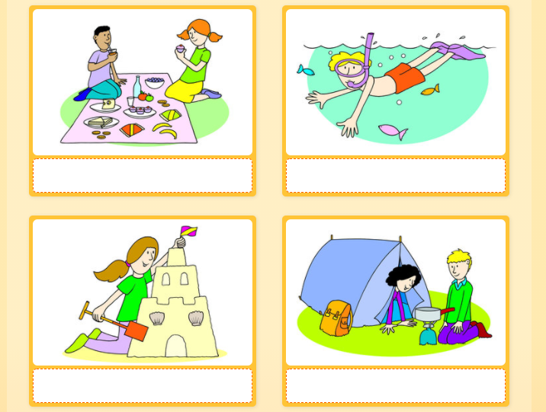
Match the word to the picture.
1.
2.
have a picnic
snorkel
make a sandcastle
go camping
3.
4.

Slide 9
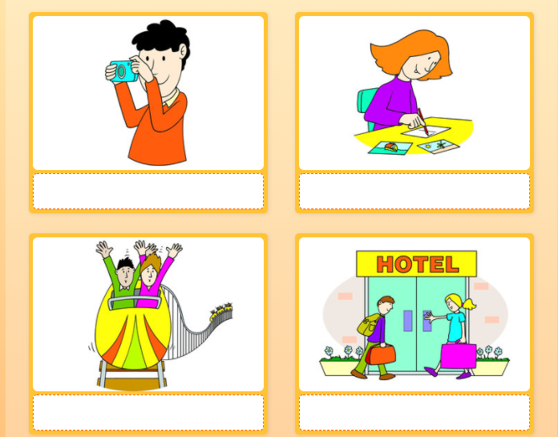
Match the word to the picture.
take photos
write a postcard
ride on a rollercoaster
stay in a hotel
1.
2.
3.
4.

Slide 10


Slide 11
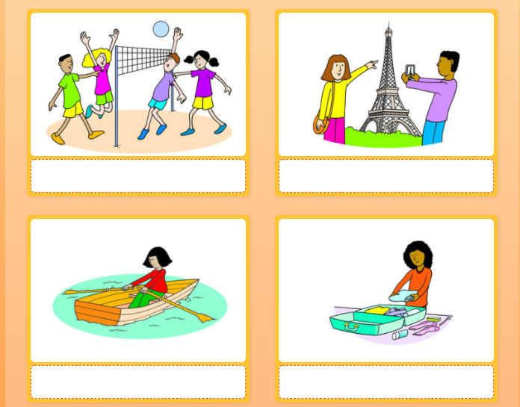
Match the word to the picture.
play beach volleyball
go sightseeing
row a boat
pack a bag
1.
2.
3
4.

Slide 12

What activities do you like doing when you are on holiday?
Do you like taking photos?
Can you swim?

Slide 13
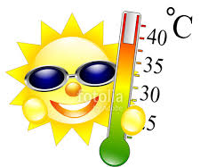

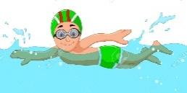


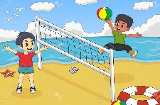

Complete the text with the correct words
My favourite season is . It’s very
in my country and people spend most mornings
at the beach. They go or row a . I
like but my brother prefers . At
weekends, we usually with family.
Summers are fun.

Slide 14

Home task
write a report about your last holiday.
describe the place, weather
write about activities people can do
tell why you like this place

Slide 15
In today’s lesson:
learnt about new places to visit
described holiday activities
talked about your holidays

Slide 17


Slide 18
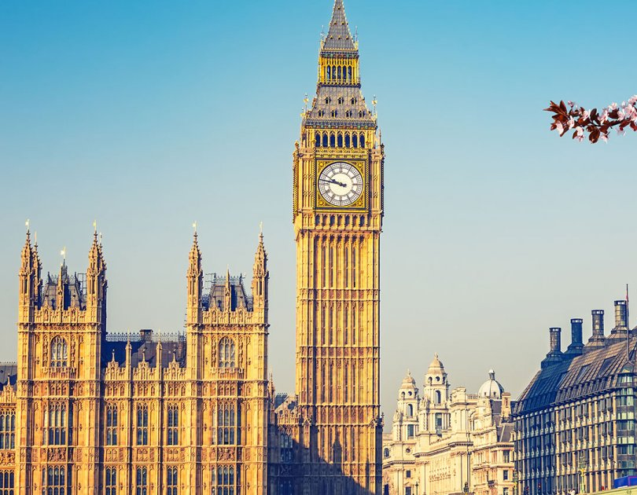
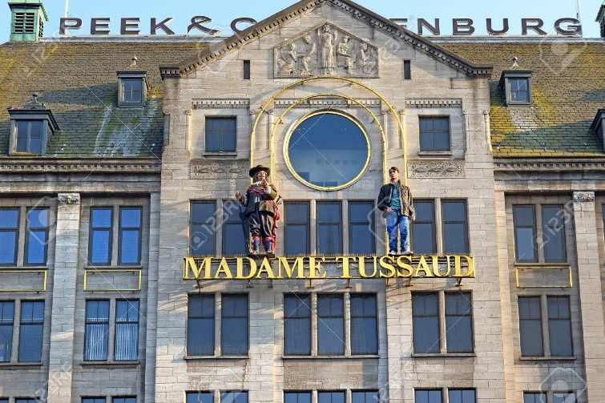
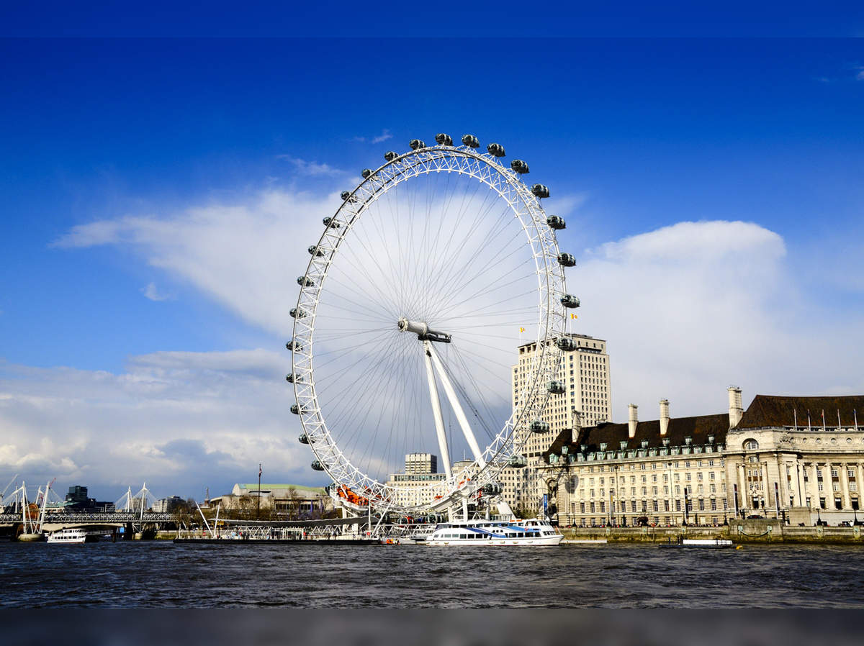
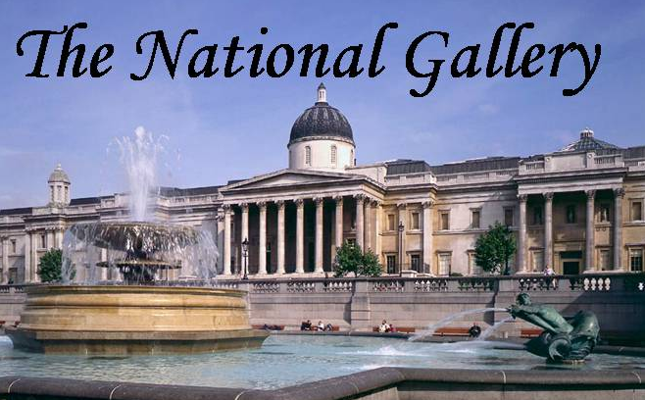
Big Ben
London eye
London is the capital of Great Britain. London is a beautiful city. There are many places of interest to visit in this city: cinemas, museums, libraries and parks. Big Ben is a popular clock. London Eye is the largest and the most beautiful wheel in the world. London National Gallery is one of the richest galleries in the world. Madam Tussaud's Museum is famous for its collection of waxworks. Everyone likes to visit London.

Slide 19
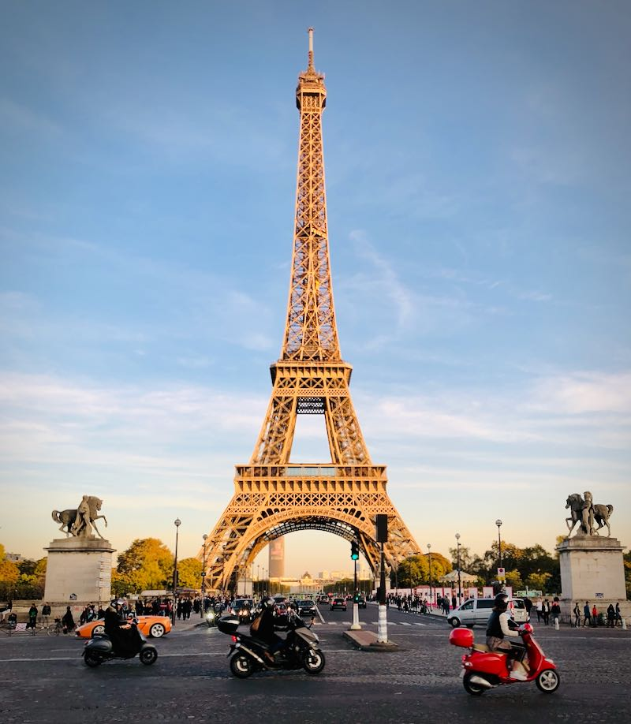
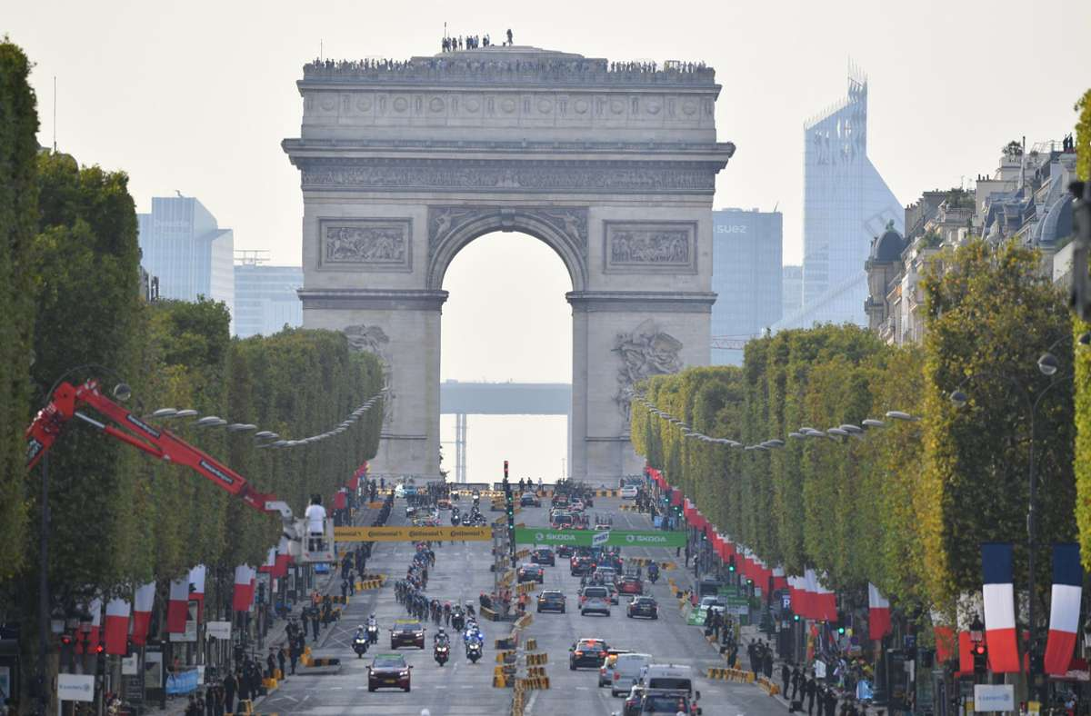
Arc de Triumph
Eiffel tower
Paris is the capital of France. It is a large city and has a population of 2,2 million. There are famous landmarks like Eiffel tower and the Arc de Triomphe. A lot of tourists come to Paris every year. You can walk in the parks and take pictures.

