Slide 1
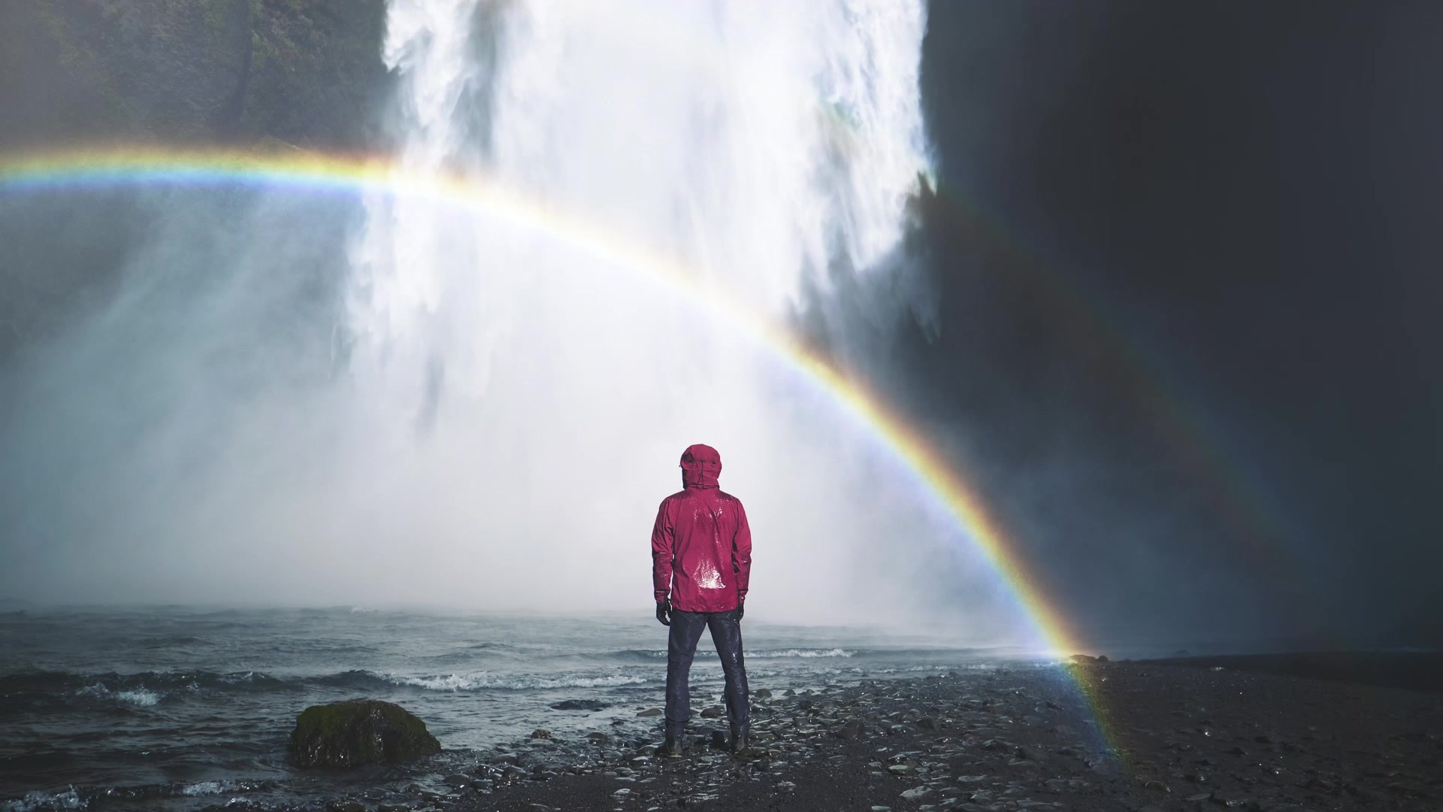
let’s go to the cinema!

Slide 2


What can you see in the photo ?
What are the teenagers doing?
Why are they laughing?
Where are they?

Slide 3
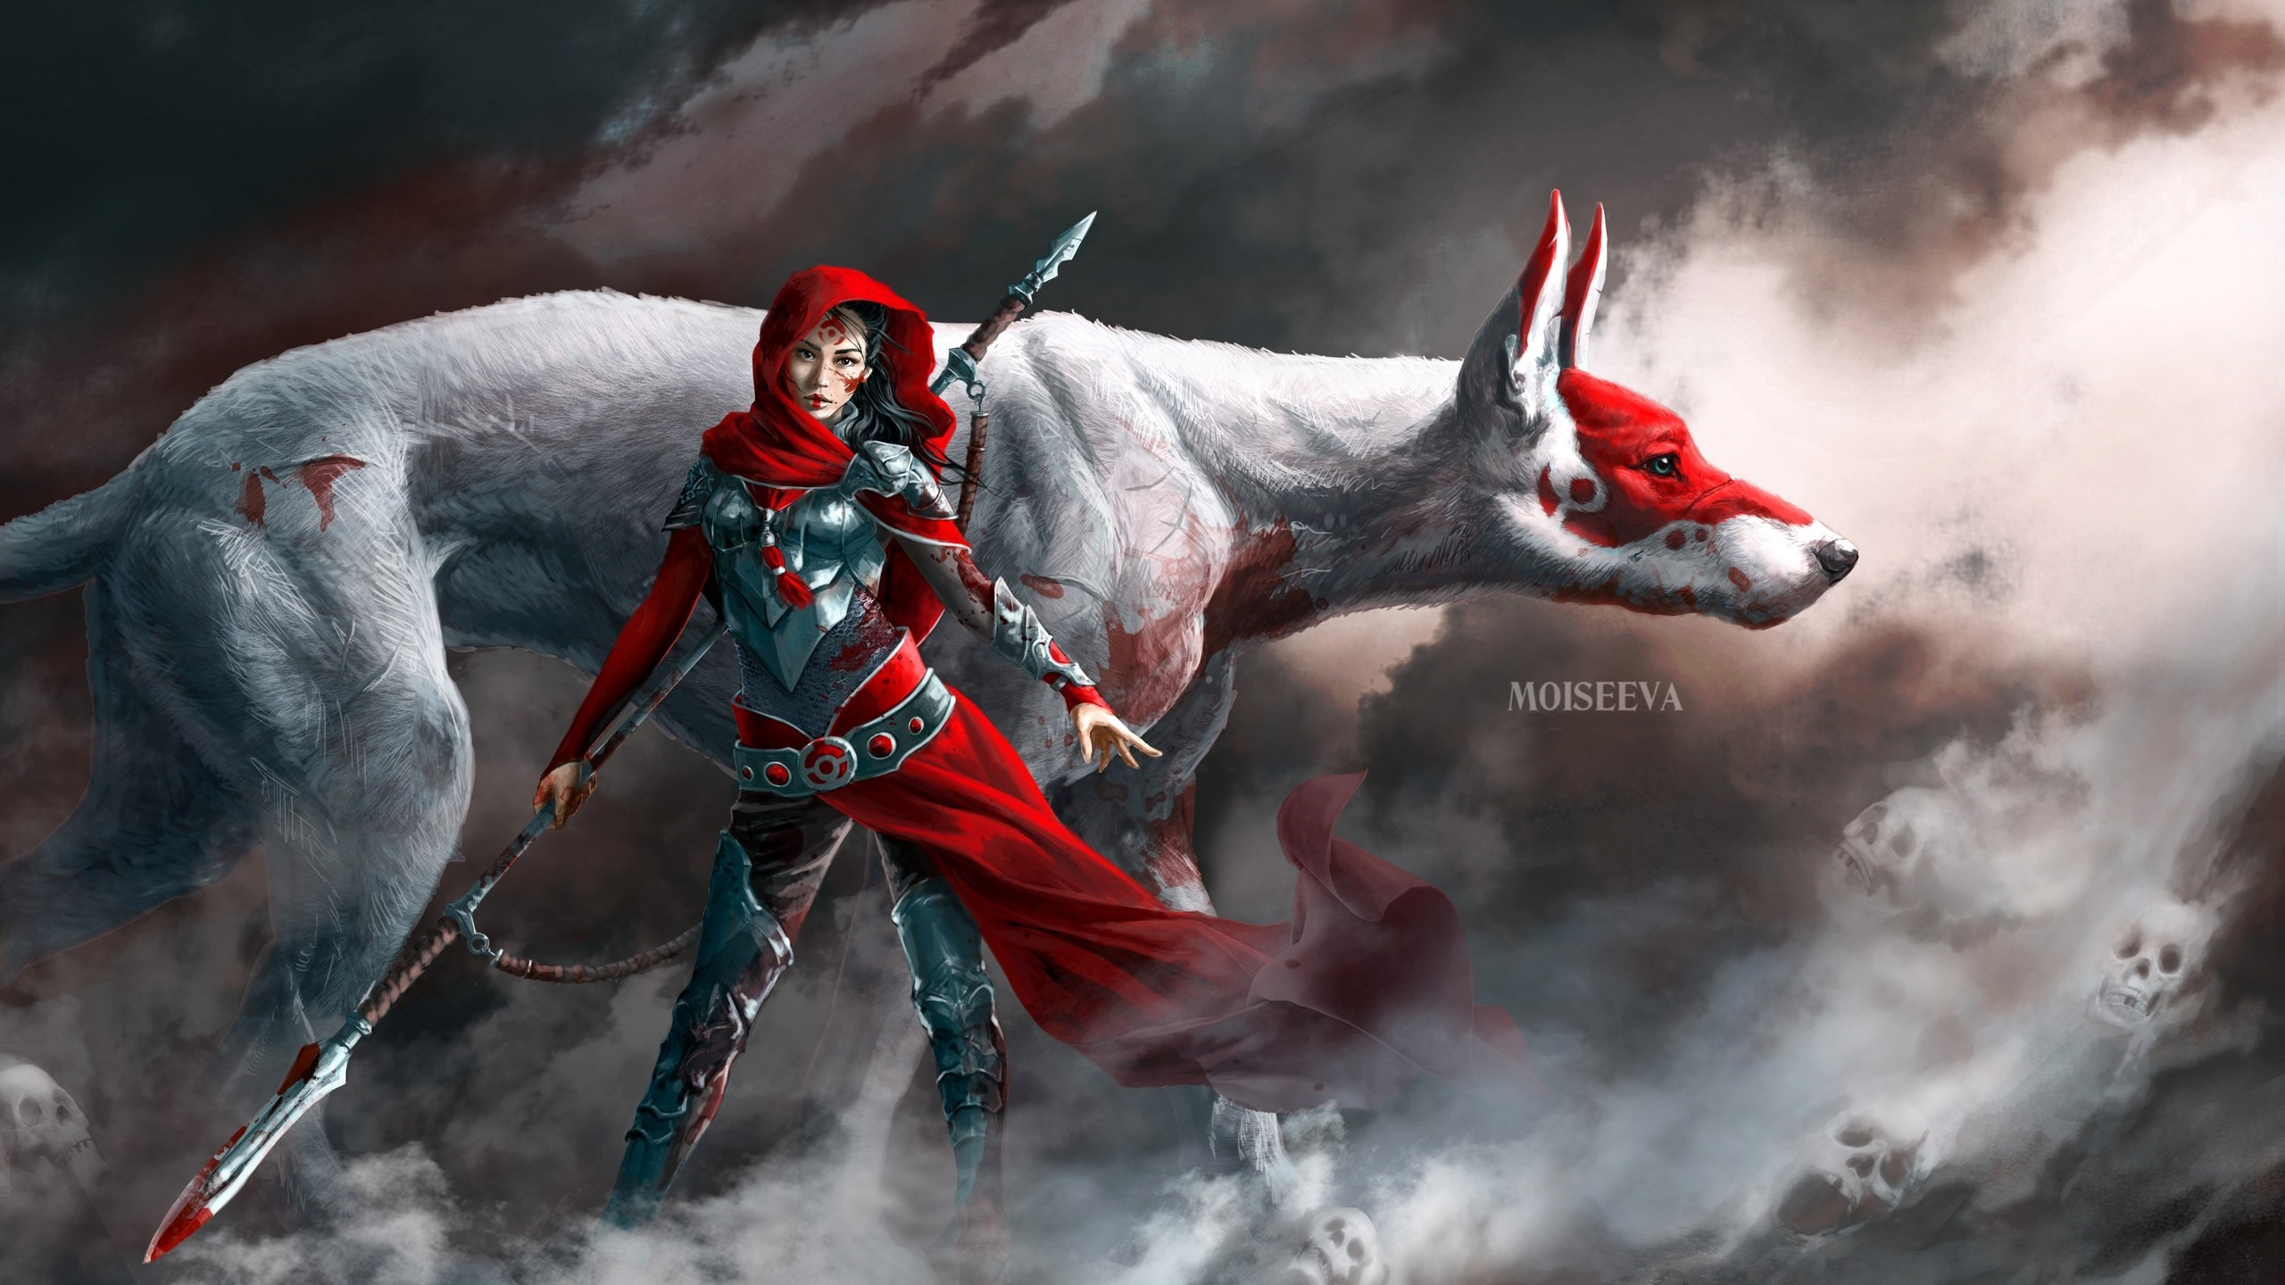
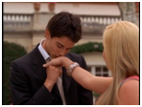


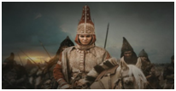
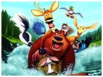
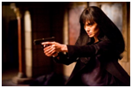
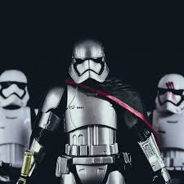
Match the genres with the pictures: western, comedy, science-fiction, documentary, fantasy, romance, thriller, action, historical drama, animation.

Slide 4
romance

Slide 5
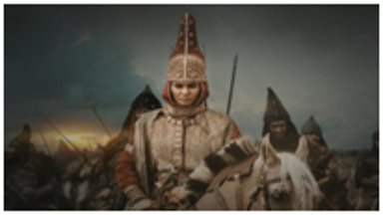
Historical drama

Slide 6

animation

Slide 7
Comedy

Slide 8
fantasy

Slide 9
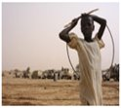
documentary

Slide 10

thriller

Slide 11
Science-fiction

Slide 12
Western
( extra word)

Slide 13
Fill the blanks with the words.
( frightening, comedy, boring, action, western, exciting, cartoon)
1. An -------------------- movie is a movie which with a lot of fighting and it can be violent.
2. A ------------------ is a movie which is funny and it make us laugh.
3. Chost movies are ------------------------- .
4. Adventures movies are ------------------------------- .
5. Romantic movies are sometimes ---------------------------- .
6. ----------------------------- is a movie about American cowboys usually riding horses quickly and wearing hats.
7. ----------------------------- is a movie with animations like Tom and Jerry

Slide 14
Right answers
1. An action movie is a movie which with a lot of fighting and it can be violent.
2. A comedy is a movie which is funny and it make us laugh.
3. Chost movies are frightening.
4. Adventures movies are exciting.
5. Romantic movies are sometimes boring.
6. Western is a movie about American
cowboys usually riding horses quickly and wearing hats.
7.Cartoon is a movie with animations like Tom and Jerry

Slide 15
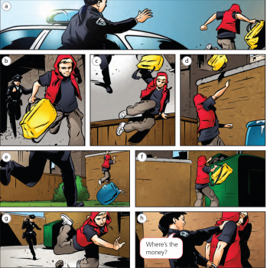
Ex 2 p 43. SB
Look at the story about the thief. What did the thief steal?
Match the pictures with the words in the box :
Catch chase climb hide fall over jump run away throw

Slide 16
Right answers
catch –h
fall over-g
chase -b jump -c
climb -e run away-a
hide -f throw-d

Slide 17
Ex 3, p 43. (SB)
Complete the sentences with the past simple form of the verbs in Exercise 2.
1 The thief ran away from our car.
2 I the thief.
3 The thief _____ into a garden.
4 The thief____his bag over a wall.
5 The thief _____over a wall.
6 The thief _____the bag.
7 The thief_____ .
8 I_____ the thief.

Slide 18
Right answers
1 The thief ran away from our car.
2 I chased the thief.
3 The thief jumped into a garden.
4 The thief threw his bag over a wall.
5 The thief climbed over a wall.
6 The thief hid the bag.
7 The thief fell over.
8 I caught the thief.

Slide 19

Bye!

