Slide 1
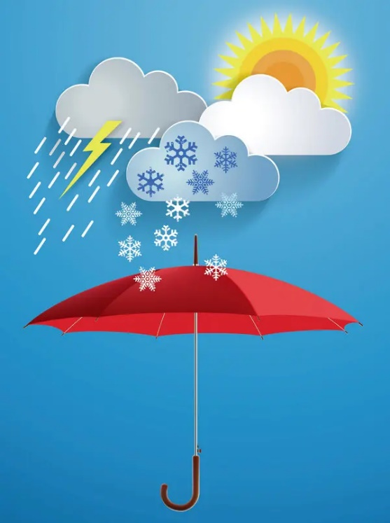
English. Grade:6
Theme: Learning about the weather and how to create a cloud

Slide 2
Learning objectives
6.2.5.1 understand most specific information and detail of supported,extended talk on a range general and curricular topics

Slide 3
Warm-up.
What is the weather like today? What is the weather like in your country in summer? What is the weather like in your country in winter? How often does it rain? What is your favourite season?

Slide 4
Brainstorming
Guess the riddles:
This season brings us the snow, it is always cold 2) This season brings us sunny days and rain, it is usually warm
3)This season brings us cold, fog. Days are shorter, nights are cool.
4)The sun shines. It is very hot

Slide 5
Weather types quiz
https://www.youtube.com/watch?v=pfKRatZYytU

Slide 6
Do you know any English proverbs connected with the weather?
For discussion.
1. After rain comes fair weather. 2. Rain at seven, fine at eleven. 3. There’s no bad weather, there are bad clothes 4. Into every life a little rain must fall. 5.Everything is good in it’s season

Slide 7
Complete the sentences with the correct word
Foggy, sunny, boiling, hot, raining, warm, snowing, chilly
It is 40 °outside. It is _____. It is ______.take your umbrella. It is so ____ I can not see. Look! It is ______. Lets make a snowman. It is hot and ___ today. Lets go to the beach. John is wearing a jacket because it is ____ outside We are not going swimming today because it is not very_____
Answers: 1)boiling 2)raining 3)foggy 4)snowing 5) sunny 6)chilly 7)warm

Slide 8
Make a story about your favourite season Our favourite season is … The months of this season are … We can see (there are) in … The sky is … The sun is … The weather is … People can … in …
The temperature is something like …centigrade above(below) zero

Slide 9
Cities | Weather | Temperature
Amsterdam Moscow St.Petersburg Washington Helsenki Canberra Wellington Ottawa Tokyo |  | +6 -1 0 +13 +10 +23 +28 +4 +20

Slide 10
Cities | Weather | Temperature
Amsterdam Moscow St.Petersburg Washington Helsenki Canberra Wellington Ottawa Tokyo | Cool, wet Sunny, cloudy Cloudy,windy Dry, warm Sunny,dry Wet ,hot Sunny ,cloudy Stormy, windy Cloudy, dry | +6 -1 0 +13 +10 +23 +28 +4 +20

Slide 11
Now read the definition of the words and write them.
a strong, dangerous wind which moves across the ground (t……) a long period without rain (d..) (of weather) characterized by strong winds and usually rain, thunder, lightning (s…..) Cloudy air near the ground which is difficult to see through (f….) Weather the temperature falls to 0 below (f…..) When it rains a lot (w..t) Having a lot of light from the sun (s….)
1)Tornado 2) dry 3) stormy 4)foggy 5)freeze 6) wet 7)sunny

Slide 12
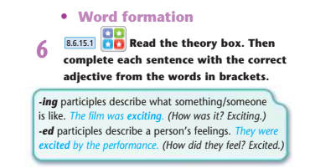
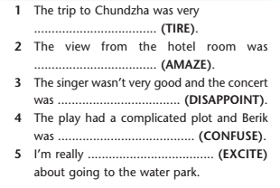

Slide 13

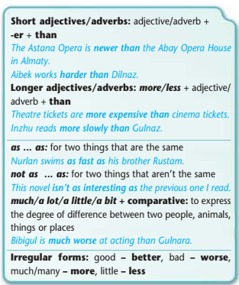

Slide 14
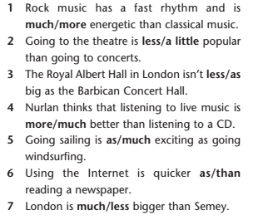
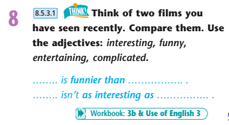

Slide 15



Slide 16

Workbook 3b

