Slide 1
English. Grade:6
Theme: Descriptive language to create an atmosphere.

Slide 2
Learning objectives
6.4.2.1 understand independently specific information and detail in short, simple texts on a limited range of general and curricular topics

Slide 3
Warm-up
Brainstorming What is the most beautiful place in Kazakhstan? What do you know about National Nature Park Burabai? And have you been in there? What do you say about Burabai’s atmosphere?

Slide 4
New Words
pearl |pɜːrl|- інжу, маржан
National Nature Park - Ұлттық табиғат саябағы
area [ˈerɪə] - аудан, аймақ
camping [ˈkæmpɪŋ| - лагерь
sightseeing [saɪtsiːɪŋ] – көрікті жерлер
trip [trɪp] - саяхат

Slide 5
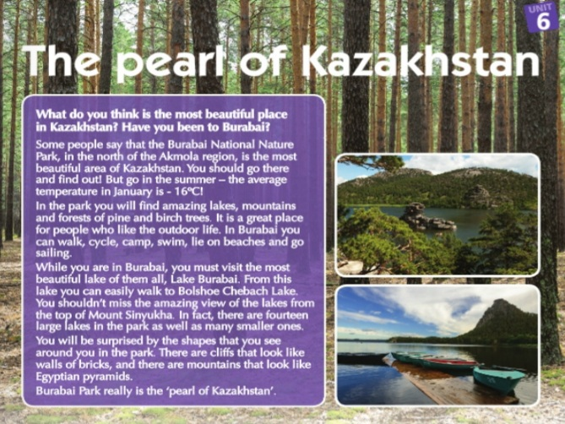
Reading text: The pearl of Kazakhstan.

Slide 6
Read the text and answer the questions.
Why shouldn’t you go to Burabai in the winter? 2. What trees grow in the forests of Burabai? 3. What can you see from Mount Sinukha? A pearl is a beautiful, expensive piece of jewellery. Why do you think people call Burabai the pearl of Kazakhstan.
(Answers: Student’s own answers)

Slide 7
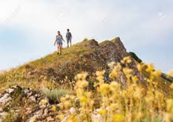
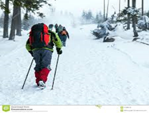
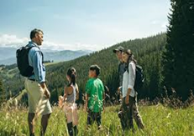
3. Look at the photos. Where are the people? What are they doing? And how is the weather there?

Slide 8
Answers
- The people in each photo are camping and the photos show the mountains and in the forest in Burabai.
- They are walking, skating and camping.
- Weather is warm, cold and hot.

Slide 9
4.Vocabulary. On holiday. Complete the sentences with these words: sunny, stove, year, swimming, rucksack, sleeping bag, torch, pasta, food, bus
The weather will be ____ at the weekend. Tim went camping in the mountains last ____ . Lucy is going ___ in the sea. They are going to cook some ___ . Lucy has got a tent and a small ___ . Jake is going to make some ___ . They are going to travel by ___ . Jon is going to take a ____ , a ____ , and a ____

Slide 10
1 sunny. 2 year, 3 swimming, 4 food, 5 stove, 6 pasta, 7 bus, 8 rucksack, sleeping bag, torch.
Answers

Slide 11
Feedback
Name 3 things:
I have learnt…
I still want to know…
I didn’t understand
Doing task: Write an email about favourite film.

