Slide 1



Slide 2
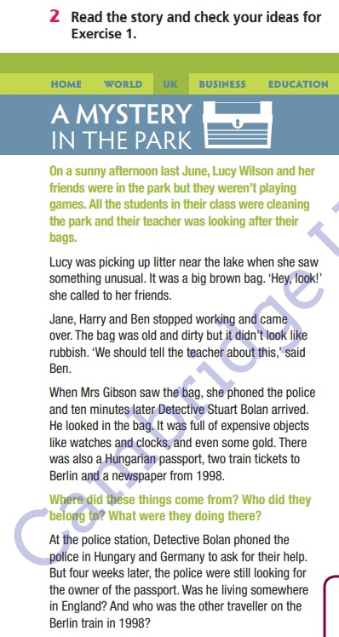
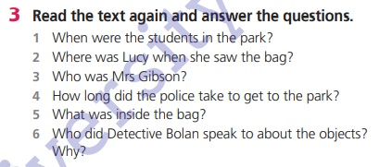

Slide 3
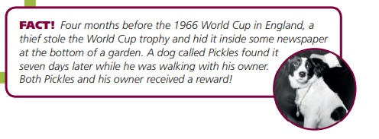

Slide 4
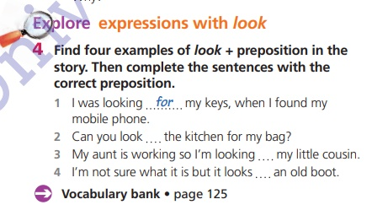

Slide 5
Answers
1 - look for
2 - look in
3 - look after
4 - look like

Slide 6



Slide 7

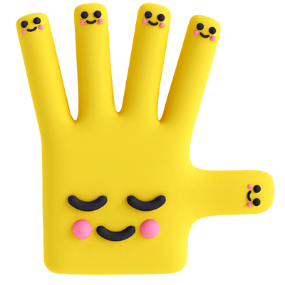
Bye!

