Slide 1
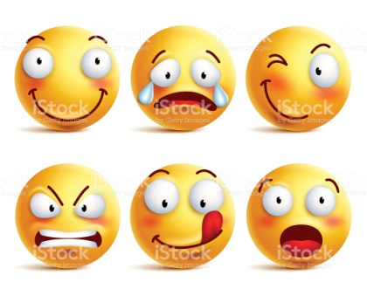
How are you today?
How are you today?

Slide 2
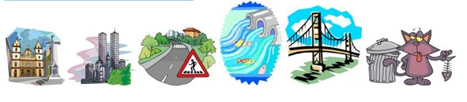
Warm-up “A Five Minute Activity”(I). Free talk about the Past. Give only Past simple, past continuous

Slide 3
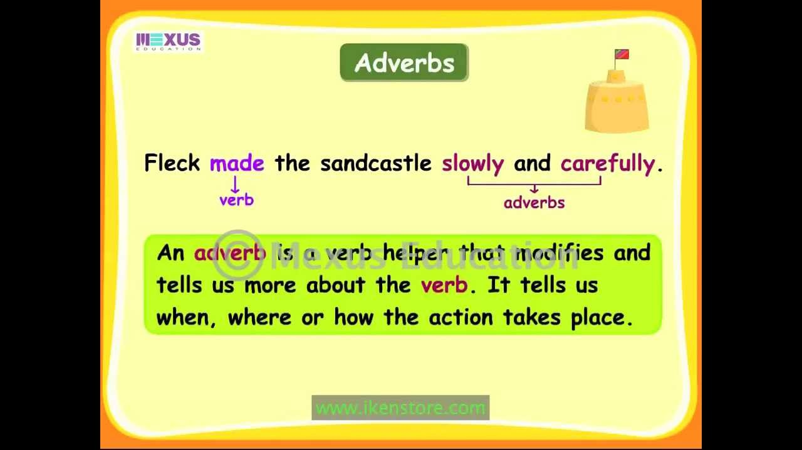

Slide 4
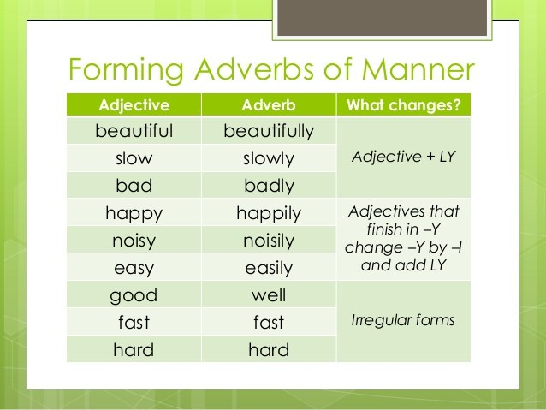

Slide 5
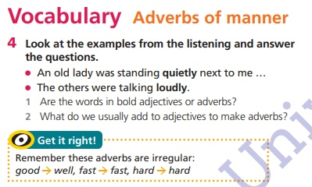

Slide 6
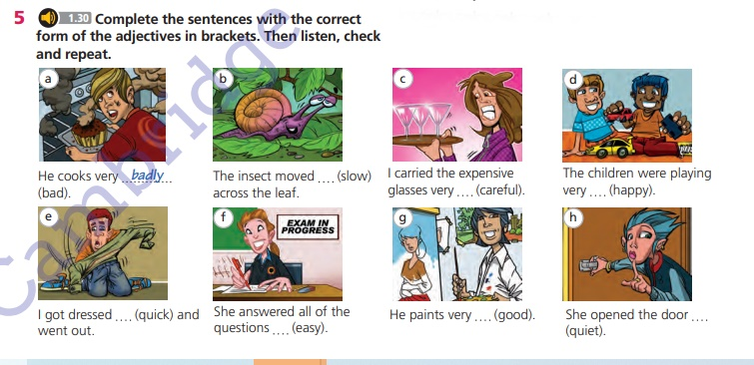

Slide 7
Answers
a – badly
b – slowly
c – carefully
d – happily
e – quickly
f – easily
g - well
h - quietly

Slide 8
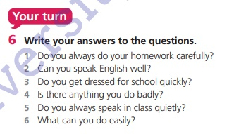

Slide 9

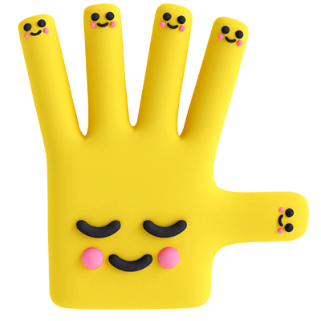
Bye!

