Slide 1
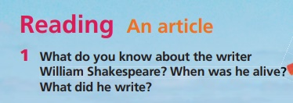
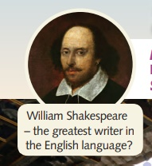
How are you today?

Slide 2
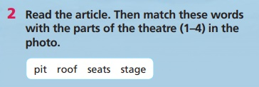

Slide 3
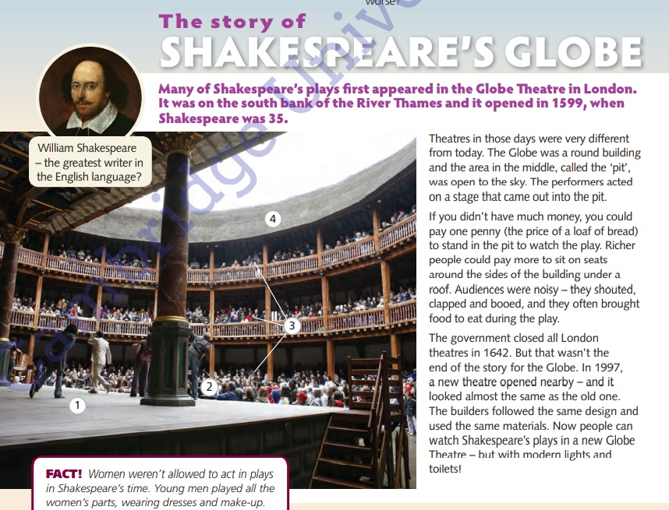

Slide 4
Answers
1 – stage
2 – pit
3 – seats
4 – roof

Slide 5
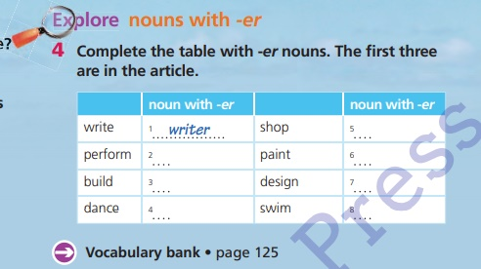

Slide 6
Answers
1 – writer
2 – performer
3 – builder
4 – dancer
5 – shopper
6 – painter
7 - designer
8 - swimmer

Slide 7
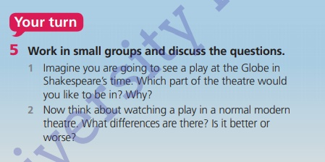

Slide 8

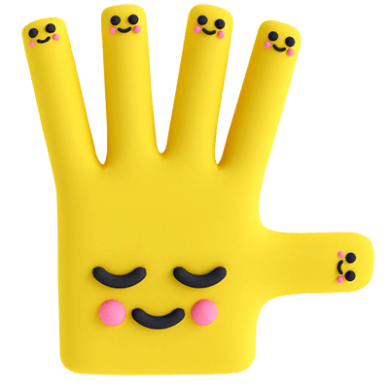
Bye!

