Slide 1
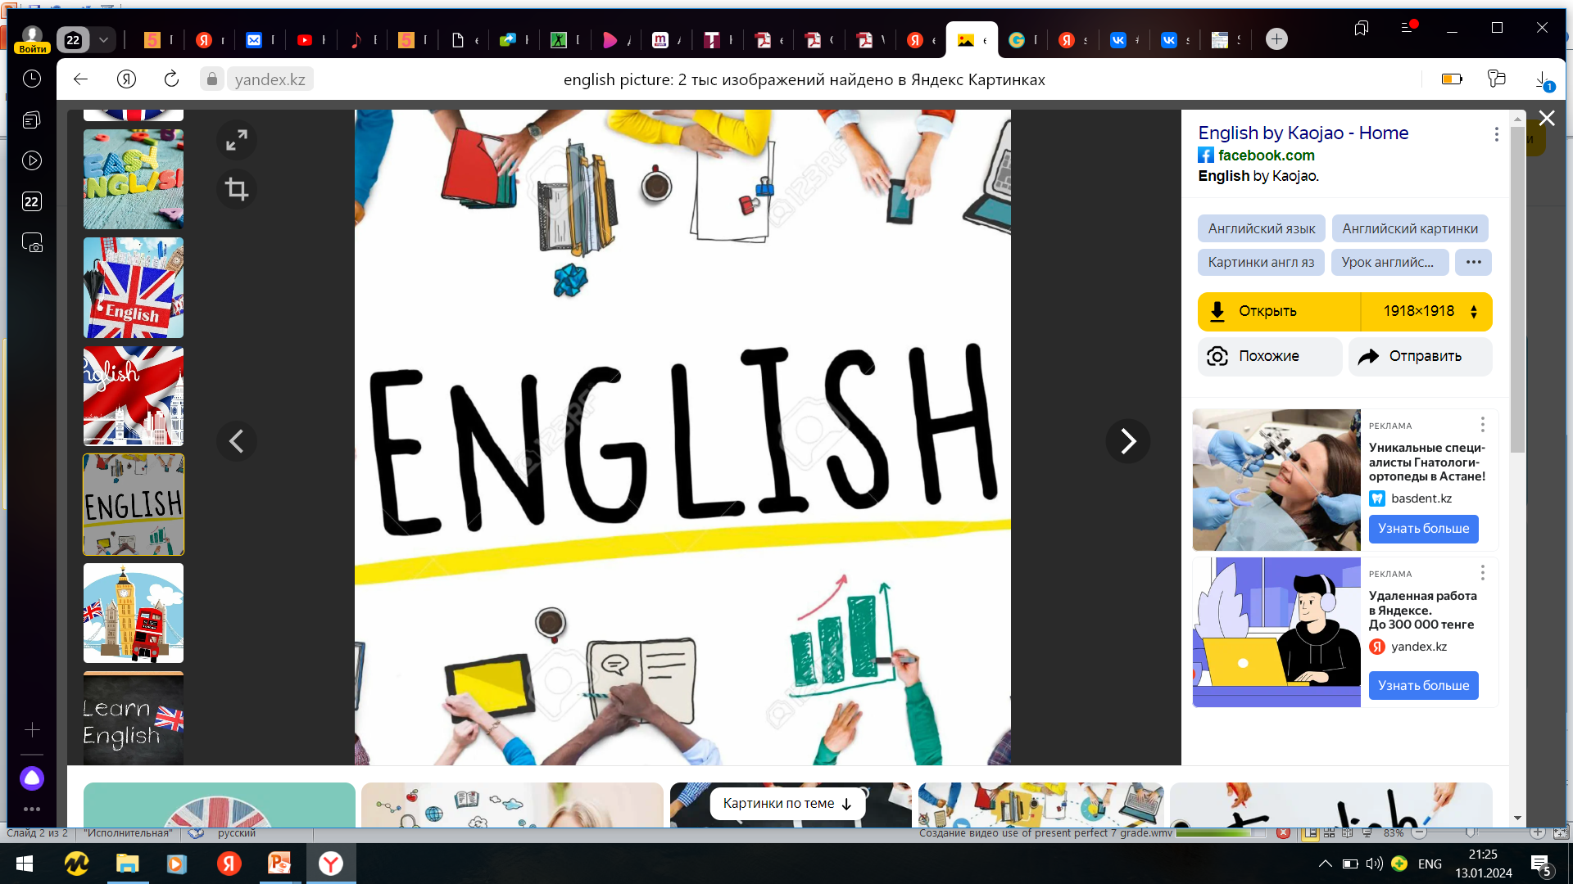
Subject: English language
Grade: 6
The theme of the lesson: Shops

Slide 2
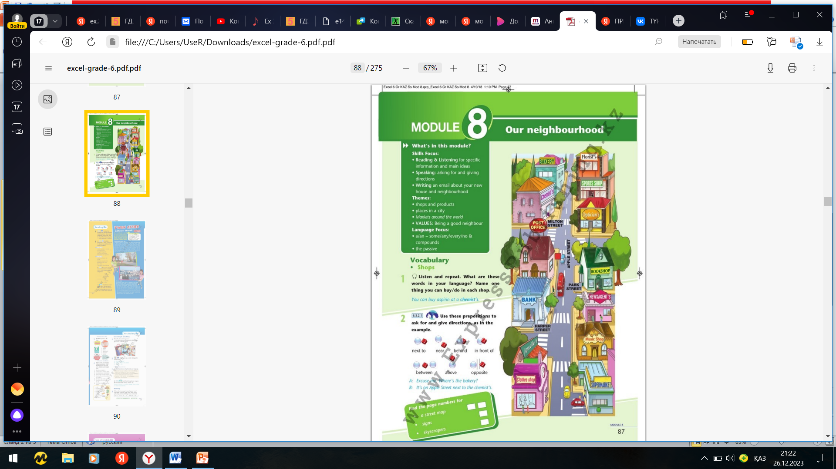
Module 8
Our neighbourhood

Slide 3

New words
Bakery – наубайхана
Florist`s – гүл дүкені
Chemist`s – дәріхана
Sports shop – спорт дүкені
Optician`s – оптика
Post office – пошта
Bookshop – кітап дүкені
Bank – банк
Jeweller`s – зергерлік дүкені
Music shop – музыка дүкені
Clothes shop – киім дүкені
Supermarket – супермаркет

Slide 4
Preposition
A preposition is a word that we use before noun, pronoun, or noun phrase. Such a word shows the relation of nouns, pronouns, noun phrases with other words in the sentence. So, the proposition is defined as a word showing the relation of nouns, pronouns, or noun phrases with other words in a sentence. When do we use prepositions in English? We use prepositions in English when we have to show the relationship between more places, things, or people.
Here are some examples.
A rabbit slept under a tree.
The boys are playing on the ground.

Slide 5

How do you use prepositions correctly?
There is no particular rule to use the preposition. Sometimes there might be confusion as in the native language, there might be several meanings of prepositions used in the sentences according to their uses.
We use a preposition to show-
position
direction
time
to introduce an object.
Prepositions- place (position)
We can use a preposition to show the position of an object that is where it is placed– on the surface, inside something, or another position. We can see some common prepositions of position in the sentences given below.
In front of: She stood in front of a hardware store.
In: I kept my lunch box in the kitchen.
On: Your book is on the table.

Slide 6
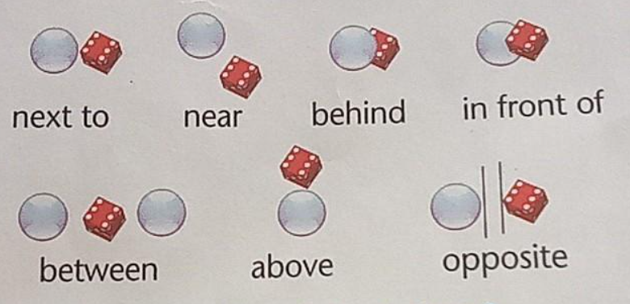
Preposition of place and movement
Орын демеуліктері
жанында
жанында
қасында
артында
алдында
арасында
ортасында
жоғарыда
қарама – қарсы

Slide 7
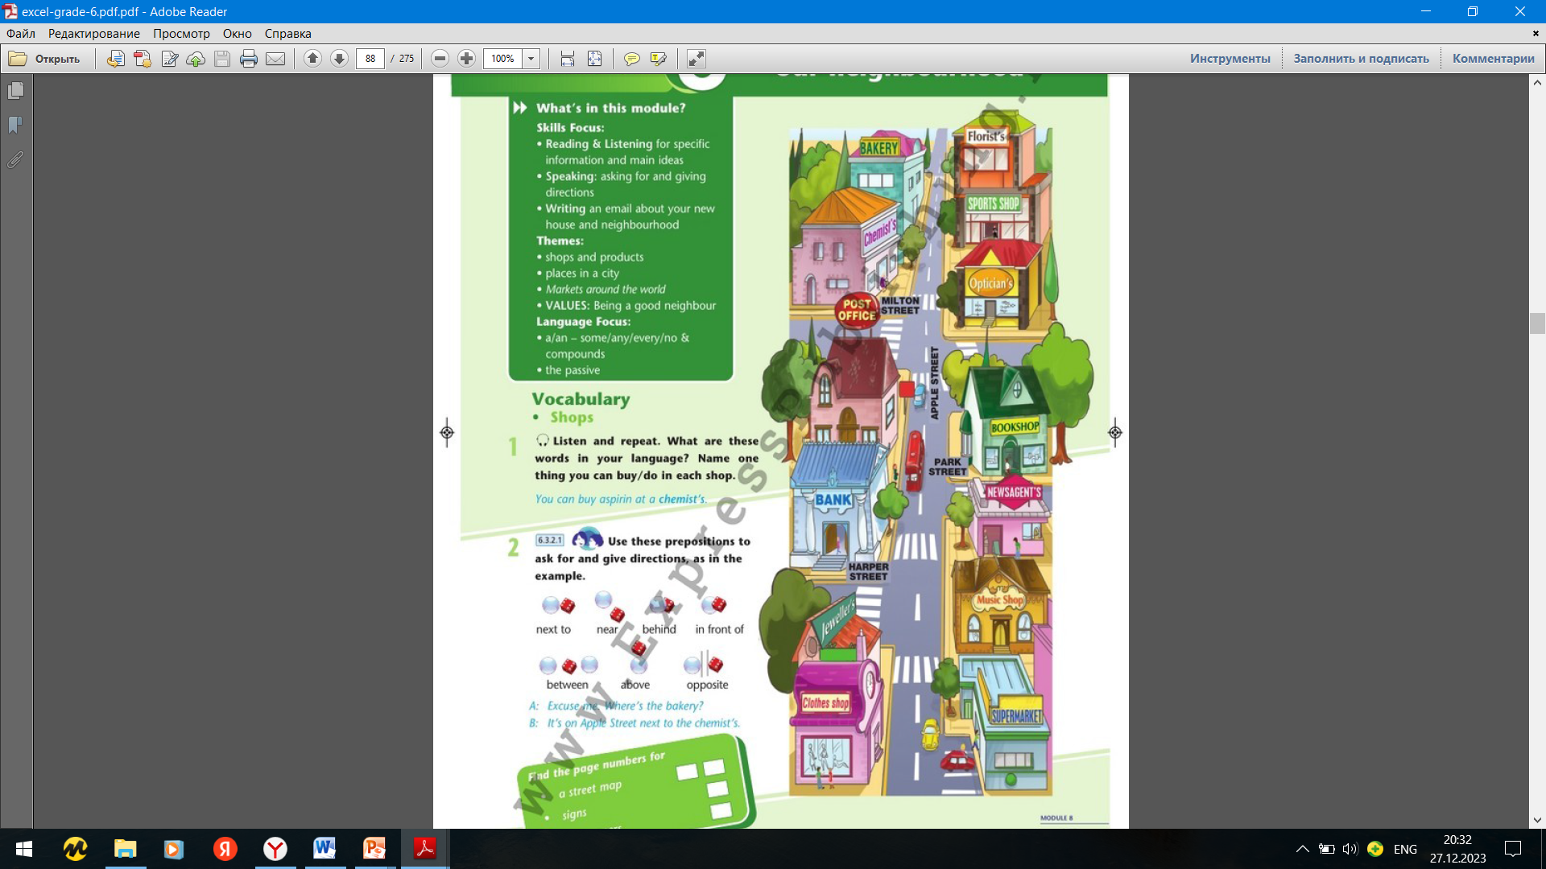
Ex.1,p.87
Listen and repeat. Where are these words in your language? Name one thing you can buy/do in each shop.
You can buy aspirin at a chemist`s.
You can buy bread at a bakery.
You can buy flowers at a florist`s.
You can buy stamps at a post office.
You can buy football shoes at a sports shop.
You can buy food at a supermarket.
You can buy books at a bookshop.

Slide 8
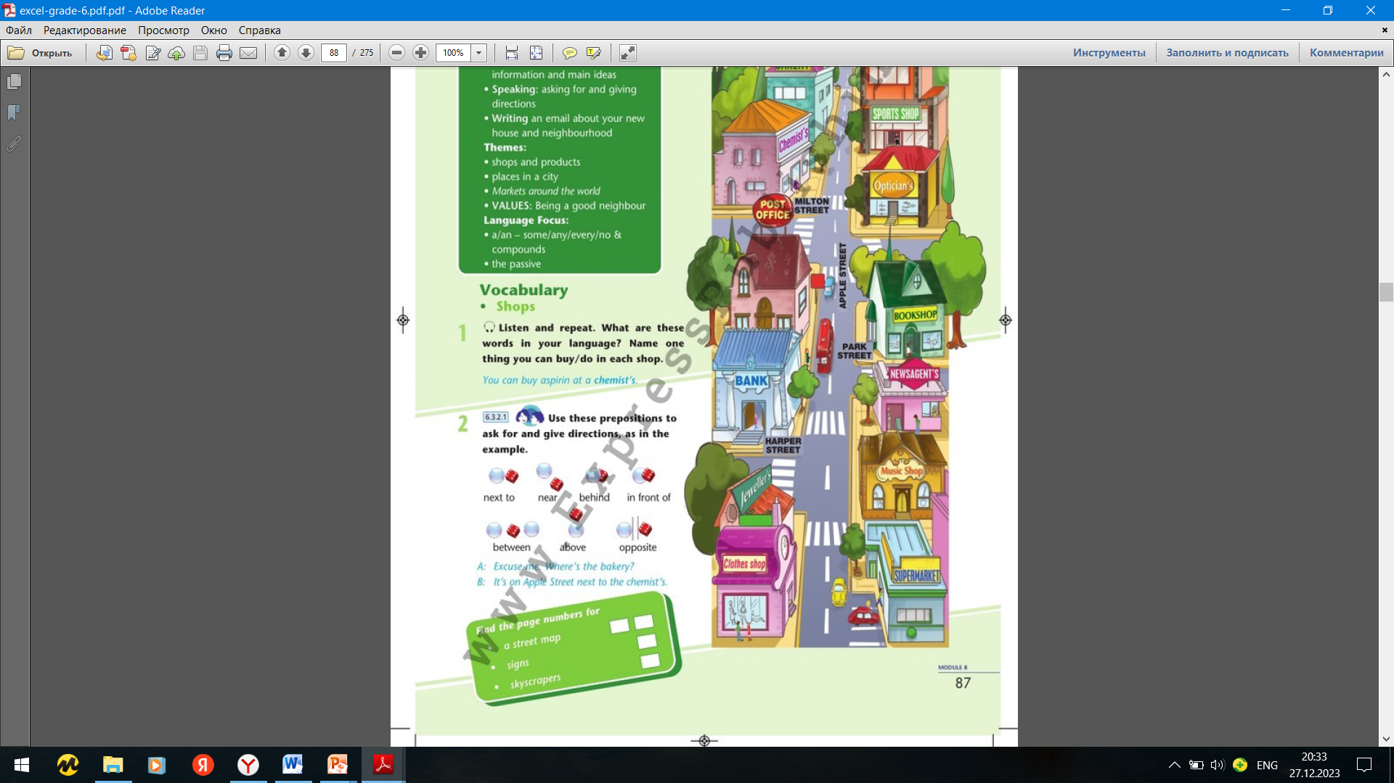
Ex.2,p.87
Use these prepositions to ask for and give directions, as in the example.
A: Excuse me. Where`s clothes shop?
B: It`s on Apple street next to the jeweller`s.
A: Excuse me. Where`s optician`s?
B: It`s on the Milton street in front of the sports shop.
A: Excuse me. Where`s music shop?
B: It`s on Apple street between the supermarket and the newsagent`s.
A: Excuse me. Where`s bank?
B: It`s on Harper street opposite the jeweller`s.

Slide 9
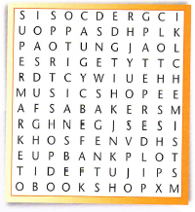
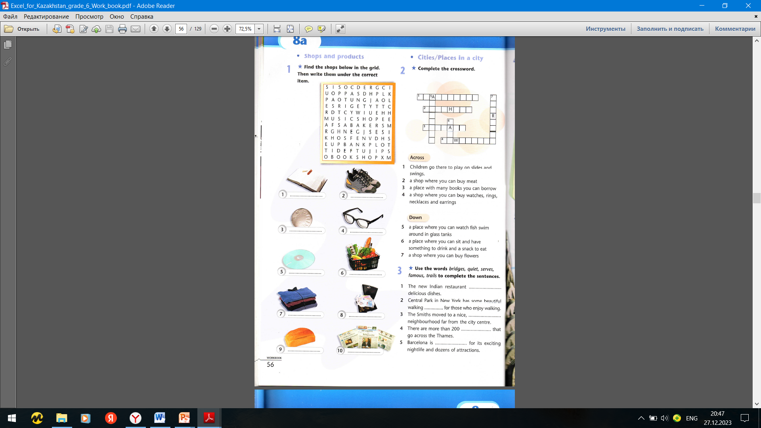
Ex.1,p.56 Workbook
Find the shops below in the grid. Then write under the correct item.
bookshop
sports shop
post office
optician`s
music shop
supermarket
clothes shop
jeweller`s
bakery
newsagent`s

Slide 10


