Slide 1
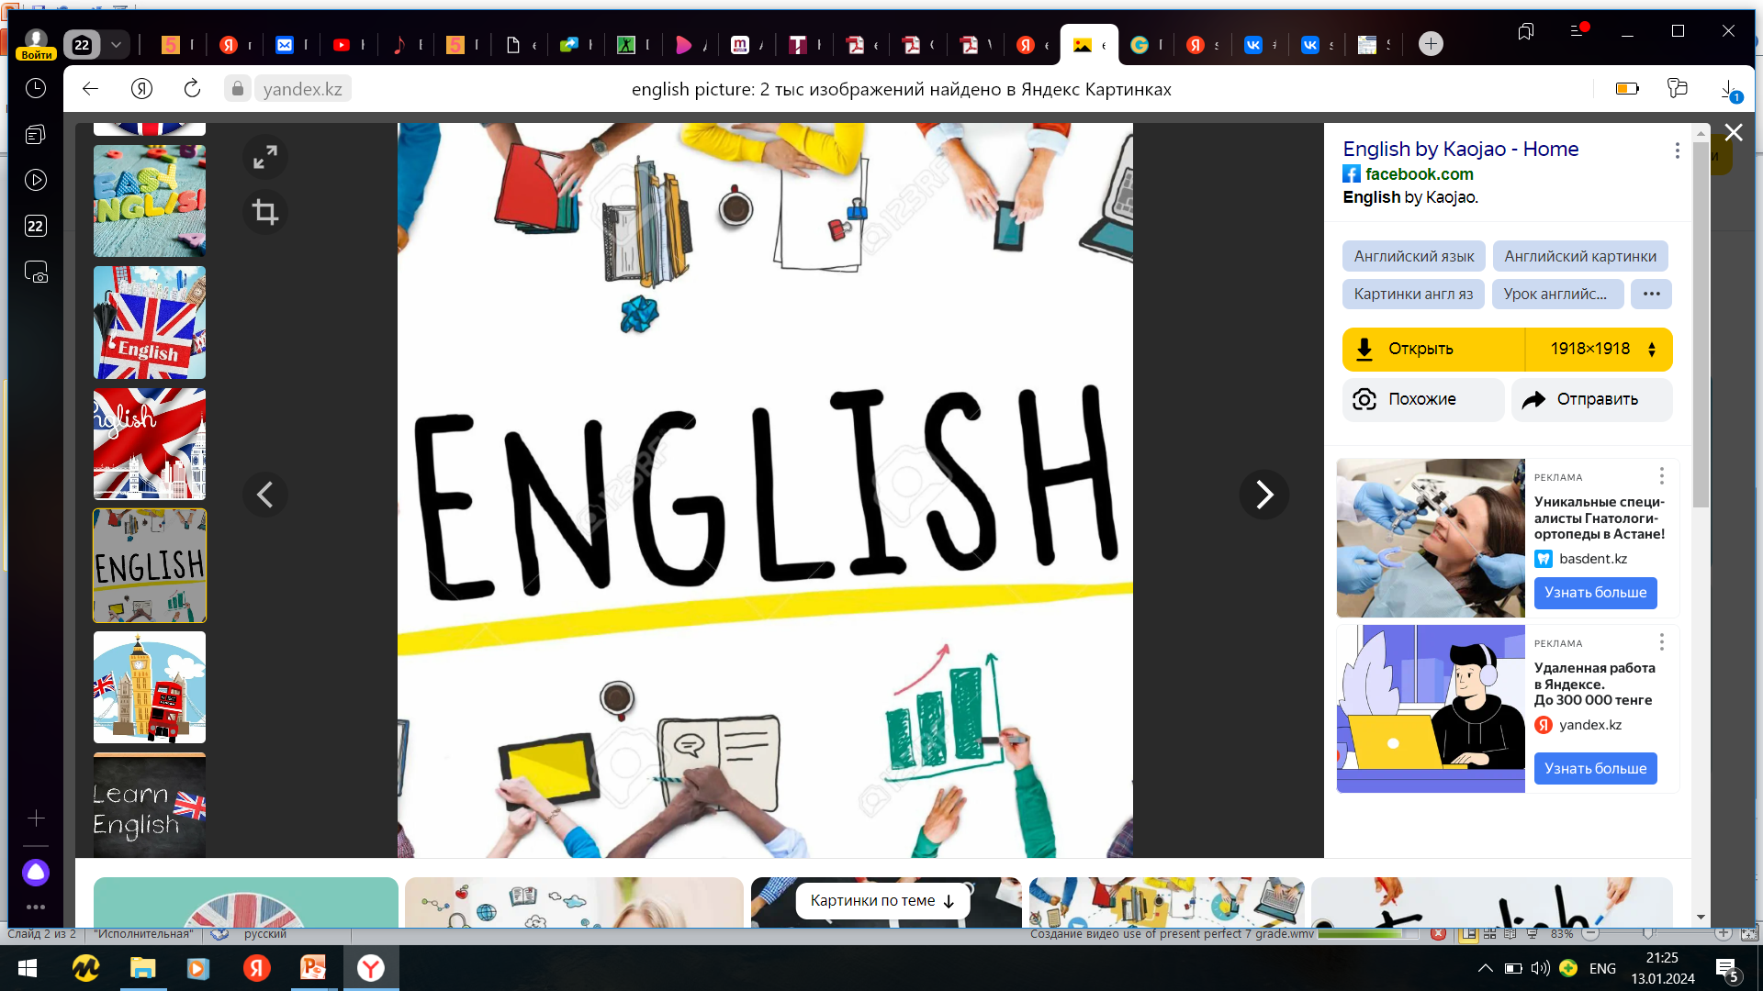
Subject: English language
Grade: 6
The theme of the lesson: Twin cities different world

Slide 2
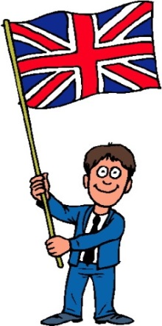
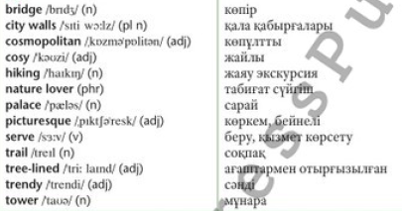
New words

Slide 3
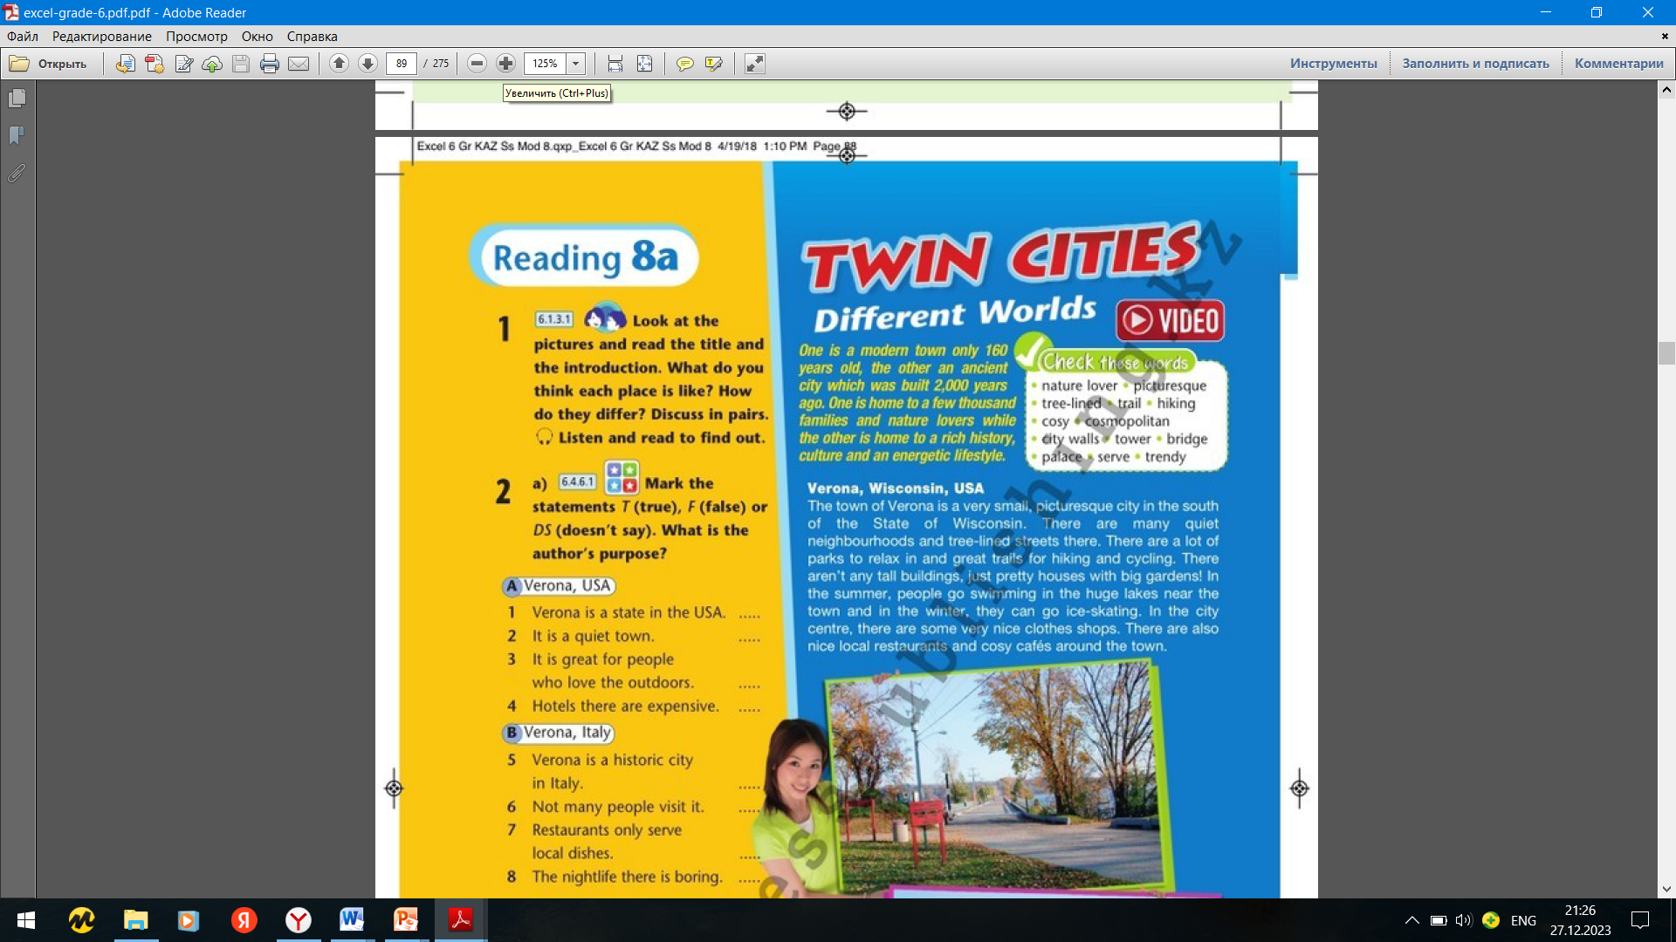
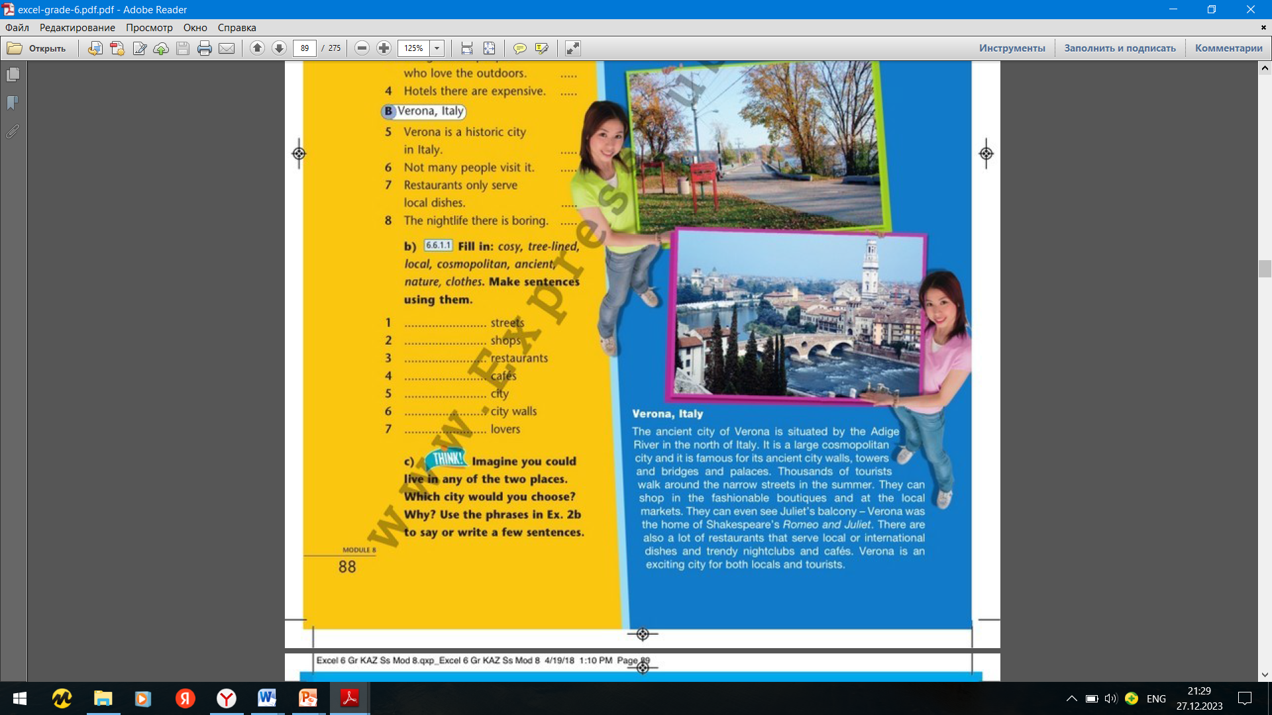
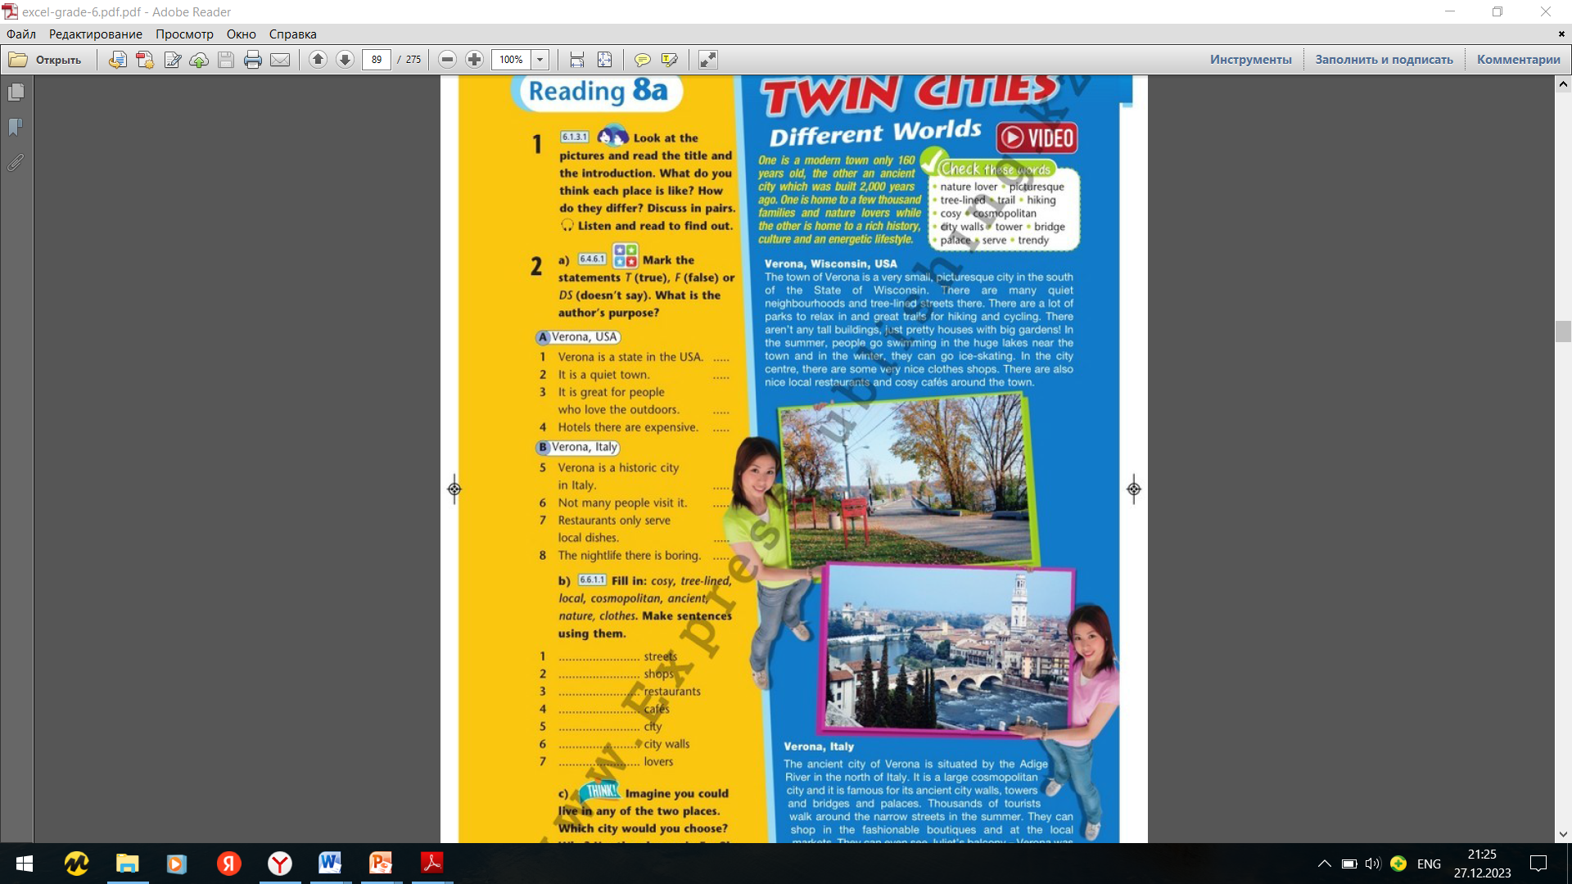
Ex.1,p.88
Look at the pictures and read the title and the introduction. What do you think each place is like? How do they differ? Discuss in pairs. Listen and read to find out.
Verona , Italy is large and cosmopolitan.
Verona, USA is small and quiet.

Slide 4
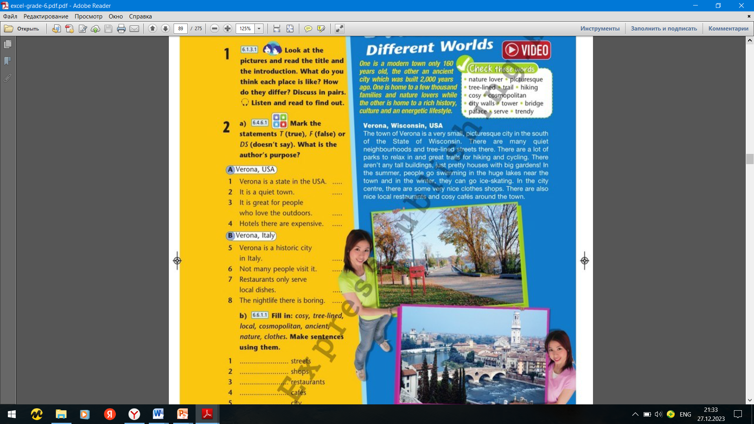
Ex.2,p.88
Mark the statements T (true), F (false) or DS (doesn`t say). What is the author`s purpose?
F
T
T
DS
The author`s purpose is to inform readers about two cities with the same name that are very different.
T
F
F
F

Slide 5
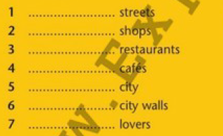
Ex.2,p.88 b) Fill in: cosy, tree-lined, local, cosmopolitan, ancient, nature, clothes. Make sentences using them.
tree - lined
clothes
local
cosy
cosmopolitan
ancient
nature

Slide 6
Ex.2,p.88 c) Imagine you could live in any of the two places. Which city would you choose? Why? Use the phrases in Ex.2b to say or write a few sentences.
Verona, USA is quiet but Verona, Italy is busy. Verona, USA has a lot of parks and tree – lined streets, but Verona, Italy has a lot of towers, bridges and palaces. Verona, USA is for nature lovers, but Verona, Italy is a cosmopolitan city. Verona, USA is a modern city, but Verona, Italy has still got its ancient city walls. Both cities have nice clothes shops and local restaurants. Not many people live in Verona, USA, but a lot of people live in Verona, Italy and thousands of tourists visit every year. I would live in Verona, USA , because I like quiet neighbourhoods. It would be nice to be close to nature./I would live in Verona, Italy because I like big cities. It would be nice to have an exciting lifestyle.

Slide 7
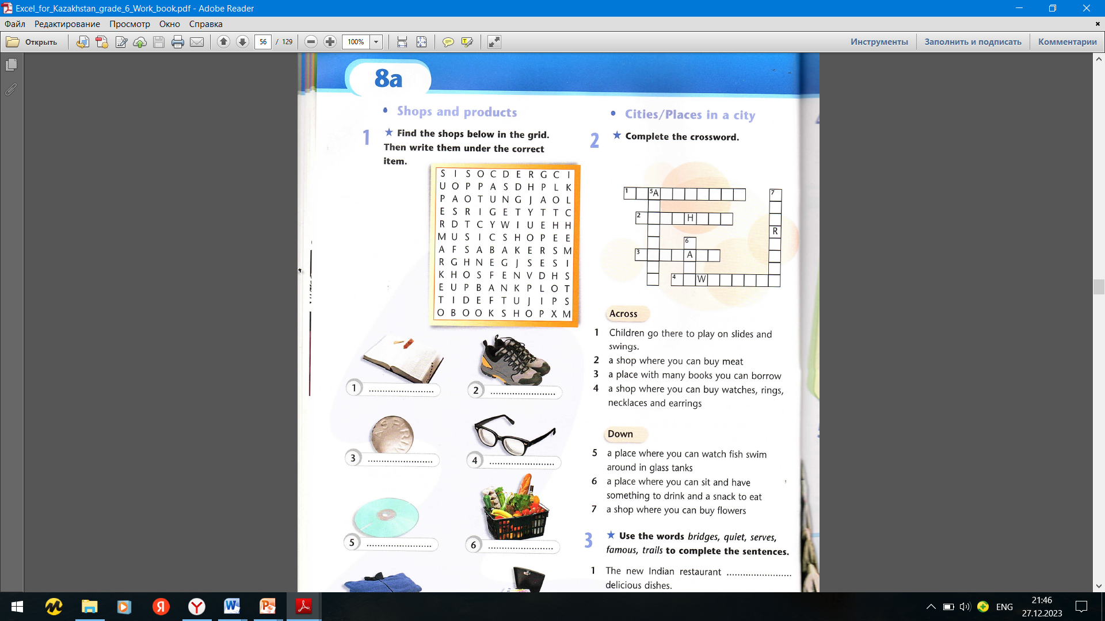
Ex.2,p.56 Workbook
Complete the crossword.
p
l
y
g
r
o
u
n
d
f
q
l
b
u
t
c
e
r
s
o
a
r
c
i
l
i
b
r
r
y
s
u
f
t
m
j
e
e
l
l
e
r
s

Slide 8
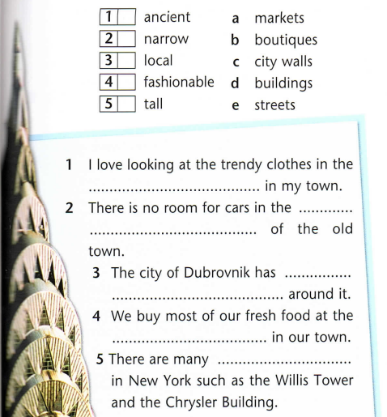

Ex.5,p.57 Workbook
Match the words to form phrases, then use them to complete the sentences.
c
e
a
b
d
fashionable boutiques
ancient city walls
narrow streets
local markets
tall buildings

Slide 9

Ex.6,p.57 Workbook
Fill in: lifestyle, international, cosmopolitan, trendy, tree-lined.
international
cosmopolitan
lifestyle
tree-lined
trendy

Slide 10


