Slide 1
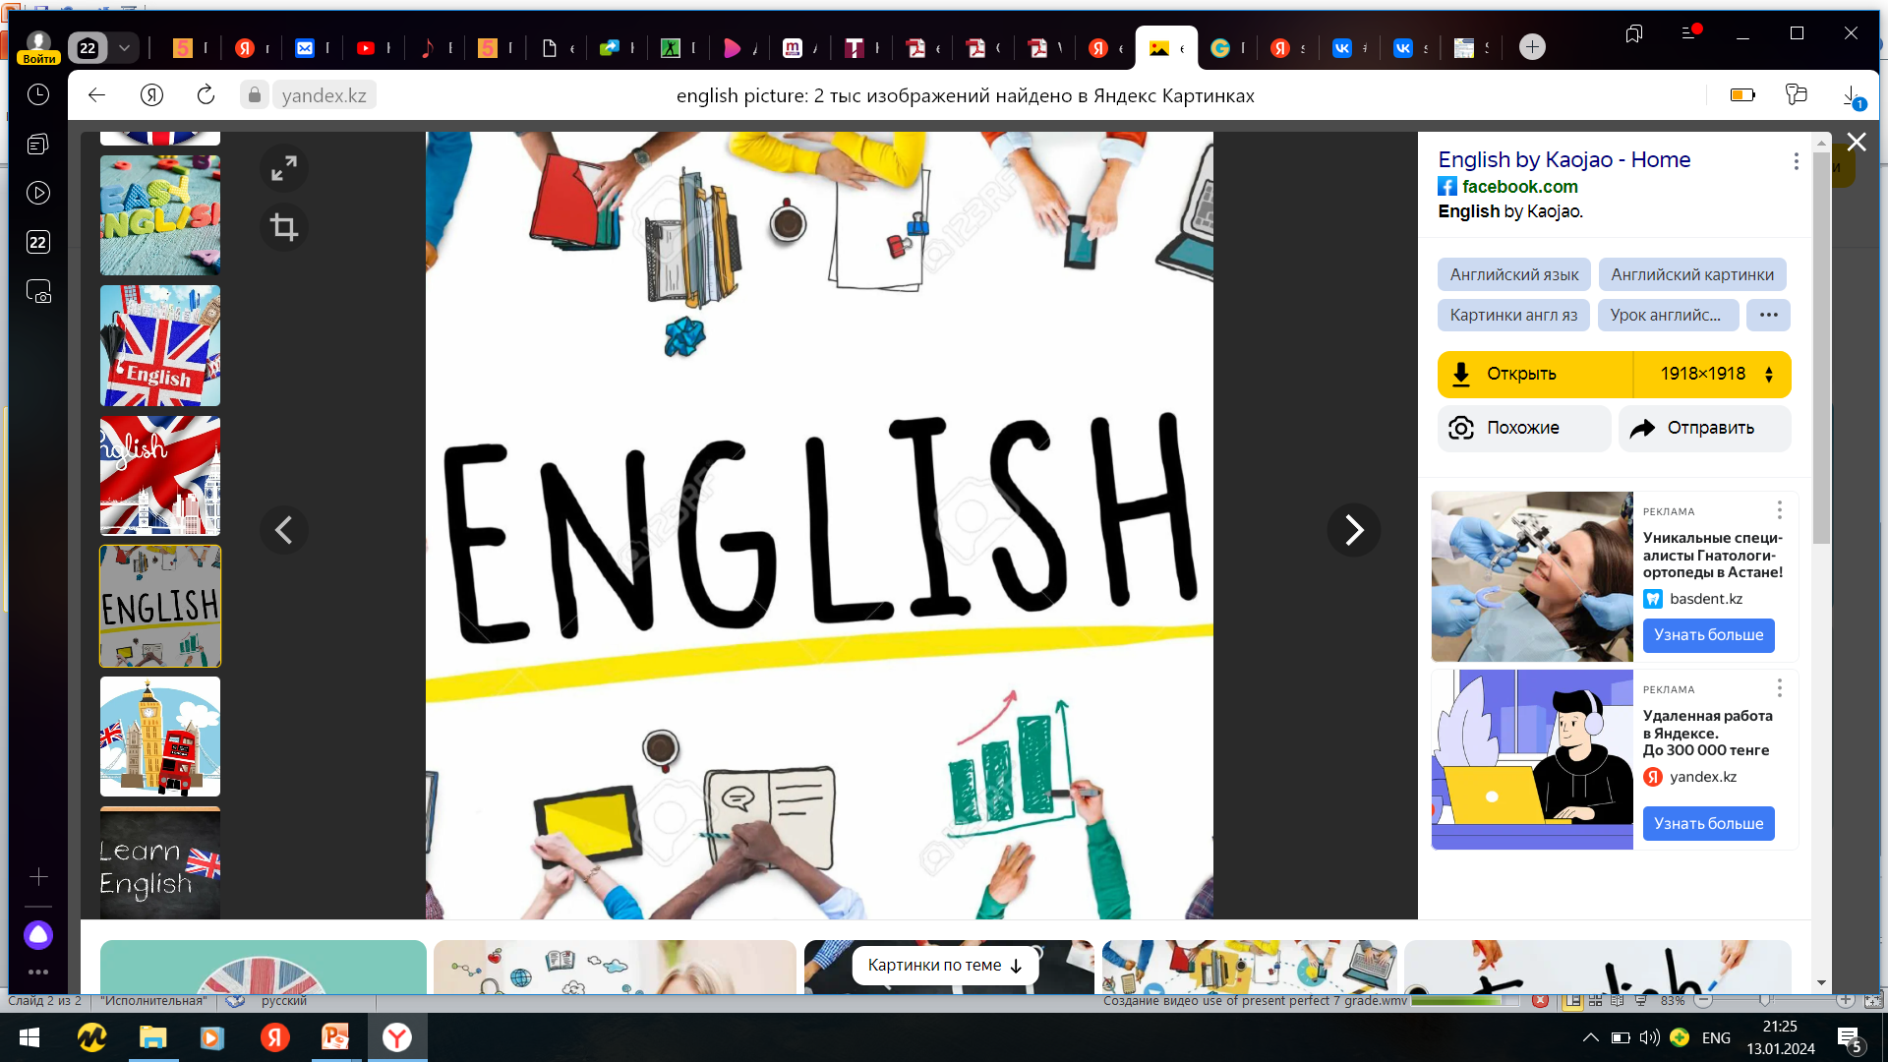

Subject: English language
Grade: 6
The theme of the lesson: Places in a city

Slide 2
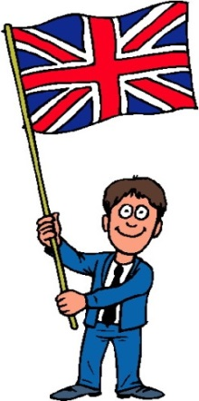
New words
Biscuit [ˈbɪskɪt] печенье
Aisle [aɪl] қатар
Bunch of tulip [bʌntʃ əv ˈtjuː.lɪp] қызғалдақ шоғы
Chain [tʃeɪn] шынжыр
Silver [ˈsɪlvə(r)] күміс
Feed [fiːd] жем
Beef [biːf] сиыр еті

Slide 3
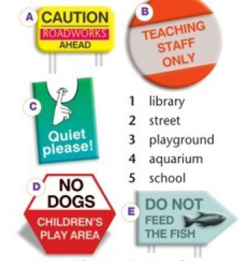
Ex.3,p.89
Match the places to the signs.
1 C
2 A
3 D
4 E
5 B

Slide 4
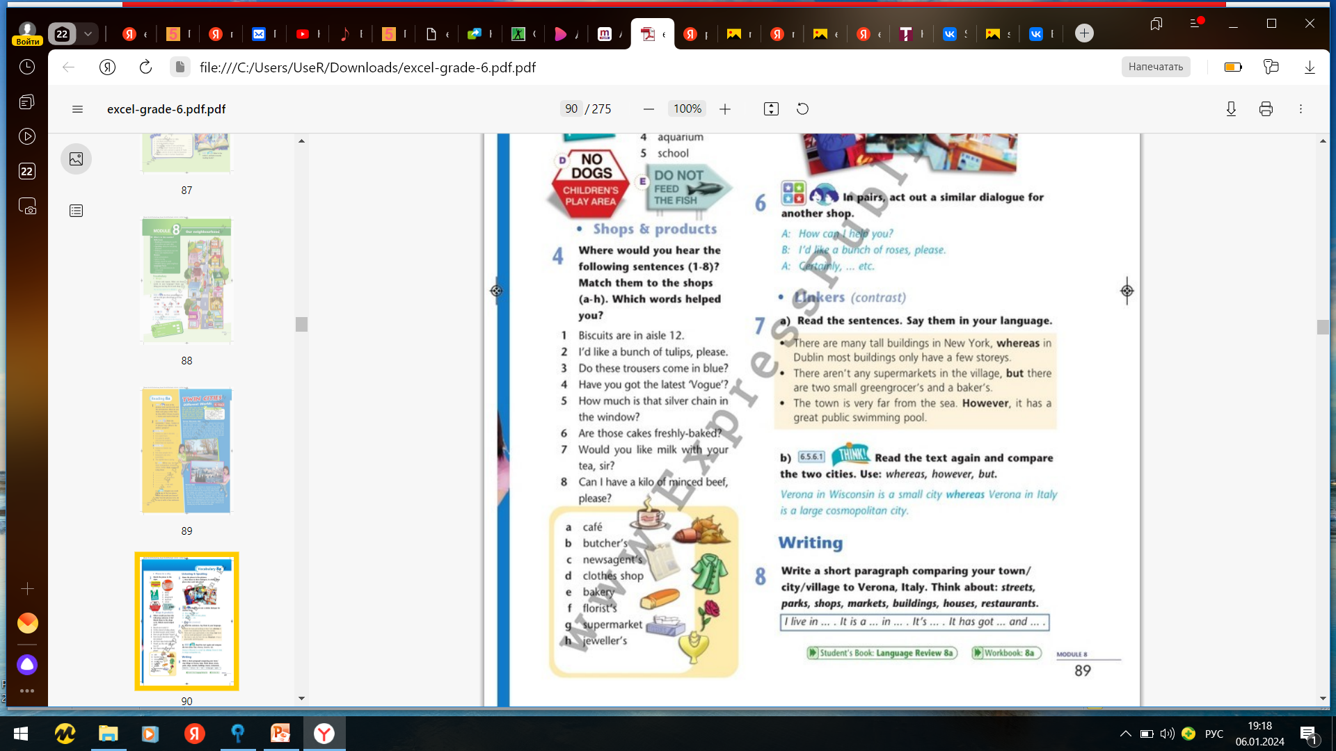
Ex.4,p.89
Where would you hear the following sentences (1-8)? Match them to the shops (a-h). Which words helped you?
1 G
2 F
3 D
4 C
5 H
6 E
7 A
8 B

Slide 5
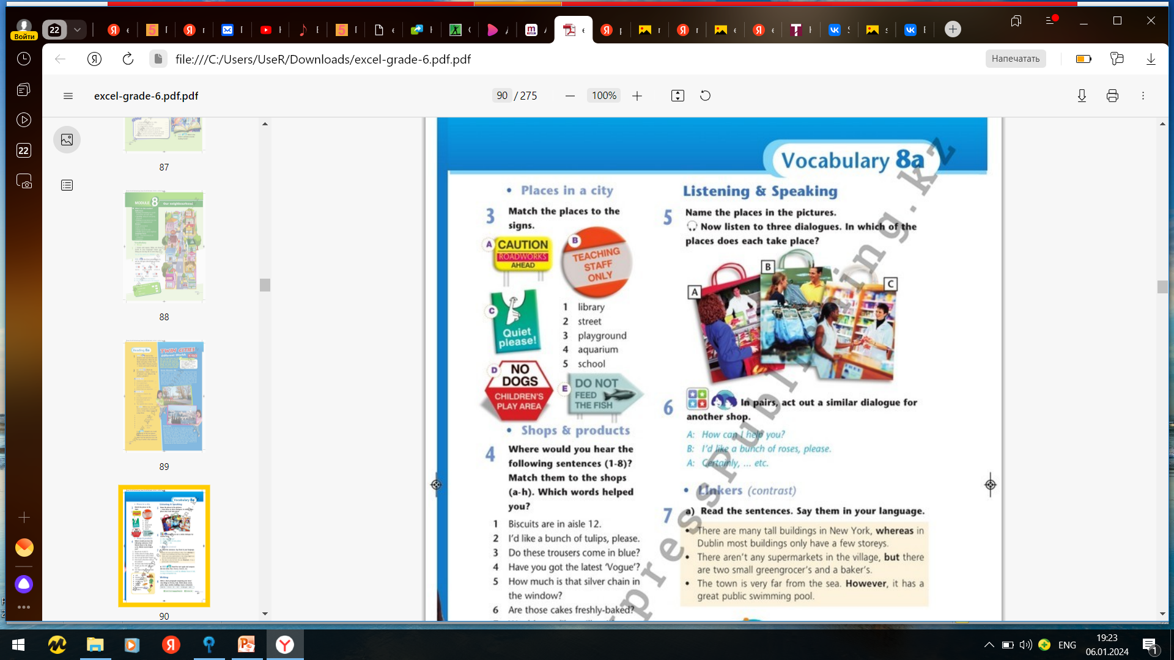
Ex.5,p.89
Name the places in the pictures.
Now listen to three dialogues. In which of the places does each take place?
Butcher`s
Clothes shop
Chemist`s

Slide 6
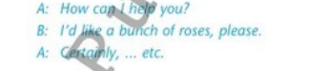
Ex.6,p.89
In pairs, act out a similar dialogue for another shop.
A: How can I help you?
B: Do you have these shoes in a size 6?
A: Yes, here you are.

Slide 7
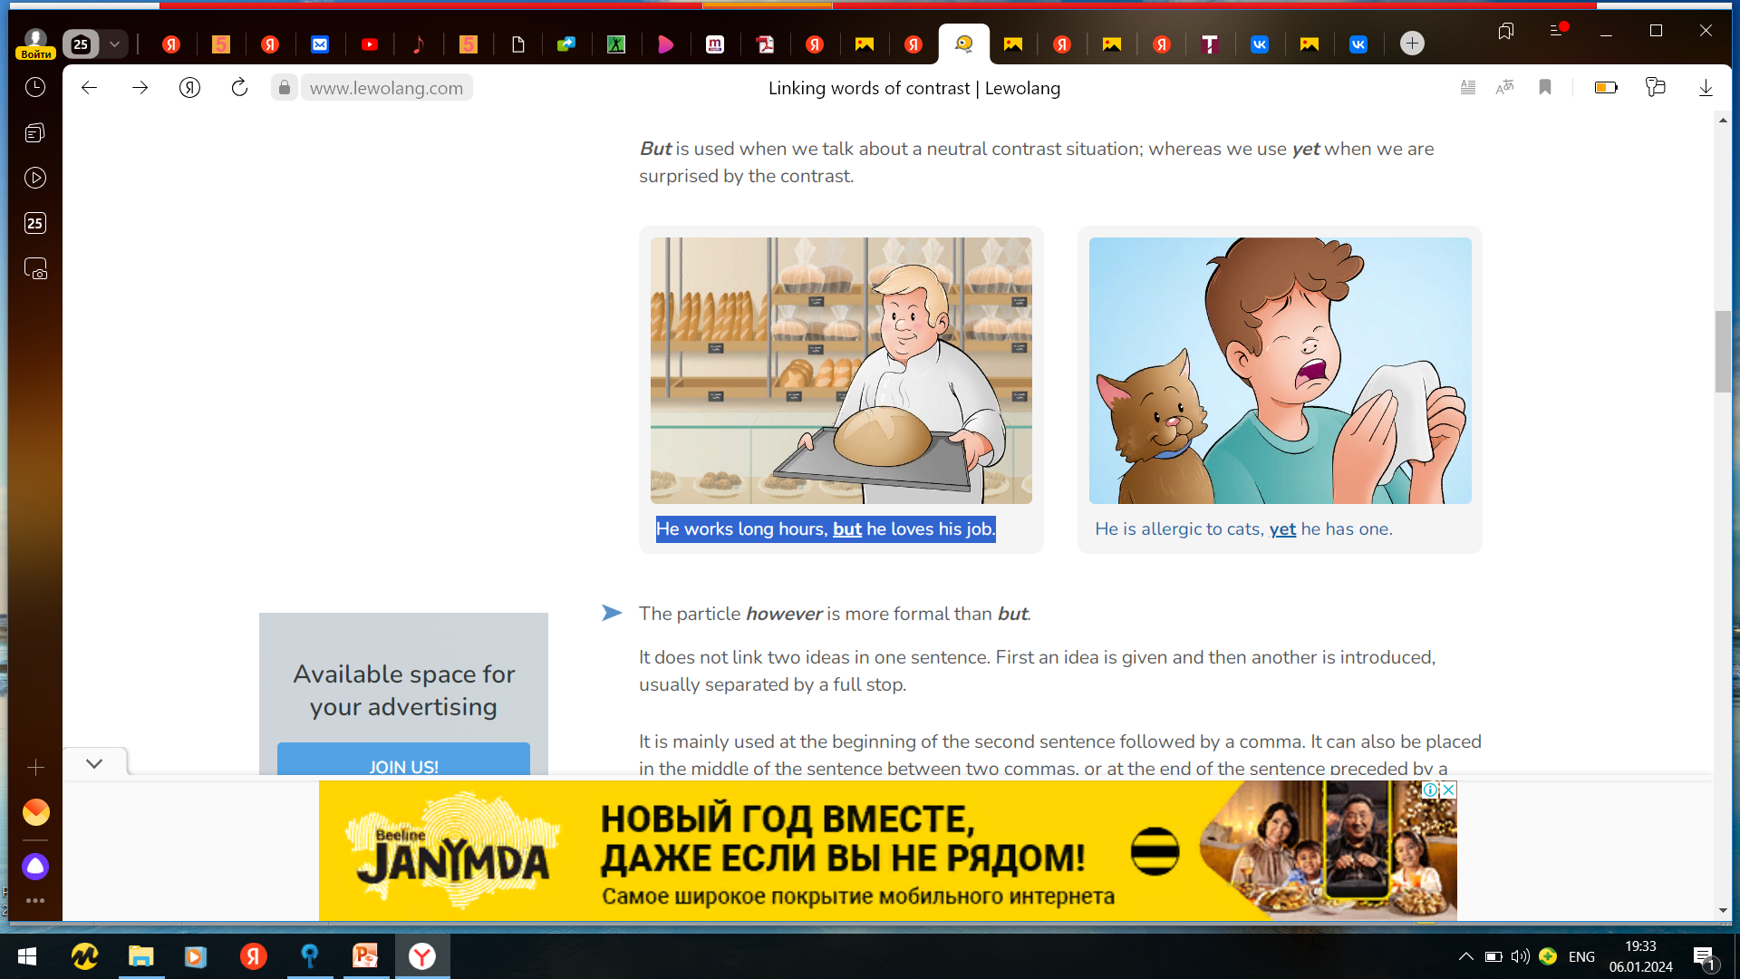
Linkers of contrast
Linking words of contrast are words used to contrast two ideas.
But is used when we talk about a neutral contrast situation; whereas we use yet when we are surprised by the contrast.
He works long hours, but he loves his job.

Slide 8
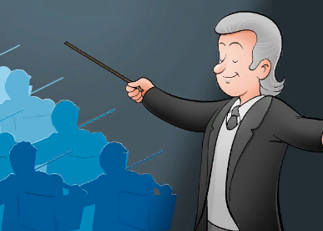
The particle however is more formal than but.
It does not link two ideas in one sentence. First an idea is given and then another is introduced, usually separated by a full stop.
It is mainly used at the beginning of the second sentence followed by a comma. It can also be placed in the middle of the sentence between two commas, or at the end of the sentence preceded by a comma.
The concert was great. However, it was long.

Slide 9
Ex.7,p.89
Read the text again and compare the two cities. Use: whereas , however, but.
There aren’t any tall buildings in Verona, USA, but there are pretty houses with big gardens. Verona in Italy is an ancient city. However, it has a lot of trendy nightclubs and cafés.

Slide 10
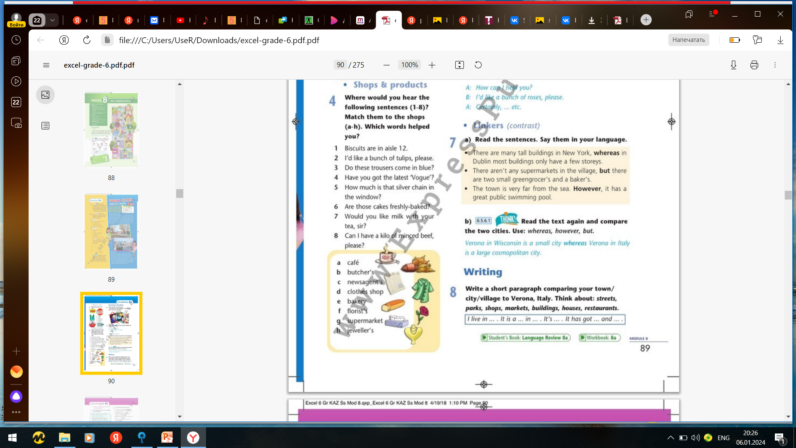
Ex.8,p.89
Write a short paragraph comparing your town/city/village to Verona, Italy. Think about: streets, parks, shops, markets, buildings, houses, restaurants.
I live in Astana. It is a large, cosmopolitan city in Kazakhstan. It’s famous for its modern buildings. It has got lots of shops and restaurants as well as parks, palaces and theatres. Astana is very different from Verona, Italy.

Slide 11
