Slide 1
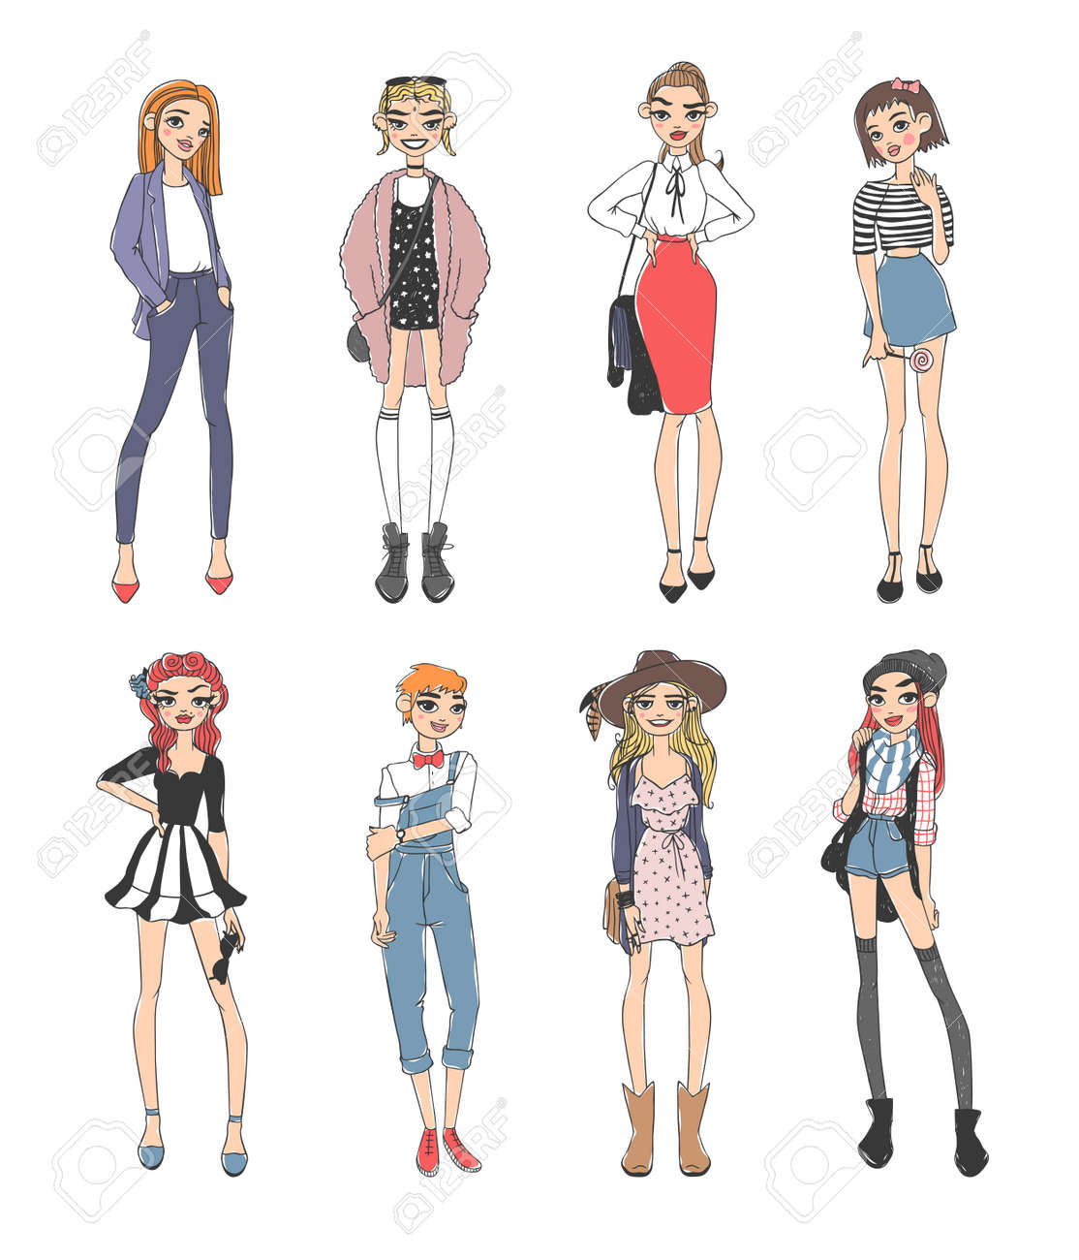
Clothes and fashion

Slide 2
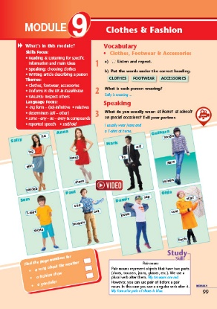
Look at the picture. What can you see?
Brainstorming activity (WG)

Slide 3
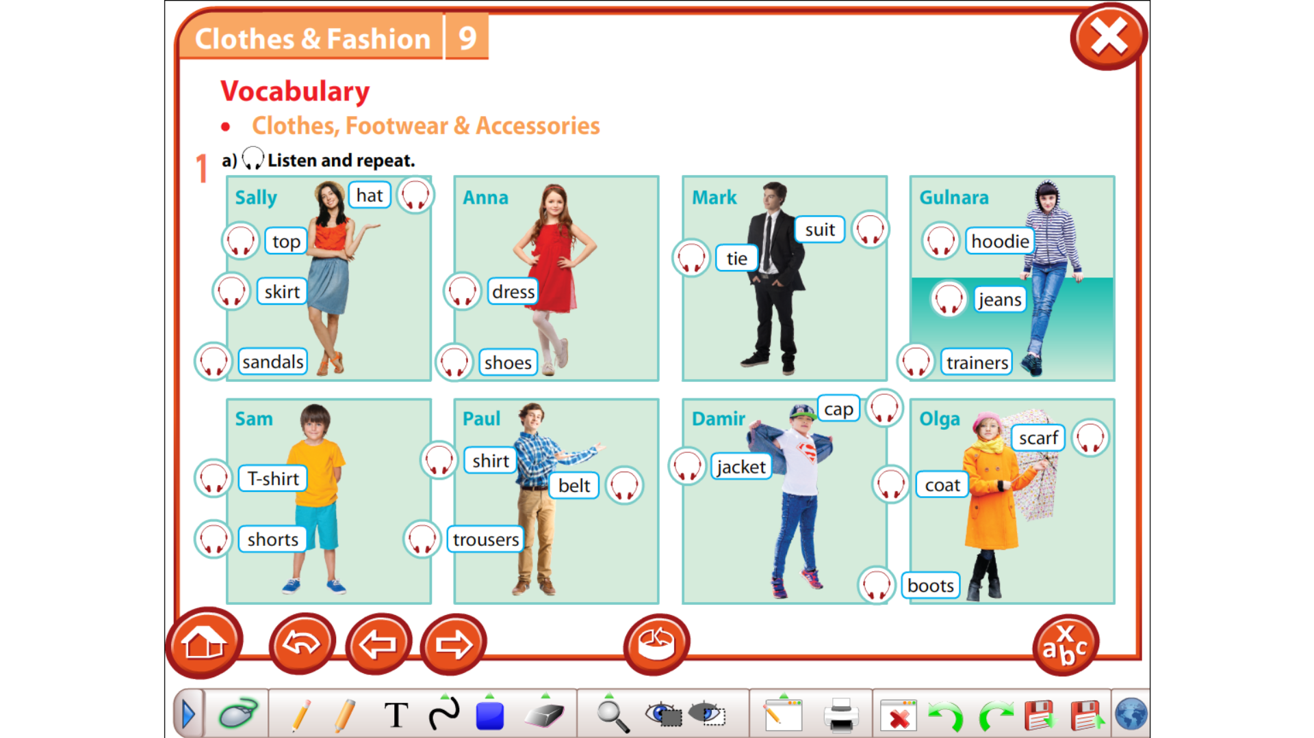

Slide 4
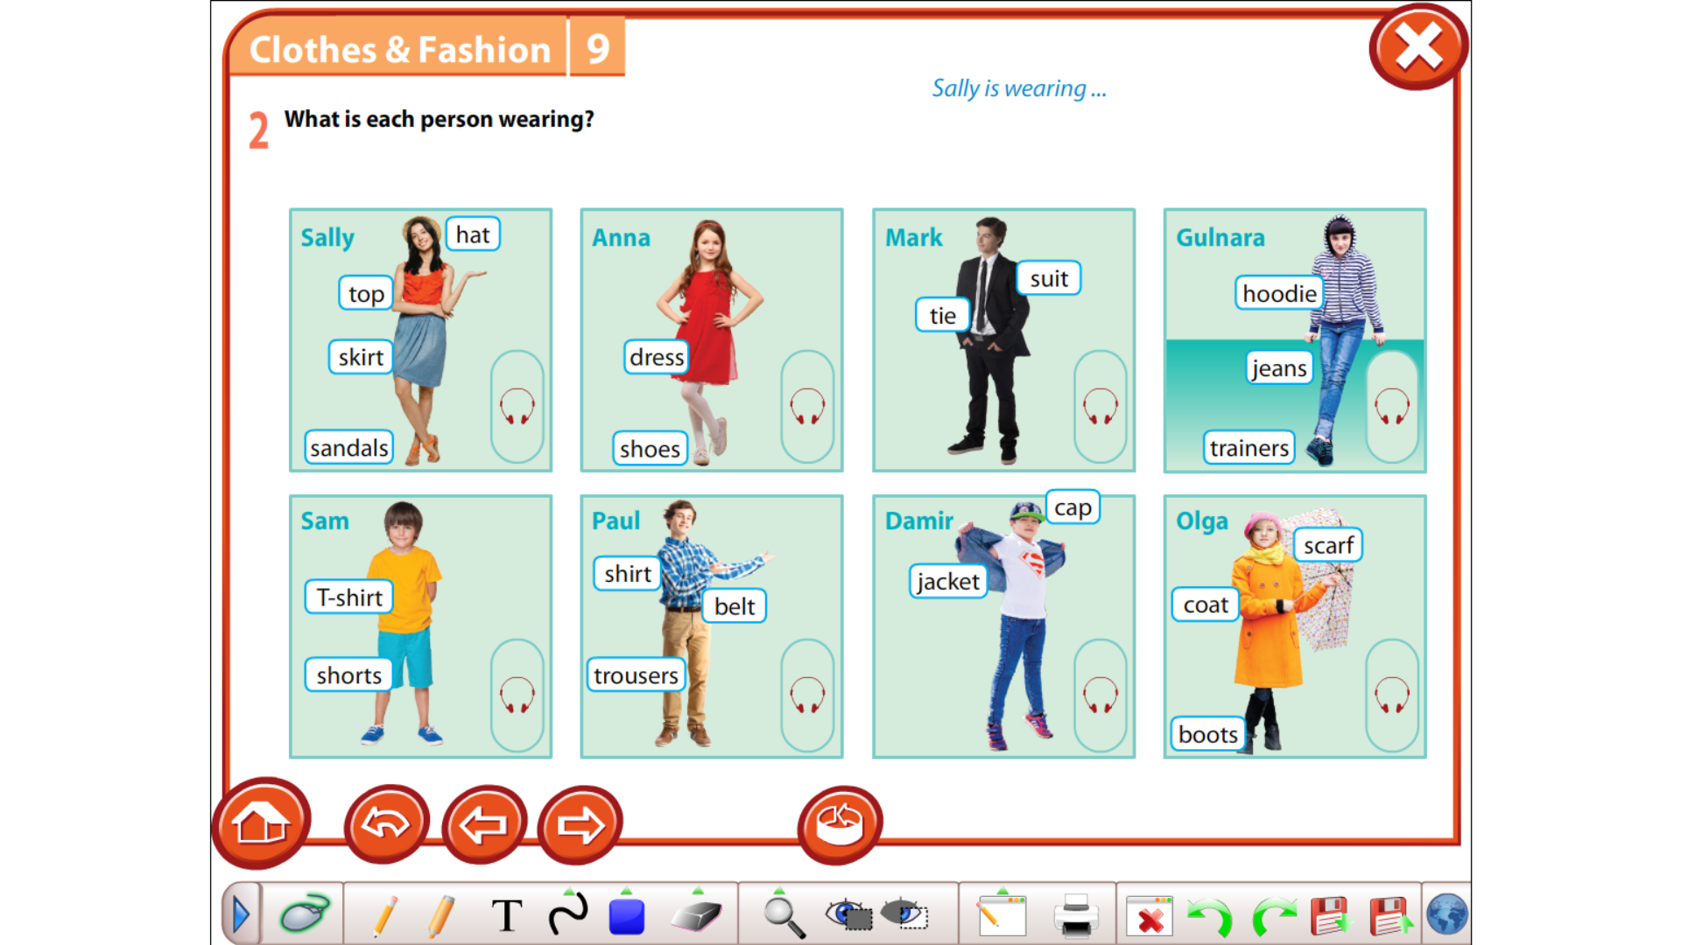

Slide 5
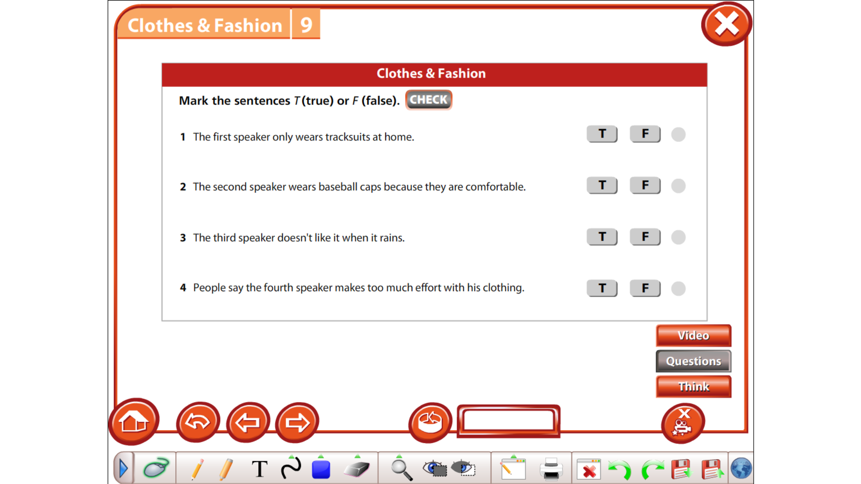
Activity 3. Watch the video.
https://www.youtube.com/watch?v=WQF04SGpadY

Slide 6
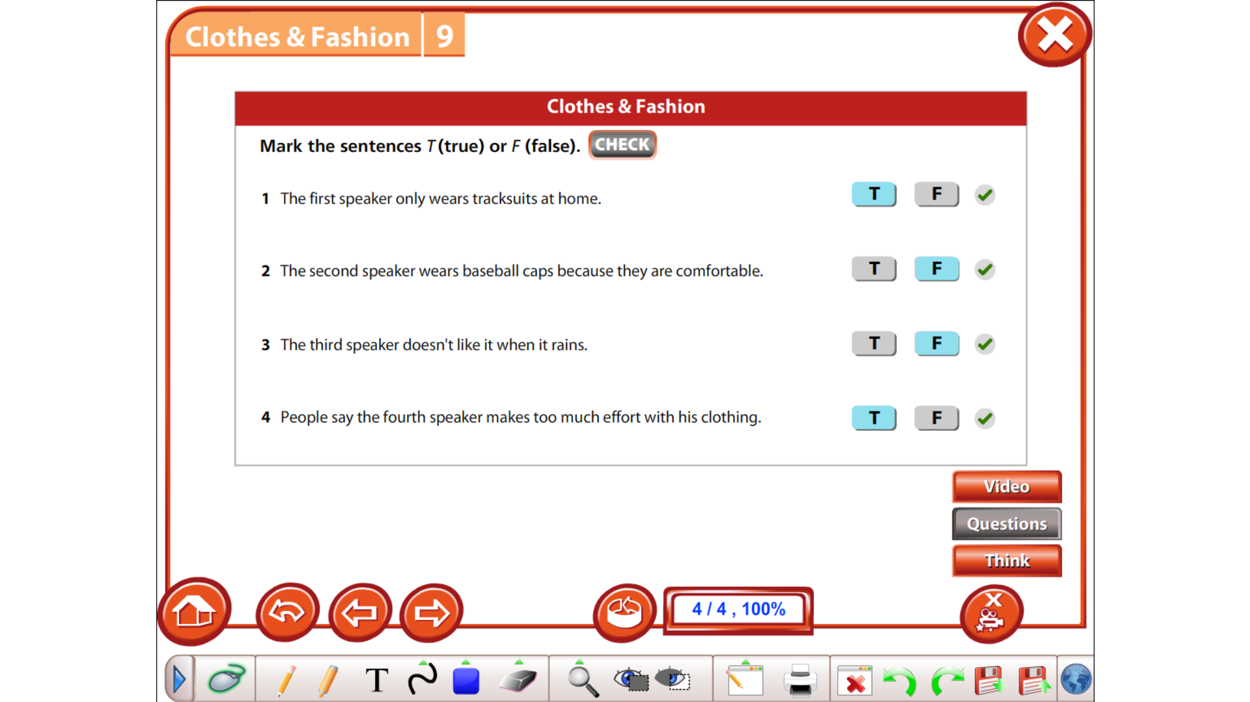
Let’s check

Slide 7
Speaking. What do you usually wear?
Example: I usually wear jeans and a T-shirt at home.
Activity 4. In pairs make a dialogue. Comment on clothes.

