Slide 1
Verbs – ing/to-infinitive-infinitive without –to
Relatives (who/ which/where)

Slide 2
Brainstorming activity
What is an infinitive?
Are there any infinitives in the Kazakh and Russian languages?
Why do we use relatives?
What relatives do you know?

Slide 3
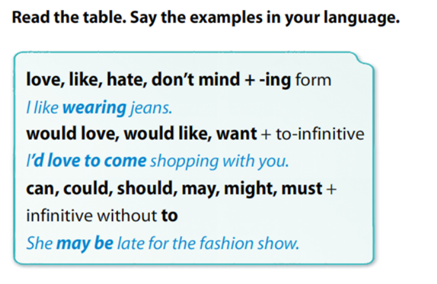

Slide 4
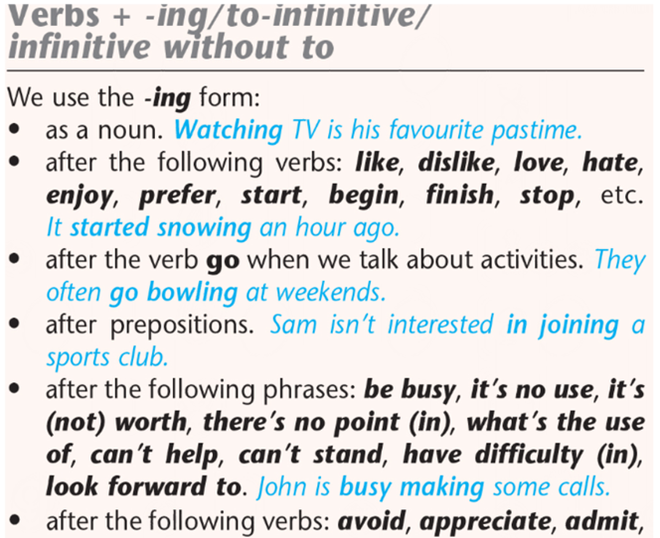
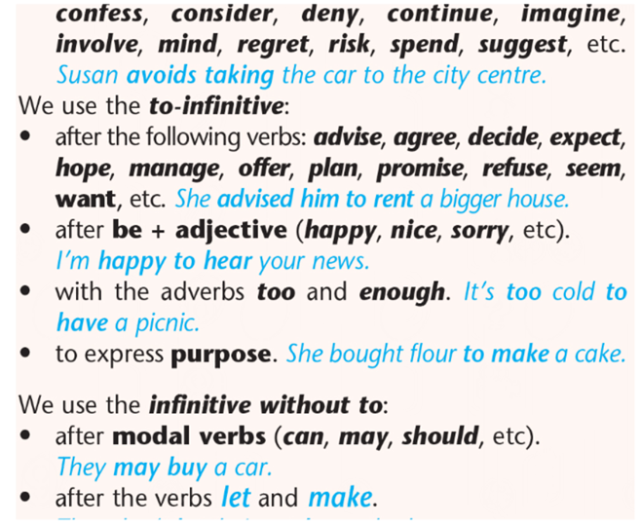

Slide 6
Put the verbs in brackets into the correct form
Saule doesn’t like ……….(walk) far in sandals.
You can ……. (pay) in cash or buy card.
I want ……. (buy) a new pair of trainers.
You can …….. (borrow) my red dress for the party.
We would like …… (try on) some of these winter coats.
Natalya loves …… (read) about the latest fashions in magazines.

Slide 7
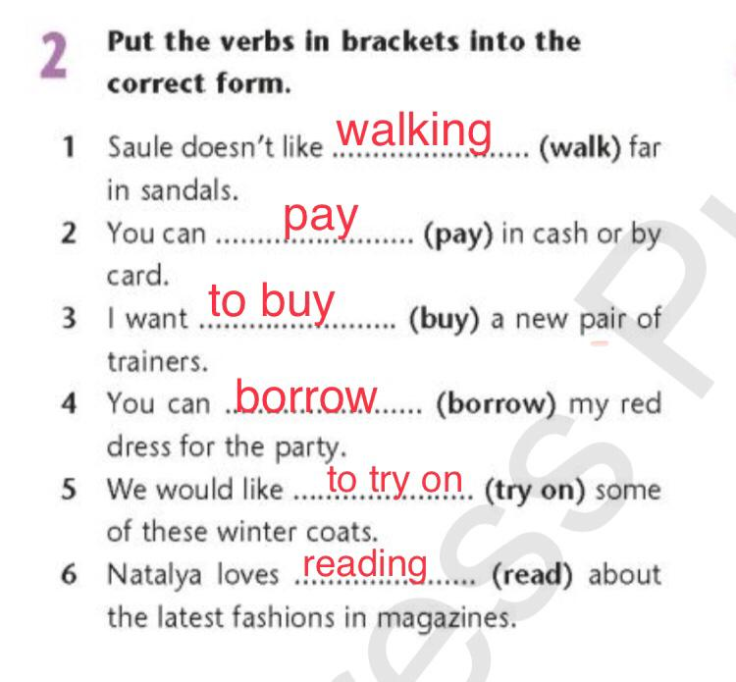
Let`s check the answers

Slide 8
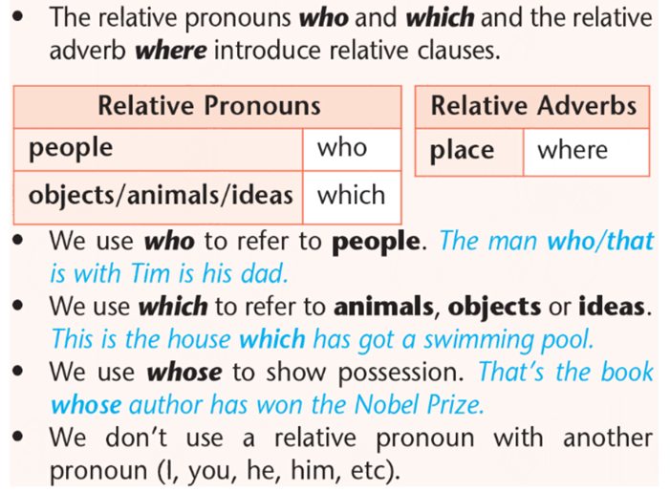
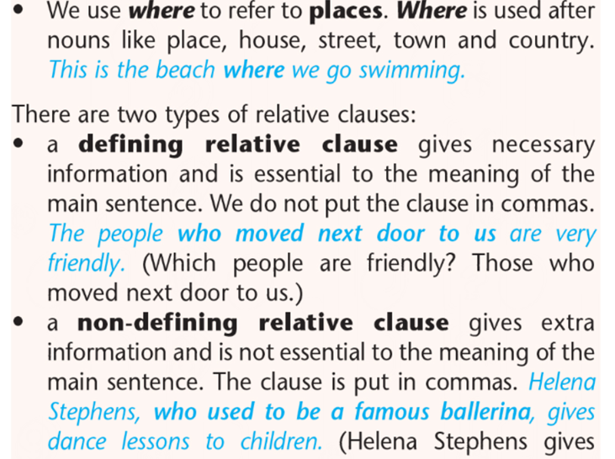

Slide 10
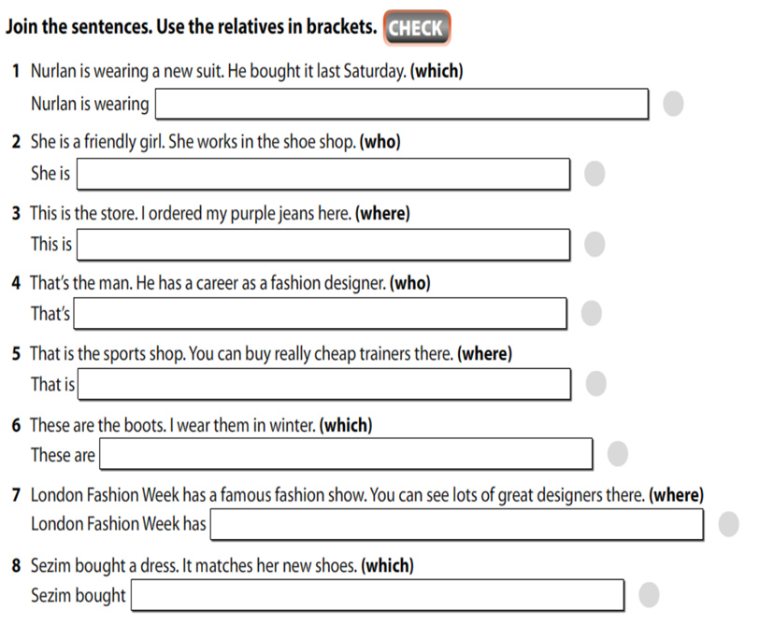


Slide 11
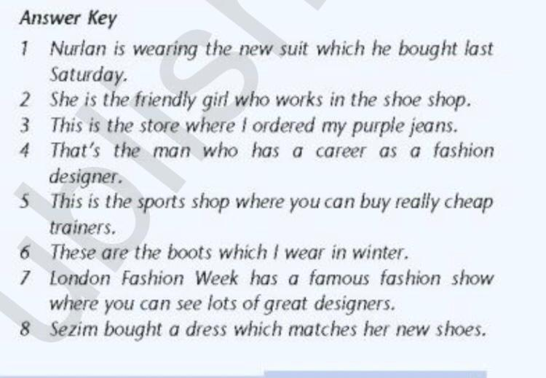
Let`s check the answers

Slide 12
Make sentences about the following. Use who, where or which
• Sandals
• Department store
• Designer
• Shoe shop
• Gloves
Sandals are shoes which we usually wear in the summer

Slide 13
Feedback (WG)
KWL Chart (Know, want to know, learned)
What I know | What I want to know | What I learned

