Slide 1
Determiners - Indefinite Pronouns
all – other
some – any – every - no

Slide 2
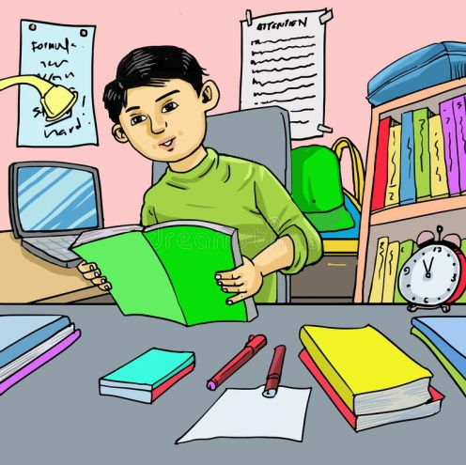
Determiners
Some students like to study in the morning.
noun noun
Determiners introduce nouns.
A determiner comes at the beginning of a noun phrase to point out the noun or nouns.

Slide 3
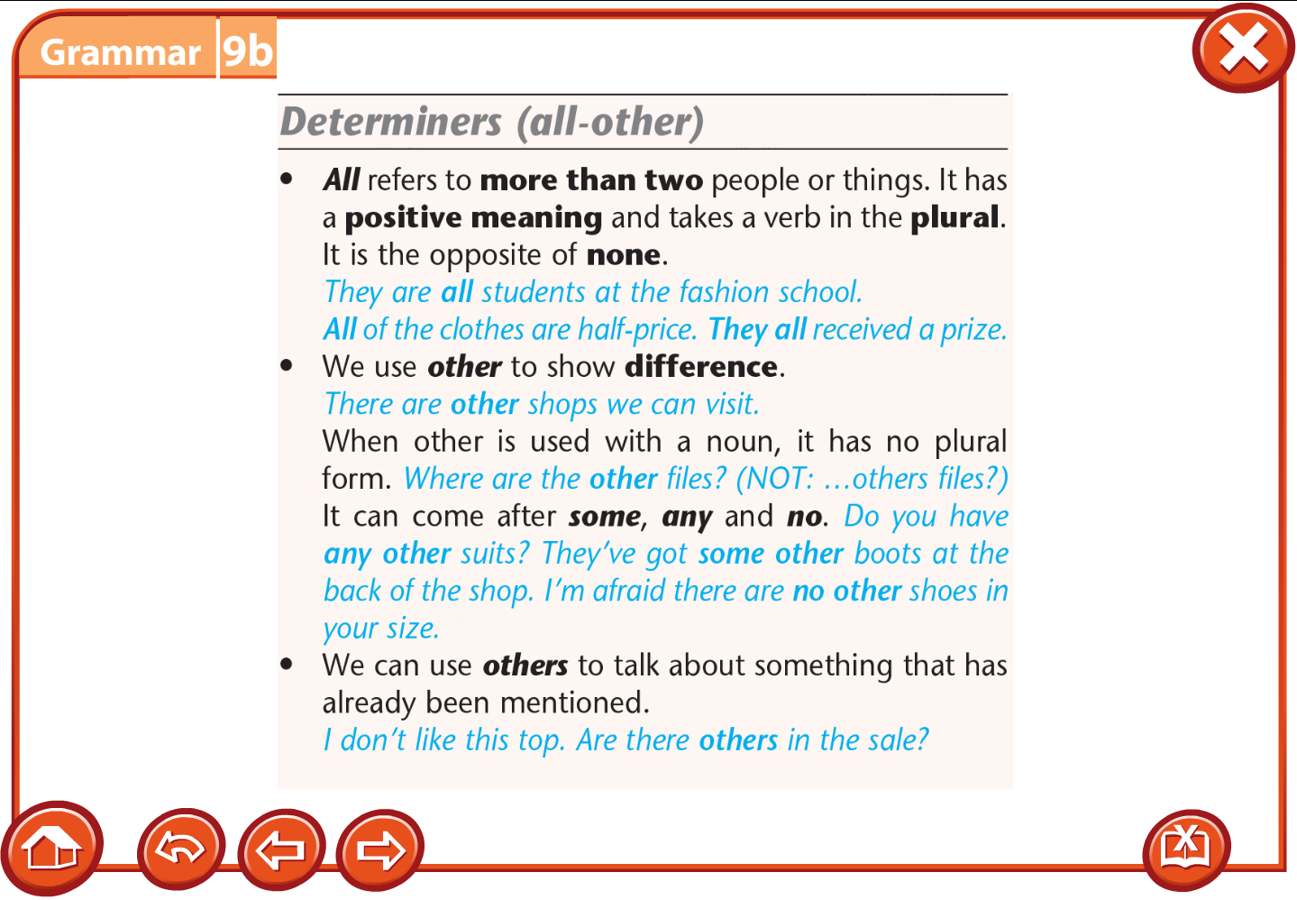
General determines (all - other)
Determines can be general or specific.
General determines are not specific.
We use when we refer to someone or something in general.
We use all to refer to more than two people/things. It has a positive meaning.
We use other to show difference.
It can come after some, any or no.
We can use others to talk about something that has already been mentioned.

Slide 4
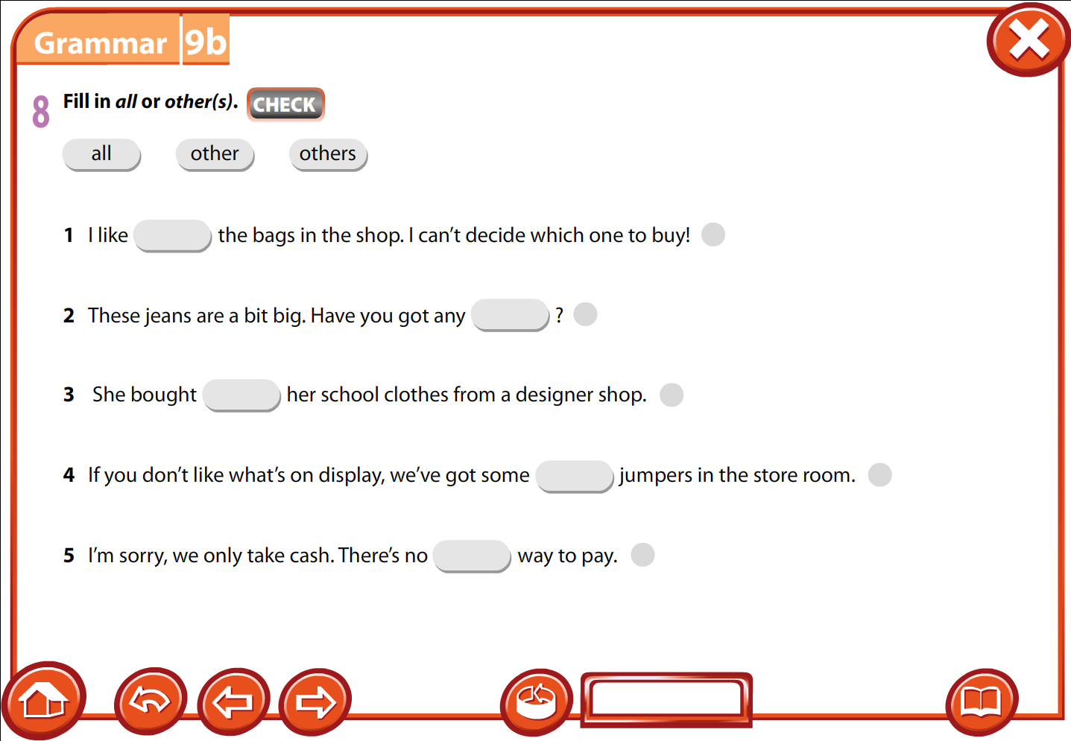

Slide 5
Indefinite Pronouns some – any – no & compounds
Some
some
something
someone
somewhere
I would really like some water.
I will meet some friends later.
I would really like someone to take my order.

Slide 6
Indefinite Pronouns some – any – no & compounds
Any
any
anything
anyone
anywhere
He doesn’t have any money.
We don’t know anything about that restaurant.
Did you go anywhere last night?

Slide 7
Indefinite Pronouns some – any – no & compounds
No
no
nothing
noone
no where
I see nothing I like on the menu.
Nobody wants to help me!

Slide 8
Indefinite Pronouns some – any – no & compounds
Some
requests, offers and invitations
Some can be used in the interrogative in requests.
Have I met you somewhere before?
(Expect the answer to be yes)
Would you like something to eat?
Did someone eat my cake?

Slide 9
Indefinite Pronouns some – any – no & compounds
Any (it doesn’t matter)
You can use any computer you like.
I don’t care where we eat. Let’s go anywhere.
I usually eat anything people give me.

Slide 10
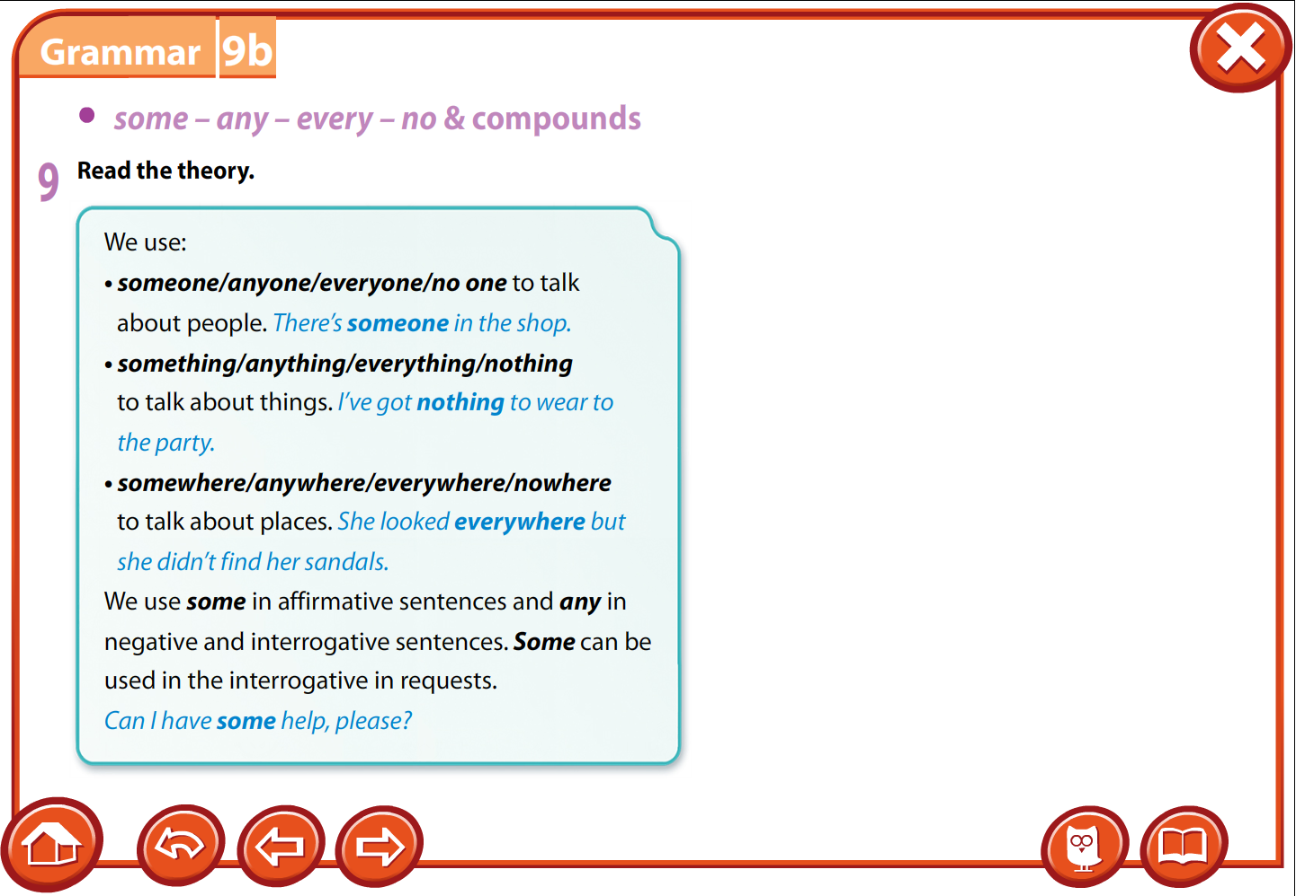
Indefinite Pronouns some – any – no & compounds

Slide 11
