Slide 1
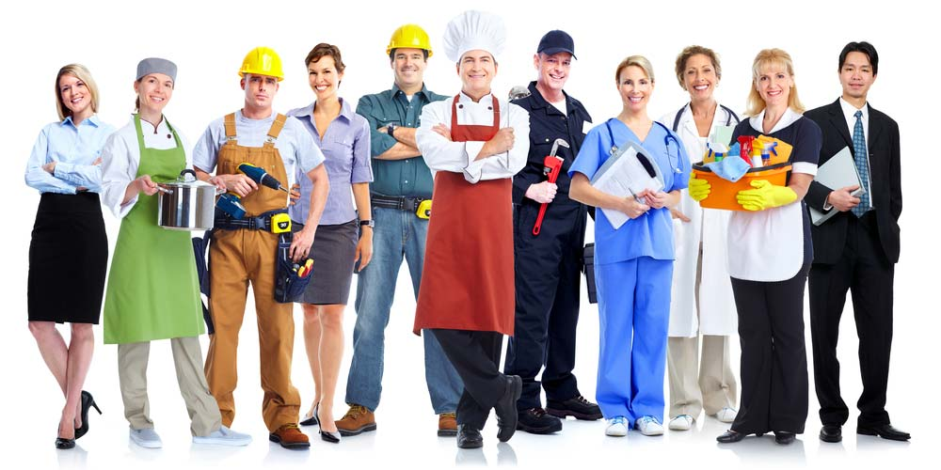
Uniforms across the world

Slide 2
The aim of the lesson: 1. To understand the meaning of the text independently 2. To answer the questions according to the text

Slide 3

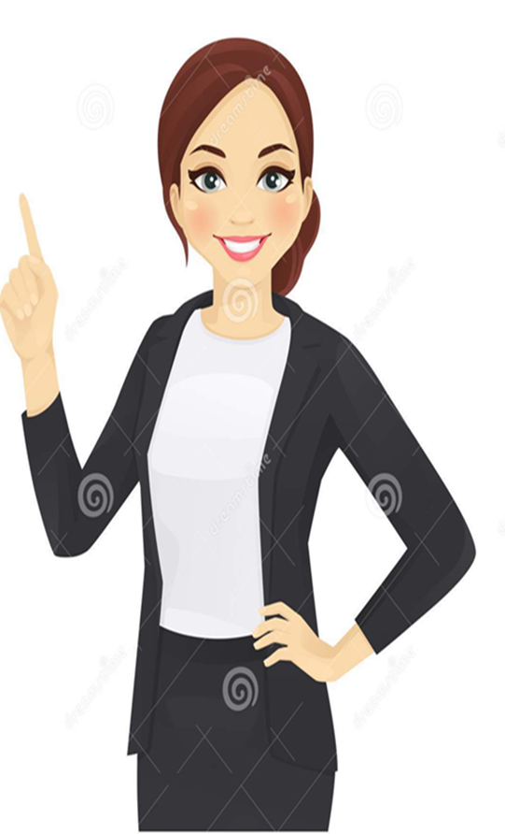
Uniform- униформа
Spot- тану- узнавать
Protect- қорғау - защищать
Guard- күзетші-сторож
Comes to mind- ойға келеді- приходит на ум
Palace- сарай- дворец
Soldier- сарбаз- солдат
Gondola- Гондола
Float- жүзу- плавать
Canals- каналы
Stripes- жолақтар- полосы
Straw hat- сабан баскиім- соломенная шляпа
Ribbon- лента
Beret- беретка
Handsome- әдемі- красивый
First of all, let`s learn today`s new words.

Slide 4

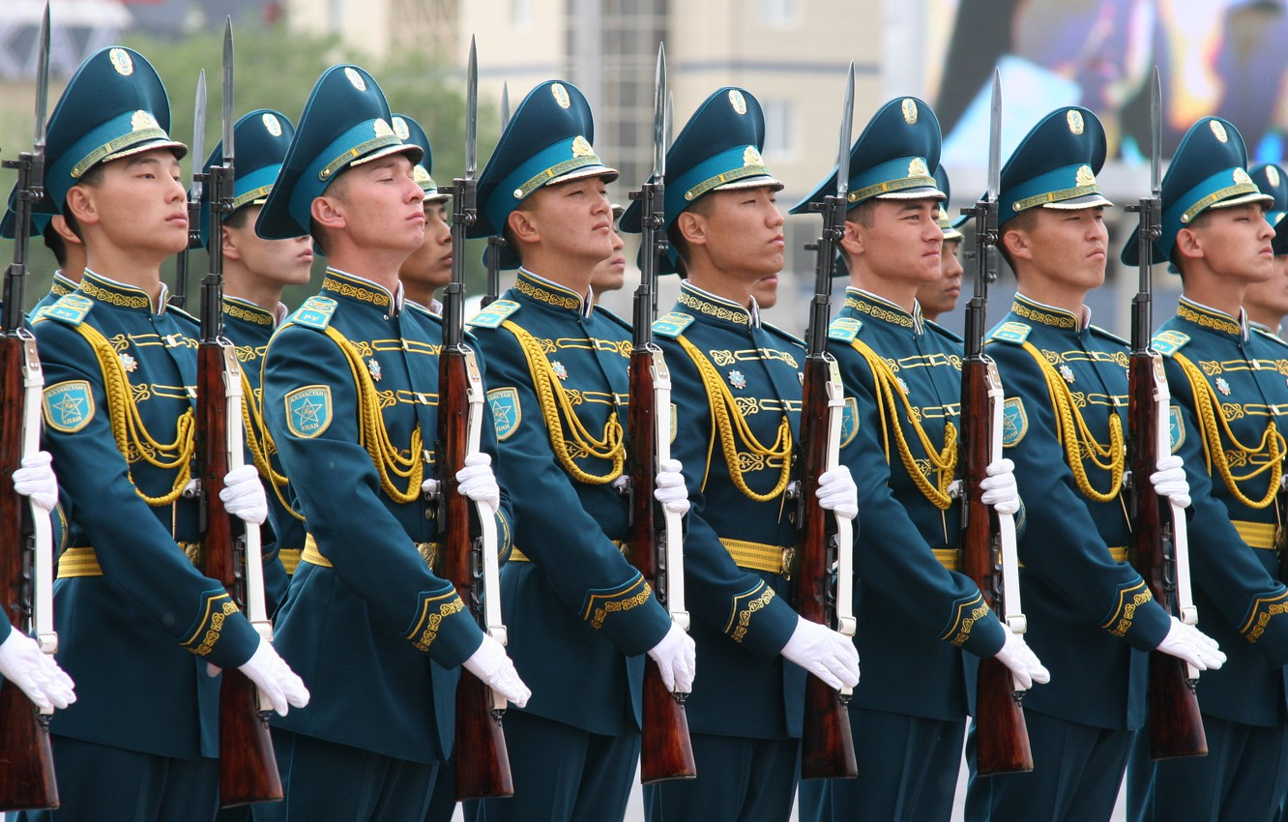
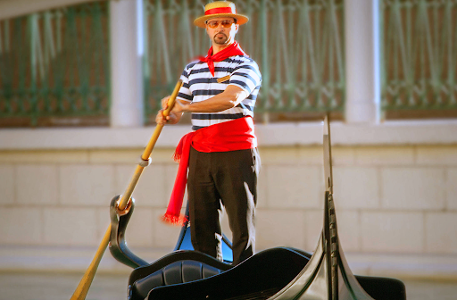
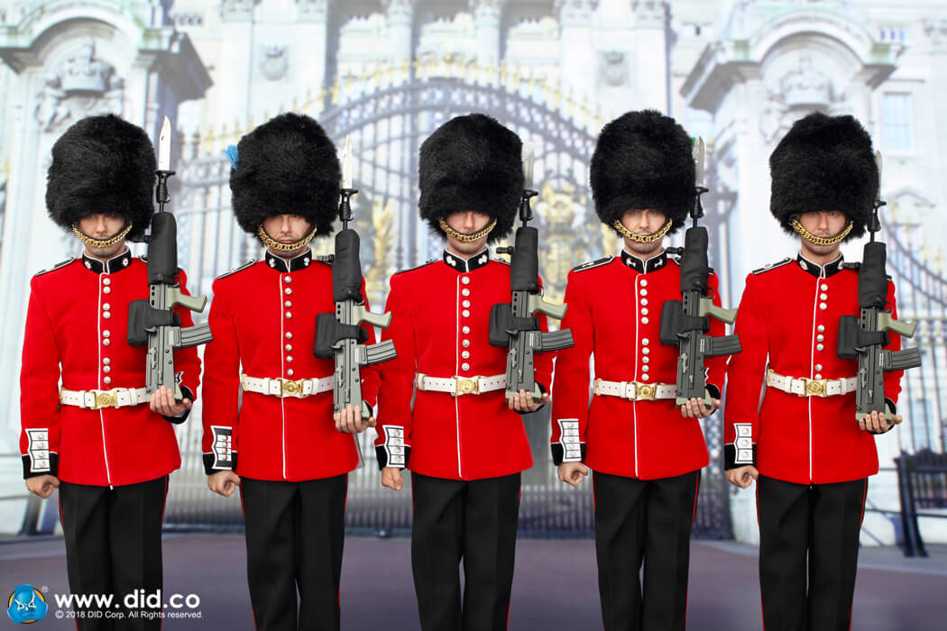
Task: Look at the pictures. Guess what do these people do?

Slide 5
Yes, you are right! The foot Guards guard the queen and Buckingham palace. The national guard of Kazakhstan guard the president and keep him safe. Gondoliers steer the gondolas that float up and down the canals of venice.

Slide 6
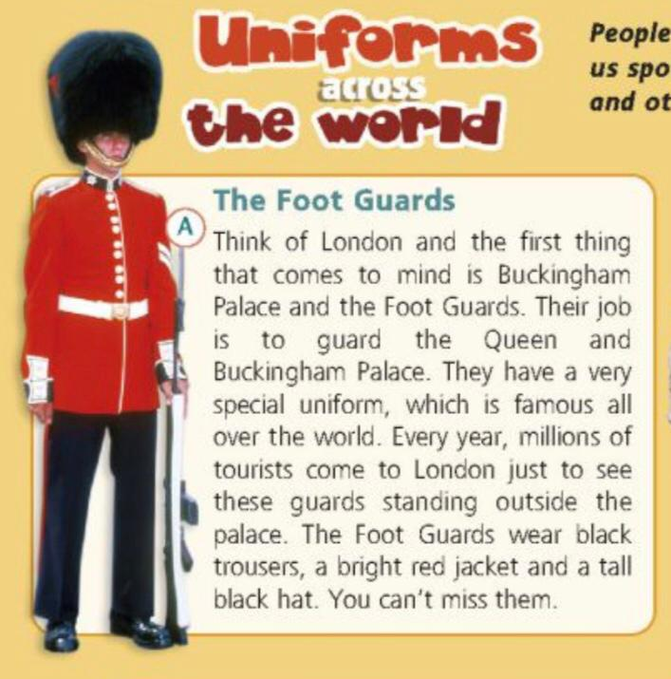
Task: Pb p104 Listen and read to find out
People all around the world wear uniform. Some uniforms help us spot people who can help us, others protect us while we work, and others show we work together belong to the same team.

Slide 7
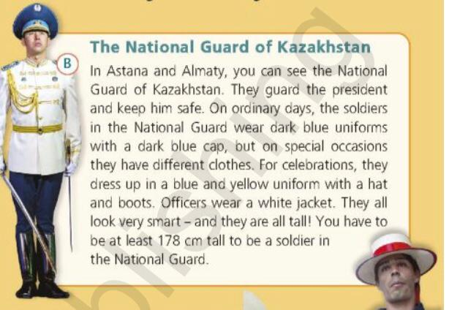
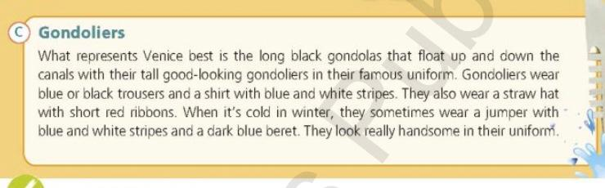

Slide 8
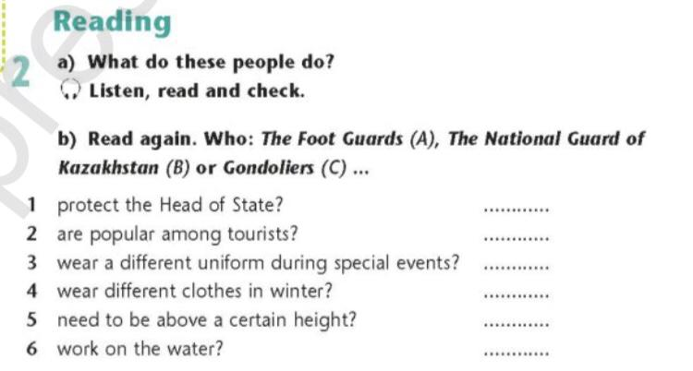

Slide 9
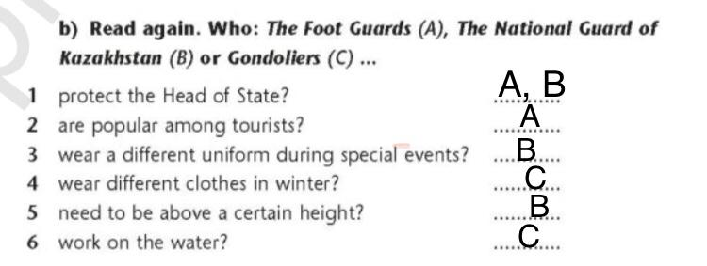
Now, let`s check the answers

Slide 10
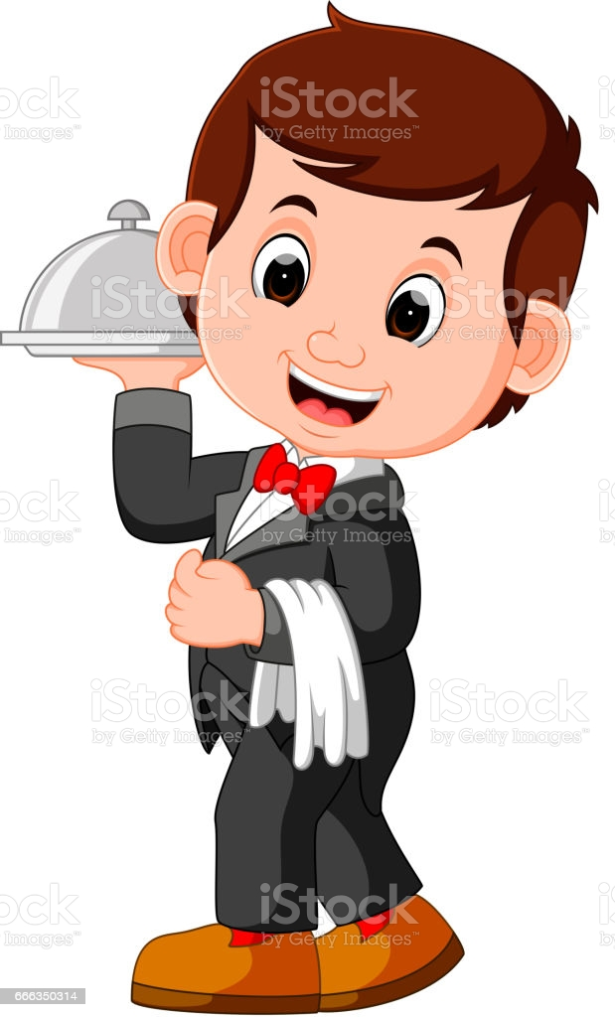
Task for independent study of the theme. Look at the picture of the waiter. Describe his uniform as in the text.

