Slide 1
unit: 6
THE NATURAL WORLD
Theme of the lesson:
Language focus 2.
Reported questions

Slide 2
Learning objective (s) that this lesson is contributing to
8.6.5.1- use questions which include a variety of different tense on a range of familiar general and curricular topics;
8.6.7.1- use a variety of simple perfect forms to express recent, indefinite and unfinished past on a range of familiar general and curricular topics;

Slide 3
Lesson objectives
All learners will be able to:
learn reported questions and indirect questions.
Most learners will be able to:
report a conversation about a natural feature

Slide 4
Warm-up
He asked if I liked computer games.

Slide 5
He asked
‘Do you like computer games?’

Slide 6
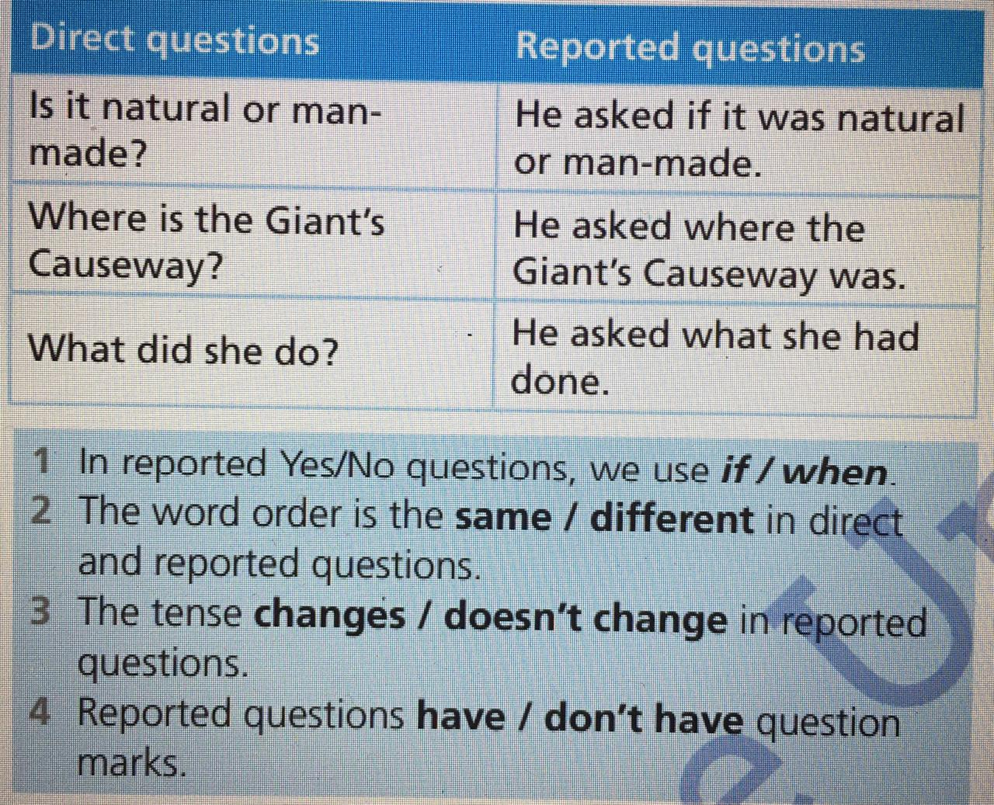

Slide 7
Answers
1 In reported Yes/No questions, we use if.
2 The word order is different in direct and reported questions.
3 The tense changes in reported questions.
4 Reported questions don’t have question marks.

Slide 8
Put the words in order to complete the reported questions.
1 ‘Were there ever giants in Ireland?’
(there / been / giants / ever / had / if / in / Ireland)
He asked me if there had ever been giants in Ireland

Slide 9
2 ‘Do you think legends are interesting?’ (interesting / she / if / legends were / thought) I asked her
3 ‘How old are the rocks?’ (old / the / were / rocks / how) They asked him
4 What did you learn from the radio show?’ (learned /from / what / I / had / the / radio show) She asked me
5 ‘Which explanation do you prefer?’ (she / which / preferred / explanation) I asked her

Slide 10
Let s check
2. I asked her if she thought legends were interesting.
3. They asked him how old the rocks were.
4. She asked me what I’d learned from the radio show.
5. I asked her which explanation she preferred.

Slide 11
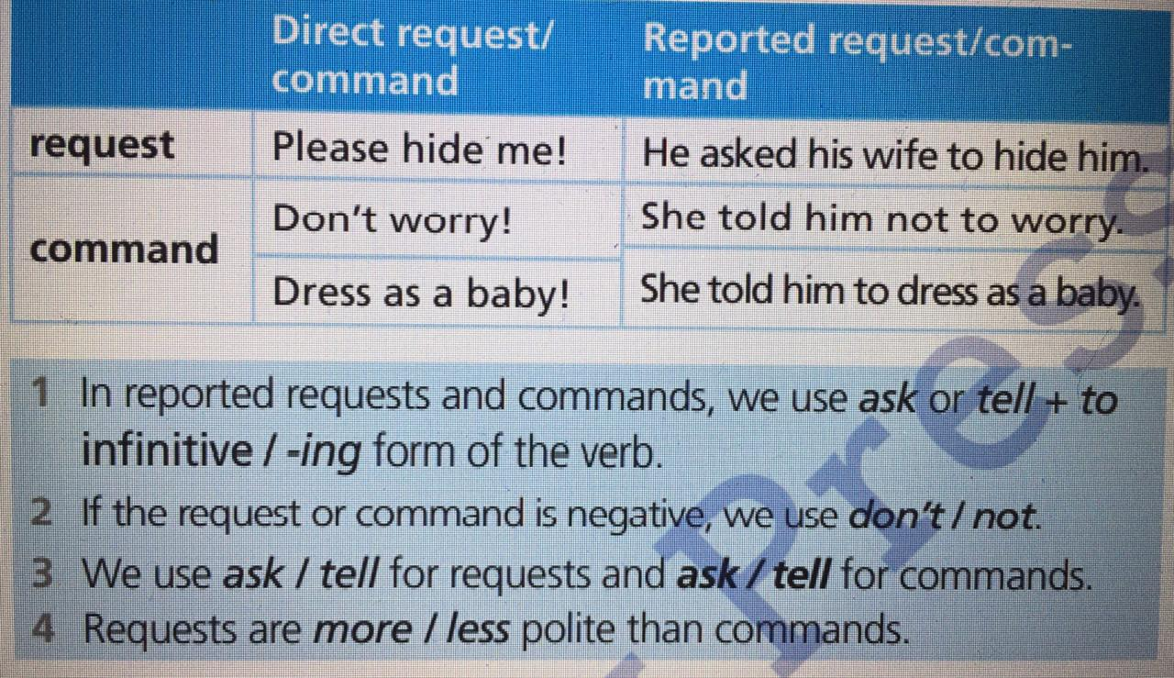

Slide 12
Answers
1 we use ask or tell + to infinitive form of the verb.
2 if the request or command is negative, we use not.
3 We use ask for requests and tell for commands.
4 Requests are more polite than commands.

Slide 13
Ex 2 read the direct speech and complete the reported requests and commands.
1 ‘Could you help me with my homework, please?’ (she – me)
She asked me to help her with her homework.

Slide 14
2 ‘Stop shouting!’ (he – the children)
3 ‘Don’t talk in the library.’ (the teacher – us)
4 ‘Don’t put your shoes on the chair.’ he – her
5 ‘Could you wait ten minutes, please?’ (she – them)

Slide 15
Let s check
2 He told the children to stop shouting.
3 The teacher told us not to talk in the library.
4 He told her not to put her shoes on the chair.
5 She asked them to wait ten minutes.

Slide 16
Reflection
What did the learners learn?
What did/didn’t you like?
What was difficult?

Slide 17
The lesson is over
Good bye!

