Slide 1

Unit 5. Reading for pleasure
Theme of the lesson: A story summary. War Horse

Slide 2
Learning objectives:
1. Read the summary text War Horse
2. Understand story summaries
3. Write a story summary

Slide 3

hjghhjb
Open this link and watch the video a story summary about ''War Horse'' by Michael Morpurgo
https://youtu.be/hbyj-6GjDAM

Slide 4

Task 1. Read the summary about ''War horse''.
Students book page 59.

Slide 5

Task 2. Read the summary again about ''War horse'' and answer the questions.
1. Who wrote the story?
2. What type of story is it?
3. When and where does it take place?
4. Who are the main characters?
5. How does the story begin?
6. What are the main events in the story?
7. How does it end?

Slide 6

Task 3. Look at the Useful language box. Find similar phrases in the text on this page and write your copybook.

Slide 7

Task 4. Complete the sentences with information about your favourite book.
For example:
My favourite book is a … story about … It was written by …

Slide 8
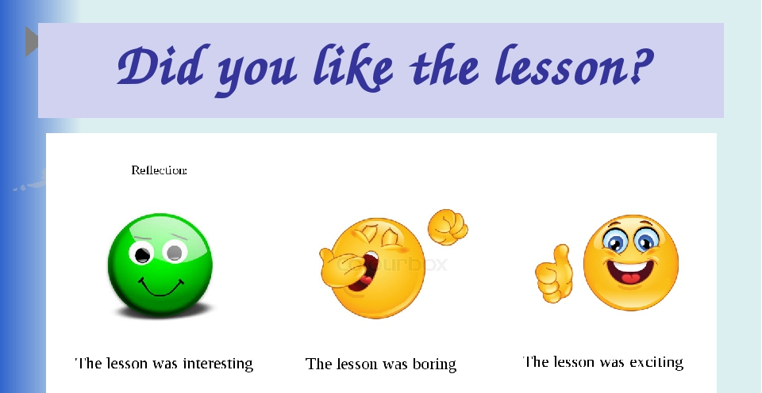

Slide 9

Homework
Do some research and find a science-fiction book that you would like to read.

Slide 10


